Slide 1
Introduction to SQL Azure Databases
Name
Title
Microsoft Corporation

Slide 2
Agenda
Starting with the Basics
Build and Deploy your Database
Secure your Database
Exploring Advanced Capabilities

Slide 3
Starting with the Basics

Slide 4
A Server is not a Machine
SQL Server
A Machine
SQL Azure Server
A TDS Endpoint

Slide 5
How it Works
Applications
Tools
ODBC
ADO.NET
Architecture
Client Layer - Used by application to communicate directly with SQL Azure.
Services Layer – Gateway between Client layer and Platform layer.
Platform Layer – Includes physical servicers and services that support the Services layer.
Infrastructure Layer – IT administration and physical HW and OS.
TDS
SQL Azure Server
Connection Routing
Billing
Provisioning
Server
Server
Server
SQL Server
SQL Server
SQL Server
SQL Azure Fabric
SQL Azure Fabric
SQL Azure Fabric

Slide 6

Start With the Basics
SQL Azure Database is
SQL Server database technology delivered as a service on the Windows Azure Platform
Ideal for both simple and complex applications
Enterprise-ready with automatic support for HA
Designed to scale out elastically with demand
Get started quickly
Choose a plan
Choose a billing option
Provision servers
Ready to get started?
Let’s jump into development

Slide 7
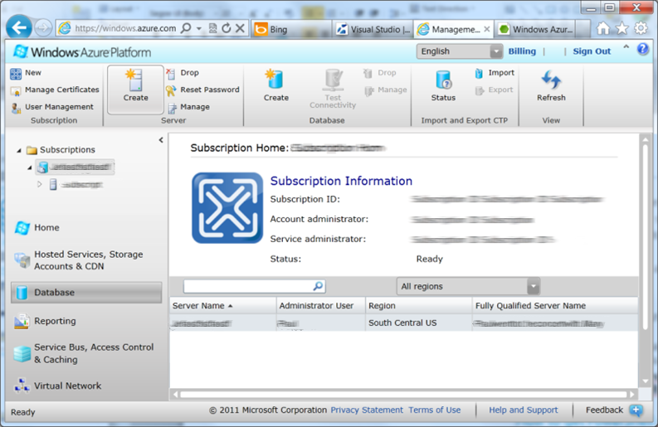
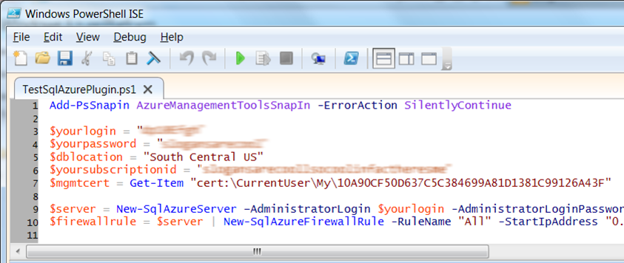
Provision Your Server
Server defined
Service head that contains databases
Connect via automatically generated FQDN (xxx.database.windows.net)
Initially contains only a master database
Provision servers interactively
Log on to Windows Azure Management Portal
Create a SQL Azure server
Specify admin login credentials
Add firewall rules and enable service access
Automate server provisioning
Use Windows Azure Platform PowerShell cmdlets (or use REST API directly)
wappowershell.codeplex.com

Slide 8
Creating a SQL Azure DB
demo
Notes:
Demo – Creating a SQL Azure DB through the Management Portal

Slide 9
Build and Deploy your Database

Slide 10
Build Your Database
Use familiar technologies
Supports Transact-SQL
Supports popular languages
.NET Framework (C#, Visual Basic, F#) via ADO.NET
C / C++ via ODBC
Java via Microsoft JDBC provider
PHP via Microsoft PHP provider
Supports popular frameworks
OData, Entity Framework, WCF Data Services, NHibernate
Supports popular tools
SQL Server Management Studio (2008 R2 and later)
SQL Server command-line utilities (SQLCMD, BCP)
CA Erwin® Data Modeler
Embarcadero Technologies DBArtisan®
Differences in comparison to SQL Server
Focus on logical vs. physical administration
Database and log files automatically placed
Three high-availability replicas maintained for every database
Databases are fully contained
Tables require a clustered index
Maximum database size is 150 Gb
Unsupported SQL Server features
BACKUP / RESTORE
USE command, linked servers, distributed transactions, distributed views, distributed queries, four-part names
Service Broker
Common Language Runtime (CLR)
SQL Agent

Slide 11
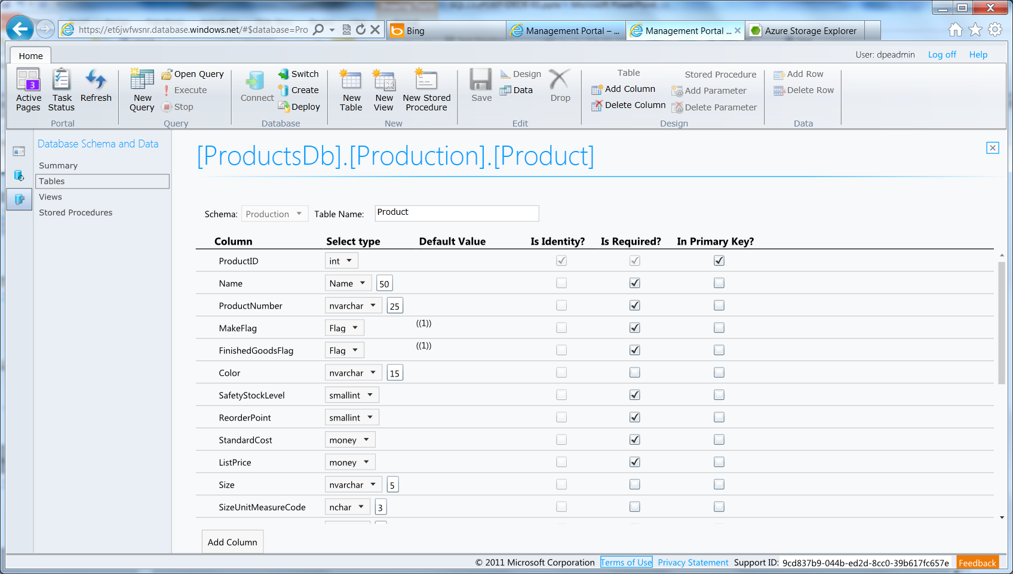
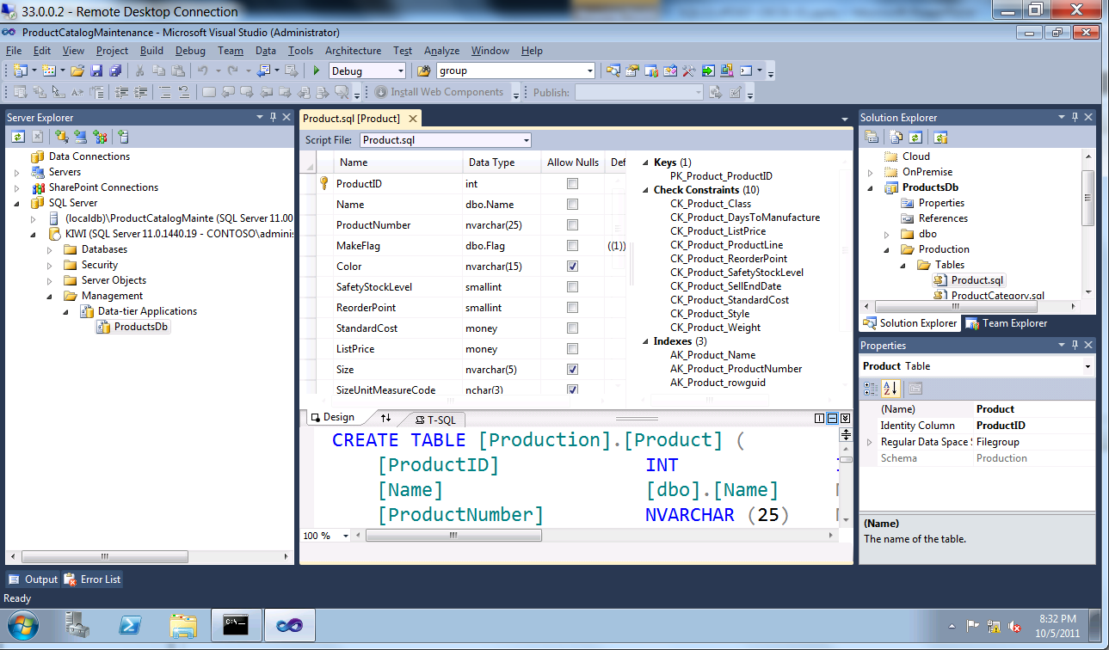
Build Your Database
Thin client database development
Introducing the SQL Azure management portal
Web designers for tables, views, stored procs
Interactive query editing and execution
Rich client database development
Introducing SQL Server Data Tools (SSDT)
Visual Studio IDE for database development
Includes modern designers and projects with declarative, model-driven development
Develop and test in both connected and disconnected states
Platform targeting for both SQL Server (2005 and above) and SQL Azure
Get it free with Web PI, with SQL Server 2012 and with Visual Studio 11

Slide 12
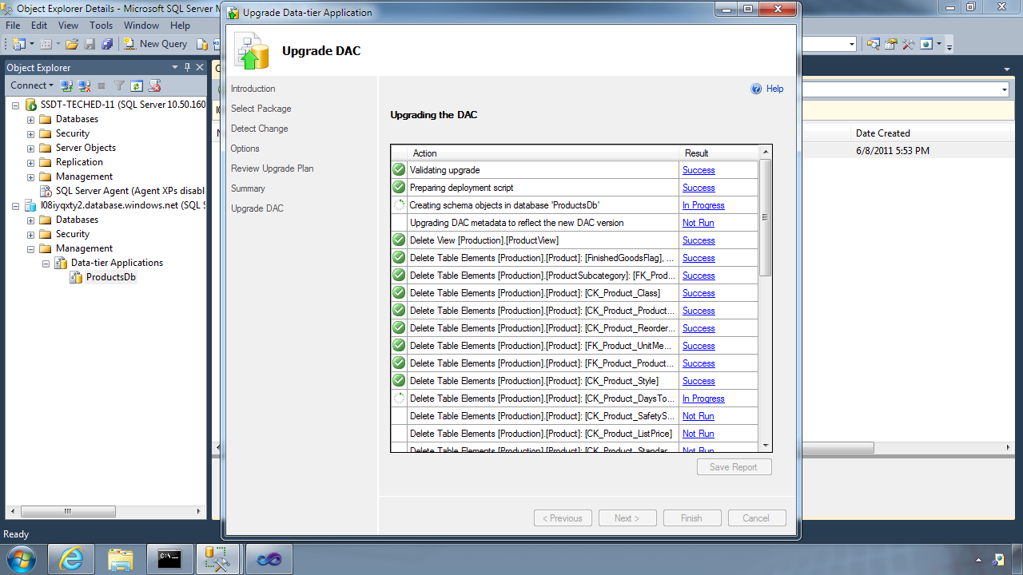
Deploy Your Database
Data-tier Application Framework (DAC Fx)
Alternative to traditional script based approach
Dramatically simplifies deployment, migration and versioning of databases
Provides a single unit of deployment for schema (dacpac) or for schema + data (bacpac)
Supports automatic versioning of database schemas
Supports platform targeting for both SQL Server (2005 and above) and SQL Azure
Build from scratch or extract from existing db
How to get the latest DAC Fx
With SQL Server Data Tools
With SQL Server 2012 Management Studio
With SQL Azure Import/Export Service
Via sqldacexamples.codeplex.com

Slide 13
DAC deployment from Visual Studio
demo
Notes:
Demo – Creating a SQL Azure DB through the Management Portal

Slide 14
Secure your Database

Slide 15
There are two ways to secure a database:
On the Server
Within the Database

Slide 16
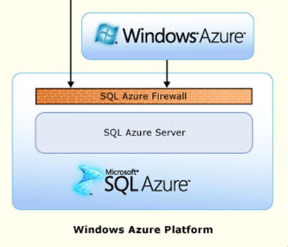
SQL Azure Firewall
Internet
IP Address-based access control for SQL Azure
No IP authorized by default
Configurable using the SQL Azure Portal
Option to disable/enable access from applications hosted in Windows Azure
Notes:
Rather than using a REST API like the other Azure storage services, SQL Azure is accessed via Tabular Data Stream (TDS), the same protocol used by Microsoft SQL Server (operating over port TCP/1433). To help protect the data, the SQL Azure firewall prevents all access to your SQL Azure server until you specify which computers have permission. The firewall grants access based on the originating IP address of each request.
Initially, all access to your SQL Azure server is blocked by the SQL Azure firewall; connection attempts originating from the Internet or Windows Azure will not be able to reach your SQL Azure server. In order to begin using your SQL Azure server, you must go to the SQL Azure Portal and specify one or more firewall settings that enable access to your SQL Azure server. Use the firewall settings to specify which IP address ranges from the Internet are allowed, and whether or not Windows Azure applications can attempt to connect to your SQL Azure server.

Slide 17
Server Benefits
Server identity and access control
SQL authentication supported
Integrated authentication not supported
Connect to master to administer logins and create / drop databases
The admin login (configured during service provisioning) is like sa
The admin login has full rights on the server (and all databases) and should only be used for administration
Manage logins with CREATE / ALTER / DROP LOGIN commands
Membership in the loginmanager server role grants CREATE / ALTER / DROP LOGIN privileges
Membership in the dbmanager server role grants CREATE / DROP DATABASE privileges

Slide 18
Database Benefits
Database identity and access control
Logins must have an associated user account to connect to a database
The admin login is automatically associated with a special user known as dbo (database owner)
The dbo has full rights in the database and should only be used for administration
Manage users with CREATE / ALTER / DROP USER commands
Add users to system or user-defined database roles to grant privileges via sp_add_rolemember
Organize database objects into schema containers based upon common access control requirements
Grant privileges to schema containers instead of individual objects for better productivity

Slide 19
Connect Your Application
Connecting to SQL Azure
TDS (Tabular Data Stream) protocol over TCP/IP supported
SSL required
Use firewall rules to connect from outside Microsoft data center
ASP.NET EXAMPLE:
Special considerations
Legacy tools and providers may require special format for login: [login]@[server]
Idle connections terminated after 30 minutes
Long running transactions terminated after 24 hours
DoS guard terminates suspect connections with no error message
Failover events terminate connections
Throttling may cause errors
Use connection pooling and implement retry logic to handle transient failures
Latency introduced for updates due to HA replicas
No cross-database dependencies, result sets from different databases must be combined in application tier
<connectionStrings>
<addname="AdventureWorks"connectionString=
"Data Source=[server].database.windows.net;
Integrated Security=False;
Initial Catalog=ProductsDb;
User Id=[login];
Password=[password];
Trusted_Connection=False;
Encrypt=true;"
providerName="System.Data.SqlClient"/>
</connectionStrings>

Slide 20
Exploring advanced Capabilities

Slide 21
Explore Advanced Capabilities
Rapid innovation
Improved engineering efficiencies
Quarterly service update cadence
Improved operational agility
Powerful new services Buy / sell finished data sets on the Windows Azure Marketplace
Visualize data with SQL Azure Reporting
Synchronize data with SQL Azure Data Sync
Scale out data with SQL Azure Federations
New developer opportunities
Devices connected to continuously available cloud services
Consumer applications
SaaS applications

Slide 22
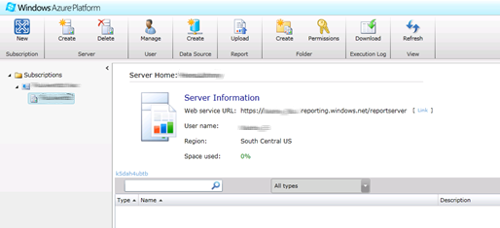
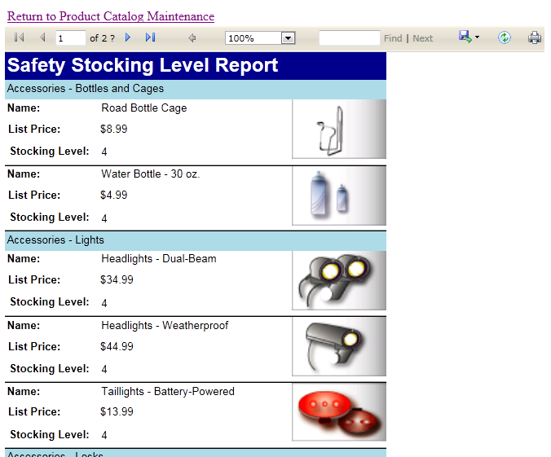
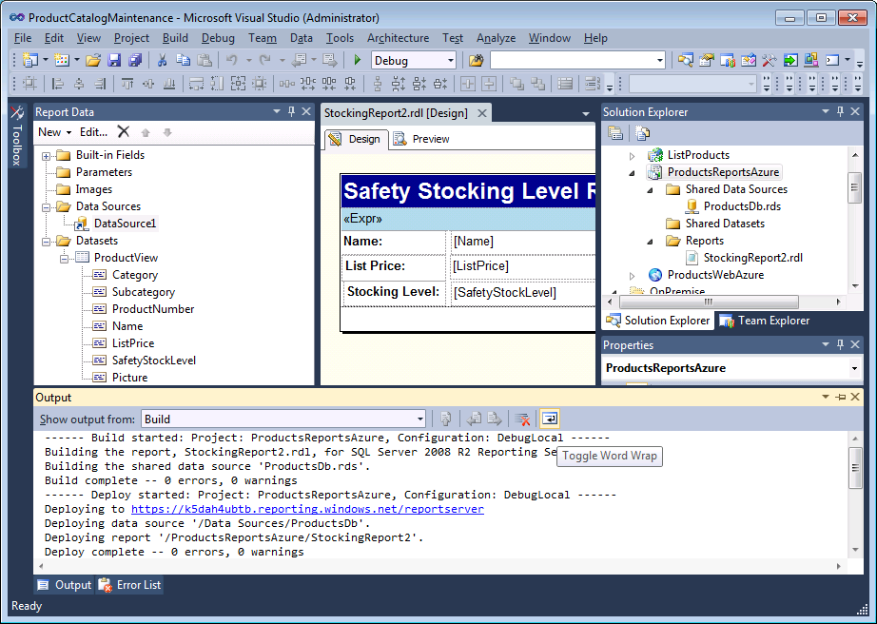
Visualize Your Data
SQL Azure Reporting is
SQL Server Reporting Services technology delivered as a service on the Windows Azure Platform
Ideal for operational reporting against SQL Azure data
Enterprise-ready with automatic support for HA
Designed to scale elastically with demand
Get started quickly
Provision report server via Windows Azure Management Portal
Build reports with Reporting Services Report Designer
Deploy reports to report server
Render reports with Visual Studio ReportViewer controls

Slide 23
Visualize Your Data
Use familiar technologies
Visual Studio Report Designer
RDL (Report Definition Language)
Report items and visualizations
Report Server Web Service / URL access
Visual Studio ReportViewer Control
Differences in comparison to Reporting Services
Focus on logical vs. physical administration
Report catalog and temporary database automatically provisioned
Windows Azure Management Portal replaces Report manager
SSL Required
SQL Azure data sources only
Identity and access control
SQL authentication supported (no support for integrated authentication)
Admin user configured during provisioning
Admin user has all rights on server, use for administration only
Provision users using portal or web service
Add users to appropriate item (Browser, Publisher) and system roles (User, Admin)
Grant item-level permissions to folders or reports
Unsupported Reporting Services features
Report Builder
Subscriptions, schedules, caching
Custom extensions
Report models
External images

Slide 24
SQL Azure Reporting Services
demo

Slide 25
Synchronize Your Data
SQL Azure (Hub)
SQL Azure (US)
SQL Azure (WE)
SQL Server (OnPrem)
SQL Azure Data Sync is
Microsoft Sync Framework technology delivered as a service on the Windows Azure Platform
Ideal for scheduling synchronization between data sets hosted in SQL Azure or SQL Server
Uses a hub and spoke topology
Special considerations
Conflict resolution policy configured centrally (hub or client wins)
Sync direction configured between each client and the hub (to hub, from hub, bi-directional)
Sync schedule must be between 5 minutes and 1 month
Data sets include multiple tables and can be filtered, triggers are added to data set tables
Tables added to hub and client schemas
Agent must be installed for on-prem clients

Slide 26
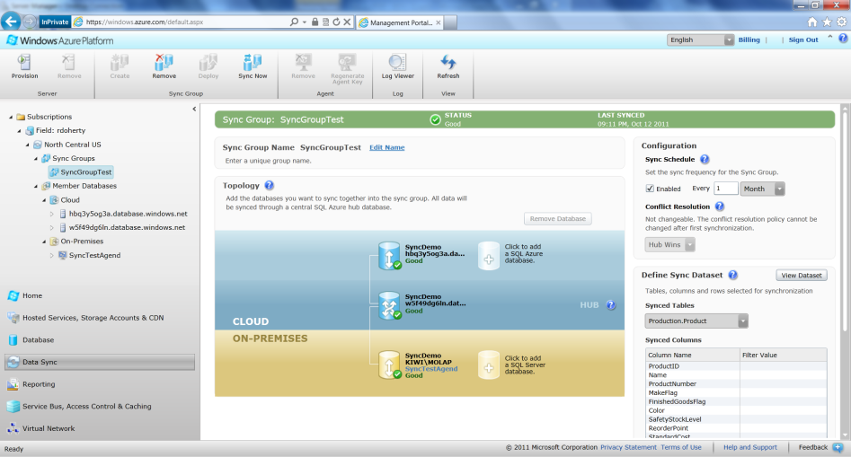
Synchronize Your Data
Provisioning synchronization groups
Deploy database to hub and clients
Set synchronization schedule
Set conflict resolution policy
Define data set
Add SQL Azure clients to topology
Install agents on SQL Server clients and add them to topology using keys
Deploy topology
Operational considerations
Manual synchronization supported
Hub updates require one synchronization to distribute to all clients
Client updates require two synchronizations to distribute to all clients
Sync Framework triggers may affect application behavior

Slide 27
SQL Azure DataSync
demo

Slide 28
scale out your data
SQL Azure Federations provides
Integrated database sharding that can scale to hundreds of nodes
Multi-tenancy via flexible repartitioning
Online split operations to minimize downtime
Automatic data discovery regardless of changes in how data is partitioned
Special considerations
A logical database can contain multiple federations
Distribution scheme supports int, bigint, guid, and varbinary types
Filtering routes connection to appropriate shard regardless of changes in partitions
Merge, fan-out queries and automatic distribution of schema changes not supported in initial release
Federation Root
Multi-Tenant Db
Tenant 1
Tenant 2
Tenant 3 Db
Tenant 4
Tenant 4 Db 1
Tenant 4 Db 2

Slide 29
SQL Azure Federations
demo

Slide 30
Thank You

Slide 31
Appendix

Slide 32
SQL Azure Billing Rates (As of February 2012)
Database Size | Price Per Database Per Month
0 to 100 MB | Flat $4.995
> 100 to 1 GB | Flat $9.99
> 1GB to 10 GB | $9.99 for first GB, $3.99 per additional GB
> 10 GB to 50 GB | $45.954 for first 10 GB, $1.998 for each additional GB
> 50 GB to 150 GB | $145.874 for first 50 GB, $0.999 for each additional GB
Based on graduated rate based on database size
Charged at monthly rate per database
Amortized over month -> calculated on daily basis
No Transaction Charges
Data Transfers
North America and Europe regions $0.14 per GB out
Asia Pacific region $0.20 per GB out
All inbound data transfers are at no charge.

Slide 33
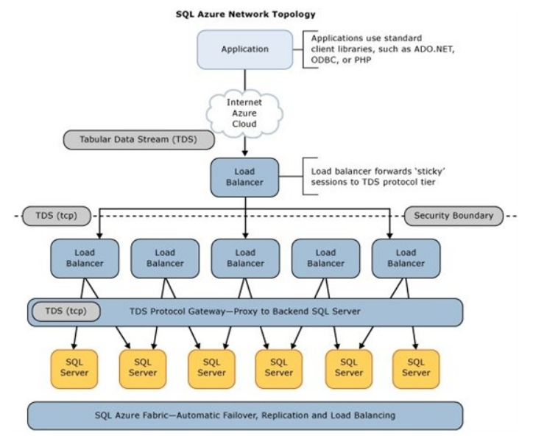
SQL Azure Database Architecture

