Slide 1
Managing, Debugging, and Monitoring Windows Azure Applications
Name
Title
Microsoft Corporation

Slide 2
Agenda
Help you understand the Windows Azure deployment and management model
Discover how to monitor your services and any caveats that might apply
Discuss how to troubleshoot your services in the cloud

Slide 3
Understanding Packaging and Config
Windows Azure Services are described by two important artifacts:
Service Definition (*.csdef)
Service Configuration (*.cscfg)
Your code is zipped and packaged with definition (*.cspkg)
Encrypted(Zipped(Code + *.csdef)) == *.cspkg
Windows Azure consumes just (*.cspkg + *.cscfg)

Slide 4
Service Definition
<?xml version="1.0" encoding="utf-8">
<ServiceDefinition name="WebDeploy" xmlns=http://schemas.microsoft.com/ServiceHostings/2008/10/ServiceDefinition>
<WebRole name="WebUX">
<Startup>
<Task commandline="..\Startup\EnableWebAdmin.cmd" executionContext="elevated" tasktype="simple" />
</Startup>
<Imports>
<Import moduleName="RemoteAccess" />
<Import moduleName="RemoteForwarder" />
</Imports>
<Sites>
<Site name="Web">
<Bindings>
<Binding name="HttpIn" endpointName="HttpIn" />
</Bindings>
</Site>
</Sites>
<Endpoints>
<InputEndpoint name="HttpIn" protocol="http" port="80" />
<InputEndpoint name="mgmtsvc" ptotocol="tcp" port="8172" localport="8172" />
</Endpoints>
<ConfigurationSettings>
<Setting name="DiagnosticsConnectionString" />
</ConfigurationSettings>
</WebRole>
</ServiceDefinition>
Describes the shape of your Windows Azure Service
Defines Roles, Ports, Certificates, Configuration Settings, Startup Tasks, IIS Configuration, and more…
Can only be changed by upgrades or new deployments

Slide 5
Service Definition
<?xml version="1.0"?>
<ServiceConfiguration serviceName="WebDeploy" xmlns=http://schemas.microsoft.com/ServiceHosting/2008/10/ServiceConfiguration>
<Role name="WebUX">
<Instance count="1" />
<ConfigurationSettings>
<Setting name="DiagnosticConnectionString" value="UseDevelopmentStorage=true" />
<Setting name="Microsoft.WindowsAzure.Plugins.RemoteAccess.Enabled" value="True" />
<Setting name="Microsoft.WindowsAzure.Plugins.RemoteAccess.AccountUsername" value="dunnry" />
<Setting name="Microsoft.WindowsAzure.Plugins.RemoteAccess.AccountEncryptedPassword" value="MIIBrAYJKOZIhvcNAQCDoIIBnTCCAZ" />
<Setting name="Microsoft.WindowsAzure.Plugins.RemoteAccess.AccountExpiration" value="2010-12-23T23:59:59.0000000-07:00" />
<Setting name="Microsoft.WindowsAzure.Plugins.RemoteForwarder.Enabled" value="True" />
</ConfigurationSettings>
<Certificates>
<Certificate name="Microsoft.WindowsAzure.Plugins.RemoteAccess.PasswordEncryption" thumbprint="D6BE55AC439FAC6CBAFF432BD" />
</Certificates>
</Role>
</ServiceConfiguration>
Supplies Runtime Values (Scale, Config Settings, Certificates to use, VHD, etc.)
Can be updated any time through Portal or API

Slide 6
Fault and Upgrade Domains
Fault Domains
Represent groups of resources anticipated to fail together
i.e. Same rack, same server
Fabric spreads instances across fault domains
Default of 2
Upgrade Domains
Represents groups of resources that will be upgraded together
Specified by upgradeDomainCount in ServiceDefinition
Default of 5
Fabric splits Upgrade Domains across Fault Domains and Across Roles

Slide 7
Fault and Upgrade Domains Visualized
Fault Domain
Fault Domain
Rack
Rack
Web Role
Web Role
U/G Domain #1
VM
VM
U/G Domain #2
VM
VM
Worker Role
Worker Role
U/G Domain #1
VM
VM
U/G Domain #2
VM
VM

Slide 8
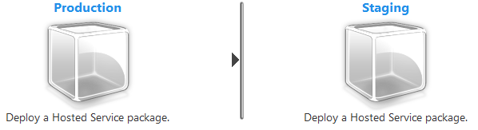
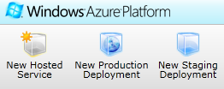
Deployment Environments
Two Environments to choose from
Nearly Identical…
<servicename>.cloudapp.net
<deploymentID>.cloudapp.net
VIP Swap between them

Slide 9
Deploying Services
Delete/Create Deployment
Visual Studio does this
VIP will change
Service Model Updates don’t matter
VIP Swap
Bring up another environment in Staging and swap
Only Input Endpoints (external ports) matter

Slide 10
Deploying Services
In-Place Upgrade
Rolling upgrade across roles
Most restrictive on changes (no size, endpoints, roles, etc.)
Web Deploy*

Slide 11
VIP Swap
Deployment
Web Role
Worker Role
VM
VM
Load Balancer:
VM
VM
Prod
Prod
Deployment
Stage
Stage
Web Role
Worker Role
VM
VM
VM
VM

Slide 12
In Place Upgrade
Rack
Rack
Web Role
Web Role
#1
VM
VM
Load Balancer:
#2
VM
VM
Prod
Worker Role
Worker Role
#1
VM
VM
#2
VM
VM

Slide 13
In Place Upgrade Improvements
With SDK 1.5 Supports a Wider Range of Upgrade Options without the Need to Re-Deploy
The newly allowed in-place updates are:
Change the virtual machine size (scale-up or scale-down)
Increase local storage
Add or remove roles to a deployment
Change the number or type of endpoints

Slide 14
Deployment Considerations
Sometimes you MUST delete a deployment
Try to minimize by specifying what you might need in advance
Deleting a deployment loses the VIP address
Might matter if you are whitelisting
Or… if you use A records
Use DNS as another layer of abstraction if you must delete
Use another hosted service, update DNS, wait…

Slide 15
Further Considerations
Co-Admin Capability
Up to 5 Management API Certificates
Admins are admins at Subscription Level (not hosted service)
Production should be in separate subscription to avoid mistakes

Slide 16
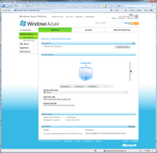

Managing Services
Management API
Your Service
Portal
REST API
Windows Live ID

Slide 17
Deployment and Management Tools
Visual Studio*
CSManage.exe
Windows Azure MMC
Windows Azure Service Management (WASM) cmdlets
3rd Party tools

Slide 18
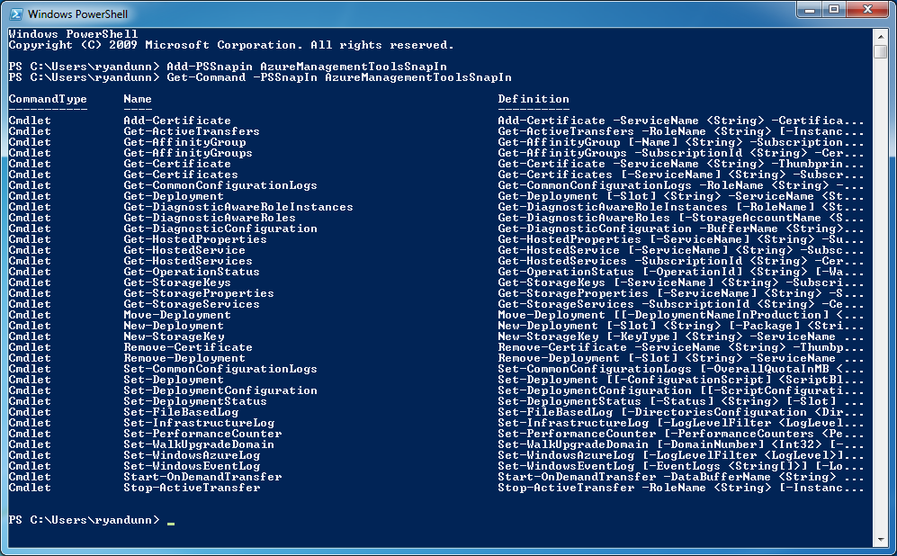

Windows Azure Service Management Cmdlets
Set of PowerShell cmdlets
Wraps Management REST API and Diagnostics API
Enables building of sophisticated deployment scripts
Works with rest of .NET CLR

Slide 19
Deploying via Cmdlets
demo

Slide 20
Monitoring
Windows Azure Diagnostics
Windows Azure Monitoring MP for SCOM
Available as RC now!
Monitors Health, Scales, and more

Slide 21
Windows Azure Diagnostics
You can monitor the following:
IIS Logs, Crash Dumps, FREB Logs
Arbitrary log files
Performance Counters
Event Logs
Debug/Trace statements
Infrastructure events

Slide 22
How Does It Work (in a nutshell)?
Role Instance Starts
Diagnostic Monitor Starts**
Monitor is configured
Imperatively at Start time
Remotely any time
Monitor buffers data locally
User can set a quota (FIFO)
User initiates transfer to storage
Scheduled or On Demand
Role Instance
Role
Diagnostic
Monitors
Local directory storage

Slide 23
Remote Configuration
Role Instance
Poll Interval
Role
Diagnostic
Monitors
Local directory storage

Slide 24
Diagnostics
demo

Slide 25
Storage Considerations
Standard costs apply for transactions, storage & bandwidth
Data Retention
Local buffers are aged out by the Diagnostic Monitor according to configurable quotas
You control data retention for data in table/blob storage
Dedicated or multiple storage accounts might be a good idea

Slide 26
Storage Considerations
Query Performance on Tabular Data
Partitioned by high-order bits of the tick count
Query by time is efficient
Filter by verbosity level at transfer time

Slide 27
Diagnostics Considerations
Monitoring vs Debugging/Troubleshooting
Volume of Data
Reaction Time
$ Cost
Monitoring 5 Performance Counters every 5 seconds for 100 instances costs > $260 US dollar per month

Slide 28
Advanced Diagnostics
Think about Scale Units
One instance monitors
Aggregate Data
Flag important events/Notify
Instance
Instance
Instance
Instance
Instance
Monitor

Slide 29
Troubleshooting
Intellitrace – DVR for debugging
Requires VS Ultimate, .NET 4 today
Remote Desktop
Custom Trace Listener

Slide 30
Troubleshooting
demo

Slide 31
Summary
Windows Azure offers a number of ways to deploy code
Know which one to choose!
Windows Azure Diagnostics
Monitoring vs Troubleshooting – use the right tools.

