Slide 1
Migrating to SQL Azure
Name
Title
Microsoft Corporation

Slide 2
Agenda
Migration Options
Tools and Utilities
Considerations
Demo

Slide 3
Migration Options

Slide 4
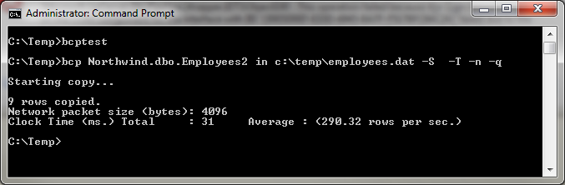
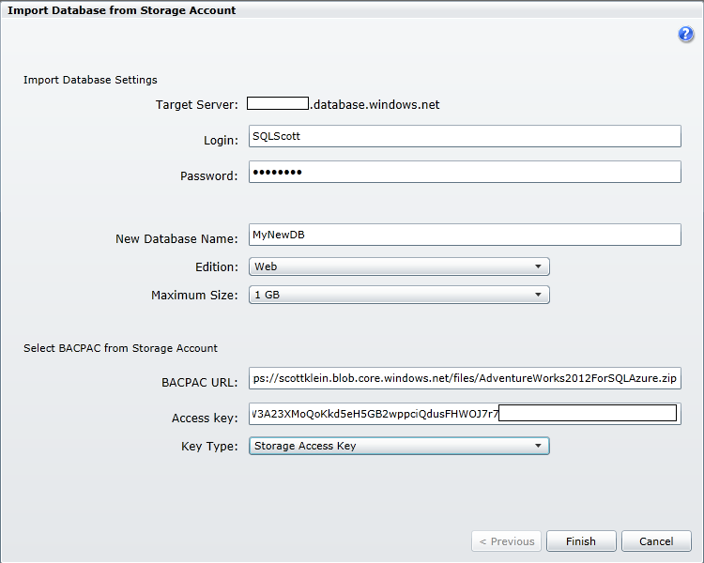
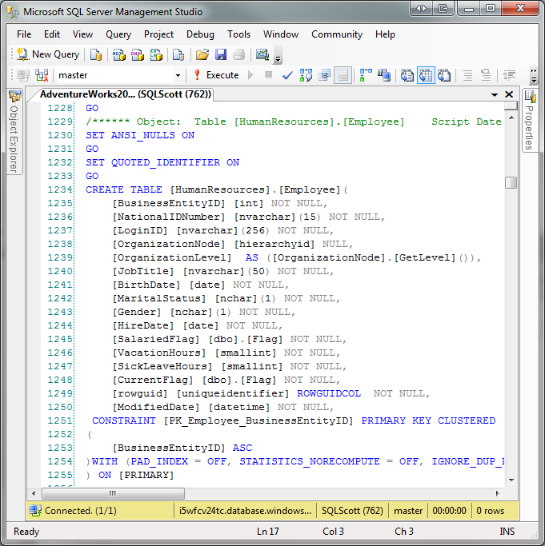
What Migration Options Are Available?
SQL Azure Import/Export Service
BCP
SSIS
Generate Scripts Wizard
SQL Azure Migration Assistants
SQL Azure Data Sync Services
SQL Azure Migration Wizard
Sync Framework

Slide 5
Tool and Utilities

Slide 6
Import / Export Service

Slide 7
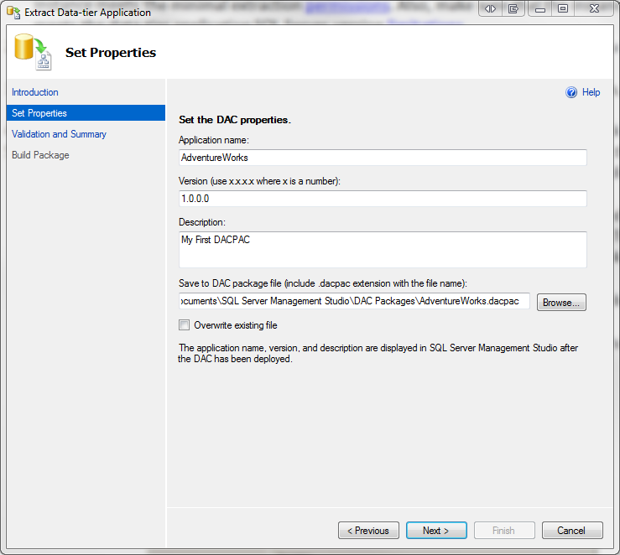
SQL Azure Import/Export Service
Designed to directly import and export between SQL Server or SQL Azure and Azure BLOB storage
Migrate both object definition and data
Use of Windows Azure Blob Storage
Supported On-Premises Versions:
SQL Server 2012
SQL Server 2008 R2
SQL Server 2008
SQL Server 2005
Notes:
A DAC is a self-contained unit of deployment that enables data-tier developers and DBAs to package SQL Server objects, including database and instance objects, into a single entity called DAC package. Developers can build a DAC package using the Data-tier Application project system in Visual Studio, whereas SQL Server Management Studio (SSMS) users can extract a DAC and generate a DAC package file for an existing database.

Slide 8
Terminology
DAC – Data-tier Application
DACFx – DAC Framework
DACPAC – File format used by DACFx. Represents the full definition of an application. Schema Only.
BACPAC – Contains both application definition as well as the data.

Slide 9



Architecture
SQL Azure
Blob Storage
Service Import / Export
BACPAC
Copy
DACFx
Import/Export Service
BACPAC
Upload/
Download
Import / Export
Request (REST)
BACPAC
Client-side Import/Export

Slide 10
Benefits
Performance
Connection Pooling and Parallelization to deliver exceptional performance
Cloud Scale to handle multiple import/export requests
Resiliency
Connectivity enhancements to provide a reliable experience
Selective Export
Select specific tables
Progressive Reporting
Import/Export status shown for progress feedback and state of the request
Notes:
Perf - The service has implemented a new connection pooling and parallelization strategy to deliver significantly improved performance for all types of databases. While actual results may vary, the average import or export should now be approximately three times faster!
ALSO - we do all the processing, so we can handle multiple import/export requests all over the world and you don’t need to do anything other than submit some simple import/export requests
Res - Several connectivity issues both transient and permanent have been identified and addressed in order to provide a more reliable experience.
SI - Customers who only want to export certain tables for performance reasons or because the data doesn’t change often can provide a list of tables to export. The resultant BACPAC will contain the full schema definition plus the table data only for the specified tables. The selectively exported BACPAC can be imported just like a fully exported BACPAC. For now, the sample EXE must be used to submit these types of requests. Customers using the service’s REST endpoints directly can always bypass the EXE.
PR - The current progress for a request will be shown as a percentage in order to provide better feedback on the current state of the request.

Slide 11
Requirements
On-Premises
SQL Server 2012
All necessary components are installed
SQL Server* 2008 R2, 2008, 2005, 2000
Data-tier Application Framework
T-SQL Language Service
ScriptDOM
Shared Management Objects
System CLR Types
DAC ImportExport Service Client Executable (1.4.1)
Windows Azure
Storage Account
SQL Azure Server
Note:
The dependencies are not needed if you plan on only using the service
Notes:
You can either install SSMS and get all the components for free –or- install the specific dependencies and call the APIs directly and/or use the reference CLI which is here: http://sqldacexamples.codeplex.com/releases/view/80705
To use the service you need to have a blob and sql azure account/server setup already and you only need to use the EXE or the wizard in the sql azure portal to perform the import/export. You don’t need all the dependencies if you plan on only using the service

Slide 12
Additional Migration Options

Slide 13
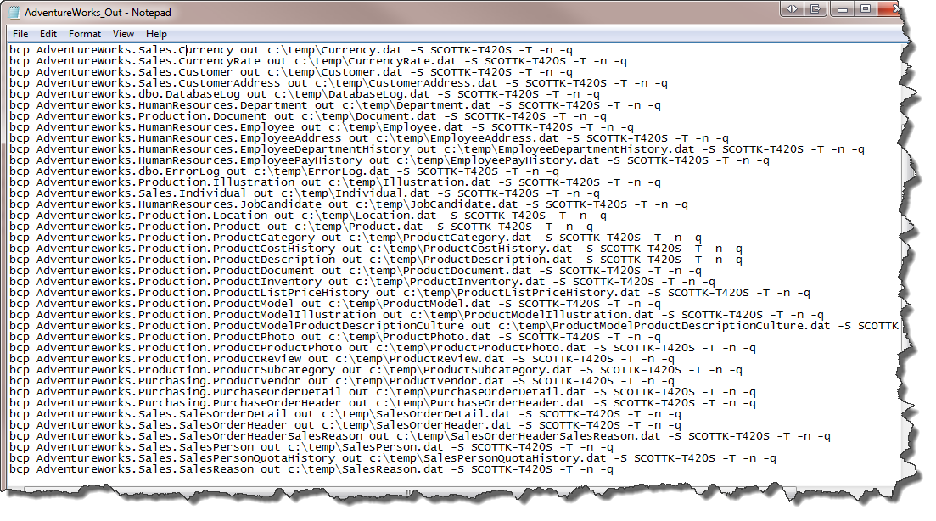
Bulk Copy (BCP)
Import and Export data between a SQL Server instance and a data file in a user-defined format
Benefits
Quick and Efficient
Easy to Maintain
Limitations
Schema
Syntax
Notes:
Fast
Maintain – even if schema changes
Limitations:
Schema must already exist
Syntax – many options…hard to figure out if new to bcp

Slide 14
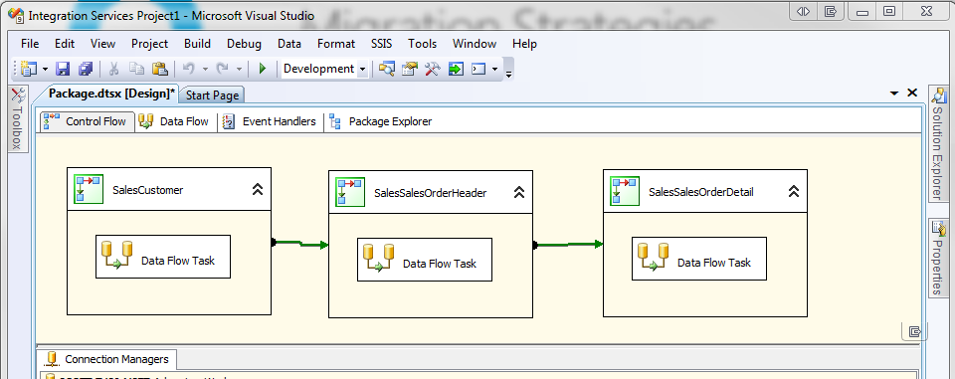
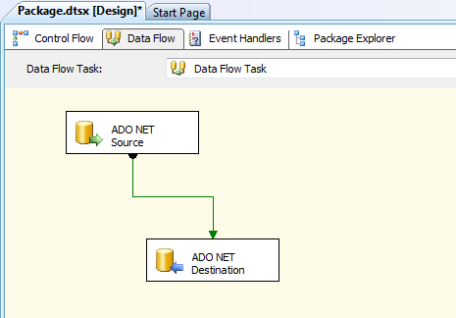
SQL Server Integration Services
Platform for building data integration and transformation solutions
Benefits
Graphical UI
Quick and Efficient
Easy to Maintain
Limitations
Schema must already exist
Notes:
Graphical UI provides easy and efficient mapping of source and destination sources
Schema:
Must already exist

Slide 15
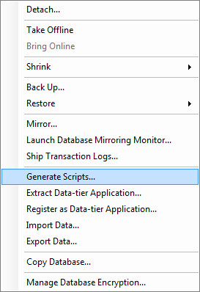
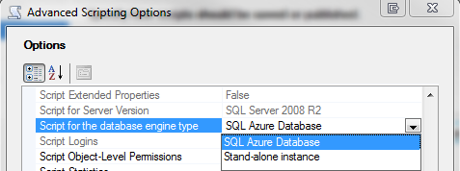
Generate Scripts Wizard
Produce Transact-SQL scripts compatible with SQL Azure
Benefits
Included with SQL Server Management Studio
Include Schema and/or data
Accuracy
Limitations
Manageability
Notes:
Large databases and data

Slide 16
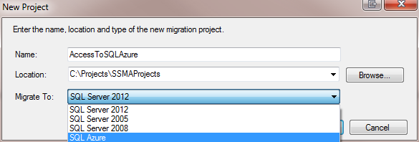
SQL Azure Migration Assistants
Migrate databases from other platforms to SQL Azure
Benefits
Supported Databases: Sybase, Oracle, MySQL, Access
Improved to further reduce cost and migration risk
Support for Multi-threading and globalization
SQL Server 2012 Support

Slide 17
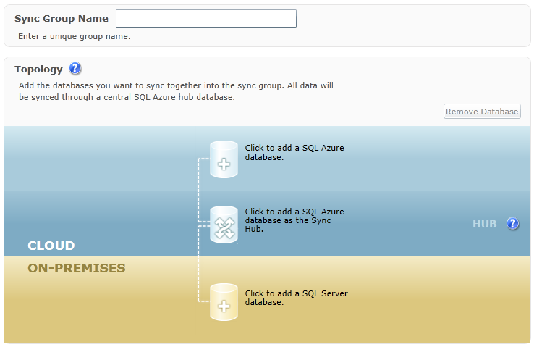
SQL Azure Data Sync Services
Windows Azure-based synchronization service built entirely upon the Sync Framework Technologies
Benefits
Extend the enterprise to the cloud
Extend data to provide geo-available data access
Services scale as resource environments grow
No Code Solution
Conflict Handling
Logging and Monitoring
Notes:
Intro – in fact, SQL Azure data sync services is so important that the development of the sync framework 4.0 was put on hold and all developers focused on the release of the sql azure data sync.
Extend – rather than replacing by synching on-premise SQL Server to SQL Azure
Conflict – easily handle issues where same data is changed in multiple locatons

Slide 18
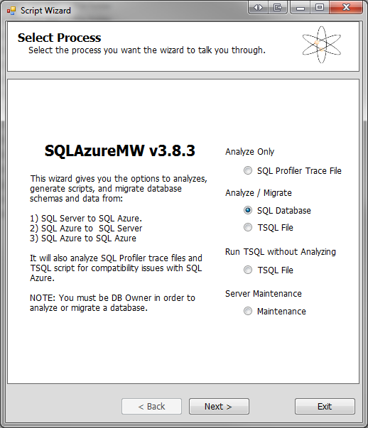
SQL Azure Migration Wizard
An open-source application designed to migrate SQL Server databases to SQL Azure
Benefits
Analyzes on-premises database for SQL Azure Compatibility
Moves Data
Interactive Wizard
No Code Solution
Multi-directional
Limitations
Unofficially Supported

Slide 19
Considerations

Slide 20
Migration Considerations
Database Size
Objects
Data
Frequency
Technology Proficiency
Easiest != Best
You can pick more than one…

Slide 21
Export
demo
Notes:
Demo – Creating a SQL Azure DB through the Management Portal

