Slide 1
Node.js on Windows Azure
Name
Title
Microsoft Corporation

Slide 2
Agenda
What is node.js?
When to use node.js?
Node.js on Windows Azure

Slide 3
What is node.js?
JavaScript on the Server!
Event driven I/O server-side JavaScript
Not thread based, each connection uses only a small heap allocation
Efficient and highly scalable

Slide 4

JavaScript Server
Started 2009 by @ryah
Open Source (MIT license)
Sponsored by
Second most popular project on GitHub
Node process
V8 runtime
Your app.js
Module
Module
Module
Module

Slide 5
Async Model
Single-threaded event loop
Thread must not stop for anything!
Run DB query
Work queue
The one-and-only thread
New request
New request
DB query results
DB query results
Poll timeout

Slide 6
Node is…
Excellent for:
OK for:
Realtime comms
Sockets, polling, etc.
Custom network services
Media servers, proxies, etc.
JSON web services
Thin app layer on top of a datastore
Client-oriented web UIs
Anything you’d build with Sinatra
“Forms over data” CRUD apps
Rails/ASP.NET give you more
Wrong for:
Doing CPU intensive processing
Video transcoding, etc.
Though it could proxy to a transcoder

Slide 7
Pros
Pros and Cons
Cons
JavaScript
Common to almost all developers
Same language on server & client
Clean, consistent API
Simple concurrency model
Even low-skilled devs can manage it
Idle connections are nearly free
Long polling? No problem.
Very high capacity for concurrent reqs
Very modular
Plug in whatever behaviors you need
Not a lot of standard framework
Testing? Validation? Pick your own approach…
Young & not yet widely deployed
Pretty bare-metal
Not aimed at drag-drop devs...!

Slide 8



Application Frameworks
Connect | Standard middleware
 | Routing + Templates (like Sinatra)
 | Full-stack MVC (wants to be like Rails)
(fab) | Totally bizarre DSL for combining modules
Ni | Full-stack MVC (wants to be like Rails)
 | Inspired by ASP.NET MVC ☺

Slide 9
Node.js on Windows
Native node.exe
IISNode – a native IIS 7.x module that allows hosting of node.js applications in IIS
Most modules supported as is
Performance on par with Linux implementation

Slide 10
IIS Node
Process management
Scalability on multi-core servers
Auto-update
Access to logs over HTTP
Side by side with other content types
Minimal changes to node.js application code
Integrated management experience
Notes:
See: http://tomasz.janczuk.org/2011/08/hosting-nodejs-applications-in-iis-on.html

Slide 11
IIS Node
<configuration>
<system.webServer>
<handlers>
<add name="iisnode"
path="app.js"
verb="*"
modules="iisnode" />
</handlers>
</system.webServer>
</configuration>
IIS
iisnode (native module)
Node.exe
Node.exe
Node.exe
Node.exe
Notes:
IISNode
– load balances across the Node.exe instances
- Auto-restarts when app.js changes
- captures console output and logs it to disk
- lets you host traditional ASP.NET code in the same IIS app (it’s just another handler)

Slide 12
Node Package Manager
Package manager for node
Allows you to easily add modules to your application
Use through the command line:
C:\nodehello> npm install express

Slide 13
NPM – Node Package Manager
> npm install somepackage
coffee-script
connect
jade
express
socket.io
redis
async
vows
request

Slide 14
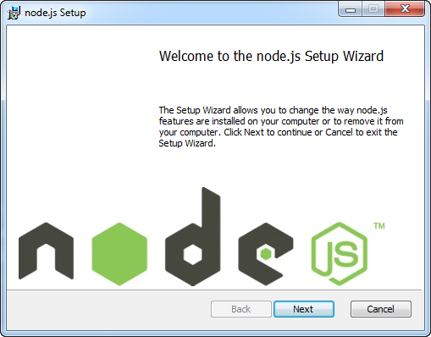
Install node.js on Windows
Single Install: node.js + npm
Download: bit.ly/nodejsdownload

Slide 15
Hello World

Slide 16
Node.js “Hello World”
server.js File:
var http = require('http'); http.createServer(function (req, res) { res.writeHead(200, {'Content-Type': 'text/plain'}); res.end('Hello, world! '); }).listen(80);

Slide 17
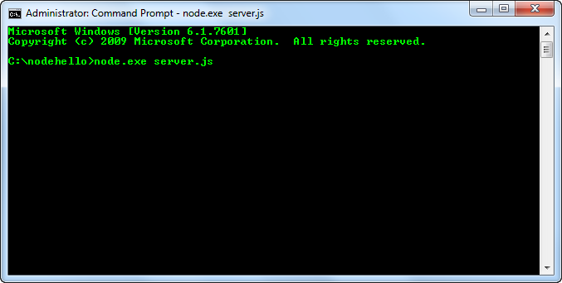
Run node.js “Hello World”
C:\nodehello> node.exe server.js

Slide 18
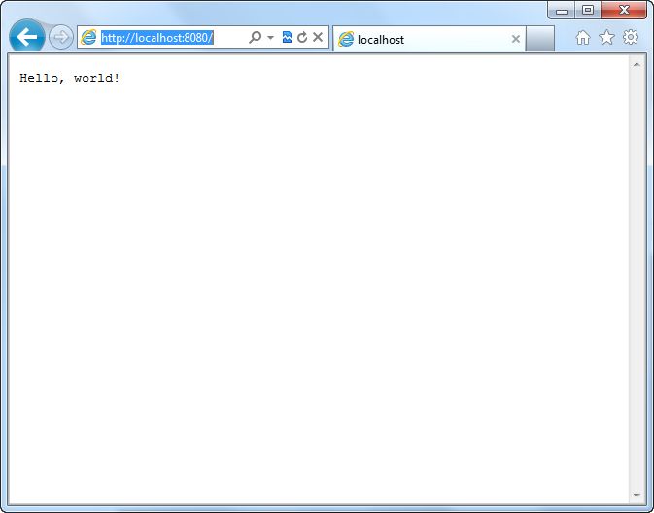
Node.js “Hello World”

Slide 19
Node.js + Express
demo

Slide 20
Node.js On Windows Azure

Slide 21
Node.js on Windows Azure
Web Role
Uses IISNode
Worker Role
Runs node.exe as role entry point
PowerShell Cmdlets
Windows Azure SDK for node.js

Slide 22
Visual Studio Not Required
Create, run, and publish all from outside of Visual Studio
Use command line and editor or IDE of your choice

Slide 23
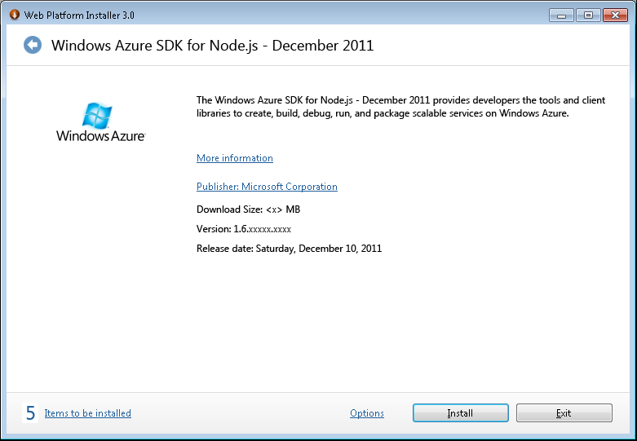
Installation
Single Install using Web Platform Installer
Node.js
IISNode
NPM for Windows
Windows Azure Emulators
Windows Azure Authoring Components
Windows Azure PowerShell for node.js

Slide 24
Node Roles
Node Web Role
Node Worker RoleRole
IIS
Role Entry Point
iisnode (native module)
Node.exe
Node.exe
Node.exe
Node.exe
Node.exe

Slide 25
PowerShell Cmdlets
Create Hosted Service
Launch Node application in local emulator
Set configuration settings
Deploy to Windows Azure

Slide 26
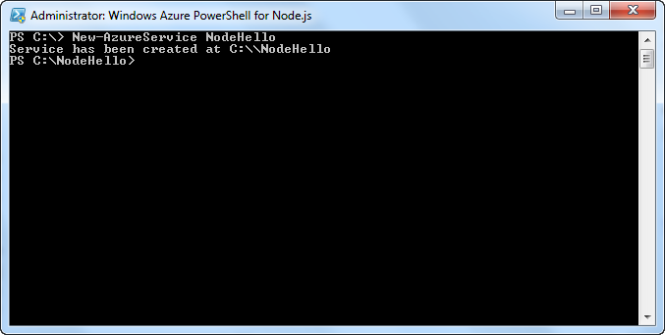
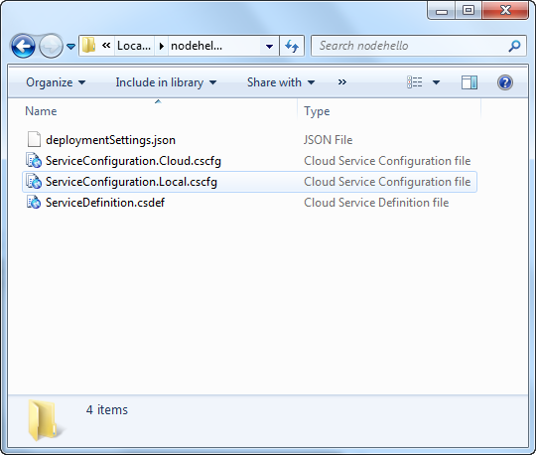
Create a Project

Slide 27
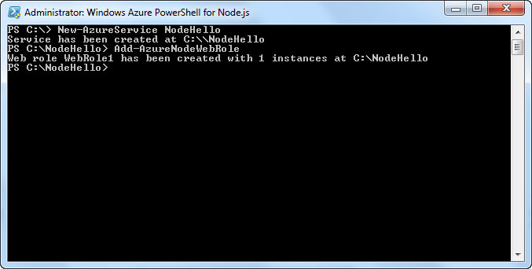
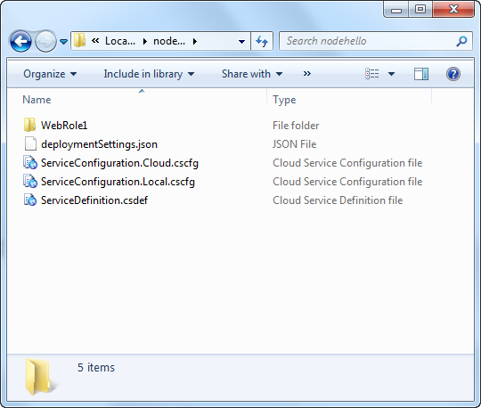
Add Web Role

Slide 28
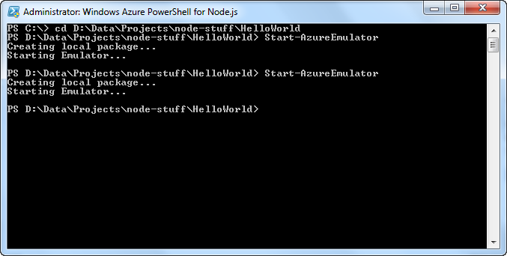
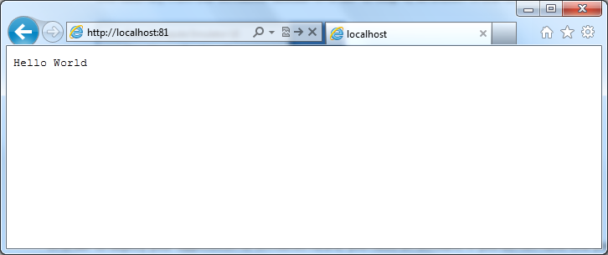
Start Local Emulator

Slide 29
Windows Azure Node SDK
Windows Azure Storage
Blobs
Tables
Queues
> npm install azure

Slide 30
Blob Storage Examples
var azure = require('azure');
var blobClient = azure.createBlobService();
// Create Blob from Text
var text = 'the text of my blob';
blobClient.createBlockBlobFromText('mycontainer', 'myblob', text,
function (error, blockBlob, response) {
// Blob created
});
// Get Blob Text
blobClient.getBlobToText('mycontainer', 'myblob',
function (error, text, blockBlob, response) {
// Blob text retrieved
});
// Delete Blob
blobClient.deleteBlob('mycontainer', 'myblob',
function (error, isSuccessful, response) {
// Container deleted
});

Slide 31
Table Storage Examples
var azure = require('azure');
var tableClient = azure.createTableService();
// Insert Entity
var item = new MyEntity();
item.PartitionKey = 'part1';
item.RowKey = uuid();
tableClient.insertEntity('mytable', item,
function (error, entity, response) {
// Entity saved
});
// Query Entity
tableClient.queryEntity('mytable', item.PartitionKey, item.PartitionKey,
function (error, successful, response) {
// Do something
});
// Delete Entity
tableClient.deleteEntity('mytable', item,
function (error, entity, response) {
// Entity deleted
});

Slide 32
Storage Queue Example
var azure = require('azure');
var queueClient = azure.createQueueService();
// Enqueue a Message
queueClient.createMessage('myqueue', 'my message text',
function (error, queueMessageResult, response) {
// Do something });
// Get Messages
queueClient.getMessages('myqueue',
function (error, queueMessageResults, response) {
// Do Something
});

Slide 33
Task List
demo

Slide 34
Summary
Node.js Overview
IIS Node
Node Modules + NPM
Node.js + Windows Azure
Windows Azure SDK for node.js

