Slide 1
SQL Azure Federations
Name
Title
Microsoft Corporation

Slide 2
Agenda
Database Scalability
SQL Azure Federations
Federation Architecture
Management
Demo

Slide 3
Scalability

Slide 4
Database Scalability
Scale-Up
Single database that houses all the data of an application
Hard to handle peak load
OK with exponential incremental cost
Scale-Out
Multiple databases spread over multiple independent nodes
Cost effective, commodity class hardware
Typical patterns: Sharding and Horizontal Partitioning
Notes:
Scale-up class of hardware typically have high administration cost due to its complex configuration and management requirements.

Slide 5
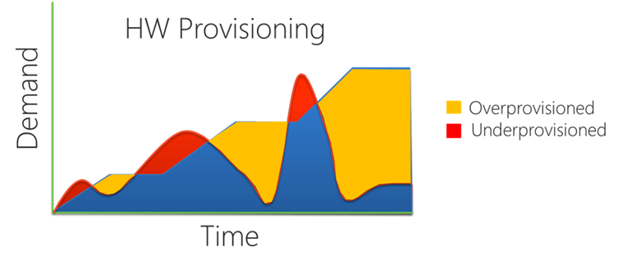
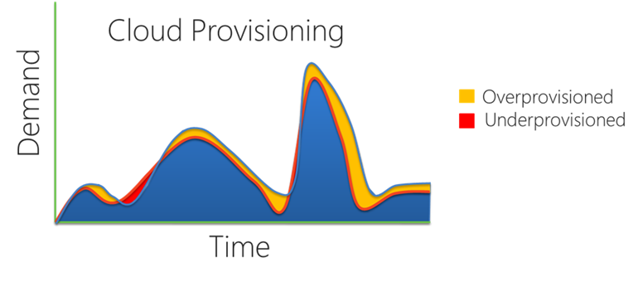
Scalability Model for the Cloud
Cloud Apps Require Scale Beyond Scale-Up
Massive aggregate capacity: 100s of nodes available for use
Cloud Apps Demand the Best Economics
Best Price/Performance
Many commodity nodes for the economics
Elasticity + Pay-as-you-go
Provision just in time and without downtime!
Reduce overcapacity

Slide 6
SQL Azure Federations

Slide 7
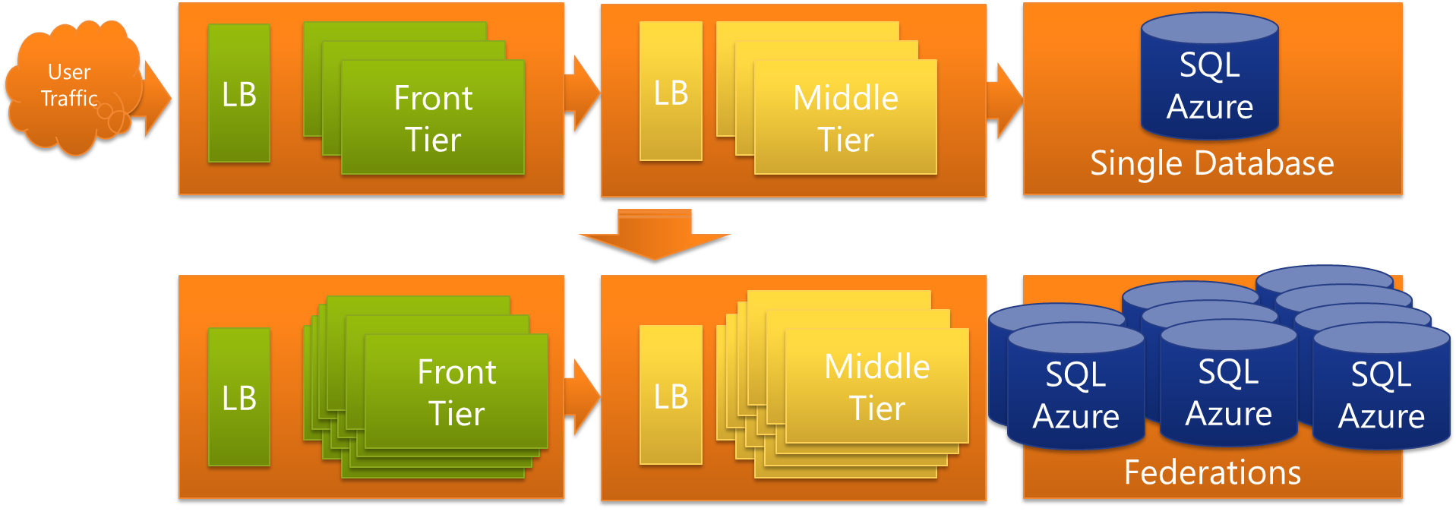
Introducing Federations in SQL Azure
Canonical 3 tier app scales by adding and removing nodes in front and middle tiers.
Federations extend the model to the DB Tier
Larger User Traffic
Front
Tier
SQL Azure
Front
Tier
Front
Tier
Front
Tier
Front
Tier
Front
Tier
Middle
Tier
Front
Tier

Slide 8
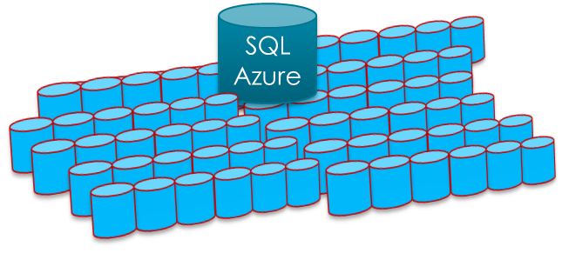
Why use Federations?
Gain practically unlimited scale by harnessing 100s of SQL Azure nodes
Create an elastic database tier that can expand and contract with your applications workload without downtime

Slide 9
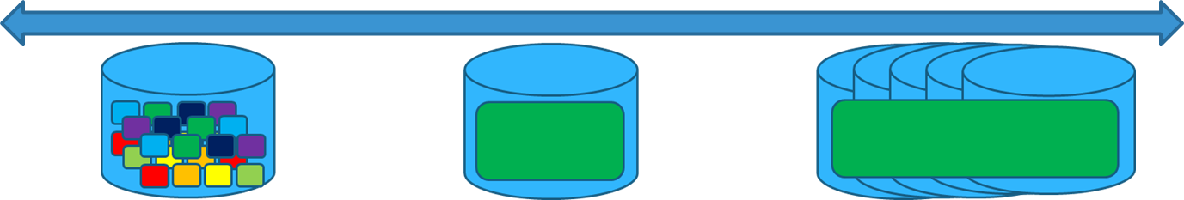

Why use Federations?
Build Multi-tenant Solutions
Single tenants per db works… But what about very small tenants and very large tenants?
Tenant Management with Federations
Federations makes tenant placement and replacement easy.
Change your tenant placement any time without downtime.
Single tenant per database
Multiple-tenants per database Multiple databases per tenant

Slide 10
Who are Federations for?
A Few Examples
Web Scale DB Solutions
Multi-tenant Saas ISVs
Workloads with Spikes, Bursts, Peaks, etc…
NoSQL Applications
Apps that need big data, big scale, massive parallelism, eventual consistency, lightweights local storage, semi structured data etc.

Slide 11
Scale Out Your Data
SQL Azure Federations provides
Integrated database sharding that can scale to hundreds of nodes
Multi-tenancy via flexible repartitioning
Online split operations to minimize downtime
Automatic data discovery regardless of changes in how data is partitioned
Special considerations
A logical database can contain multiple federations
Distribution scheme supports int, bigint, guid, and varbinary types
Filtering routes connection to appropriate shard regardless of changes in partitions
Merge, fan-out queries and automatic distribution of schema changes not supported in initial release
Federations
SalesDB
Orders_federation
Orders_federation
Orders_Fed
Federation Members

Slide 12
Architecture

Slide 13
Overview - Architecture
Federation
Federation are objects contained within a user database just like other objects. Federation define the scheme for the federation and represent the database being sharded.
Federation Root
The database that houses federation object and is the central repository for information (federation metadata) about distribution of scaled-out data.
Federation Member
A physical container covering the full range of data for a federation. Managed by the federation dynamically as data is repartitioned.
Each federation member contain parts of federations data and are system managed SQL Azure databases.
Federations
SalesDB
Orders_federation
Orders_federation
Orders_Fed
Federation Root
Federation Members

Slide 14
Overview – Architecture cont.
Federation Distribution Key
The key used for data distribution in the federations.
Atomic Unit
Represent a single instance of a federation key. An AU contains all rows in all federated tables with the same federation key value.
Federations
member: Range [1000, 2000)
SalesDB
Orders_federation
AU PK=5
AU PK=25
AU PK=35
Orders_federation
Orders_Fed
AU PK=5
AU PK=25
AU PK=35
AU PK=1005
AU PK=1025
AU PK=1035
Federation Root
Federation Members
Atomic Units

Slide 15
Overview – Architecture cont.
Federated Table
Table that contains only atomic units for the member’s key range.
Reference Table
Non-sharded table.

Slide 16
Overview – Concepts
Repartitioning Operations without Downtime!
SPLIT members to spread workloads over to more nodes
DROP members to shrink back to fewer nodes
ALTER FEDERATION Orders_Fed SPLIT AT (tenant_id=7500)
SalesDB
Orders_federation
Orders_federation
Orders_Fed
[5000, 7500) & [7500, 10000)
[5000, 10000)

Slide 17
Reliable Routing
Built-in Data-Dependent Routing (DDR)
DDR ensure app can discover where the data is just-in-time
Apps no longer has to cache ‘shard map’
Federations guarantee routing to the right member even when repartitioning operations are going on in the background.
USE FEDERATION Orders_Fed(tenant_id=7509)
SalesDB
Orders_federation
Orders_federation
Orders_Fed
[5000, 7500) & [7500, 10000)

Slide 18
Management

Slide 19
Dynamic Management Views
sys.federations
Returns the federations within a database
sys.federation_distributions
Returns the distribution type and data types used by a federation
sys.federation_members
Returns Information on member to federation associations
sys.federation_member_distributions
Returns distribution information about members within a federation
sys.federation_table_columns
Returns specialized federation properties of federated tables

Slide 20

Dynamic Management Views
sys.federation_history
Returns historical information about a federation
sys.federation_distribution_history
Returns historical information about the distribution type and data types used by a federation
sys.federation_member_history
Returns historical information for each member of a federation
sys.federation_member_distribution_history
Returns historical information about the distribution range for federation members.
NOTE:
Cleanup of historical data is performed automatically every two weeks.
Notes:
Cleanup is triggered by operations that update the log information. This can result in historical information being retained for longer than two weeks if no new operations have been performed.

Slide 21
Sample

Slide 22
Create Database & Federation
CREATE DATABASE SalesDB (EDITION='business',MAXSIZE=150GB)
connect to SalesDB…
CREATE FEDERATION Orders_Federation(ID BIGINT RANGE)
Create a Federation use a BIGINT as the Federation Key

Slide 23
Create Partitioned Table
USE FEDERATION Orders_Federation(0) WITH RESET
CREATE TABLE orders(
customerid bigint,
orderid bigint,
odate datetime,
primary key (orderid, customerid))
FEDERATED ON (ID = customerid)
CREATE TABLE orderdetails(
customerid bigint,
orderdetailid bigint,
orderid bigint,
partid bigint,
primary key (orderdetailid, customerid))
FEDERATED ON (ID = customerid)
Establish the customerid as the Federation Key
Data with the same customerid in these two tables should be treated as an Atomic Unit

Slide 24
Insert Some Data
INSERT INTO orders VALUES(10,1,getdate()), (10,2,getdate()), (11,3,getdate())
INSERT INTO orders VALUES(110,11,getdate()), (110,12,getdate()), (111,13,getdate())
INSERT INTO orders VALUES(210,21,getdate()), (210,22,getdate()), (211,23,getdate())
INSERT INTO orders VALUES(310,31,getdate()), (310,32,getdate()), (311,33,getdate())
INSERT INTO orderdetails VALUES(10,1,1,1), (10,2,1,2), (10,3,1,10),(10,4,2,100),(10,5,2,1000), (11,6,3,101)
INSERT INTO orderdetails VALUES(110,11,11,1), (110,12,11,2), (110,13,11,10),(110,14,12,100),(110,15,12,1000), (111,16,13,101)
INSERT INTO orderdetails VALUES(210,21,21,1), (210,22,22,2), (210,23,21,10),(210,24,22,100),(210,25,22,1000), (211,26,23,101)
INSERT INTO orderdetails VALUES(310,31,31,1), (310,32,31,2), (310,33,31,10),(310,34,32,100),(310,35,32,1000), (311,36,33,101)

Slide 25
Simple SELECT
SELECT * FROM ORDERS
RESULTS
--------
ORDER 10
ORDER 110
ORDER 210
ORDER 310

Slide 26
Split Database
Federation Root houses the Directory
USE FEDERATION ROOT WITH RESET
ALTER FEDERATION orders_federation SPLIT AT 100
Split the Federation Member into two at the customerid 100 boundary

Slide 27
SELECT with Federation Key
USE FEDERATION Orders_Federation(ID=0) WITH RESET, FILTERING = OFF
SELECT * FROM ORDERS
RESULTS
--------
ORDER 10
USE FEDERATION Orders_Federation(ID=100) WITH RESET, FILTERING = OFF
SELECT * FROM ORDERS
RESULTS
--------
ORDER 110
ORDER 210
ORDER 310
Use Federation Member
that contains customerids < 100
Use Federation Member
that contains customerids > 100

Slide 28
Best Practices and Design Considerations
Select a Federation Key that will allow you to federate data from multiple, related tables.
Handle data distribution of new data at the application layer.
Application must implement logic for joining data from multiple federation members
Notes:
Allows rows to be stored together
All federation members should be equally utilized
This is because there is a physical separation of data contained in different federation members and SQL Azure doesn’t support cross-data queries. Ex: a query that needs to join data from two federations would need to perform queries against each and join the data within the application.

Slide 29
SQL Azure Federations
demo
Notes:
Demo – SQL Azure Federations
Create Federation (specify fed key)
Query system federation tables showing federations, fed members, etc.
Split
Use Different federation members (USE FEDERATION)
Query data

