Slide 1
SQL Azure Reporting Services
Name
Title
Microsoft Corporation

Slide 2
Agenda
Overview
Architecture
Features
Walkthrough
Demo

Slide 3


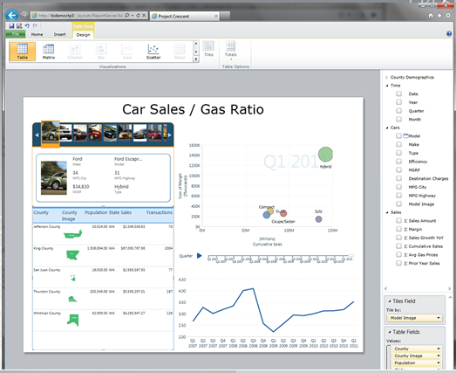


Overview
SQL Azure Reporting Services is
Cloud-based reporting service built on SQL Azure and SQL Server Reporting Service Technologies
Easily provision and deploy reporting solutions to the cloud
Take advantage of enterprise-class availability, scalability, and security
SQL Azure
GOAL
To ensure the same cloud benefits (elasticity, uptime, etc.) were extended to Reporting Services

Slide 4
Under the Hood - Architecture
http://server.reporting.windows.net/reports/report.rdl
RS GPM
Tenant Data
Load Balancer
Gateway
Gateway
Gateway
Directory Services
RS Instance
Allocation + Service
RS Instance
Monitor/Comm
[SLA & Usage]
[Performance]
[Traces & Logs]
SLA Conformation
RS Instance
Monitor/Comm
[SLA & Usage]
[Performance]
[Traces & Logs]
Monitor/Comm
[SLA & Usage]
[Performance]
[Traces & Logs]
Load Balancing
Operations
RS Engine
Monitoring
[Alerting]
[Performance]
[Traces & Logs]
RS Engine
RS Engine
Customer Service
Billing/Usage
SQL Azure
Notes:
Referencing a web service endpoint pointing to report1.rdl
Request comes through the load balancer will hit a few application tiers – intelligent meta data routing tier much like the way SQL Azure database have been implemented.
Smart routing (request is processed and sent to next best rs instance)..increase control and security or the availability of the system. If a particular report takes down a node, quickly stop routing requests to that node.
Multi-tenant – each tenant will get their own catalog and tempdb database…since it is built
Built on top of SQL Azure…data tier used for SQL Azure reporting services is sQL Azure.
Application tier is built on Windows Azure for scalability
Security – authentication mechanism is basic auth – because reporting is built on SQL Azure…inherit a lot of the security mechanisms...

Slide 5
Features

Slide 6
Key Features
Rich Reporting Experience
View reports using Report Viewer control or Web browser
Easy to design visual and interactive reports
Manageability
Administrative overhead removed. No need to procure, license, install or maintain hardware.
Familiar Development Tools
Author and publish reports using familiar tools
High Availability and Scalability
No scalability and high availability management overhead
Cost Effective
Service scales as resource requirements grow to support elastic scale
Notes:
based on the Windows Azure Platform and t uses the same architecture for scalability and high availability for report servers

Slide 7
Feature Comparison
 | SSRS | Azure SSRS
Tooling | BIDS, Report Builder | BIDS, Report Builder
Data Sources | Assorted Data Sources | SQL Azure Databases
Report Management | Report Manager or SharePoint | Windows Azure Developer Portal, URL Browsing
Developer | Custom Data Sources, assemblies, etc. | No extensibility yet
Security Model | Windows Authentication | SQL Azure Auth.

Slide 8
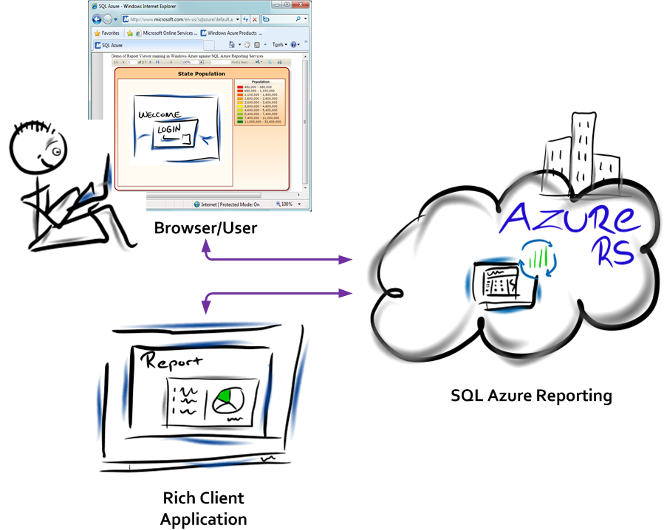
Security
Credentials not saved in report definition
Passwords stored securely on the report server, separate of the .rdl
Shared data sources
Help manage credentials in a single location
Uses same roles and permission model as SSRS
Author and publish reports using familiar tools
Report items inherit security based on folder permissions
Each tenant has their own Catalog and TempDB
SQL Azure user name and password authentication
Notes:
Prompt - Alternatively, a report author can set data source credentials to Prompt. After report readers login to the SQL Azure Reporting portal, they must then type the login user name and password for each data source when they run the report.

Slide 9
Walkthrough

Slide 10
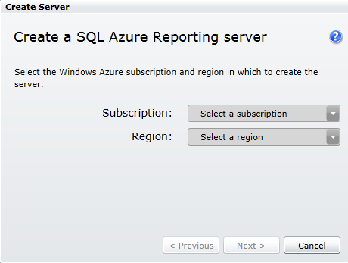
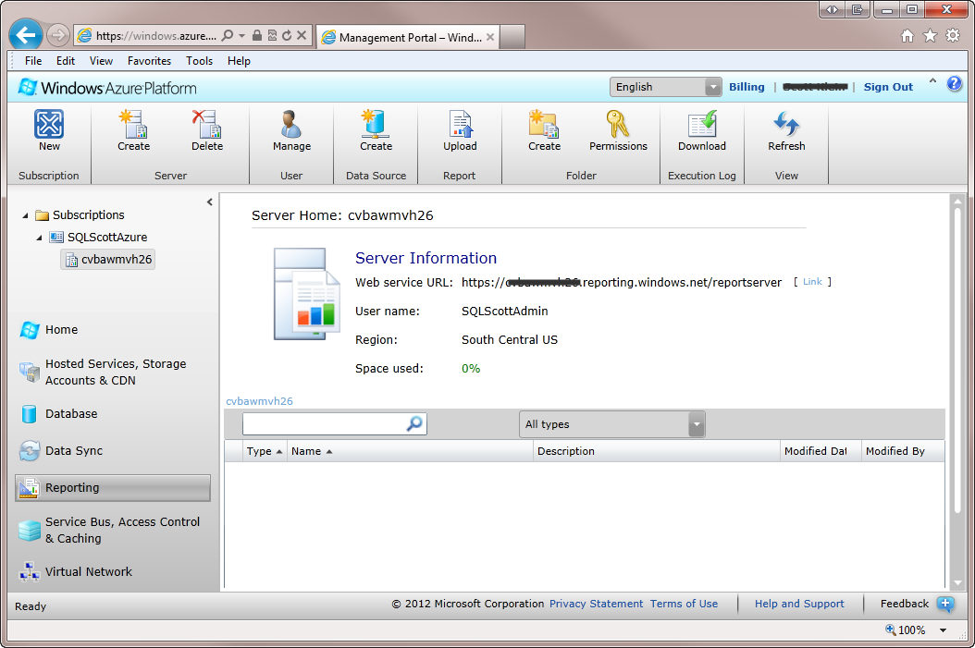
Server Provisioning
Create the Reporting Server
Need to Specify:
Subscription
Region
Report Server Administrator
Username
Password

Slide 11
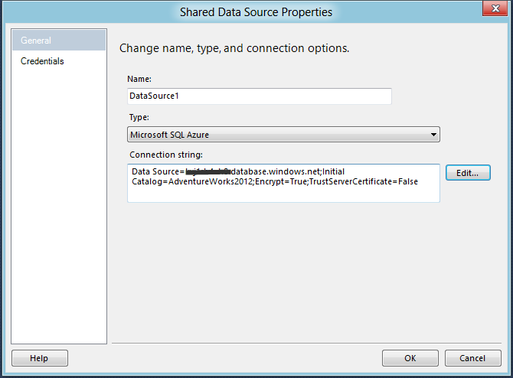
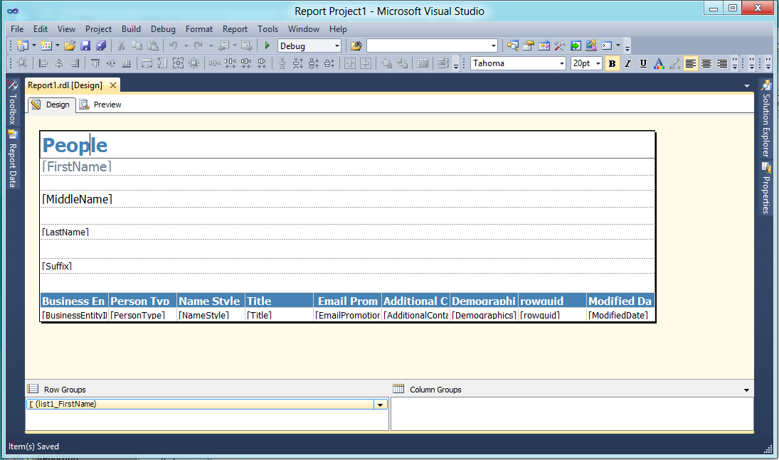
Report Creation
Tools
SQL Server 2012
SQL Server Data Tools
SQL Server 2008 R2
Business Intelligence Development Studio

Slide 12
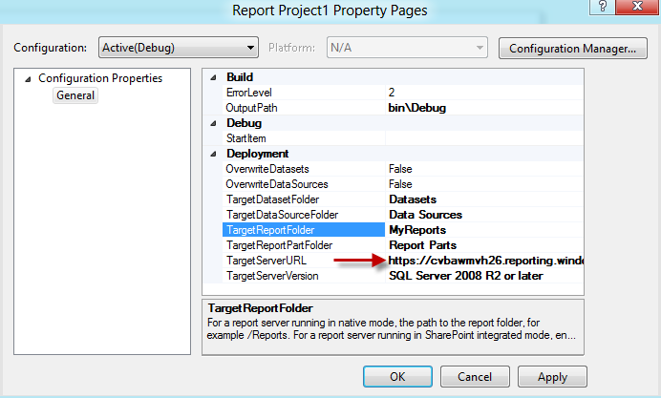
Report Deployment
Report Properties
Properties are identical to those of on-premise, but the TargetServerURL must include the name of the server.
https://<ServerName>.reporting.windows.net/reportserver
Deployment
For a single report, right mouse click the report and click deploy.
For all reports, right mouse click the project and click deploy.

Slide 13
Report Deployment
demo
Notes:
Demo – Deploying a report to SQL Azure Reporting Services
Provision Server
Open SSDT
Create simple Report
Deploy report
Access report via server

