Slide 1
Securing, Connecting, and Scaling in Windows Azure
Name
Title
Microsoft Corporation

Slide 2
Agenda
Securing
Connecting
Scaling

Slide 3
Assumptions
You know the basics
Web/Worker Roles
SQL Azure
Windows Azure Storage
Asynchronous Programming
Windows Azure diagnostics

Slide 4
Securing

Slide 5

Access Control Service

Slide 6
Access Control Service
Makes it easy to authenticate and authorize users
Integration Single Sign On and centralized authorization into your web applications
Standards-based identity providers
Enterprise directories (e.g. Active Directory Federation Server v2.0)
Web identities (e.g. Windows Live ID, Google, Yahoo!, and Facebook)

Slide 7
ASP.NET & ACS
demo

Slide 8
Access Control
Browser
Identity Provider
Access Control
Application
1. Request Resource
2. Redirect to ACS
3. Auth/N
4. Home-realm
Discovery
5. Redirect to IdP
6. Login
7. Authenticate &
Issue Token
8. Redirect to AC service
9. Send Token to ACS
10. Validate Token, Run Rules Engine, Issue Token
11. Redirect to RP with ACS Token
13. Send ACS Token to Relying Party
14. Return resource representation
12. Validate
Token

Slide 9
Access Control Features
Integrates with Windows Identity Foundation and tooling
Claims-based access control
Support for OAuth WRAP, WS-Trust, and WS-Federation protocols

Slide 10
Access Control Features
Support for the SAML 1.1, SAML 2.0, and Simple Web Token token formats
Integrated and customizable Home Realm Discovery
OData-based Management Service to ACS configuration

Slide 11
Connecting

Slide 12
Connecting
Service Bus
Windows Azure Connect

Slide 13
Service Bus
Provides secure messaging and connectivity
Enables various communication protocols and patterns for developers to engage in reliable messaging
Exchange messages between loosely coupled applications
Network send/receive from any internet connected device
Connectivity
Messaging

Slide 14
Service Bus Connectivity
Provides secure messaging and connectivity across different network topologies
Traverse NAT/Firewall
Facilitate direct peer-to-peer connection

Slide 15
Service Bus Connectivity
Relayed One-Way Unicast and Multicast
Relayed WCF NET.TCP with Direct Connect Option
Relayed WCF HTTP with support for REST and SOAP 1.1/1.2
Endpoint protection with Access Control
Key Capabilities
Outbound TCP (Ports 9350-9353)
9350 Unsecured TCP One-way (client)
9351 Secured TCP One-way (all listeners, secured clients)
9352 Secured TCP Rendezvous (all listeners except one-way)
9353 Direct Connect Probing Protocol (TCP listeners with direct connect)
Outbound HTTP (Port 80, Listeners)
TCP equivalent tunnel with overlaid TLS/SSL formed over pair of HTTP requests
Alternate connectivity path if outbound TCP is blocked
Outbound HTTPS (Port 443, Senders)
Connectivity Options

Slide 16
Relay Programming Model
Full WCF Programming Model
Bindings functionally symmetric with WCF
WebHttpRelayBinding (HTTP/REST)
BasicHttpRelayBinding (SOAP 1.1)
WS2007HttpRelayBinding (SOAP 1.2)
NetTcpRelayBinding (Binary transport)
Special Service Bus Bindings
NetOnewayRelayBinding(Multicast one-way)
NetEventRelayBinding(Multicast one-way)
Transport binding elements for custom binding stacks
WebHttpRelayBindingprovides full interoperability with any HTTP/REST client, BasicHttpRelayBindingwith any SOAP client

Slide 17
Backend Naming
Routing Fabric
sb://solution.servicebus.windows.net/a/b/
Subscribe
Route
Service Bus
Frontend Nodes
TCP/SSL HTTP(S)
NLB
TCP/SSL HTTP(S)
outbound connect one-way net.tcp
outbound connect bidi socket
Msg
Msg
Sender
NAT Firewall Dynamic IP
Receiver

Slide 18
Service Bus Messaging
Reliable, decoupled, transaction aware message queues
Addressable over HTTP REST

Slide 19
Queues
S
Queue
R
Load Leveling
Receiver receives and processes at its own pace. Can never be overloaded. Can add receivers as queue length grows, reduce receiver if queue length is low or zero. Gracefully handles traffic spikes by never stressing out the backend.
Offline/Batch
Allows taking the receiver offline for servicing or other reasons. Requests are buffered up until the receiver is available again.

Slide 20
Queues
R
S
Queue
R
R
Load Balancing
Multiple receivers compete for messages on the same queue (or subscription). Provides automatic load balancing of work to receivers volunteering for jobs.
Observing the queue length allows to determine whether more receivers are required.

Slide 21
Topics
R
R
S
Topic
Sub
R
Sub
Sub
R
R
Message Distribution
Each receiver gets its own copy of each message. Subscriptions are independent. Allows for many independent ‘taps’ into a message stream. Subscriber can filter down by interest.
Constrained Message Distribution (Partitioning)
Receiver get mutually exclusive slices of the message stream by creating appropriate filter expressions.

Slide 22
Runtime API Choices
Apps
HTTP REST
SOAP WS-* (Relay Clients)
WCF Service Model
Messaging API
NetMessagingBinding
Service Bus Relay Protocol Implementation (private)
Service Bus

Slide 23
Connecting
Service Bus
Windows Azure Connect

Slide 24
Windows Azure Connect
Secure network connectivity between applications in Windows Azure and on-premises resources
Supports standard IP protocols
Example use cases:
Enterprise app migrated to Windows Azure that requires access to on-premise SQL Server
Windows Azure app domain-joined to corporate Active Directory
Remote administration and trouble-shooting of Windows Azure Roles
Simple setup and management
Enterprise
Windows Azure

Slide 25
Windows Azure Connect Details
Enable Windows Azure (WA) Roles for external connectivity via service model
Enable local computers for connectivity by installing WA Connect agent
Network policy managed through WA portal
Granular control over connectivity
Automatic setup of secure IP-level network between connected role instances and local computers
Tunnel firewalls/NAT’s through hosted relay service
Secured via end-to-end IPSec
DNS name resolution
Enterprise
Windows Azure
Role A
Role B
Relay
Role C
(multiple VM’s)
Dev machines
Databases

Slide 26
Windows Azure Deployment
To use Connect with a WA service, enable one or more of its Roles
For Web & Worker Role, include the Connect plug-in as part of Service Model (.csdef file)
For VM role, install the Connect agent in VHD image using the Connect VM install package
Connect agent will automatically be deployed for each new role instance that starts up

Slide 27
Windows Azure Deployment
Connect agent configuration managed through the ServiceConfiguration (.cscfg) file
One required setting – “ActivationToken”
Unique per-subscription token, accessed from Admin UI

Slide 28
On-Premises Deployment
Local computers are enabled for connectivity by installing & activating the Connect agent
Connect agent tray icon & client UI
View activation state & connectivity status
Refresh network policy

Slide 29
On-Premises Deployment
Connect agent automatically manages network connectivity
Sets up virtual network adapter
“Auto-connects” to Connect relay service as needed
Configures IPSec policy based on network policy
Enables DNS name resolution
Automatically syncs latest network policies

Slide 30
Scaling

Slide 31
Scaling
Caching
CDN
Traffic Manager

Slide 32
Caching
ASP.NET providers for session state and page output caching
Cache any managed object
No object size limits
No serialization costs for local caching
Easily integrates into existing applications

Slide 33
Caching
Consistent development model across both Windows Azure Cache and Windows Server Cache
Secured by Access Control

Slide 34
Caching
Expiration default is 48hrs can set explicitly with Add/Put operations
Cache Sizes of 128MB, 256MB, 512MB, 1GB, 2GB, 4GB

Slide 35
Latency Pyramid
Lowest latency
Windows Azure Caching (local cache)
Memory
Windows Azure Caching (distributed cache)
Lower latency
Network
Highest latency
Storage
Disk

Slide 36
Caching Service in Action
demo

Slide 37
Caching Features
ASP.NET providers for session state and page output caching
Extremely low latencies with the local cache
Cache any managed object
No object size limits
No serialization costs for local caching
Easily integrates into existing applications
Secured by the Access Control service

Slide 38
Scaling
Caching
CDN
Traffic Manager

Slide 39
Content Delivery Network (CDN)
High-bandwidth global blob content delivery
24 locations globally (US, Europe, Asia, Australia and South America), and growing
Same experience for users no matter how far they are from the geo-location where the storage account is hosted
Blob service URL vs CDN URL:
Windows Azure Blob URL: http://images.blob.core.windows.net/
Windows Azure CDN URL: http://<id>.vo.msecnd.net/
Custom Domain Name for CDN: http://cdn.contoso.com/

Slide 40


Windows Azure CDN
GET
http://guid01.vo.msecnd.net/images/pic.1jpg
Edge Location
To Enable CDN:
Register for CDN via Dev Portal
Set container images to public
404
Edge Location
Edge Location
TTL
Content Delivery Network
http://sally.blob.core.windows.net/
⬅➔
http://guid01.vo.msecnd.net/
pic1.jpg
Windows Azure Blob Service
pic1.jpg
pic1.jpg
http://sally.blob.core.windows.net/images/pic1.jpg

Slide 41
Scaling
Caching
CDN
Traffic Manager

Slide 42
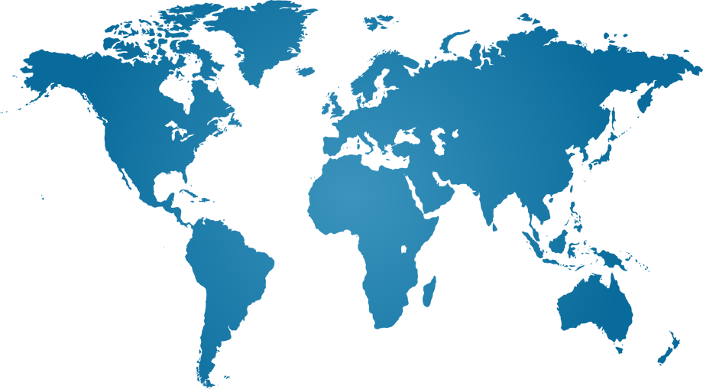
Why Performance Matters

Slide 43
Why Performance Matters
50ms

Slide 44
Why Performance Matters
100ms
50ms

Slide 45
Why Performance Matters
200ms
100ms
50ms

Slide 46
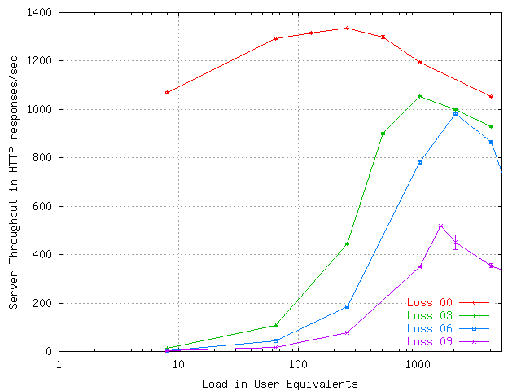
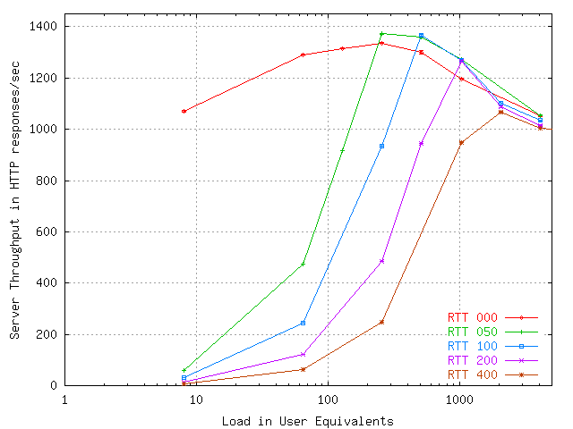
Why Performance Matters
200ms
100ms
50ms
Throughput vs. Loss Rate
Throughput vs. RTT

Slide 47

Why Performance Matters
More responsive applications
Faster page load times
8 seconds vs. 3 seconds?
Higher interactivity – new type of applications
Better user experience – more $$$

Slide 48
Traffic Manager

Slide 49
Traffic Manager

Slide 50
Traffic Manager – What is it?
Business continuity (Failover)
Decrease network latency (Performance)
Scale applications (Performance)
Cloak DNS (Disable policy)
Perform Maintenance (Transfer live traffic)

Slide 51
Traffic Manager
demo

Slide 52
Traffic Manager Features
Live ID Account
Windows Azure Portal (no API, no SDK)
Sends traffic to Windows Azure Hosted Services
Load Balancing Methods (not nested)
8 seconds vs. 3 seconds? Performance
Round Robin
Failover

Slide 53
Traffic Manager Features
TTL configuration (>30 seconds)
HTTP and HTTPS monitoring on any port, with probe file config(HTTP GET)
Create/Read/Update/Delete policies
Enable and Disable traffic to policies and endpoints

Slide 54
What We Covered
Securing
Access Control Service
Connecting
Service Bus
Windows Azure Connect
Scaling
Caching
CDN
Traffic Manager

Slide 55
Thank You

