Slide 1
Introduction to Windows Azure Marketplace for Applications
Name
Title
Microsoft Corporation

Slide 2
Agenda
The Windows Azure Marketplace

Slide 3
Momentum
Launched Windows Azure Marketplace with DataMarket at Nov 2010
Launched Windows Azure Marketplace combining Data and Applications at WPC2011
Today
First Information marketplace with premium and public domain datasets
Hundreds of Applications
Thousands of subscribers
Millions of transactions

Slide 4
Windows Azure Marketplace
Windows Azure Marketplace is a Global marketplace for cloud applications and data providing Premium experiences with Secure commerce platform.
Global Reach
Global marketplace for applications and datasets
Rich ISV and developer eco-system building and delivering applications
Commerce platform that can scale globally
Reach IWs across the globe through Excel, PowerPivot, SQL Server, Bing integrations
Premium Marketplace
Curated Applications and Datasets provided by trusted partners of Microsoft
Easy discovery, subscriptions and purchase,
Trial offers to try before you buy with no credit card requirement
Insightful experiences and rich visualizations around datasets
Seamless integration with applications on marketplace providing rich integrated experience for information workers
Secure Platform
Secure commerce platform with integrated billing and reporting providing peace of mind to end users
Consistent, flexible and context optimized secure APIs for Developers to power any application on any platform and any screen size
Authorization & authentication model that allows simple access to subscriptions
One Stop Shop for Cloud Data and Applications
Built completely on the Windows Azure platform

Slide 5

Getting Started
Ready
Publish
Sell
Ensure your App meets Qualifications
Ready your App with Publishing Kit
Submit Commerce Ready App
Sign online Agreement
Start selling
80/20 Revenue Share

Slide 6
Application Qualification Criteria
All Apps Must:
Use some part of the Windows Azure Platform (verified by Marketplace publishing team)
Be commercially available (not sample code, not beta)
Be supported by the publisher or a 3rd party (support contacts provided)
Be highly available (99.9% SLA of application)
Of a nature and quality suitable for public display and distribution
Of no less quality than equivalent offerings published, sold or licensed by Publisher through other distribution channels
Not automatically install any software on a User’s computer or device without affirmative consent from the User
All pricing info and documentation for app must be provided
Windows Azure Marketplace Agreement has been signed & received

Slide 7
Modifying an Application to Support Windows Azure Marketplace Subscriptions
demo

Slide 8

Purchase/Cancel Subscription Token Flow
Purchase
Purchase Confirmation + Redirect (incl Token)
User Redirect (incl Token)
Cancel Subscription (incl Token)
(4)
Your Application
Windows Azure Marketplace
(2)
(3)
(1)
User

Slide 9
1-2-3
1
Register My Application
2
Create Endpoint & Handle Incoming Subscription Request
3
Associate Subscription with New or Existing User

Slide 10
Adding Support for Unsubscribe
demo

Slide 11
Publishing Application

Slide 12
Publishing Steps
Get Your App Ready
Submit Your Application
Questions or Edits to Your Application
Download the Publishing Kit for a simple guide to readying your data or application
Use the Tutorial online or in the Kit to learn for a step by step example
Watch the How To Videos or visit, http://marketplace.windowsazure.com/publishing
Sign Marketplace Agreement. Visit the submission portal to submit new offering, select Commercial application, complete required information. And submit. Once submitted your application will be added to the Windows Azure Marketplace publishing queue and you will be contacted by a marketplace representative.
If you have questions or need to make edits to your application once published, please contact appmarketbd@microsoft.com.

Slide 13
Submission Portal
demo
Notes:
https://publishing.marketplace.windowsazure.com/

Slide 14
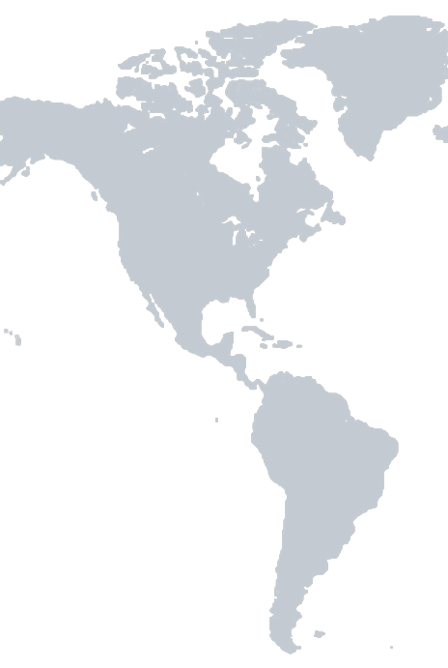
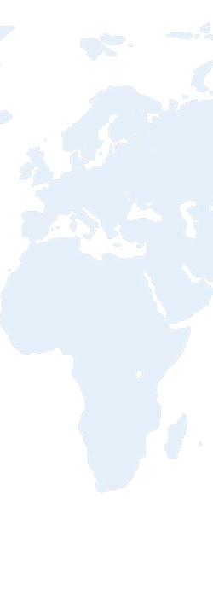

International Availability
Expand Your Reach – 26 countries world wide
Country | Currency
Austria | EUR
Belgium | EUR
Canada | CAD
Czech | CZK
Denmark | DKK
Finland | EUR
France | EUR
Germany | EUR
Hungary | HUF
Ireland | EUR
Italy | EUR
Netherlands | EUR
Norway | NOK
Country* | Currency
Poland | PLN
Portugal | EUR
Spain | EUR
Sweden | SEK
Switzerland | CHF
UK | GBP
US | USD
Australia* | AUD
Hong Kong* | HKD
Japan* | JPY
Mexico* | MXN
New Zealand* | NZD
Singapore* | SGD
*ISV must legally send tax invoices to all of his customers through extra step. Details in Publishing Guidance deck
**Marketplace currently in English in all 26 countries, localized versions of sites will rollout in December 2011

Slide 15
ISV Remittance Process
Countries: Australia, Hong Kong, Japan, Mexico, New Zealand, Singapore
ISV must legally send tax invoice to all customers
ISV publishes Tax Invoice Request Process
Customer requests tax invoice - including required information for ISV
1
ISV contacts Microsoft Support to request customer transactions & tax info
Microsoft Support provides detailed information on customer transactions and applicable tax
2
ISV generates tax invoice that satisfies country specific requirements
ISV sends tax invoice to customer
3
Microsoft Support 866-MSONLINE (676-6546) or visit Microsoft Support.

Slide 16
Questions??

