Slide 1
Windows Azure Migrating Applications and Workloads
Speaker
Title
Microsoft Corporation

Slide 2
Agenda
Motivation and App Selection
Migration Approaches
Virtual Networking
Extending Identity with IaaS
Managing Application Data
Monitoring and Managing VMs

Slide 3
Motivation and App Selection

Slide 4



Drivers for Cloud Adoption
IT Agility
The ability to instantly provision new hardware for new opportunities or respond quickly to business demand can be a competitive advantage.
Focus
Focusing less on infrastructure leaves more time for improving the success of the business through better IT.
More on Innovation and less on Infrastructure.
Economics
Cloud Computing lowers the cost of delivering IT and increases the utilization and efficiency of your data center.
Notes:
Agility: The first factor driving adoption of cloud computing is agility. Cloud computing speeds up an organization’s ability to capitalize on new opportunities and to respond to changes in business demand. Applications can be deployed much faster and more efficiently, and solutions can be delivered to end users nearly anywhere, at any time, across devices, and in ways that are both secure and manageable. Also, with cloud computing, all of the IT infrastructure that an organization needs to operate quickly and efficiently is available at the “flip of a switch.” So, the next time the marketing department launches a campaign without first telling anybody, the organization’s website is much less likely to go down. The public or private cloud environment can quickly scale up or down to meet spikes in demand.
Focus: The second factor driving adoption of cloud computing is focus—the ability to focus on improving the success of a business through better IT. Put another way, a business can focus more on innovation and less on infrastructure.
Today, the typical IT department spends most of its time and money on maintenance and operations. Cloud computing enables IT departments to cut those costs down dramatically. Infrastructure is abstracted and resources are pooled, so IT runs more like a utility than a collection of complicated (and often fragile) software and hardware systems. When you can pay more attention to ideas than IT complexity, you add a new kind of value to the business.
IT staff that were dedicated to maintenance tasks such as operating system and application updates, or hardware management, can now be transitioned to more innovative and strategic roles within your the IT organization.
Economics: The third factor driving adoption of cloud computing is economics. Economically, cloud computing lowers the cost of delivering IT and increasing the utilization and efficiency of your data center. Delivery costs go down, because with cloud computing applications and resources become self-service , and usage of those resources becomes measurable in new and very precise ways.
Hardware utilization also increases because infrastructure resources (storage, computer, and network) are now pooled and abstracted. So, for example, when a self-service application is finished, the server and storage resources it used will go back into the pool. The environment is highly automated, so systems are always at work.

Slide 5
Traditional Cloud Workloads
On and Off
Overprovisioned capacity is wasted
Unpredictable Bursting
Sudden Spike Impacts Performance
Growing Fast
Keeping up with growth is a big IT Challenge
Predictable Bursting
Peeks due to Periodic Demand – Wasted Capacity
Inactivity
Period
Compute
Average
Usage
Time
Compute
Average Usage
Time
Compute
Average Usage
Time
Compute
Average Usage
Time
Notes:
Up until now we were pretty prescriptive on what workloads were targeted for Windows Azure.
The four most common:
On and Off: when capacity is needed only at specific times (9AM – 5PM for example). Why pay for it after 5PM and before 9AM?
Unpredictable Bursting: Capacity quickly needed – the new advertising campaign worked much better than anticipated. With the cloud you can instantly provision new capacity. Running your own data center you have to have this additional capacity on hand.
Growing Fast: Capacity requirements change and evolve too fast to easily keep up.
Predictable Bursting: Overprovisioned to handle known high capacity. With the cloud it is possible to optimize your capacity and not pay for overprovisioning during the slower periods.

Slide 6
IaaS Workloads – all about the app
Line of Business Applications
Custom Applications, CRM, CMS, ERP, Business Intelligence
Application Infrastructure File Servers, Databases, Identity, Source Control
Developer, Test and Staging Environments
Quickly Provision and Un-provision Entire Environments
Hybrid Applications
Applications that span your data center and the cloud
Notes:
With the introduction of Windows Azure Virtual Machines and Virtual Networks there are an entirely new set of workloads that are suitable.

Slide 7
Application Considerations
Software Requirements
Dependency on non-supported OS or application?
Licensing
Do your software licenses transfer to the cloud?
Hardware Requirements
Multiple network cards or other hardware requirements?
Notes:
Before making the leap into the cloud the workload or application will need to be analyzed.
Software requirements?
Older versions of Windows Server such as 2003 are not officially supported in the cloud. If the OS is not 64 bit it will not work at all.
Hardware requirements – if the application in question requires on hardware based drivers such as thumbprint scanners, multiple network cards, or any other device not available in the cloud.

Slide 8
Migration Approaches

Slide 9
Application Migration Reasons
Forklift Migration
Bring entire application and all dependencies
Hybrid Migration
Bring portion of application to the cloud while some resources stay on-premises
IaaS to PaaS Migration
Migrating application to web or worker roles with dependencies that work better on a VM

Slide 10
Migration Approaches
Migrating an Existing Virtual Machine
Application, Configuration and Data in an installed Working State
Requires uploading a large amount of data and a higher risk of drivers or other hardware dependencies on VM not available in the cloud
Build VMs in the Cloud
Lowers upload time and dependency risk
Requires upload and installation of application and data
Notes:
There are essentially two ways of migrating an application to the cloud.
The first is to attempt to migrate an entire existing virtual machine. For HyperV users this involves uploading the VHD(s) and then configuring a virtual machine to use the disks.
For non-HyperV users this means finding a method of converting either their running machine to a VHD OR their current virtualization format to VHD. Many solutions exist to both.
The second option comes down to configuring and booting the VM in the cloud directly. Uploading the application and data via Windows Azure storage and configuring the VMs.

Slide 11
Virtual Machine Migration
Windows Azure Supports VHD File Format
Other formats will have to be converted or migrated before upload
Upload Existing VHDs using CSUpload.exe
Supports Resuming Failed Transfers
Converting from Dynamic to Fixed Disk on Upload
Things to Do Before Uploading OS Disk
Enable Remote Access (RDP or SSH)
Notes:
Dynamic Disks are not supported directly in the cloud. Before uploading a dynamic disk it will have to be converted into a fixed disk.
CSUpload.exe supports converting the dynamic disk to fixed on upload. The benefit is unused blocks are not uploaded so it is a more efficient/optimized upload.
CSUpload.exe also supports resuming a failed transfer.

Slide 12
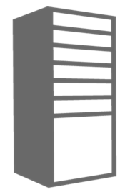
Migrating a Simple Virtual Machine
Migration Steps
1) Upload VHDs
CSUpload or other Tools
2) Create VM
OS Disk=APP-OS.vhd
3) Configure Data Disks
Data Disk 1 = APP-Data.vhd
Data Disk 2= App-Logs.vhd
4) Adjust App for Drive Letters
5) Add Input Endpoint(s)
80, TCP, http
443, TCP, https
Cloud Service
Name: myapp1.cloudapp.net
On-Premises Virtual Machine
Machine Name: APPSRV1
Memory: 8 GB
Cores: 4
Ports: 80/443 for http/https
Deployment
Slot Production
Virtual Machine
Role Name: appsrv1
4 Cores
7 GB Ram
Guest: C:\
Host: C:\VMs\APP-OS.vhd
Windows Azure
Storage
TCP Endpoints 80 and 443
Guest: D:\
Host: D:\VMs\APP-Data.vhd
Guest: C:\
WAStorage\VMs\APP-OS.vhd
Guest: E:\
Host: E:\VMs\APP-Logs.vhd
Guest: E:\
WAStorage\VMs\APP-Data.vhd
Guest: F:\
WAStorageVMs\APP-Logs.vhd
Notes:
This animation is a simple example of the steps needed to migrate a VM running in HyperV on premises to Windows Azure.
4) The reason for the adjustment in drive letters is the Windows Azure VM exposes the local server physical storage as the D: drive on Windows. This location should be considered temporary because it is not backed by Windows Azure storage. Since the D: is taken VMs that are currently using the D: drive will need to be adjusted on upload.

Slide 13

Migrating a Multi-VM Application
Cloud Service Acts as a Networking Boundary
All VMs in the same service can communicate directly
Name resolution between VMs is automatic with Windows Azure provided DNS
Cloud Service
Name: myapp1.cloudapp.net
Load Balancer
Public IP
Virtual Machine
VM Name: appsrv1
10.1.5.6
Virtual Machine
VM Name: appsrv2
10.1.5.7
DIP
DIP
DIP
Virtual Machine
VM Name: SQLServer1
10.1.5.8
Notes:
In the Windows Azure management portal there are two methods of creating a VM.
Quick create always creates a new cloud service but it does not display the cloud service. Each time this wizard is used a cloud service with a single VM will be created.
Gallery method gives the option of creating a Stand Alone VM or the option to Connect to an existing VM.
Stand alone VM gives similar behavior to Quick Create. A new cloud service will be created with the new VM being the sole occupant.
Connect to an existing VM allows you to add a single VM to an existing cloud service.
All VMs within the same cloud service can directly communicate with each other over the network. If they are not deployed inside of a virtual network they will also have name resolution by default with Windows Azure provided DNS. If deployed into a VNET the requirement is shifted to the user to provide name resolution.

Slide 14
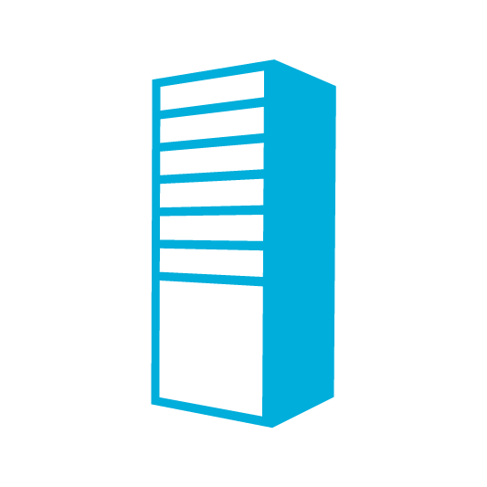
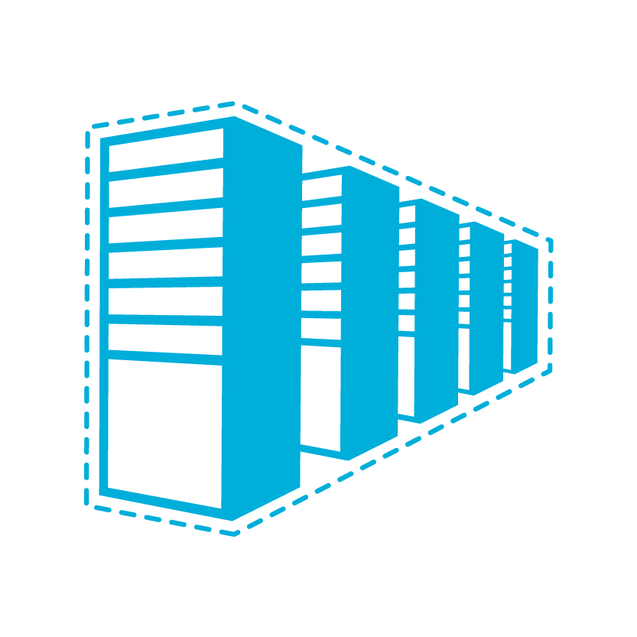
Migrating an Intranet Application
Hardware Load Balancer on client side for load balancing across internal only VPN tunnel.
On Premises
Cloud Service
Web/App
Mirrored DBs
Load Balancer
VPN Gateway
HTTP
AD / DNS
Site to Site VPN Tunnel
Web/App
HTTP
Exchange
Notes:
There currently is no built in method of doing load balancing coming directly from the virtual network VPN gateway.
The Windows Azure load balancer currently works only on the public endpoint of the cloud service.
This slide depicts a possible solution if there is a hard requirement for only accessing an application over the secure VPN tunnel.

Slide 15
Migrating an Intranet Application
Software Load Balancer for Internal LB
Use an SLB such as the ARR extension of IIS7.5 when site-to-site only connectivity is a requirement.
On Premises
Cloud Service
Web/App
Mirrored DBs
SLB
VPN Gateway
HTTP
AD / DNS
Site to Site VPN Tunnel
Web/App
HTTP
Exchange
Notes:
There currently is no built in method of doing load balancing coming directly from the virtual network VPN gateway.
The Windows Azure load balancer currently works only on the public endpoint of the cloud service.
This slide depicts a possible solution if there is a hard requirement for only accessing an application over the secure VPN tunnel.
Note: The SLB in this solution is a single point of failure.

Slide 16
Virtual Networking

Slide 17
Does Your App Need a Virtual Network?
Persistent IP Address Requirements
Virtual Machines deployed into a virtual network have an infinite DHCP lease.
Hybrid On-Premises Cloud Apps
Requirement for connectivity between your data center and the public cloud.
Connectivity between cloud services.
Deploying Active Directory in the Cloud or connecting a PaaS to IaaS Service.
Corpnet
Windows Azure
VM 1
VM 2
Subnet 1
Subnet 2
ROLE 1
Notes:
Windows Azure Virtual Networks provide functionality above and beyond site to site networking.
VNETs also provide persistent IP addresses through an infinite DHCP lease (not static but effectively the same thing).
VNETs also provide the capability of connecting cloud services in the same affinity group directly. This allows for scenarios like web and worker roles to virtual machines running services like SQL Server 2012 or SharePoint.

Slide 18
Deploying a Virtual Network
Define an Affinity Group
All resources in the same virtual network must belong to the same affinity group.
Define Address Space and Subnets
Roadmap: ACLs Between Subnets for Service Isolation
Roadmap: Active Routing allows/disallows traffic between subnets in Windows Azure and on-premises
Define Gateway Settings for Hybrid Connectivity
Need Public IP of On-Premises Gateway Device
Notes:
Deploying a virtual network requires some up front planning.
The first step is to define the affinity group in the region where your cloud services will be hosted.
Next define the address space and subnets needed for your virtual network in the cloud and optionally define the address space of the on-premises network you will be connecting to.
In the preview release VMs deployed on a subnet will be able to directly communicate with VMs on other subnets. Adding access control lists to control traffic flow between subnets and on-premises is on the roadmap so it is best to plan accordingly.
Optionally, include the IP address for the VPN server/device you are configuring for hybrid connectivity.

Slide 19
Virtual Network Definition Example
<VirtualNetworkSite name="ADVNET" AffinityGroup="adag1">
<AddressSpace>
<AddressPrefix>10.1.0.0/16</AddressPrefix>
</AddressSpace>
<Subnets>
<Subnet name="AppSubnet">
<AddressPrefix>10.1.1.0/24</AddressPrefix>
</Subnet>
<Subnet name="DNSSubnet">
<AddressPrefix>10.1.2.0/24</AddressPrefix>
</Subnet>
<Subnet name="GatewaySubnet">
<AddressPrefix>10.1.4.0/24</AddressPrefix>
</Subnet>
</Subnets>
</VirtualNetworkSite>
Notes:
Example of a VNET Definition in XML
- Same configuration can be made in the Windows Azure Management Portal

Slide 20
On Premises Configuration (optional)
<LocalNetworkSites>
<LocalNetworkSite name="onpremises">
<AddressSpace>
<AddressPrefix>192.168.1.0/24</AddressPrefix>
</AddressSpace>
<VPNGatewayAddress>157.40.1.50</VPNGatewayAddress>
</LocalNetworkSite>
</LocalNetworkSites>
Notes:
Example of a VNET Definition in XML
- Same configuration can be made in the Windows Azure Management Portal

Slide 21
Gateway Creation and Configuration
Create Gateway
Through Portal or PowerShell
Retrieve Shared Key and Gateway IP
Needed to establish VPN/IPSec Tunnel
Configure VPN Device
IKE v1, AES 128/256, SHA1/SHA2
Specify Gateway IP Address and Shared Key

Slide 22
Configuring the Deployment
Cloud Service
Affinity Group
Storage Account for VHDs
Same Region as Affinity Group
Deployment Properties
VirtualNetwork, DNSSettings
Virtual Machine
Subnet(s)
MyAffinityGroup
North Central US
Cloud Service
Affinity Group: MyAffinityGroup
Name: app-cloudservice.cloudapp.net
ADVNET
10.2.0.0/16
Deployment
Virtual Network: ADVNET
DNS Ips: 192.168.1.4
Windows Azure
Storage
Affinity Group: MyAffinityGroup
Virtual Machine
Role Name: app-srv1
Subnet: app-subnet
IP Address: 10.2.0.4
Virtual Machine
Role Name: app-srv2
Subnet: app-subnet
IP Address: 10.2.0.5
DIP

Slide 23
Extending Identity with IaaS

Slide 24
AD in the Cloud
Support pre-requisites for other apps or services
Direct Authentication for Applications in the cloud
Federation with ADFS
Serve as a substitute or failover for existing domain
Serve as primary auth for cloud only data center

Slide 25
Deploying AD in a Windows Azure VM
Cloud Service with Initial Domain Controller
Virtual Network Name
Existing DNS Servers (If any)
Virtual Network Subnet
Domain Join Settings (If existing domain)
Separate Data Disk for Active Directory Database
DCPromo
Create Separate Cloud Service for AD Members
Specify DNS at Deployment Level Using PowerShell for VMs
Notes:
Deploying an Active Directory domain controller in Windows Azure requires at a minimum two cloud services and currently requires the use of PowerShell.
When creating the domain controller VM/Cloud service you will specify the virtual network to deploy it to. A VNET is required for a persistent IP address.
If this domain controller will be extending a forest from on premises you will need to set the DNS Server IP address at deployment (in PowerShell) to the on-premises AD. Note the VPN gateway should already be provisioned.
For extending an existing forest you can specify the domain join settings through PowerShell so the new DC will automatically boot up in the right domain.
Ensure that you provision a data disk for the Active Directory DIT database. The OS Disk of a VM by default has Write caching enabled which is not a safe option for a database. It is possible to turn this off via PowerShell.
Once the machine is booted up note the IP address because you will need it when deploying the second cloud service with AD client machines.
Finally, run DC Promo
When deploying the first VM that will be a domain member you will specify the DNS Server IP address of the domain controller you just deployed. This is the reason for having multiple cloud services.

Slide 26
Cloud Services Configuration for AD
Deploy DC in Separate Cloud Service
ADVNET
Cloud Service for AD Domains
Location: North Central US
Name: ad-cloudservice.cloudapp.net
Affinity Group: ADAG
Cloud Service for AD Clients
Location: North Central US
Name: app-cloudservice.cloudapp.net
Affinity Group: ADAG
Deployment
Virtual Network: ADVNET
DNS Ips: (On-Premise AD IP)
Deployment
Virtual Network: MyVNET
DNS Ips: 192.168.1.4
Virtual Machine
Role Name: ad-dc
Subnet: ADSubnet
IP Address: 192.168.1.4
DIP
Virtual Machine
Role Name: advm1
Subnet: AppSubnet
IP Address: 192.168.2.4
Notes:
The cloud service on the left holds a virtual machine running Active Directory. The DNS server IP address of this particular deployment could be pointing to an on-premise DC if it were part of an existing forest.
The cloud service on the right has the deployment DNS servers specify the IP address of the domain controller on the left. When VMs boot up in this cloud service they will inherit this setting and be able to resolve names in the domain – and join the domain.
Note: both cloud services are in the same virtual network.

Slide 27
Domain Controller On-Premises
Contoso.com Active Directory
Contoso.com Active Directory
Contoso Corp Network
The Virtual Network
in Windows Azure
SQL Servers
IIS Servers
Site to Site VPN Tunnel
AD Authentication
+
On-Premises Resources
Gateway
AD / DNS
S2S VPN Device
IIS Servers
SQL Servers
Exchange
Load Balancer
Public IP
Notes:
Diagram depicting virtual machines in the cloud consuming Active Directory services over the VPN tunnel.

Slide 28
Domain Controller in the Cloud
Contoso.com Active Directory
Contoso.com Active Directory
Contoso Corp Network
The Virtual Network
in Windows Azure
SQL Servers
IIS Servers
Site to Site VPN Tunnel
AD / DNS
AD Replication
+ On Premises Resources
Gateway
AD / DNS
S2S VPN Device
AD Auth
IIS Servers
SQL Servers
Exchange
Load Balancer
Public IP
Notes:
Diagram depicting virtual machines in the cloud consuming Active Directory services from within the cloud as part of an existing forest.
AD replication will occur over the VPN tunnel.

Slide 29
Active Directory Cloud Only
Contoso.com Active Directory
Contoso Corp Network
Extranet Active Directory
The Virtual Network
in Windows Azure
SQL Servers
IIS Servers
Site to Site VPN Tunnel
AD / DNS
On Premises Resources
Gateway
AD / DNS
S2S VPN Device
AD Auth
IIS Servers
SQL Servers
Exchange
Load Balancer
Public IP
Notes:
Diagram depicting virtual machines in the cloud consuming Active Directory services from within the cloud solely with no relation to the on-premises forest.
Hybrid connectivity is still allowed if needed.

Slide 30
Managing Application Data

Slide 31
Managing Data
Each Data Disk has its own I/O
Think Disk Controllers/Spindles
Spread I/O Across Multiple Disks for Performance
Spread database files across multiple disks (SQL File Groups)
Configure Host Caching for Appropriate Workload
Support for None, ReadOnly and ReadWrite caching. None on DataDisk only
Plan Storage Capacity
A Data Disk can be up to 1TB

Slide 32
Virtual Machine Disk Management
Capability | OS Disk | Data Disk
Host Cache Default | ReadWrite | None
Max Capacity | 127 GB | 1 TB
Imaging Capable | Yes | No
Hot Update | Cache Setting Requires Reboot | Change Cache Without Reboot, Add/Remove without Reboot.
C:\ = OS Disk
D:\ = Non-Persistent Cache Disk
E:\, F:\. G:\ ... Data Disks
Notes:
Highlight the differences in default cache policy between the OS disk and DataDisk
Call out that the D:\ drive is local storage on the blade in the data center. It is not persisted to Windows Azure storage and should only be used for temporary storage.

Slide 33
Managing Application Data Examples
Active Directory DIT
Place on Data Disk or modify OS Disk to use ReadOnly host caching
SQL Database and Transaction Logs
Place on Data Disk or modify OS Disk to use ReadOnly host caching
Split SQL database and transaction log files across multiple data disks for best performance.
Notes:
OS Disk by default enables write caching which is not safe for database files.
You can change this via PowerShell:
Get-AzureVM $cloudsvc $vm |
Set-AzureOSDisk -HostCaching ReadOnly |
Update-AzureVM
DataDisk by default has host caching ReadOnly

Slide 34
Monitoring and Managing VMs

Slide 35
Monitoring Windows Azure VMs
Windows Azure Virtual Machines are not “different”
Existing Monitoring and Management Applications will continue to work
Connectivity Will Be Key
Using Windows Azure Virtual Networks to bridge the connectivity divide
Management Applications may have more streamlined solutions such as the System Center Gateway Service

Slide 36
Summary
Consider Moving Entire VMs OR Building VMs in Cloud
Plan Virtual Network Requirements (if any)
Plan for Storage Performance and Capacity
Existing Monitoring Applications Should Just Work

