Slide 1

Improving Education by improving
School Performance
(A volunteer system to keep a check on student numbers)

Slide 2
The Problem
12,000 ghost schools in Sindh
8.4 billion taxpayer’s Rs. per year that offer nothing
1.4 million children who are out of school in Sindh
“The government has failed to provide any answer or details about the state of ghost and non-functional schools, while apparently funds and salaries were being disbursed as buildings remain abandoned or occupied by animals.”
Chief Justice Iftikhar Muhammad Chaudhry
(February, 2013)
Notes:
*Report by World Bank in Sindh
**Public Provision of Education and Government Spending in Pakistan, Muhammad Akram, 2005
***OUT OF SCHOOL CHILDREN IN SINDH: LOOKING AT ACCESS & EQUITY
Asma Bajwa, 2011

Slide 3
The Solution
Provide a simple and easy auditing tool to the
main stakeholders of the educational system...
the parents.
Whistle blowers will provide info for:
No. of students present
School Name
Date

Slide 4
The Solution
Target beneficiaries:
1. Govt. orgs/NGOs who need information on the state of education in a particular area.
2. Children 6-16 who attend Govt. Schools whose education will improve as a result of tighter community-based auditing.
Workers needed:
1. Govt. orgs/NGOs who will identify, pitch and register the “whistle blowers”.
2. Parents and members of the community who will agree to act as “whistle blowers” and provide information on their community’s school.

Slide 5
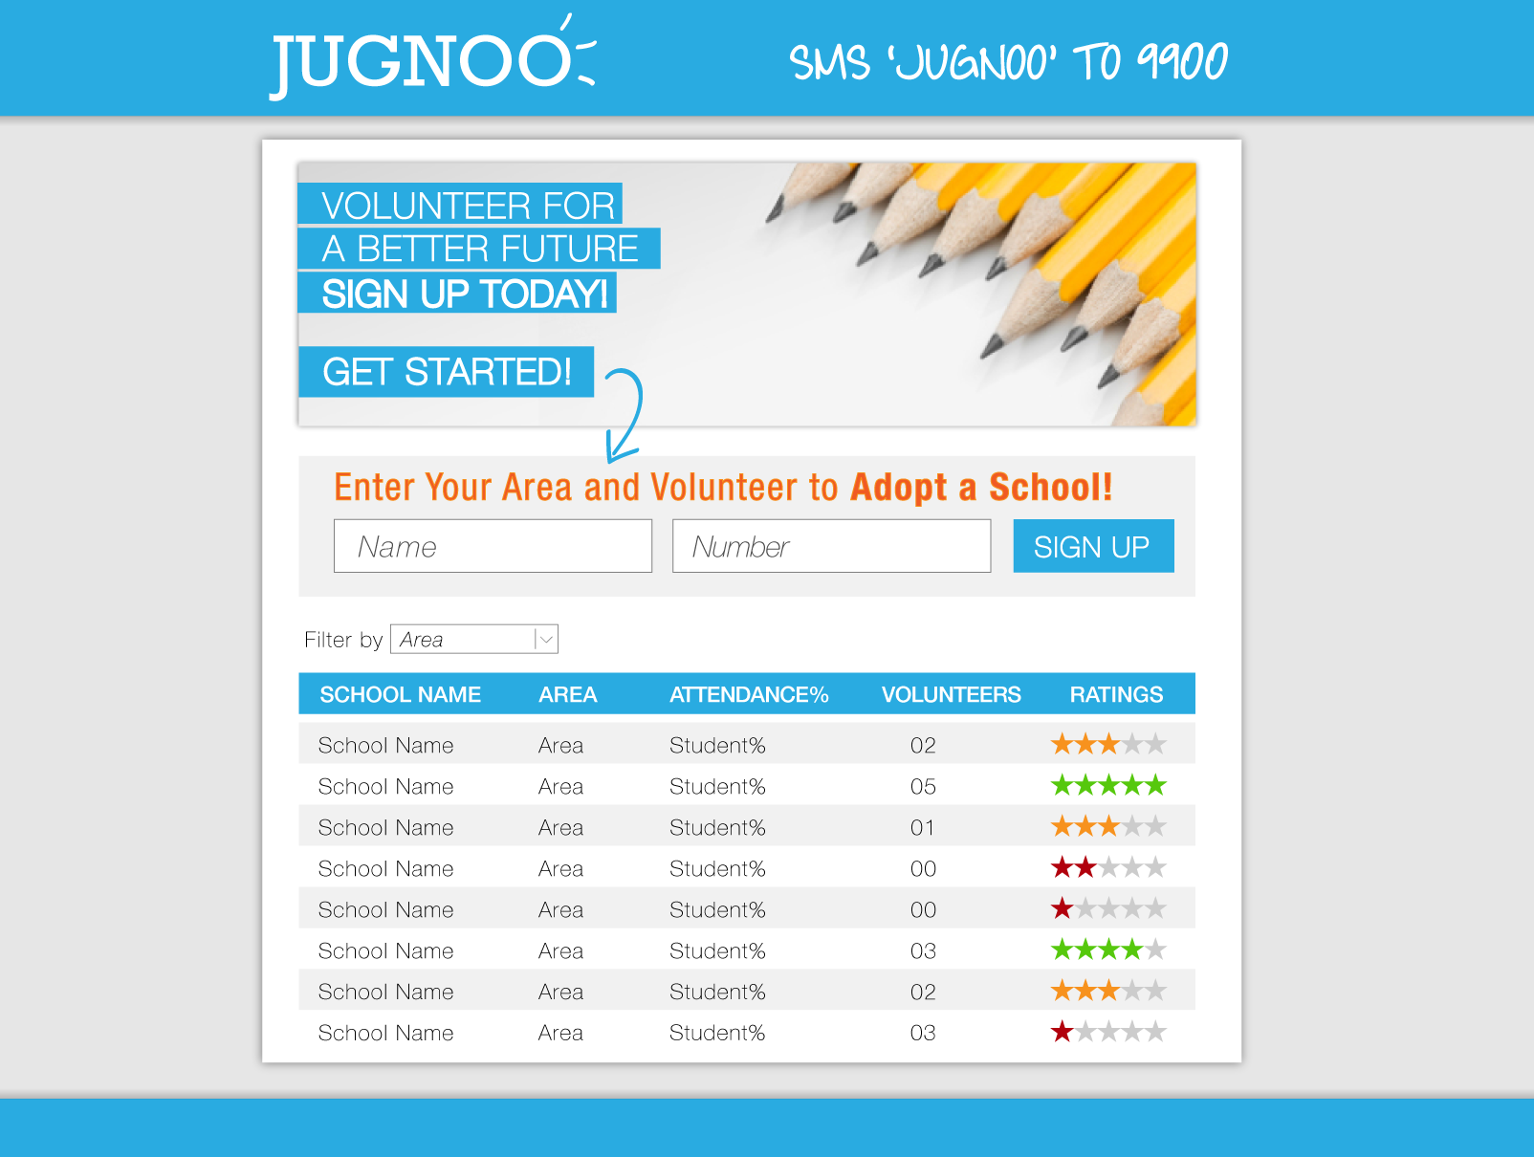
v

Slide 6
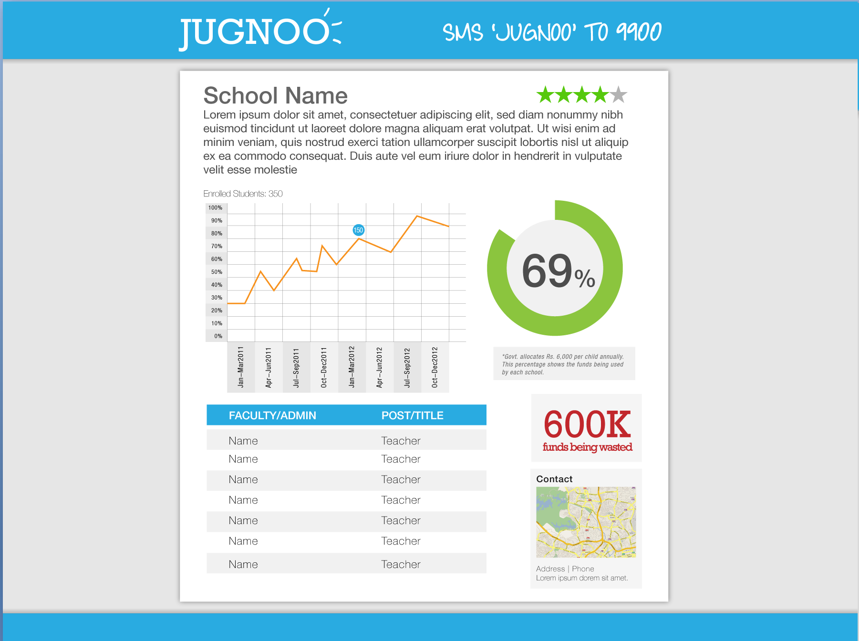

Slide 7
Data Collection
Data Base
Govt. Org/NGO’s:
School Profile
Parents/ Volunteers:
School attendance

Slide 8
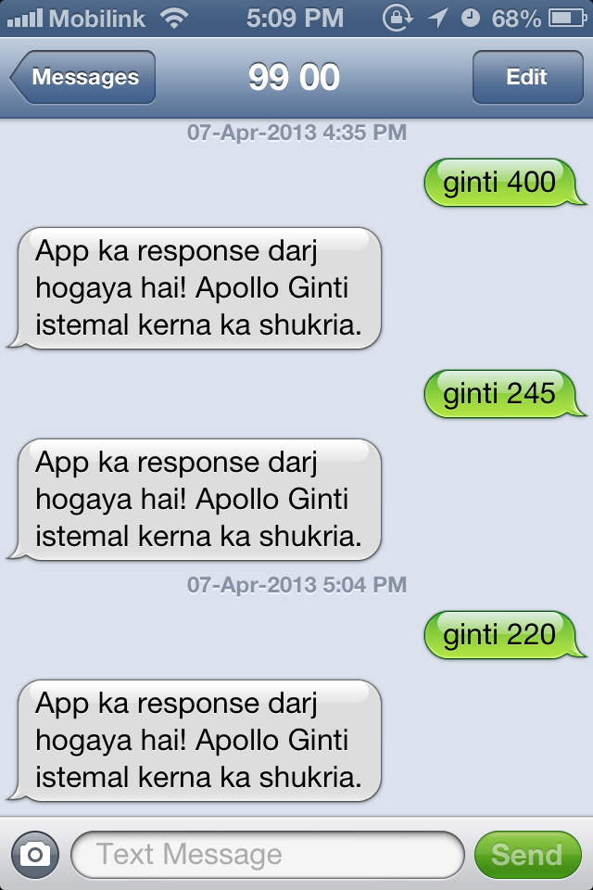
v

Slide 9
v
Volunteer Sign Up Dialogue
[Volunteer Dials xxxx]
1. Hi. Thanks for volunteering for Jugnoo. To become one of our whistle blowers we just
need a bit more info. To start, please respond to this SMS with your full name.
> Christopher Thomas
2. Great, nice to have you on board Christopher Thomas. Now we need to know what
school you would like to audit. > M. A. Jinnah Govt. School for Boys.
3. Do you know the School’s ID number? 1. Yes; 2.No
> No. 2. That’s fine, we’ll try to locate it by area. What area is it in?
> PECHS
4. Great, it looks like you have selected Mohammed Ali Jinnah Government Primary School for Boys in PECHS Block 2. Is this right? 1.Yes; 2.No
5. 1. Now that you’ve chosen your school we’d like to know what kind of relationship you have with that school. 1.My child/children study there; 2.I’m just a concerned citizen who wants to help.
6. Thank you for giving time. Your volunteer work will help your children and many more around Karachi to get the education they
deserve.
7. Count the students attending the school as accurately as possible.
Dial XXXX to report the amount of students you have counted at the school
Bad reports will make it difficult for us to keep track, so only report if you have had a
chance to count all the children, if not, no sweat... go back another day to audit them.

Slide 10
v
Volunteer Reporting Dialogue
[Volunteer Dials xxxx]
Hi Christopher Thomas, looks like you’re ready so submit a report. We can’t wait to hear
the news! Reply to this SMS with the number of students you counted at the school.
Ginti 456
So just to make sure: Monday, 21st March you counted 456 students attending the
Mohammed Ali Jinnah Government Primary School for Boys in PECHS Block 2. Is this
right? 1. Yes; 2.No
o 1. [Continues]
o 2. Sorry, there must be a mistake somewhere. Please enter the information
again.
Awesome! You have successfully submitted your report. This information will go a long
way in making more and better education available for our children. Thank you for
volunteering, and please feel free to submit audits on your school any time you can
make them! Visit our website to find out more.
-

Slide 11
Data Output
Data Base
School performance rating
Financial wastage
Map of ghost schools

Slide 12
The Process
v
Provide the tool to Gov. Orgs/NGO’s
...who mobilize Parents/Volunteers
...who gather and submit data on school performance
...which goes live immediately
...which informs further work by Gov. Orgs/NGOs

Slide 13
Assumptions
Student attendance is linked to teacher attendance and quality of education and can be used as a clear indicator of basic school performance.
Parents as main stakeholders will volunteer time to gather and submit information (Committee of 4-5 parents per school.)
Such a tool will serve as an incentive to improve teacher attendance and thus improve educational standards.

Slide 14
Scalability
Program will start in Karachi
Can seamlessly accommodate other areas of the country
Can be adapted to other fields of public service provided there is a clear indicator of performance in that field which can easily be collected by citizens.

Slide 15
Adoption
Real-world Jugnoo representative will pitch prospective parents/volunteers.
Jugnoo representative will sign up interested parents/volunteers via SMS.
Parents/volunteers will be automatically prompted to provide information.

Slide 16
Thank You.

