Slide 1
NESIS estimates for the SOC case
ATM 419
Spring 2016
Fovell

Slide 2
RIP (Read-Interpolate-Plot) package
RIP v. 4 home page
The RIP package can read WRF model output (WRF-ARW, WRF-NMM and HWRF) and compute a vast array of diagnostics
However, the package is apparently no longer being updated
We’ll use it as a black box to compute NESIS values for our SOC simulations

Slide 3
RIP package
RIP analyses proceed in two steps
(1) Use ripdp_wrfarw program to unpack wrfout* files into RIP format data files (one file per field per time)
(2) Use rip program and rip plot description files to compute diagnostics and display fields
I modified RIP to compute a NESIS statistic, based on three-hourly inputs
I have tried to make this as transparent as possible by providing a batch script

Slide 4
RIP plot description file header
&userin
idotitle=1,titlecolor='def.foreground',
ptimes=0,-60,3,
ptimeunits='h',tacc=120,timezone=-8,iusdaylightrule=1,
iinittime=1,ivalidtime=1,inearesth=0,
flmin=.09, frmax=.92, fbmin=.10, ftmax=.85,
ntextq=0,ntextcd=0,fcoffset=0.0,
idescriptive=1,icgmsplit=0,maxfld=10,itrajcalc=0,imakev5d=0
&end
&trajcalc
rtim=15,ctim=6,dtfile=3600.,dttraj=600.,vctraj='s',
xjtraj=95,90,85,80,75,70,65,80.6,80.6,80.6,80.6,80.6,80.6,
yitraj=50,55,60,65,70,75,80,77,77,77,77,77,77,
zktraj=.9,.9,.9,.9,.9,.9,.9,.99,.9,.8,.7,.6,.5,
ihydrometeor=0
&end

Slide 5
RIP plot description file body
==================================================================
feld=ter; ptyp=hc; cint=100; colr=red
feld=map; ptyp=hb
feld=tic; ptyp=hb
time=0
==================================================================
feld=GRAUPELNC; ptyp=hc; vcor=s; levs=1fb; addf=1;
feld=SNOWNC; ptyp=hc; vcor=s; levs=1fb;
feld=map; ptyp=hb
feld=tic; ptyp=hb
==================================================================
feld=nesis; ptyp=hc; vcor=s; levs=1fb; cmth=fill; cosq=0,light.gray,>
2,light.gray,>
4,white,6,white,8,white,10,white,12,light.blue,14,light.blue,>
16,light.blue,18,light.blue,20,dark.blue,22,dark.blue,24,dark.blue,>
26,dark.blue,28,dark.blue,30,red; cint=2; xwin=48,72; ywin=15,45;
feld=map; ptyp=hb
feld=tic; ptyp=hb
==================================================================
(feld=nesis is a field I added to RIP)

Slide 6
#!/bin/bash
# Job name:
#SBATCH --job-name=rip
#SBATCH -n 1
#SBATCH -N 1
#SBATCH --mem-per-cpu=7G
#SBATCH -p snow
#SBATCH -o sbatch.out
#SBATCH -e sbatch.err.out
source /network/rit/home/atm419/.bash_profile
\rm -rf RIPD*
\rm census* rip.*in OUT *.cgm
\cp /network/rit/home/atm419/NESIS/rip.nesis.in .
\cp /network/rit/home/atm419/NESIS/census2000_gridded_atm419.txt census2000_gridded.txt
mkdir RIPD1
st_tm="$(date +%s)"
echo "running ripdp"
srun -N 1 -n 1 -o ripdp.srun.out ripdp_wrfarw RIPD1/crapd1 all wrfout_d01*
echo "running rip"
srun -N 1 -n 1 -o rip.srun.out rip RIPD1/crapd1 rip.nesis.in
\rm -rf RIPD1
en_tm_real="$(date +%s)"
dt_real="$(($en_tm_real - st_tm))"
echo "rip is done, elapsed time: $dt_real sec"
submit_nesis

Slide 7
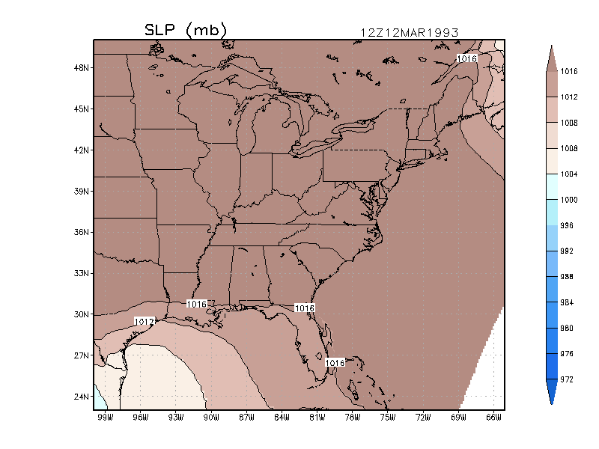
Animation of SLP field
(ECMWF reanalysis)
03/14/93 06Z
Storm Track
03/13/93 06Z
Notes:
ecmwf_movie.GIF

Slide 8
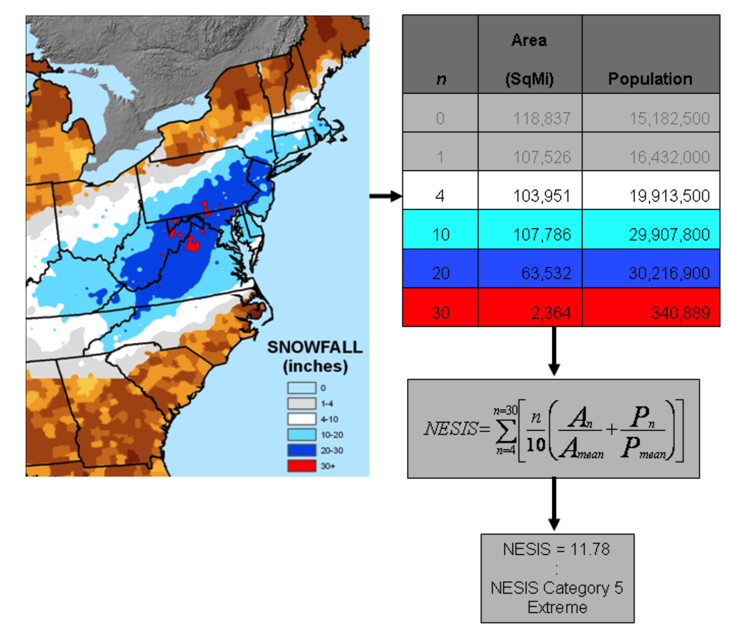
North East Storm Impact Scale (NESIS)
Snow exceeding
4”
10”
20”
30”
• area-integrated AND
• population-weighted
http://www.ncdc.noaa.gov/snow-and-ice/rsi/nesis
Kocin and Uccellini (2004)
Notes:
NOTE: Example appears to suggest 10” area > 4” area, but formula would combine 10,20,30” areas into 4” category for NESIS computation. NESIS categories are “nested”.
“However, Equation (1) defines the area and population as “greater than” 4”, greater than 10”, etc. For example, the area for category 10 would include the areas for categories 10, 20, and 30. “ – Squires and Lawrimore (2006)

Slide 9
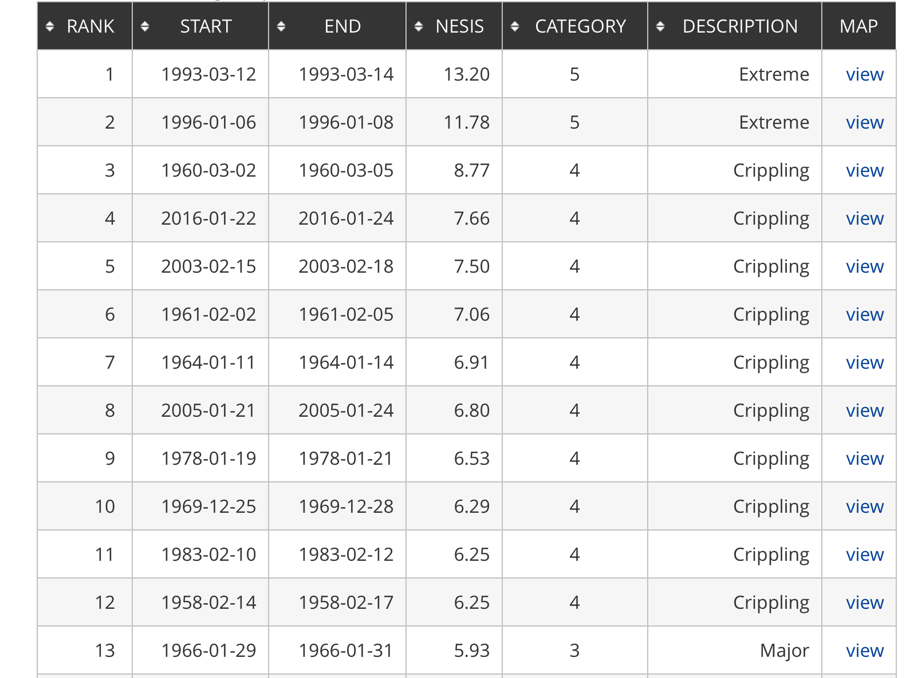

Slide 10
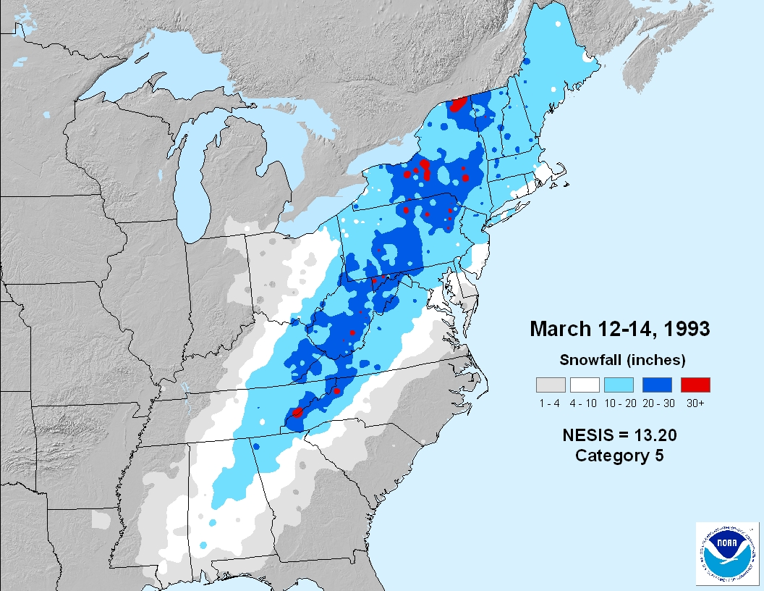

Slide 11
Computing snow depth
The models provide liquid water equivalent precipitation. How to compute snow depth? WRF field is SNOWNC: snow liquid water equivalent mass received at surface from the microphysics scheme (units are mm):
  Snow mixing ratio q_{s} is kg_{snow}/kg_{air}
  Snow terminal velocity “through” model ground is V_{s} in m/s
  Flux of snow “through” model surface is ρV_{s}q_{s}, with units kg_{snow}/m²/s, where ρ = air density
  Multiply this by the time step (∆t) = units now kg_{snow}/m²
  Divide by density of liquid (1000; it’s liquid equivalent) and convert to mm (mult by 1000)
Some different ways of converting SNOWNC to snow depth (not exhaustive):
  Just assume the classic 10:1 ratio
  Based on event observations directly relating snow depth to water content (as in Lott 1993)
  Based on dew points recorded during snowfall (also from Lott 1993)
  Utilize climatological values in some fashion, such as those provided by Baxter et al. (2005)
  Based on 3-hourly snow precipitation rate (Byun et al. 2008 for Korean observations)
  Based on neutral network analysis of multiple meteorological factors [including solar radiation, temperature, relative humidity, wind speed, etc..] (Roebber et al. 2003)
Most microphysics schemes also produce graupel mass at surface (also in mm), called GRAUPELNC. Many schemes produce a LOT of graupel. How to factor this into “snow”?

Slide 12
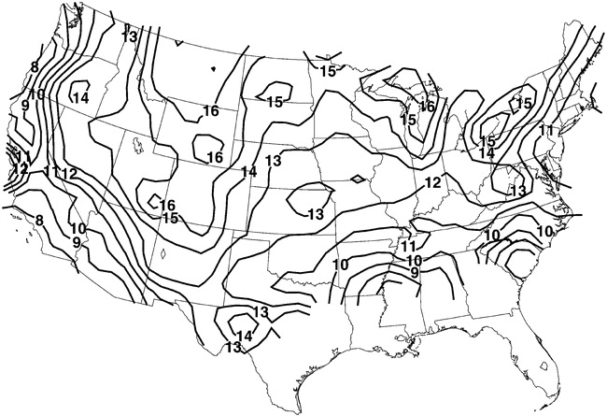
Climatological average snow-to-liquid ratio
Baxter et al. (2005)

Slide 13
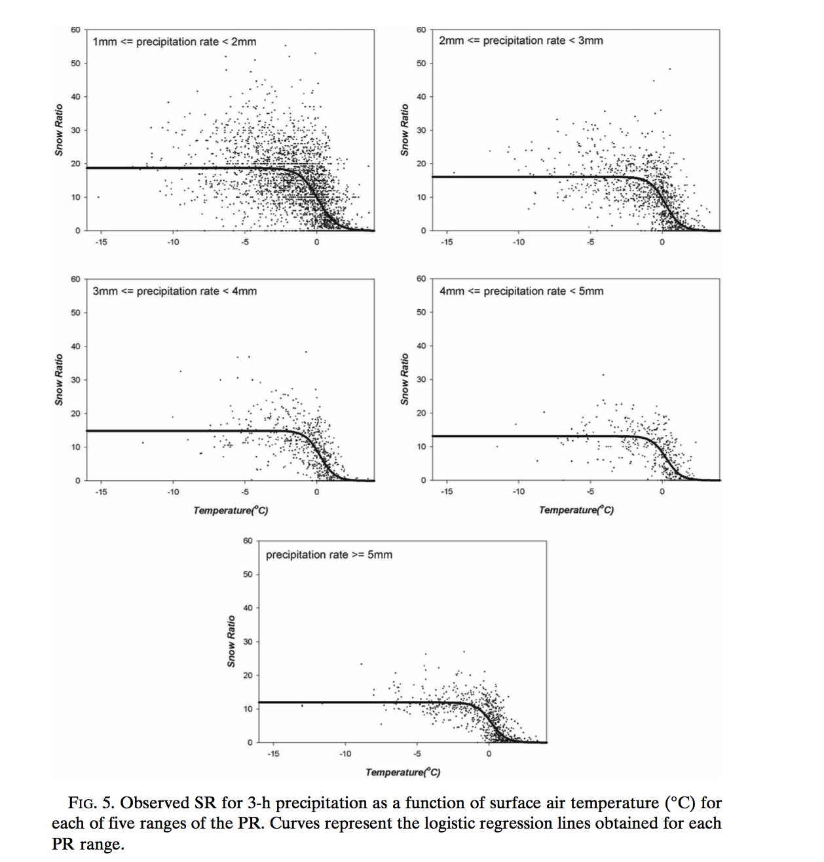
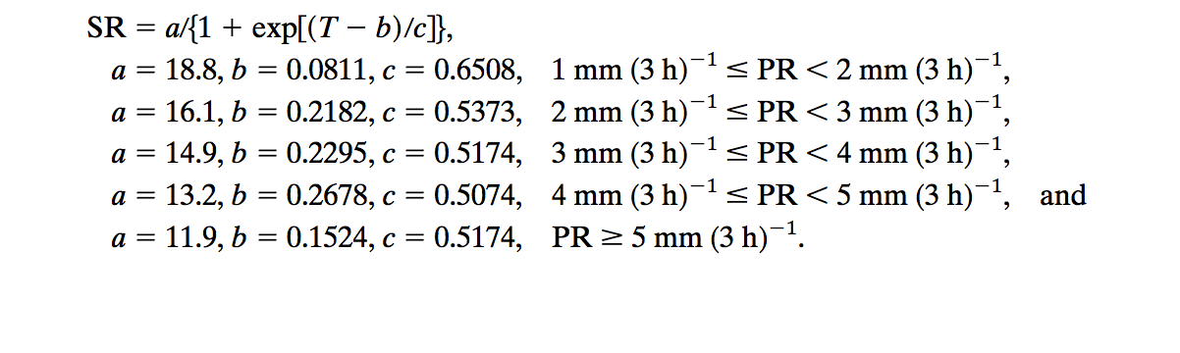
Byun et al. (2008)
Notes:
Precip rate low and T is very cold, snow ratio approaches 20:1.
Precip rate large and T closer to 0, snow ratio more like 7:1

Slide 14
Computing NESIS
Copy /network/rit/lab/atm419lab/SOC/submit_nesis into your workspace
sbatch –p snow submit_nesis … from directory containing your wrfout files
This will create rip.srun.out and rip.nesis.cgm (among other files)
tail rip.srun.out (see next slide)
Use ictrans to view snow footprint (see slide after next)

Slide 15
tail rip.srun.out
NESIS = 15.84756 ...uses Korean snow depth formula
Accum frozen pcp (inches)
map background
tic marks
====================================
We're outta here like Vladimir !!
====================================

Slide 16
Using ictrans
$ ictrans -d X11 rip.nesis.cgm
Building CGM table of contents
Read 43 frames
43 frames
ictrans> 43 plot
ictrans> skip 1
ictrans> 11,43 p
(see next slide for example plot)
(this will display plots 23 to 43, skipping every other plot.
Use this to see how footprint evolves with time)

Slide 17
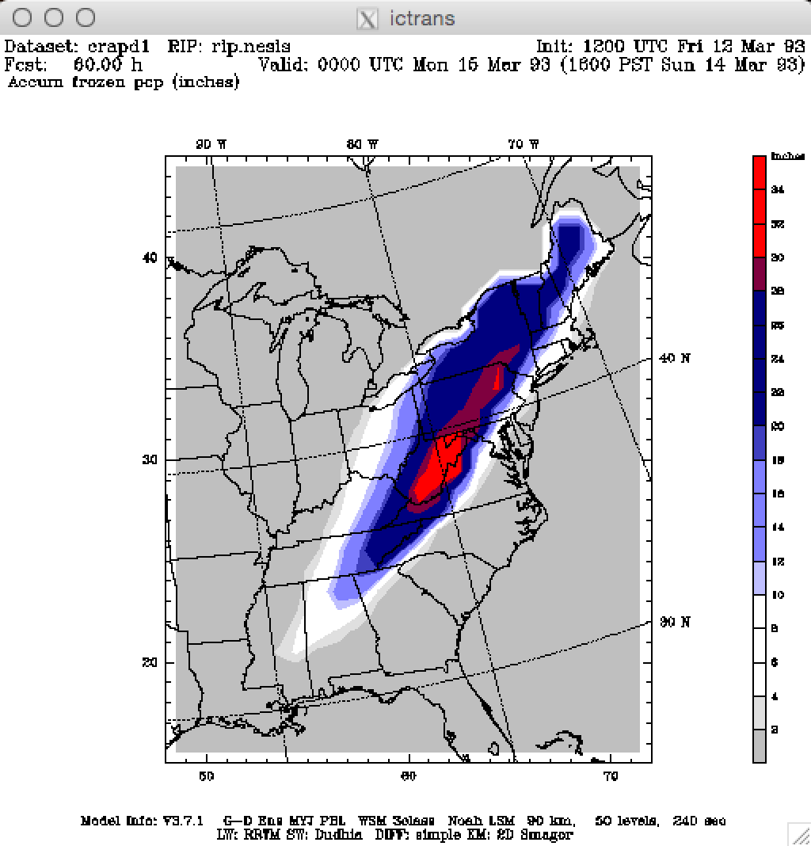
(Only part of D1 is shown)
NESIS = 11.38921
Notes:
Looks like

Slide 18
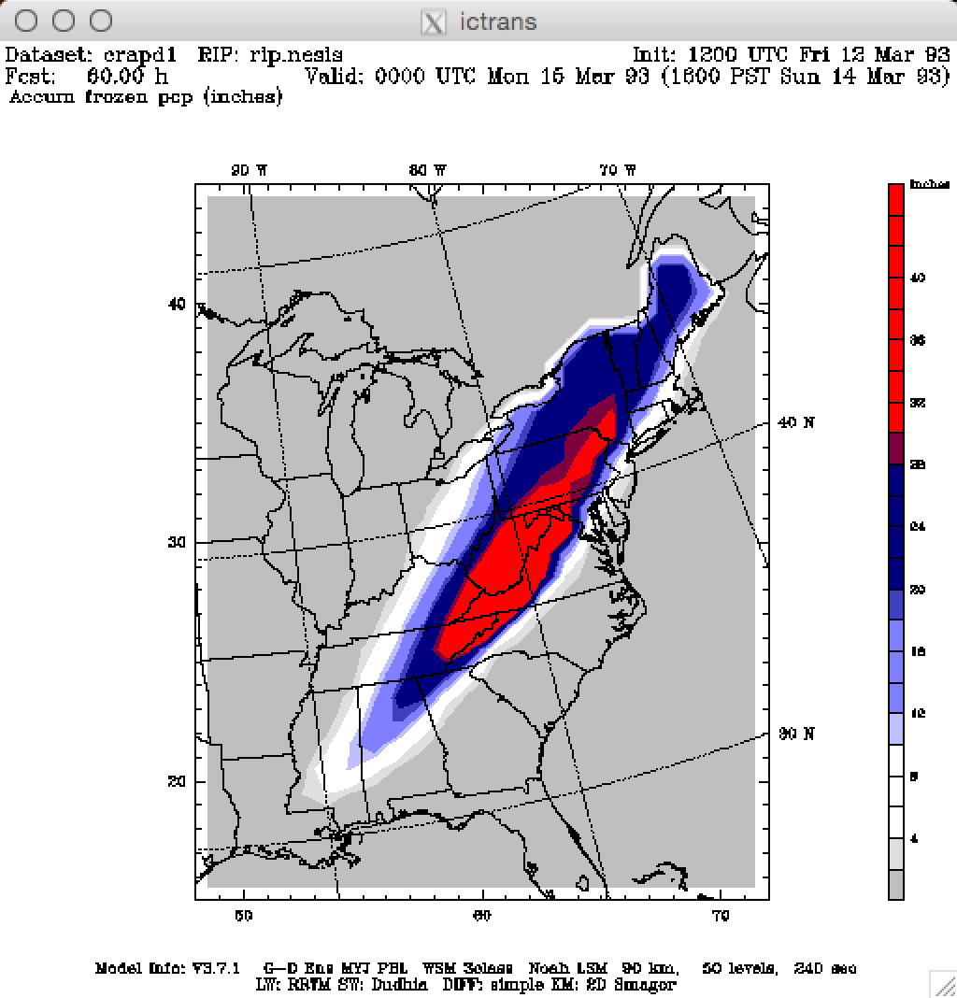
NESIS = 15.84756

Slide 19
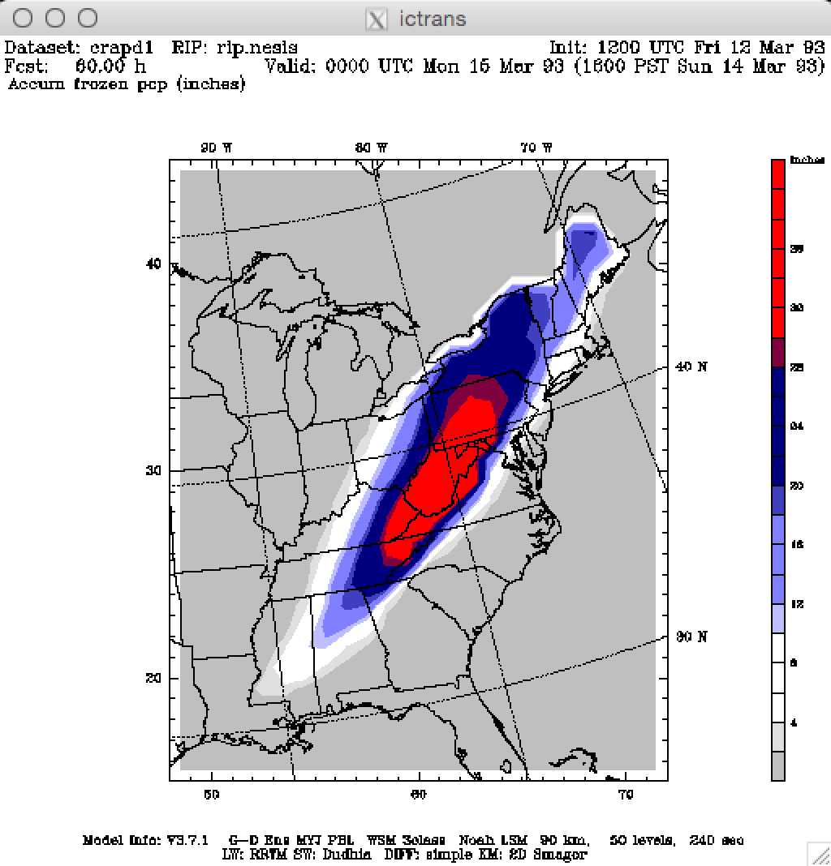
NESIS = 13.52233

