Slide 1
Examining the Impact of Microphysics Parameterizations in Simulations of a Vermont Winter Storm
Michael Wasserstein

Slide 2
The January 20-21, 2019 Winter Storm
Timing
Temperatures < -20 °C
10:1 Snow-to-liquid ratio
NWS Burlington
Notes:
Explain snow totals in VT and northern NY from the storm
Explain the storm’s cold nature / what does that mean for snowfall totals? (10:1 snowfall ratio)
Discuss the brutal winds
My personal memory - going to snow bowl to ski – only lasting 30 minutes due to cold and wind

Slide 3
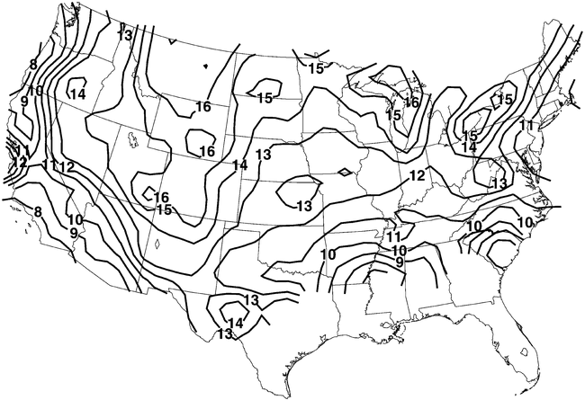
Mean snow-to-liquid ratios based on climatology from 1971-2000 (Baxter et al. (2005))

Slide 4
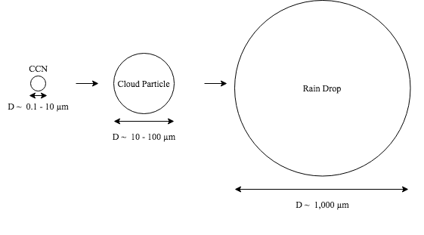
Cloud Microphysics
Study of tiny particles in the clouds
Particles grow, atmosphere becomes saturated, fall as precipitation
Such a complex process, how can we model it …?
Notes:
Condensation nuclei causes particles to stick, eventually growing to cloud particle, growing to rain drop (1 mm)
e is water vapor pressure
E_s is saturation vapor pressure
When S = 1, the atmosphere cannot hold any more moisture so atmos is saturated, particles fall.

Slide 5
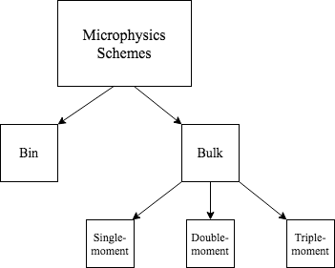
Cloud Microphysics Modeling
Notes:
Bin schemes – divide cloud particles into thousands of bins and model what cloud particles do based on each individual bin
Bulk schemes – use an empirical exponential or gamma distribution to determine particle sizes based on prognosticated total number concentration (N_T) / mixing ratio (q)

Slide 6

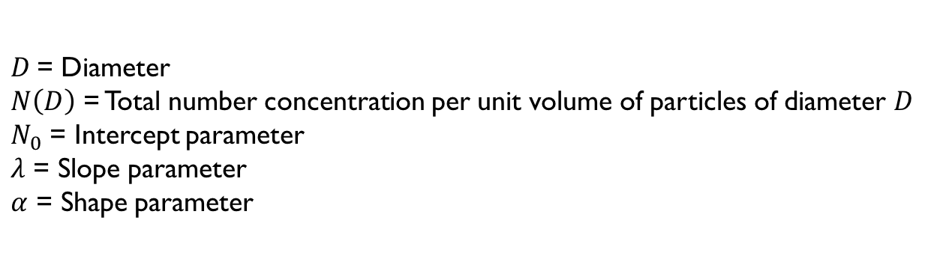
Bulk Schemes
Predict particle size distributions based on empirical gamma or exponential distribution
$$N\left(D\right)=N_{0}D^{α}e^{−λD}$$
$D$= Diameter
$N\left(D\right)$ = Total number concentration per unit volume of particles of diameter $D$
$N_{0}$ = Intercept parameter
$λ$ = Slope parameter
$α$ = Shape parameter
Single-moment: 1 parameter prognosticated, Double-moment: 2 parameters prognosticated, etc.
Notes:
Make note that different MP schemes will predict N_0, alpha, lambda.
Not all schemes follow same equations or empirical distribution exactly.

Slide 7
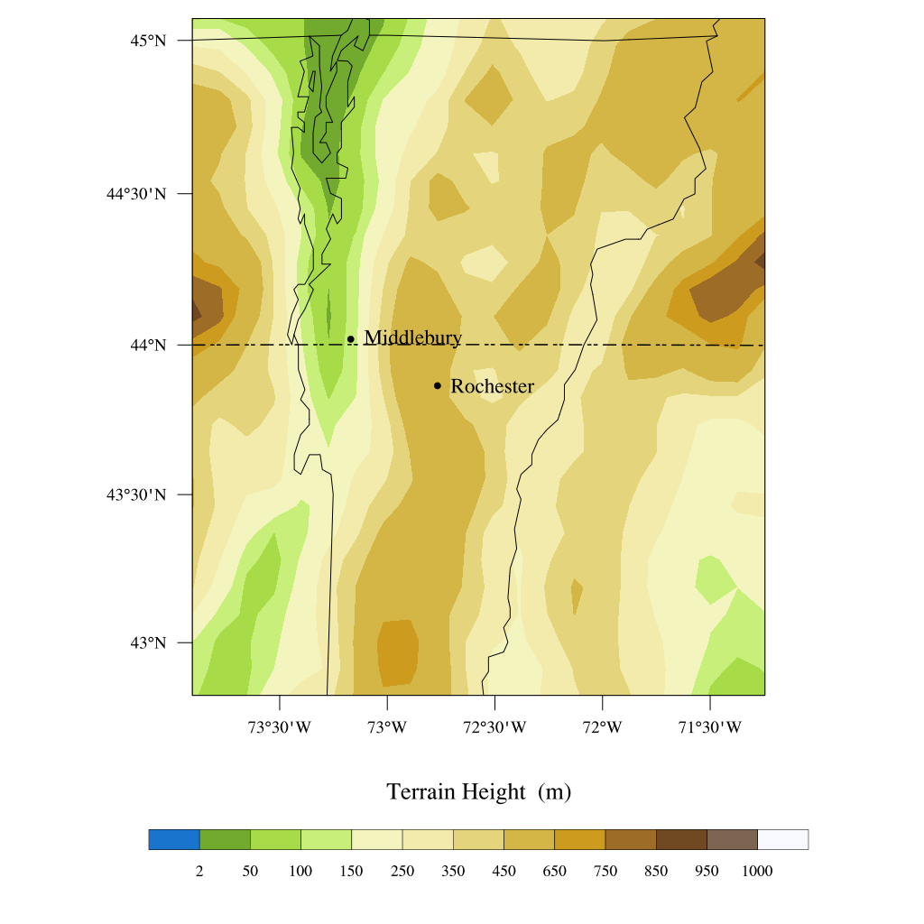
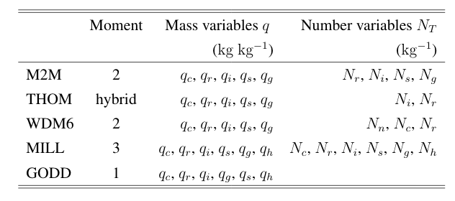
Methods
Principal tool: Weather Research and Forecasting (WRF) Model
Subscripts c,r,i,s,g correspond with hydrometeors (cloud, rain, ice, snow, graupel)
Notes:
Briefly describe the physics schemes, what they mean
Region for data analysis is shown – contains 17 longitudinal segments and 24 latitudinal, for a total of 408 gridpoints on 2D plane. Each point contains data for 38 levels of atmos extending to 20,000 meters above surface of earth.
We averaged all points in domain
We compared specific data to real storm observations from Middlebury and Rochester

Slide 8
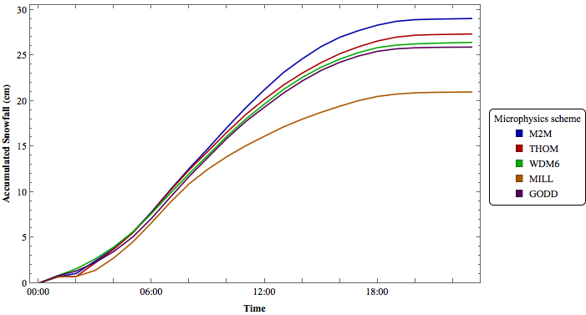

Slide 9
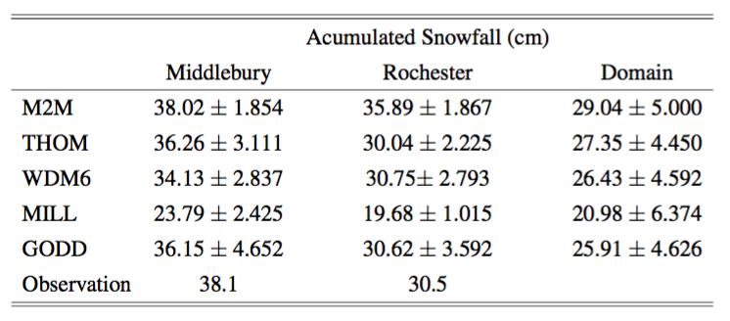
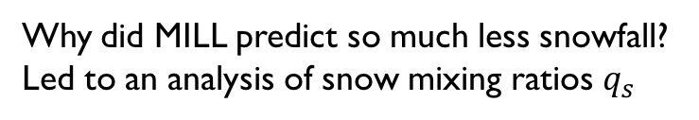
Why did MILL predict so much less snowfall?
Led to an analysis of snow mixing ratios $q_{s}$

Slide 10
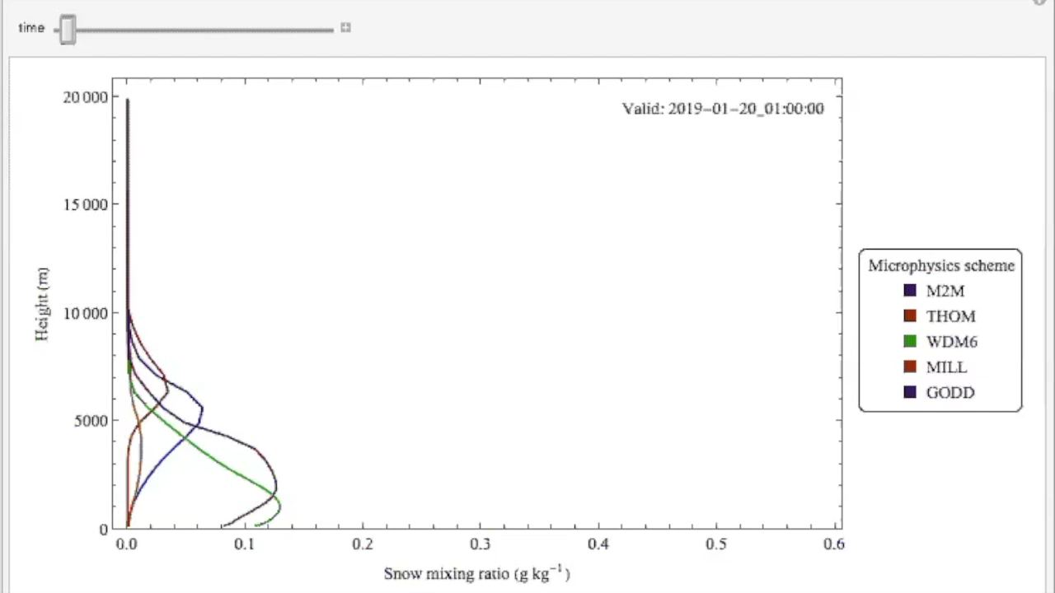

Slide 11
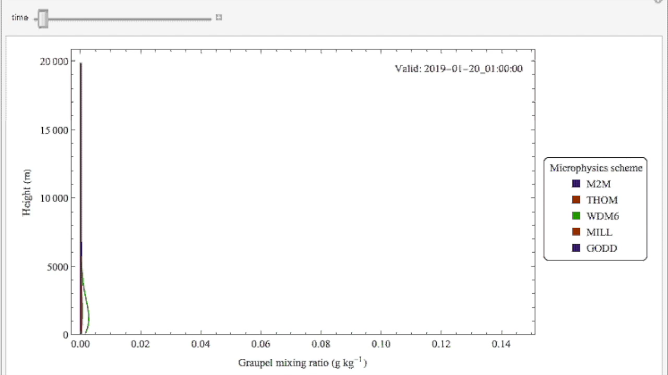
Notes:
(WORK ON THIS!!!! – But it’s the general idea!!)

Slide 12
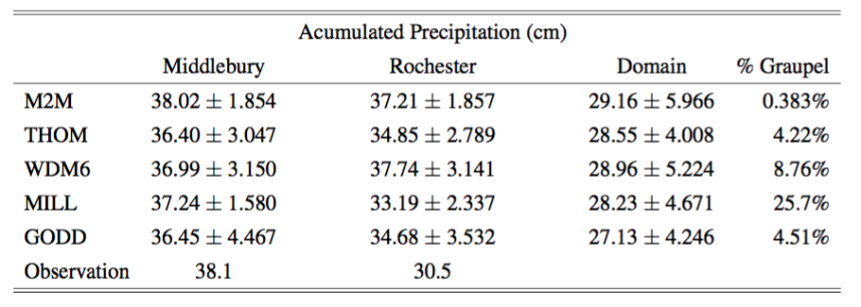
Accumulated precipitation due to graupel and snow

Slide 13
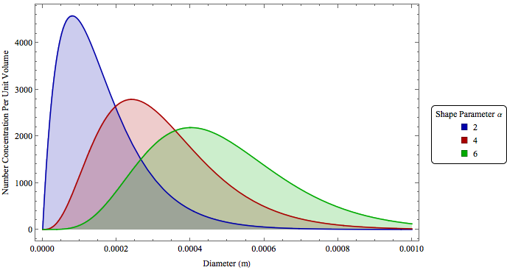

The Physics of the Milbrant-YAO Scheme
Only 3- moment microphysics scheme that we used.
$$N\left(D\right)=N_{0}D^{α}e^{−λD}$$

Slide 14
Future directions
Data verification
Include other microphysics schemes
Test for different storms

