Slide 1
Microphysics Parameterizations
1 Nov 2010
(“Sub” for next 2 lectures)
Wendi Kaufeld

Slide 2
Sources for these lectures...
Your Stensrud Parameterization Schemes book
Rogers & Yau: A Short Course in Cloud Physics
WRF User’s website: past WRF Workshop presentations
Notes from ATMS 597P, Matt Gilmore’s Cloud Microphysics Parameterization class
Notes from ATMS 501, Greg McFarquhar’s Physical Meteorology class
Comet module: “How Models Produce Precipitation and Clouds”
  http://www.meted.ucar.edu/nwp/model_precipandclouds/

Slide 3
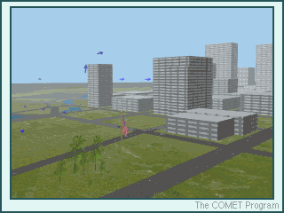
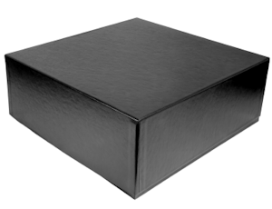
Basics...
Parameterization:
  AMS Glossary = “The representation, in a dynamic model, of physical effects in terms of admittedly oversimplified parameters, rather than realistically requiring such effects to be consequences of the dynamics of the system.”
Black Box syndrome:
  The meteorological cancer of researchers
  Ignorance of assumptions, processes, implementations within the parameterization
  → Blindly choosing a parameterization? Inconceivable!

Slide 4
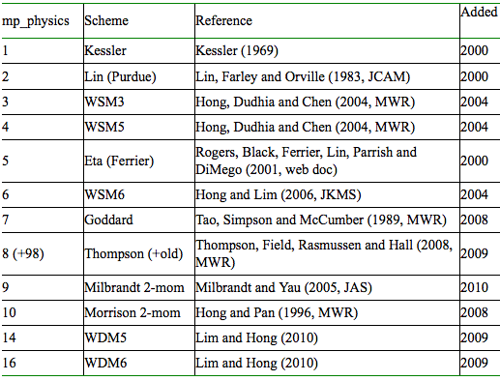
So many schemes... Why does the microphysics parameterization you choose matter?
Notes:
Different hydrometeors represented
Warm: Kessler // Cold also? Single-moment vs. double-moment
Black Box syndrome... Too complicated to deal with?
Lots added within last couple of years – more developments on the way.

Slide 5
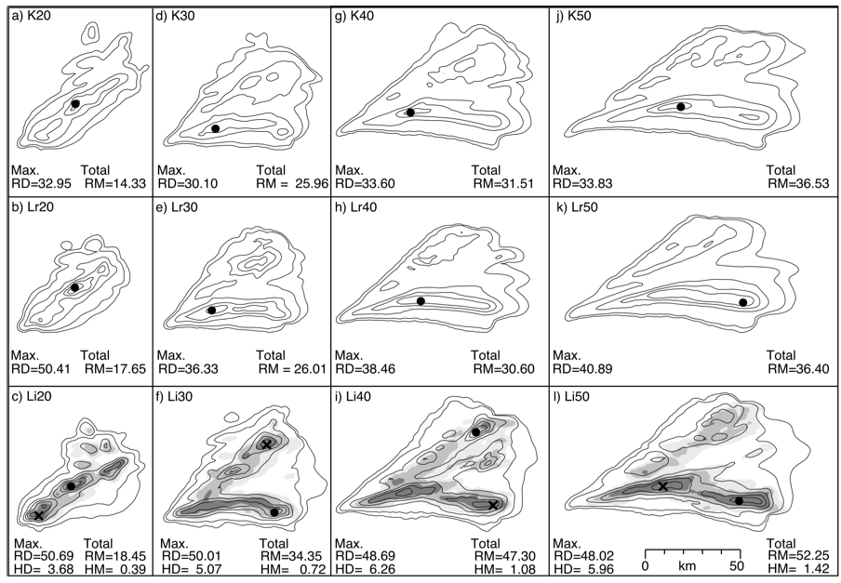
Why do microphysical parameterizations matter?
  Spatial distribution of precipitation
Kessler, Lin (no ice), and Lin (ice)
Gilmore et al. (2004b)

Slide 6
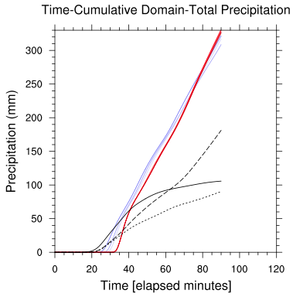
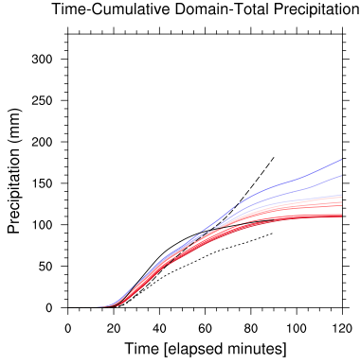

Why do microphysical parameterizations matter?
  Domain-total precipitation
  Behavior can change through the course of development
WRFv3.0.1 WRFv3.2
WRF-Chem responses to total aerosol, v3.0.1 & 3.2
Kaufeld – MS Thesis (2010)

Slide 7
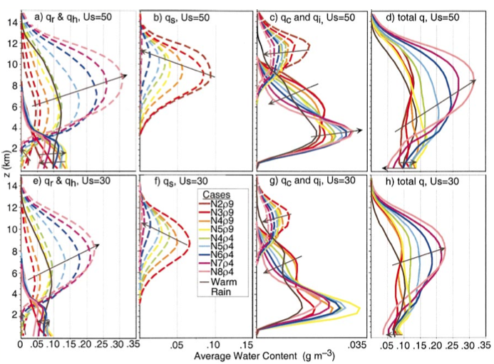
Why do microphysical parameterizations matter?
  Vertical distribution of mass (hydrometeors)
    → Vertical distribution of latent heating
Varying only intercept param. & graupel density, individually
Gilmore et al. (2004a)

Slide 8
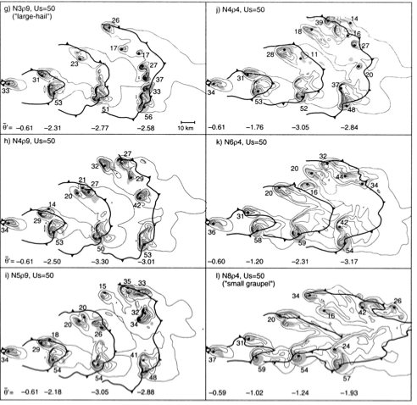
Why do microphysical parameterizations matter?
  Ultimately can dictate evolution of system
Varying only intercept param. & graupel density, individually
Gilmore et al. (2004a)

Slide 9
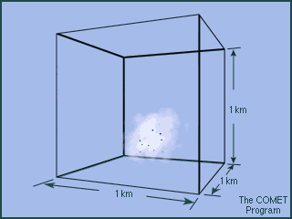
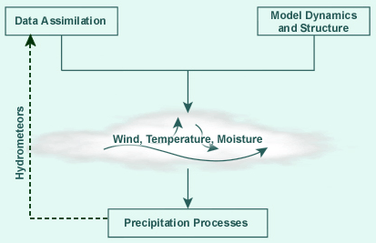
Basics... Terminology
Microphysics:
  An emulation of the processes by which moisture is removed from the air, based on other thermodynamic and kinematic fields represented within a model
  Attempting to accurately account for sub-grid scale updrafts, clouds, and precipitation
Trouble in looking at only one output variable:
illusion of getting it right for the wrong reasons!
Notes:
Hierarchy of model needs to produce “realistic” precipitation: actually other factors are “more” important than mp scheme!!! (Because it depends on the predicted quantities, u,v,T,q)

Slide 10
Basics... Interaction
Convective Parameterizations + Microphysics Parameterizations?
  CP: redistribution of Temperature, Moisture (reduce instability)
    Resolve sub-grid updrafts due to convection
  MP: Limited by CP
  High resolution: convection (updrafts) can be explicity modeled, and no sub-grid emulation of convection is required
    Convective Parameterization obsolete!
    1-2 km resolution reasonable for this assumption, though others suggest much higher resolution may be required (Bryan 2003)
  Results feed back into other schemes: radiation

Slide 11
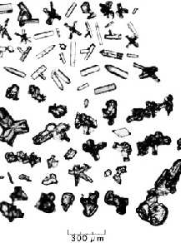
Basics... Terminology
Hydrometeors
  Species (types):
    Cloud Droplets (QCLOUD) – no terminal velocity
    Raindrops (QRAIN)
    Ice Crystals and Aggregates (QICE)
    Rimed Ice Particles, Graupel, Hail (QGRAUP)
  Habits?
  Scales represented?
  Shapes?
Non-hydrometeors:
  Aerosol vs. CN vs. CCN vs IN
  → Not in most WRF configurations
represent this!
Notes:
Habits: where things get interesting.

Slide 12
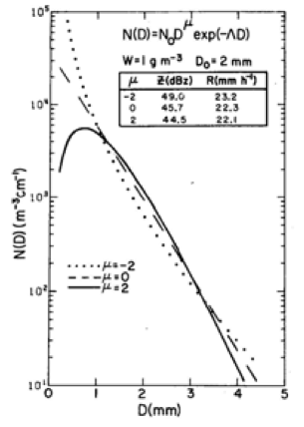
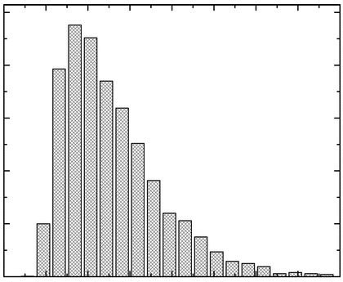
Basics... Representation
How to represent these hydrometeors (and non-hydrometeors)?
  PARTICLE SIZE DISTRIBUTIONS
BULK representation types:
  Inverse exponential (Marshall-Palmer)
  Lognormal
  Gamma function
BIN representation:
  No specified distribution
  Particle distribution divided into a finite number of categories
“Moments”
  1 = mass, 2 = number, 3 = reflectivity
Notes:
Bulk types... Differing degrees of complexity

Slide 13
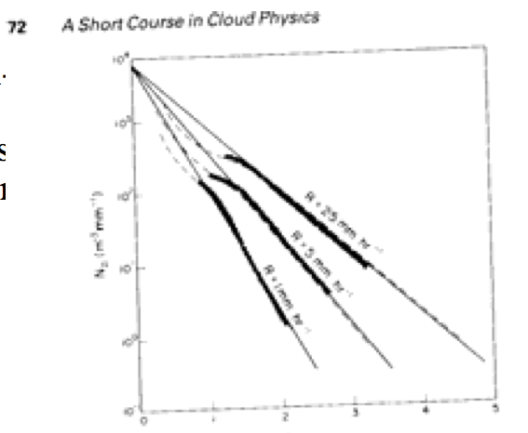
Basics... Representation
BULK representation types:
  Inverse exponential: Marshall and Palmer (1948)
  As rainfall rate increases, so does number of large particles
n (D) = n₀e^{−λD}
0 ≤ D ≤ Dmax
λ= 41 R^{-0.21}, R [mm h⁻¹], λ [cm⁻¹]
N = 8x10⁴ m⁻³ cm⁻¹
N_{D} (m⁻³ mm⁻¹)
  D = particle diameter
  N = # particles per unit volume
  λ = Slope parameter
  n₀ = Intercept parameter (max # of particles per volume at D=0)
Diameter (mm)
In double-moment schemes, this becomes a variable
Raindrops
Snow
Graupel
Hail
Notes:
Represent most hydrometeors in this fashion.
* ONLY MANIFESTS IN AVERAGES: not direct observations

Slide 14
Basics... Representation
BULK representation types:
  Gamma distribution
  Small particle size relies heavily upon μ
n(D) = n₀D^{μ}e^{−λD}
0 ≤ D ≤ Dmax
μ can be positive or negative
N_{D} (m⁻³ mm⁻¹)
  D = particle diameter
  N = # particles per unit volume
  λ = Slope parameter
  n₀ = Intercept parameter (max # of particles per volume at D=0)
Diameter (mm)
In double-moment schemes, this becomes a variable
Raindrops
Snow
Graupel
Hail
Notes:
Represent most hydrometeors in this fashion.
* ONLY MANIFESTS IN AVERAGES: not direct observations

Slide 15
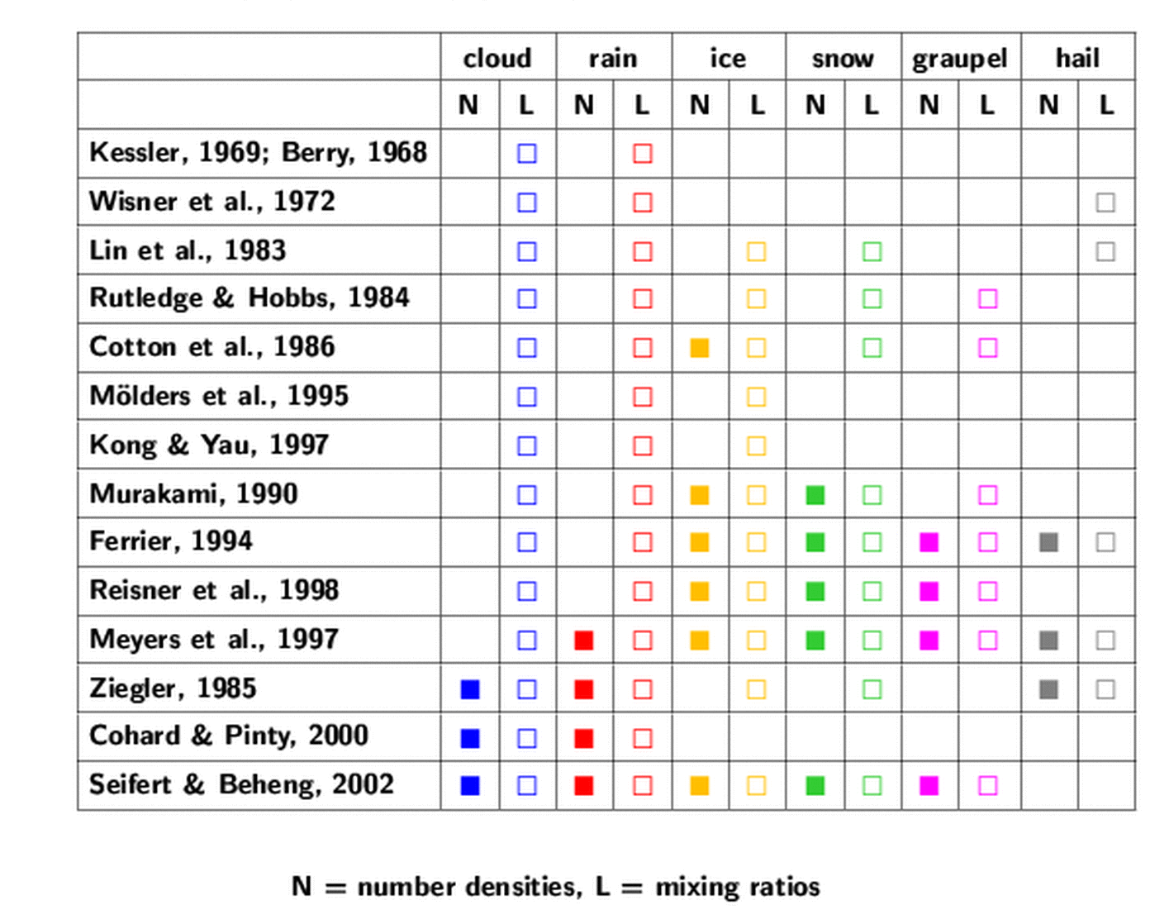
BULK representation types: increasing in complexity!
„Recently the first three-moment scheme
has been published by Milbrandt and Yau (2005)“
→ Stensrud cites one by Clark (1974)
(courtesy Seifert 2006)

Slide 16
Basics... Representation
Bulk Advantages
Bulk Limitations
Fewer number of prognostic variables = Computationally cheap!
Easy to integrate
Tweakable parameters
Cannot represent more than one distribution at a time (different distributions may exist in different parts of the cloud/domain)
“Frozen” distributions for single-moment schemes

Slide 17
Basics... Representation
Bin Advantages
Bin Limitations
More realistic
Processes that depend on size distribution (Terminal Velocity → aggregation) better represented
Represent specific parameterizations & particle interactions
Allows for bimodal (+)distributions – and for them to vary
Very computationally expensive!!!
Difficult to validate
Knowledge of ice phase physics is lacking
essentially, tests the limits of our current scientific understanding and resources

Slide 18
Basics... Representation
Single-Moment Advantages
Single-Moment Limitations
Computationally efficient
Inherent uncertainty due to fixed parameters
  Situational dependence
Double-Moment Advantages
Double-Moment Limitations
Mass and number are independent: can represent different environments!
  Less “parameter-tuning”
Difficult to validate
Mass and Number are independent: very sensible to use with bin scheme

Slide 19
Basics... Representation
What’s “better” for YOUR research –
  a BULK or BIN parameterization?
  SINGLE, or DOUBLE moment (mass, number, both)?
Small Group ACTIVITY
5 minutes: meet with small group
5 minutes: meet with larger group
Pick group spokesperson for larger group
Things to think about...
-- what are you interested in forecasting/representing?
-- what time & spatial scales are important to you?
-- computational resources
Notes:
Habits: where things get interesting.

Slide 20
Ideal MP scheme:
Includes all relevant processes and hydrometeor types
Perfect parameterizations
Infinitely small grid size
  → explicitly resolving each particle
Easy to see why this is not currently possible...
  Parameterizations appear to be situationally dependent
  Limitations on computational power
  So what does WRF have to offer?

Slide 21
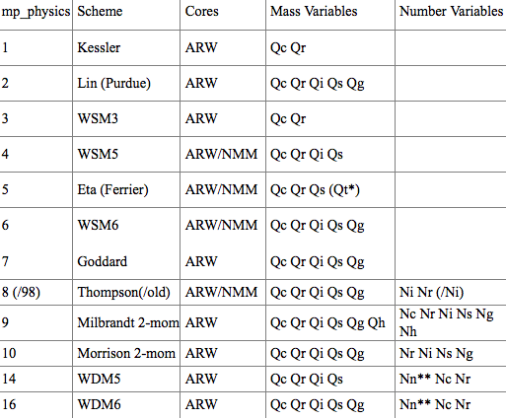
WRF: MP Schemes Available*
ALL BULK SCHEMES
* PUBLICLY available! Many more in development
Notes:
# of hydrometeors
Types of hydrometeors
Consideration of different types of cloud droplets?
HOW MANY OF THESE CAN INCLUDE DEPENDENCE ON AEROSOL?

