Slide 1

Artificial Intelligence Tag Game
Matthew Waters
G00357709
Final Year Project Presentation

Slide 2
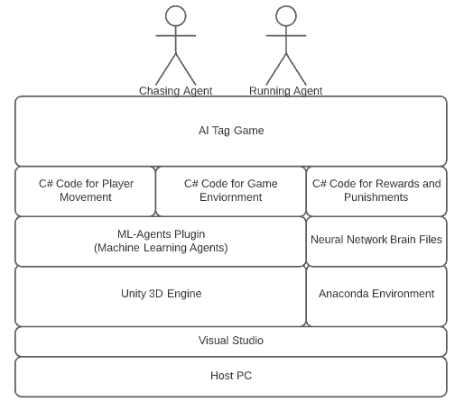
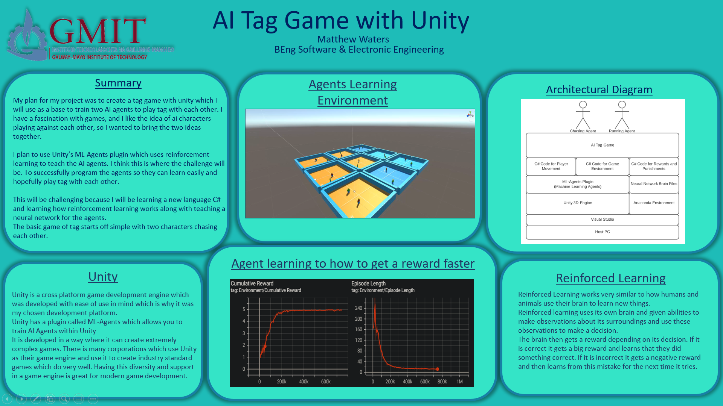
How Does it work?
Unity 3D Engine used as the environment where AI agents will be learning.
Paired with the ML-Agents plugin which powers the reinforcement learning.
Anaconda virtual environment to host the virtual Python environment for Python libraries.
All code written with Visual Studio in the C# language as that is what Unity supports.

Slide 3
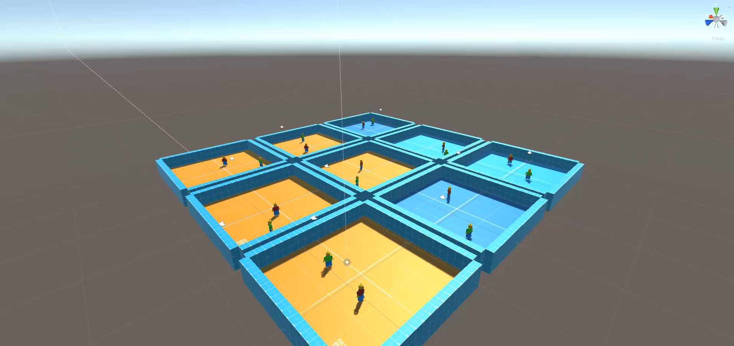
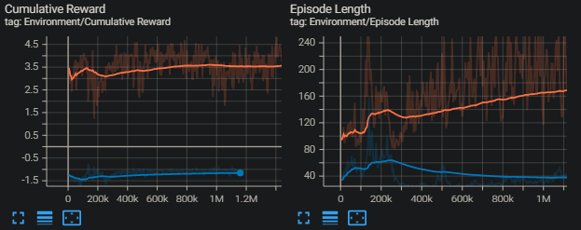
What have I accomplished?
Two AI Agents using reinforcement learning to teach themselves how to play tag with each other.
Multiple environments to speed up learning.
Specific reward system for each agent.
Colour changing for feedback.
Witnessed how they tried to outsmart each other.
AI is endless with unlimited potential.
Machine learning will surprise you.
Discovered a new area which I wish to further develop in.
Enthusiastic to continue this project and increase its complexity.

Slide 4
Thanks For Listening
Any Questions?

