Slide 1
Cross-Platform Mobile Web:
PhoneGap and BlackBerry Widgets
Michael Brooks
Nitobi

Slide 2
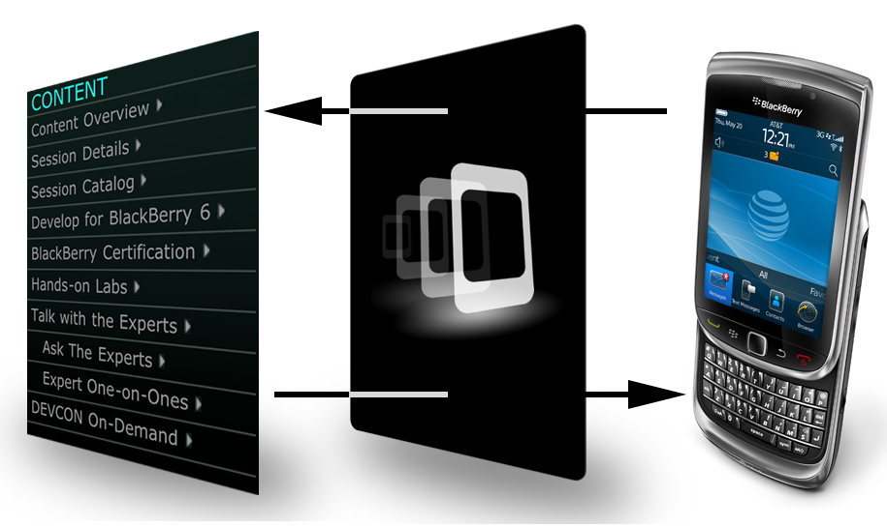
PhoneGap
Native Application using
PhoneGap Library
Web Browser
Mobile Device

Slide 3
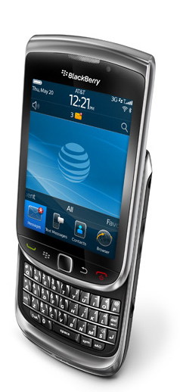
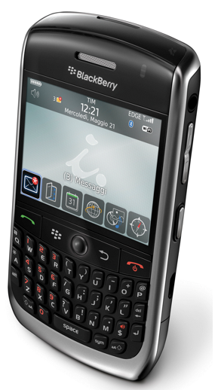
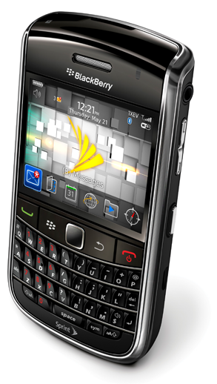
PhoneGap BlackBerry
OS 4.6
Java SDK
BrowserField
OS 5.0
Widget SDK
BrowserField2
OS 6.0
Widget SDK
WebKit

Slide 4
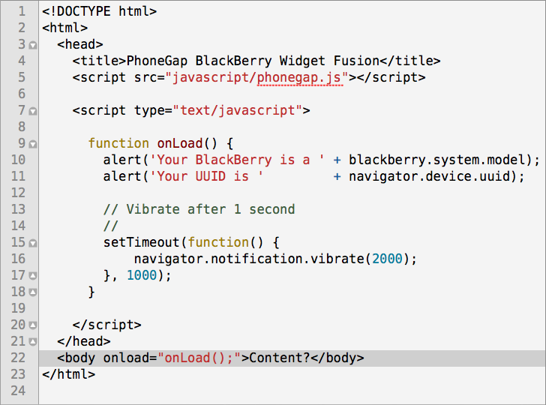
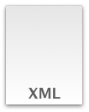


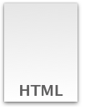
PhoneGap BlackBerry Widget
config.xml
phonegap.jar
phonegap.js
index.html

Slide 5
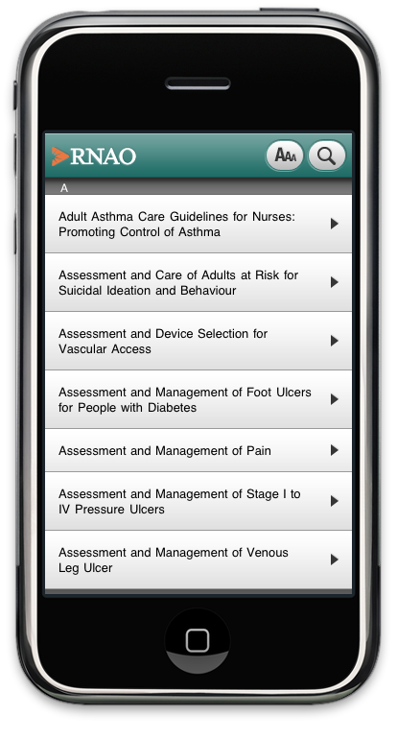
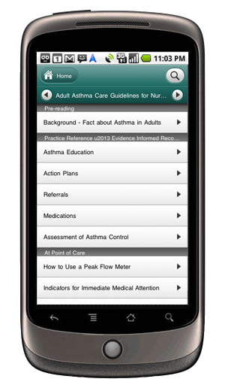
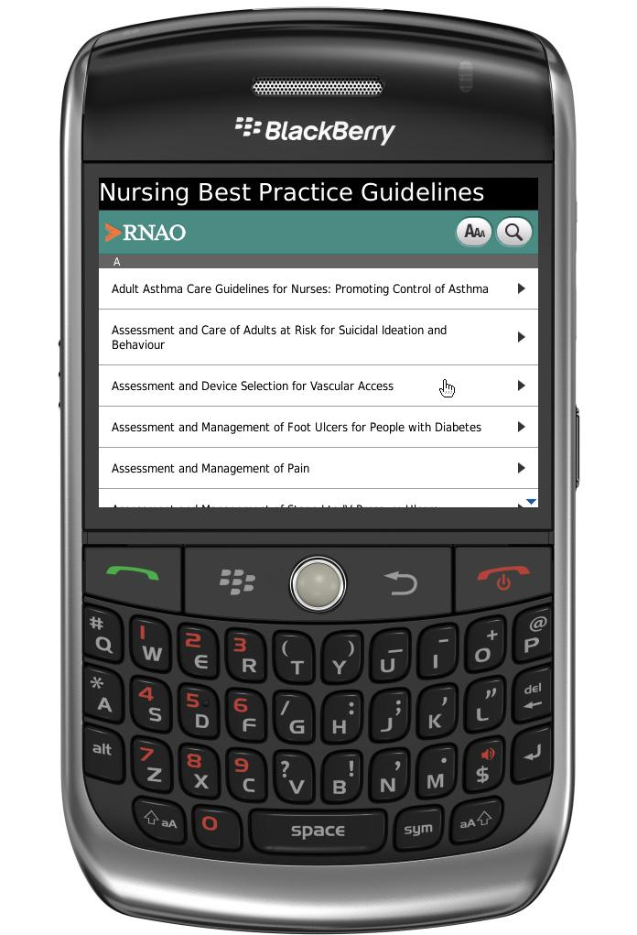
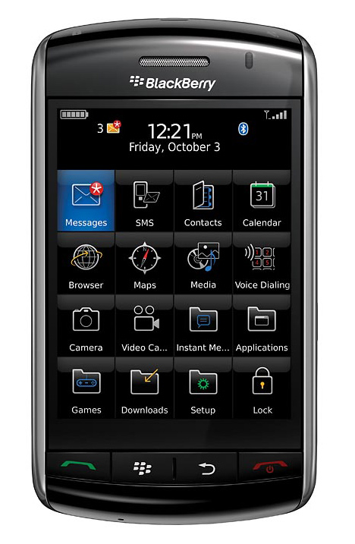
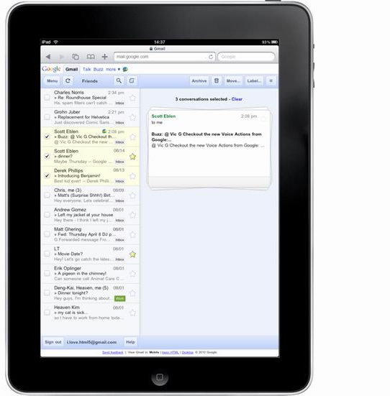
Case Study: RNAO

Slide 6
Case Study: RNAO
Libraries
  qUnit (http://docs.jquery.com/QUnit)
  XUI (http://github.com/brianleroux/xui)
  Lawnchair (http://github.com/brianleroux/lawnchair)
PhoneGap Plugins
Progressive Enhancement

