Slide 1

Porting to BlackBerry
using Apache Cordova
DEV141
Gord Tanner (@gordtanner) Michael Brooks (@mwbrooks)
May 1, 2012
Notes:
Gord

Slide 2

What is …
Notes:
M

Slide 3
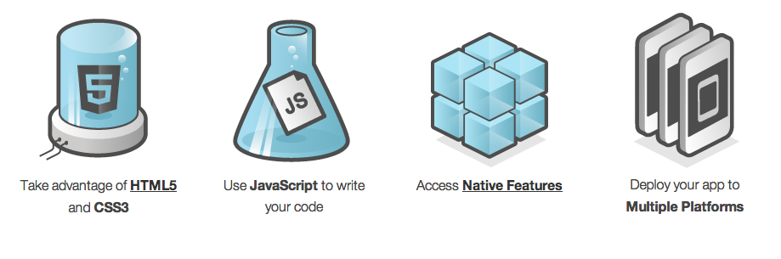
What is …
Notes:
Deploy to many Devices

Slide 4

You may know it as …

Slide 5

Wikipedia Port Demo
Notes:
G

Slide 6
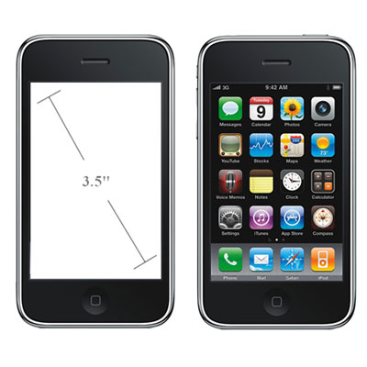
iOS
Notes:
320x480
M

Slide 7
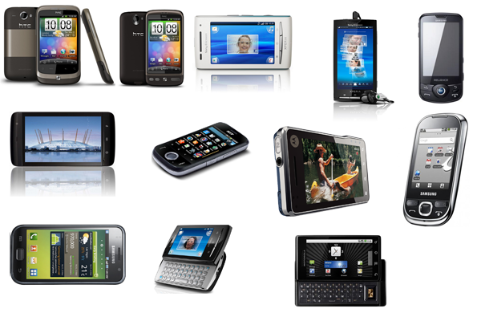
Android

Slide 8
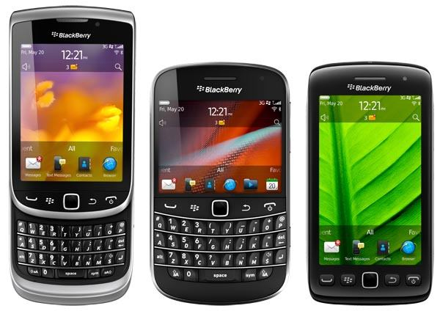
BlackBerry

Slide 9

Be Agnostic …
It will look right at first, but
When people look deeper
The will only see
what is wrong

Slide 10
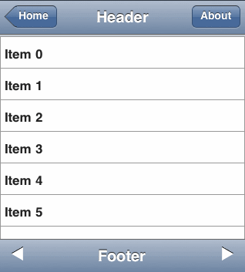
Looks Weird on BlackBerry …

Slide 11
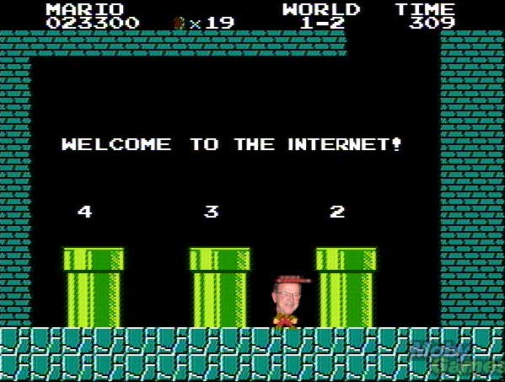
We’ve Solved this Already …
Notes:
Lucky for us we are from the internet
Solved with patterns that naturally emerged
Side – Navigation
Top – Navigation
hover

Slide 12

HTML 5 Makes it Easier …
Notes:
Our tools are awesome at this!

Slide 13
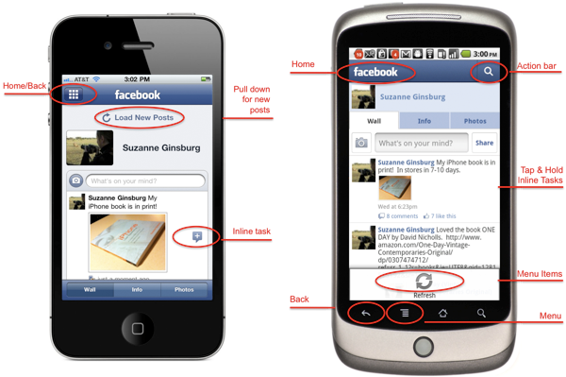
Platform UI Guidelines …
Notes:
G
Small differences but very important

Slide 14
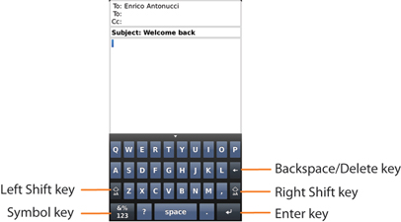
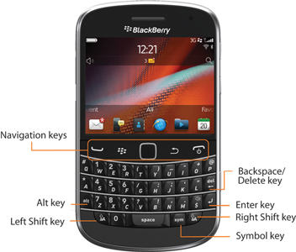
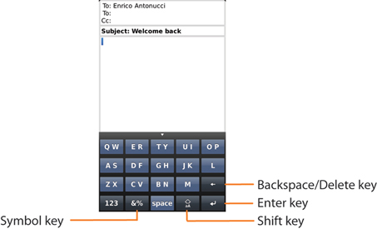
OS7

Slide 15
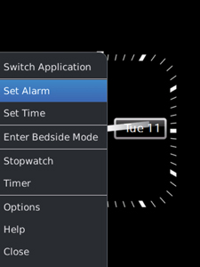
Menus

Slide 16
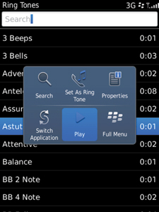
Menus
Notes:
Quick menu

Slide 17
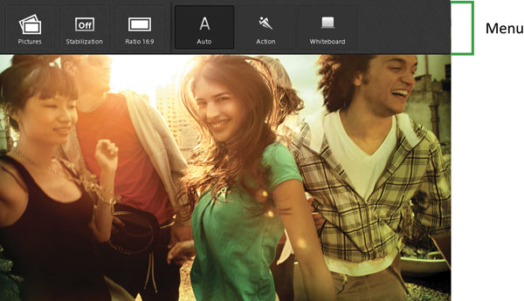
PlayBook
Notes:
Ported wikipedia app to playbook

Slide 18
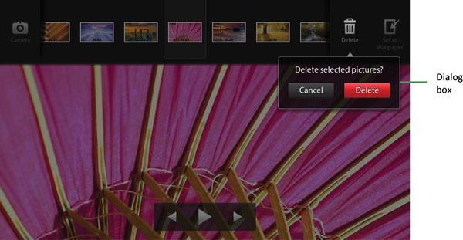
Notes:
Ported wikipedia app to playbook

Slide 19

bbUI.js
https://github.com/blackberry/bbUI.js
Notes:
Ported wikipedia app to playbook

Slide 20
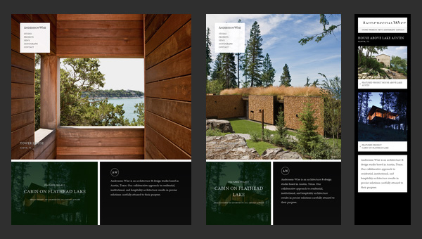
Responsive Web Design …
http://www.anderssonwise.com/
Notes:
M

Slide 21
Quick Preview …
http://responsive.is/

Slide 22
CSS Media Queries - No Magic …
#button { width: 25%; }
@media screen and (max-width: 480px) {
#button { width: 100%; }
}

Slide 23
Many Samples …
http://mediaqueri.es/

Slide 24
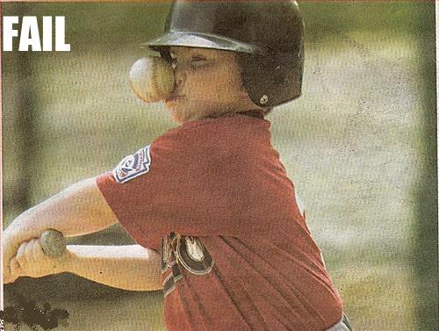
Cross-Platform Gotchas …
Interaction
Mouse Events
Touch Events (thumbs.js)
CSS Performance
JavaScript Performance
Notes:
Large images hurt the device
Maximum XHR

Slide 25
THANK YOU
DEV141
Gord Tanner (@gordtanner)
Michael Brooks (@mwbrooks)
May 1, 2012

