Slide 1
Farm Visit Lessons Learned
Rincon · Apricot Lane · Wanderment — implications for Summerland Farm
Max Buford · July 2026

Slide 2
Agenda
• Three farms (closest peer first): Rincon → Apricot Lane → Wanderment
• Market pricing: Index Fresh vs Rincon Hass + passionfruit grades
• Home ranch contrast — Summerland / Ortega Ridge erosion & opportunity
• California evidence: soils, organic, pests, crop replacement
• Decide: Tier A/B priorities → fund (grants) → staff (Armando + area lead)

Slide 3
Three farms at a glance
Rincon
Apricot Lane
Wanderment
Packing + avocado peer
Full regenerative system
Small regen + agritourism
• On-site packing house
• Avocados & exotics
• Wholesale + local sales
• Hillside orchard peer
• Organic & biodynamic
• ~234 acres, diverse crops
• Animals as managers
• Fertility center & tea
• Cardboard + mulch
• Olives / garden / avocados
• Animals + visitor revenue
• Friday produce boxes

Slide 4
RINCON FARMS
Carpinteria · avocado orchard + packing house

Slide 5
Rincon — operations takeaways
• Hedgerows along roads for erosion control and buffers
• Cover crops (and wildflowers) in avocado understory
• On-site packing for avocados & exotic fruit
• Wholesale channels plus local sales

Slide 6
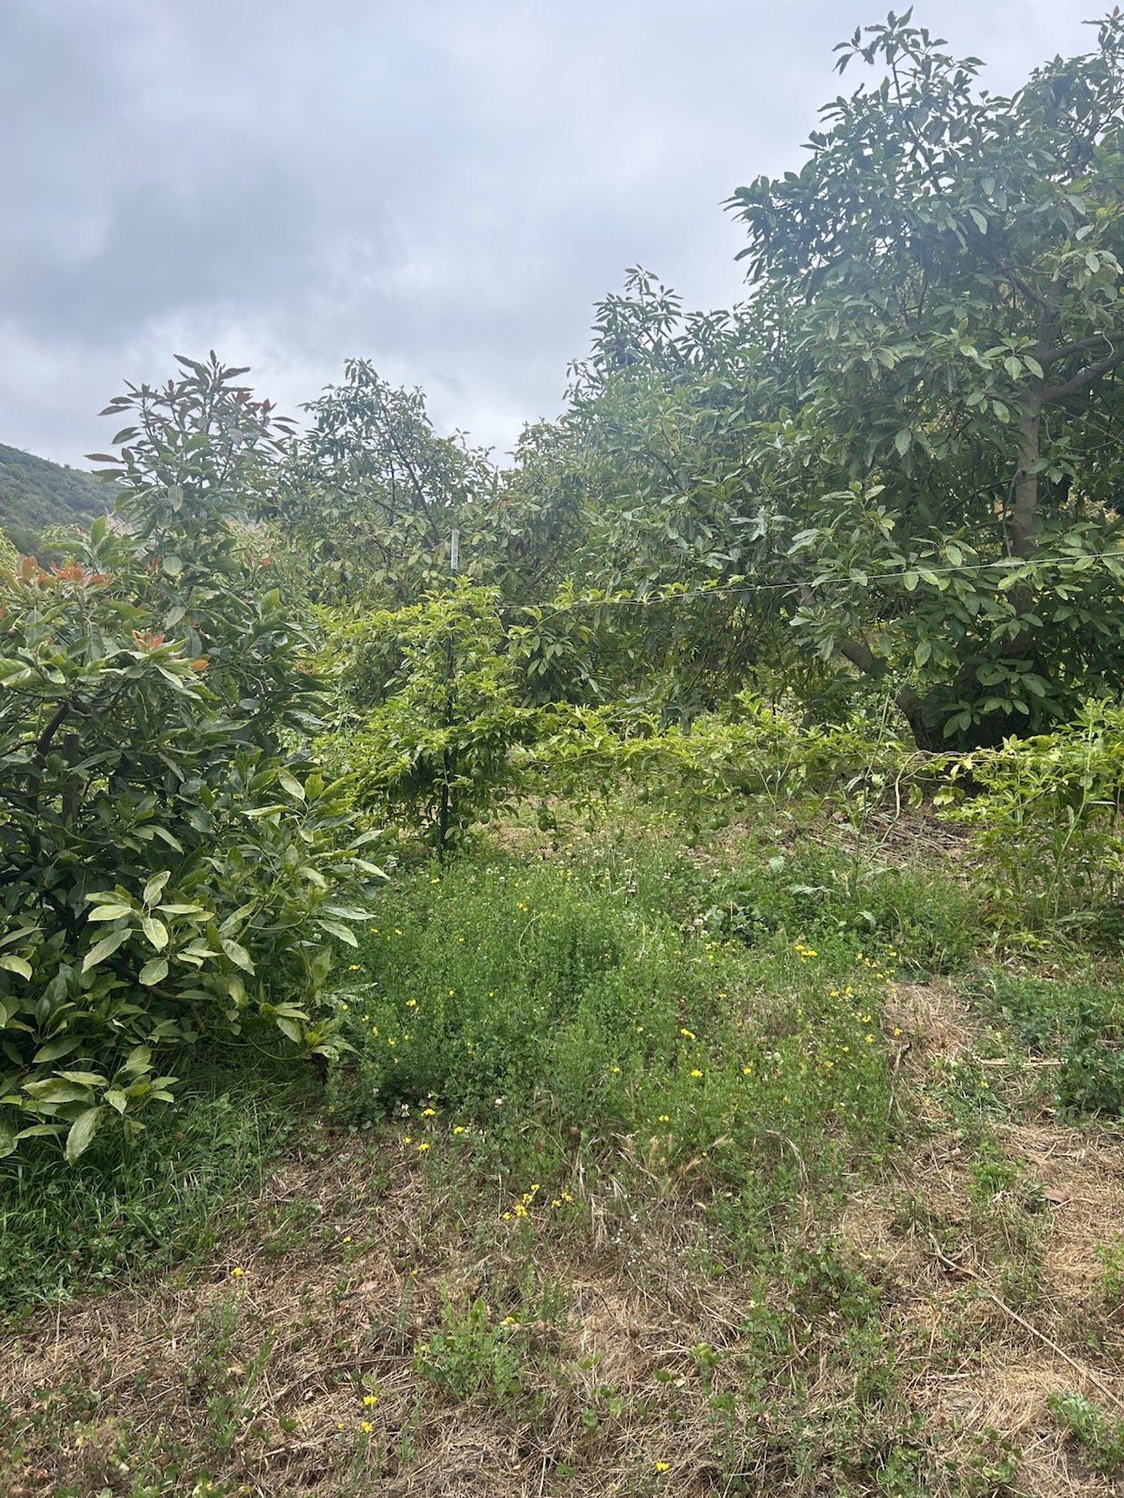
Cover crop & wildflowers under avocados

Slide 7
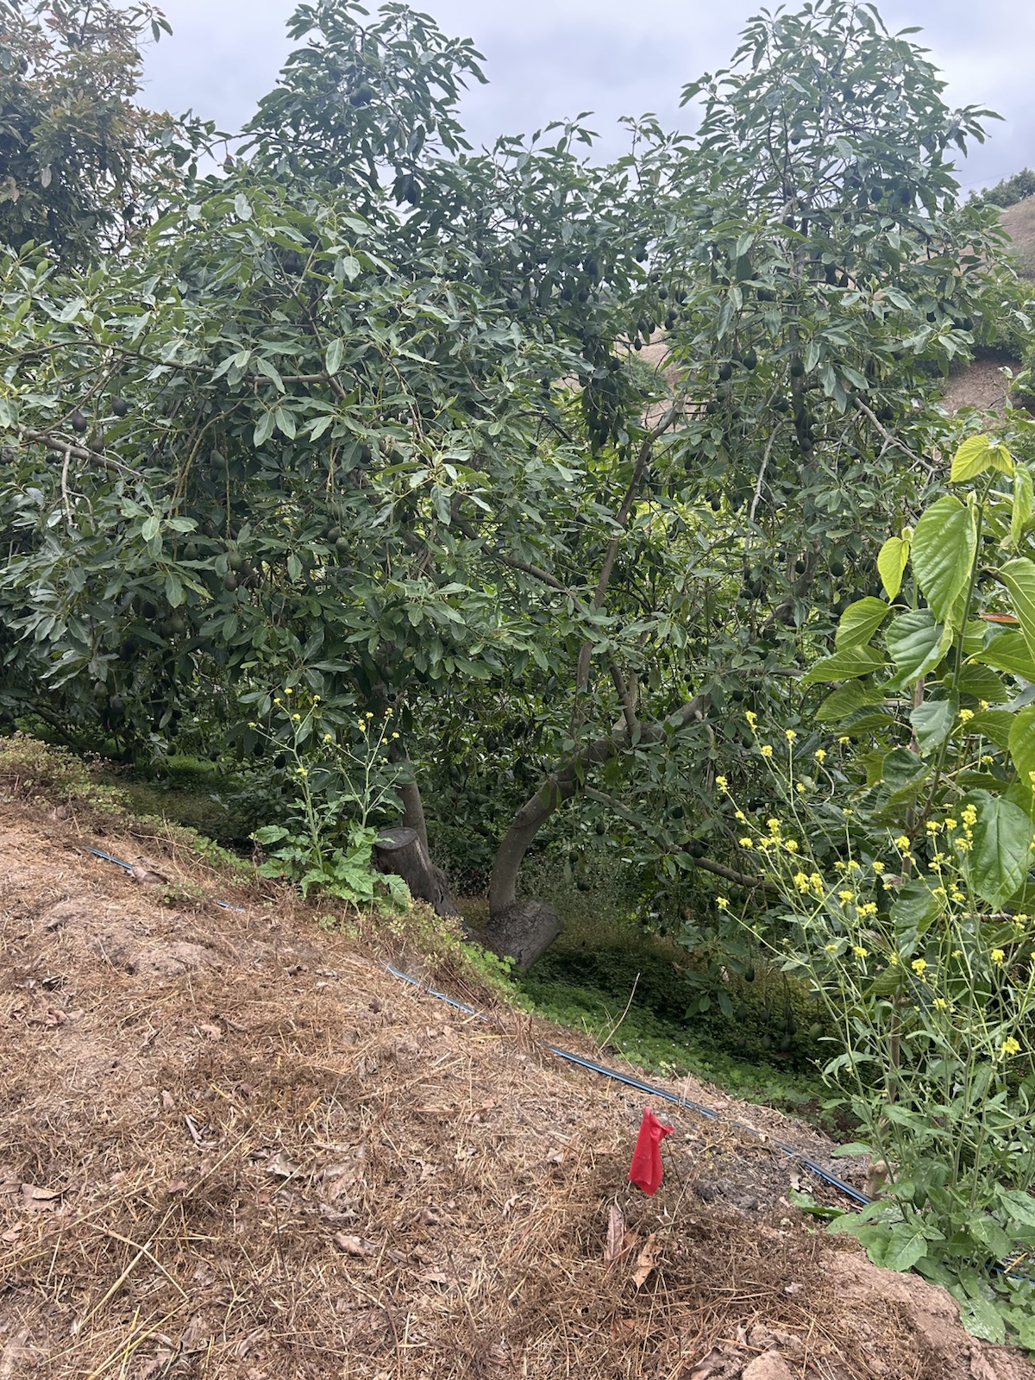
Bearing avocado grove

Slide 8
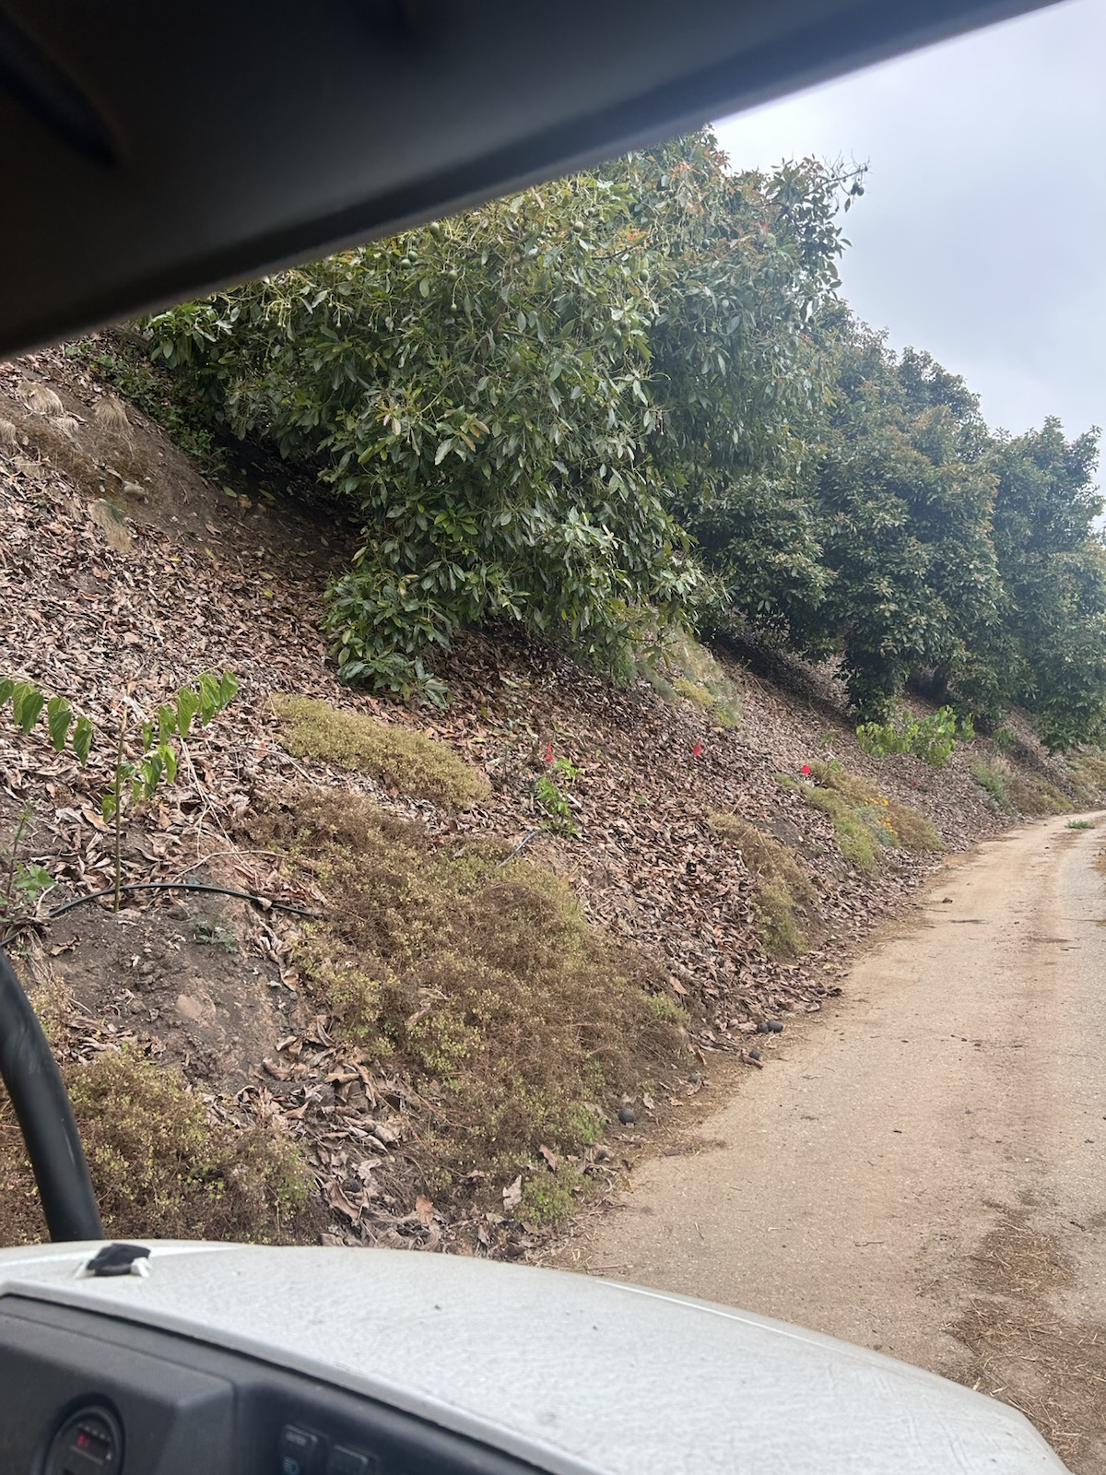
Hillside orchard with mulch & irrigation

Slide 9
MARKET PRICING
Index Fresh Fresh Facts · Rincon Farms field sheet · Passionfruit grades

Slide 10
Hass $/lb — Index Fresh vs Rincon Farms
Index Fresh = Fresh Facts mid (7/21/26) · Rincon = field price sheet (7/29–30/26) · Δ = Rincon − Index mid
Size | Index Hass | Rincon Hass | Δ Hass | Index Organic | Rincon Organic | Δ Org
32 | $1.14 | $1.30 | +$0.16 | $1.38 | $1.50 | +$0.12
36 | $1.14 | $1.30 | +$0.16 | $1.38 | $1.50 | +$0.12
40 | $1.14 | $1.30 | +$0.16 | $1.46 | $1.55 | +$0.09
48 | $1.18 | $1.32 | +$0.14 | $1.60 | $1.64 | +$0.04
60 | $0.90 | $0.90 | $0.00 | $1.46 | $1.50 | +$0.04
70 | $0.70 | $0.70 | $0.00 | $1.26 | $1.30 | +$0.04
84 | $0.54 | $0.60 | +$0.06 | $0.98 | $0.60 | −$0.38
Takeaway: Rincon quotes a premium on large Hass (32–48). Mid/small (60–70) match Index. Organic 84s are the outlier — Index still much higher than Rincon’s posted $0.60.

Slide 11
Passionfruit grades + market notes
Passionfruit — $/lb by grade
Rincon sheet — market notes (7/29–30)
#1 · $6.00 / lb
• Mexican fruit trending smaller → build-up of 60s and smaller
• Strong demand for California fruit; market steady
• Large sizes strong
• Flor Loca peaking on 60s and smaller (low oil)
• Peru sending ~11M lbs — above CA inventory
• Use with Index Fresh trends on the dashboard for packer vs peer quotes
No wrinkles — smooth fruit
#2 · $2.00 / lb
Wrinkled, scratched, ripe & edible
#3 · $0.50 / lb
Very rough shape, sunburned, overripe

Slide 12
APRICOT LANE FARMS
Moorpark · Organic & Biodynamic · ~234 acres

Slide 13
Apricot Lane — operations takeaways
• ~17 commercial crops in focus (visit note); 200+ varieties marketed
• Animals as landscape managers (not just products)
• Compost tea + vermicompost at the Fertility Center
• Dedicated pollinator / habitat land woven into the farm

Slide 14
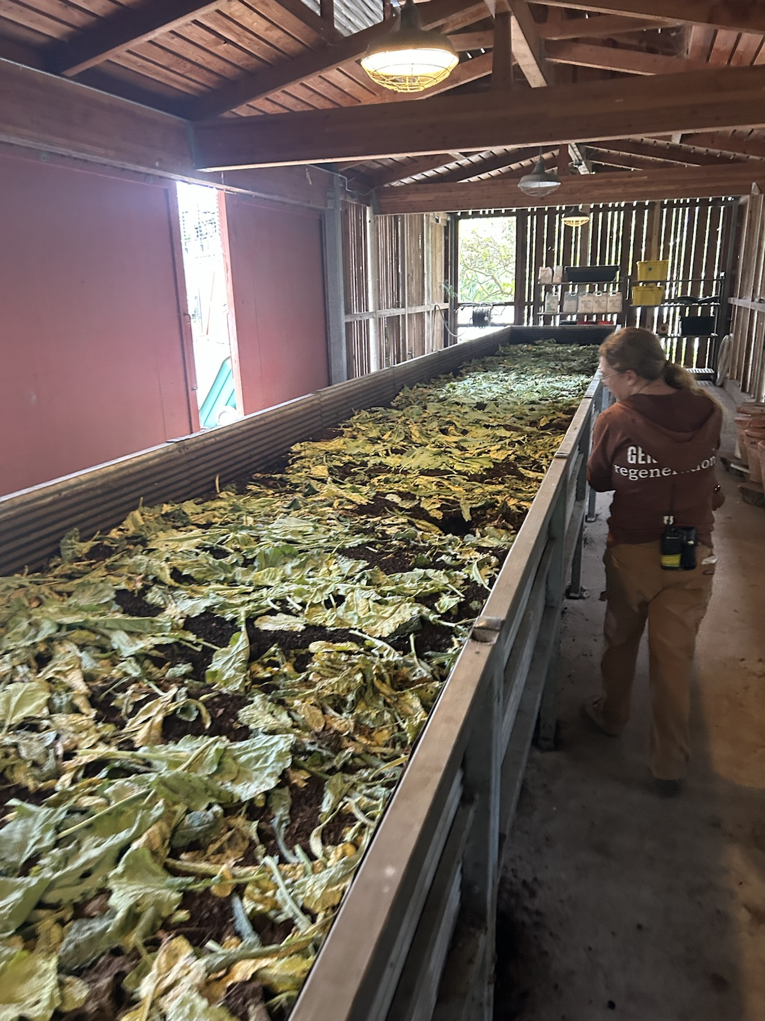
Fertility Center — vermicompost

Slide 15
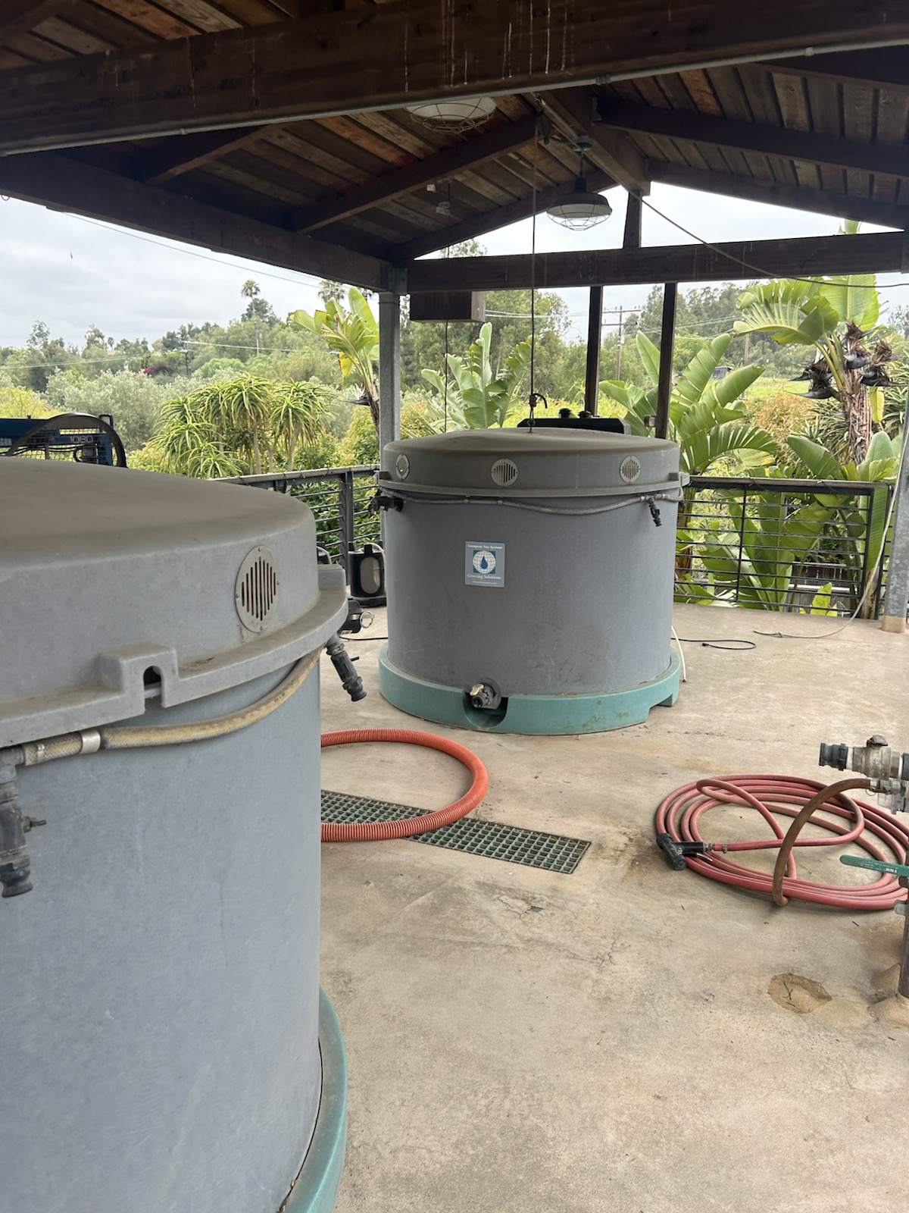
Compost tea brew system (Growing Solutions)

Slide 16
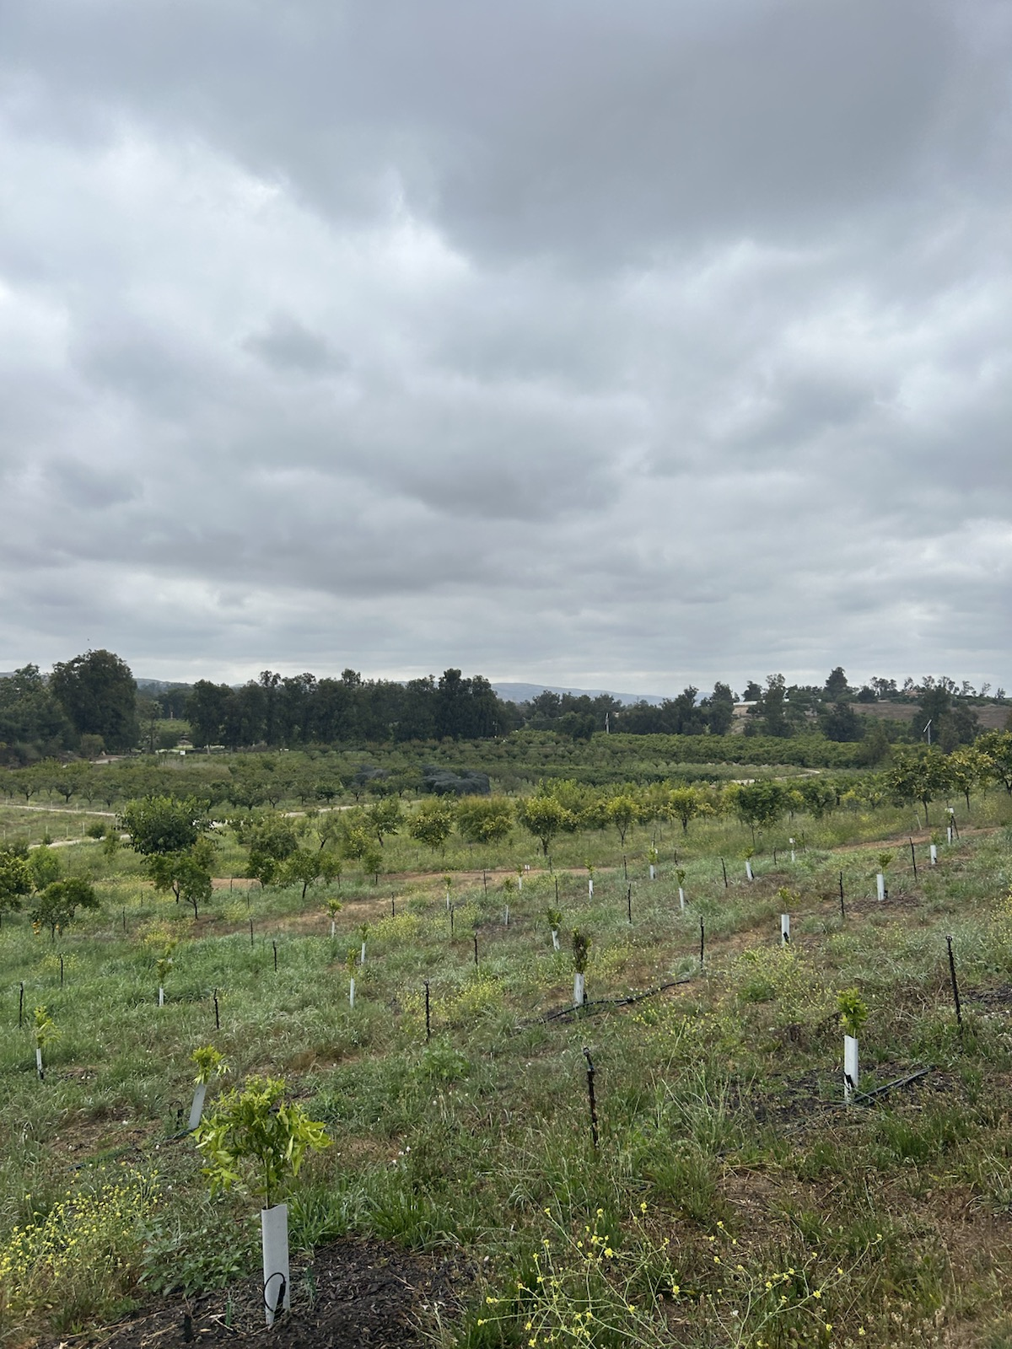
New plantings with living ground cover

Slide 17
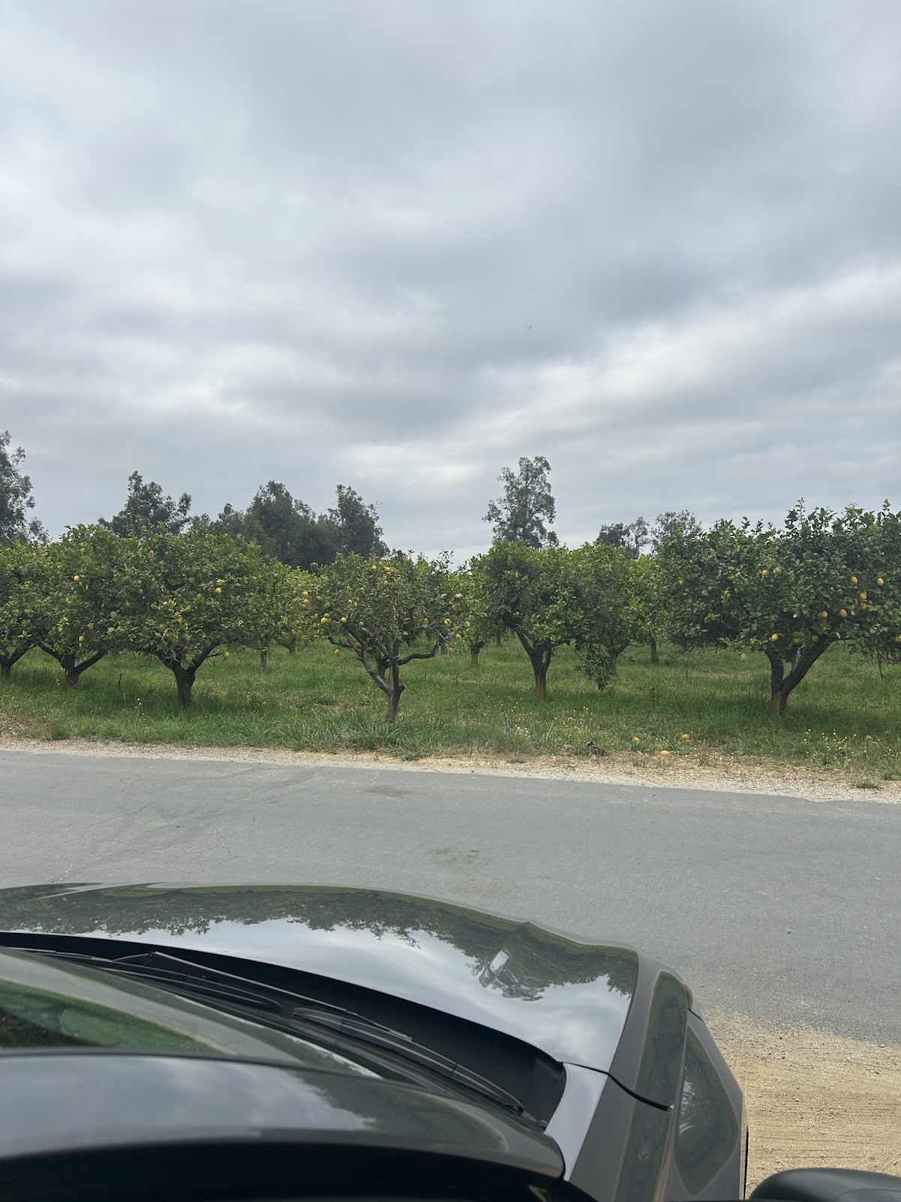
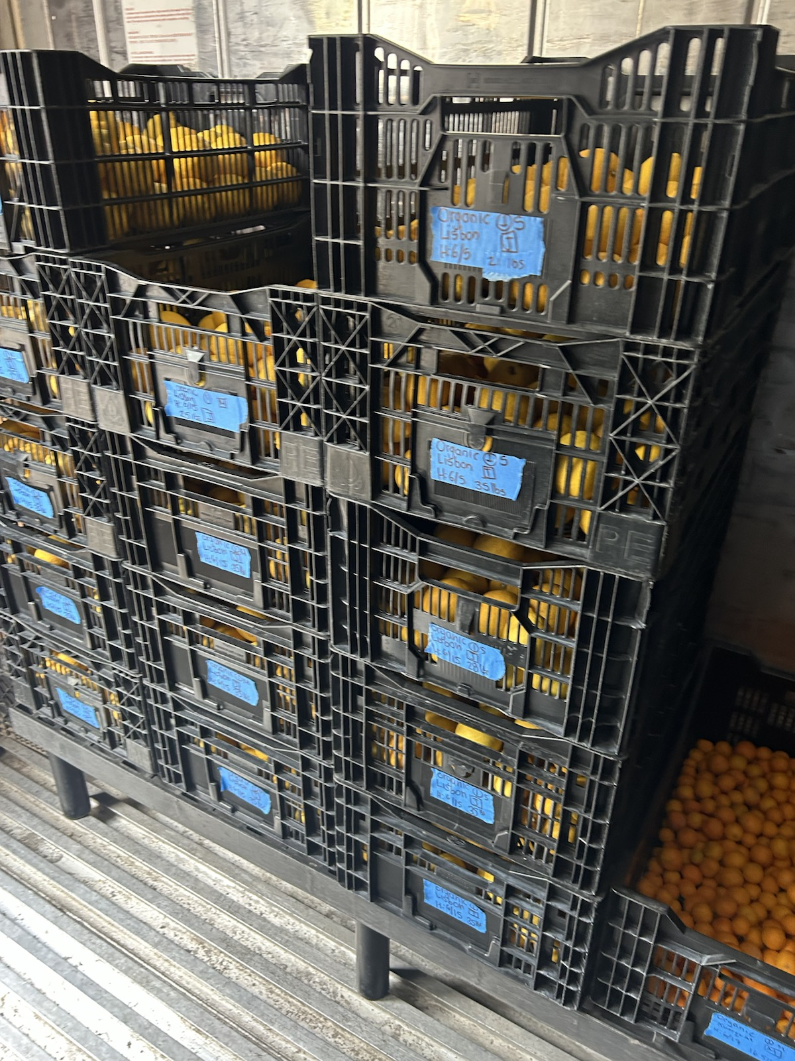
Packing / organic Lisbon lemons

Slide 18
WANDERMENT FARMS
Toro Canyon / Carpinteria · smaller regenerative model

Slide 19
Wanderment — operations takeaways
• Cardboard + mulch for weed kill on bare ground
• Olives, garden, and avocados at compact scale
• Animals + agritourism as meaningful profit centers
• Friday produce boxes — a “small Apricot Lane” feel

Slide 20
Wanderment — practices to note
Practices summarized from visit + wandermentfarms.com · no dedicated photo set
Weed suppression
Crop mix
Cardboard + deep mulch to kill weeds without herbicides
Olives, market garden, and avocados at a smaller regenerative scale
Animals + visits
Direct sales
Livestock + agritourism as profit centers alongside produce
Friday produce boxes — “small Apricot Lane” model

Slide 21
COMPOST TEA
What we saw at Apricot Lane — and how Summerland could pilot it

Slide 22
Compost tea — what it is (and isn’t)
Definition
Why farms use it
• Liquid extract / brew of finished compost applied as a soil drench or foliar spray
• Goal: move beneficial biology + soluble nutrients onto the orchard floor or canopy
• Not the same as raw compost leachate dripping from a pile (don’t spray that on food crops)
• Apricot Lane: Growing Solutions-style aerated brew system next to the Fertility Center
• Supports living soil after compost / vermicompost programs are in place
• Potential plant vigor and disease-suppression benefits when brew quality is consistent
• Fits organic / biodynamic fertility loops without synthetic foliar feeds
• Works best as part of a system (compost + cover + mulch) — not a standalone fix
Sources: Apricot Lane visit (Growing Solutions brew); UVM / MOFGA compost-tea primers.

Slide 23
Compost tea — benefits, limits, and food safety
Promising outcomes
Hard constraints
• Research reviews: can improve growth, yield/quality, and suppress some diseases when well formulated
• Best results usually come with good compost feedstock + consistent brew protocol
• Pairs with vermicompost / compost programs (Apricot Lane Fertility Center model)
• Useful learning tool for crew: makes soil biology visible and operational
• Results are variable — efficacy is still a research “black box” without standardized protocols
• Food safety: sugar additives (e.g. molasses) can grow E. coli / Salmonella in the brew
• NOP guidance: potable water; properly heated compost; avoid untested additives on food crops
• Labor + equipment: tanks, aeration, filtration, spray logistics — not free
Sources: Environmental Technology & Innovation CT fruit-tree review (2026); USDA ARS pathogen studies; NOP / UVM food-safety notes.

Slide 24
Compost tea for Summerland — pilot recommendation
• Sequence: lock Tier A ground cover / mulch / compost first — tea is Tier B, not day-one
• Start small: one aerated brewer on a trial avocado block; soil drench preference over foliar until protocol is proven
• Safety rules: finished hot compost only, potable water, no molasses/sugar additives unless lab-tested batches
• KPIs before scaling: tree vigor scores, disease notes, labor hours/brew, cost per acre vs. solid compost alone
• People: area lead + Armando own the SOP; don’t hand an untrained intern the brew alone

Slide 25
What the three farms taught us
• Rincon: hedgerows + cover crops + packing access work on the same coastal hills we farm
• Apricot Lane: fertility, animals, and habitat are a system — copy pieces, not the whole capital stack
• Wanderment: cardboard+mulch and direct sales scale down to a smaller regenerative op
• Common thread: ground cover, living edges, and a clear market channel beat bare soil + wholesale-only

Slide 26
HOME RANCH
Summerland / Ortega Ridge · photos from SB Farms set

Slide 27
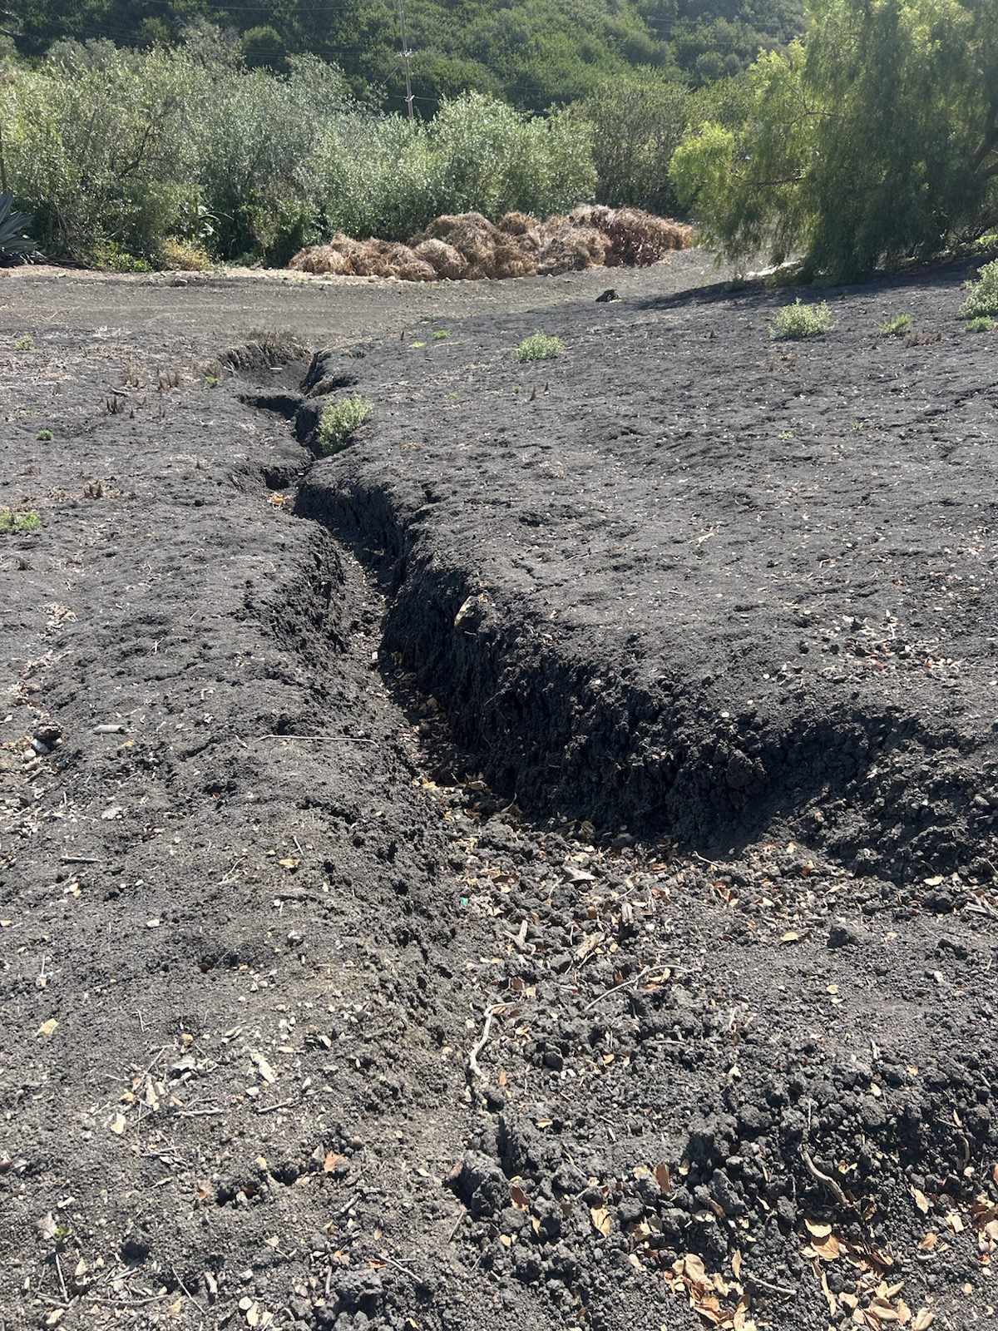
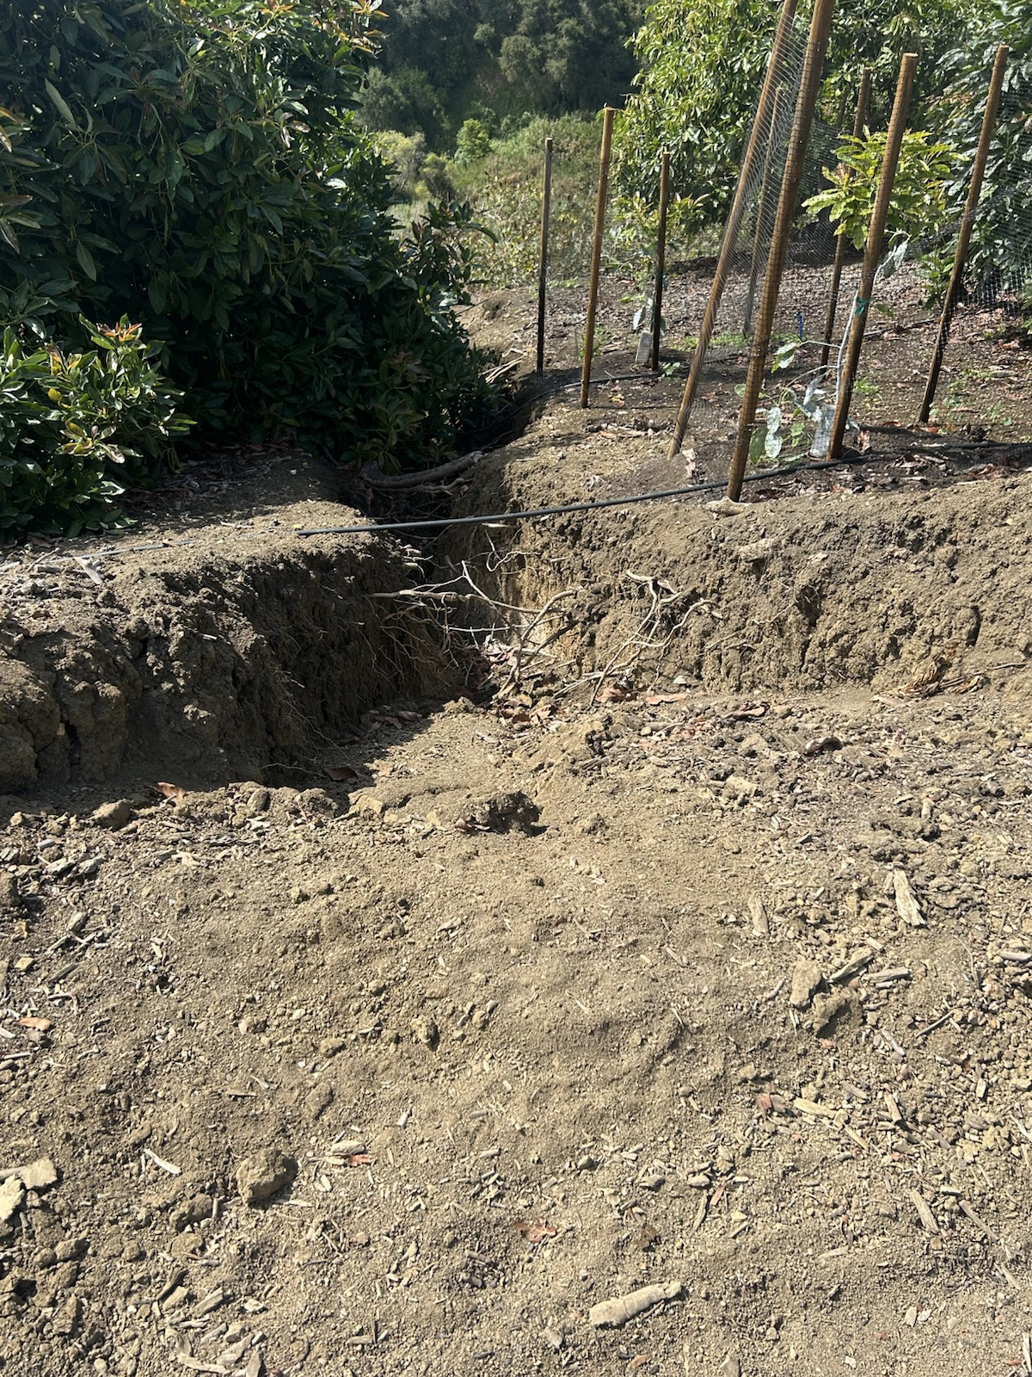
Erosion problem — bare soil and runoff channels

Slide 28
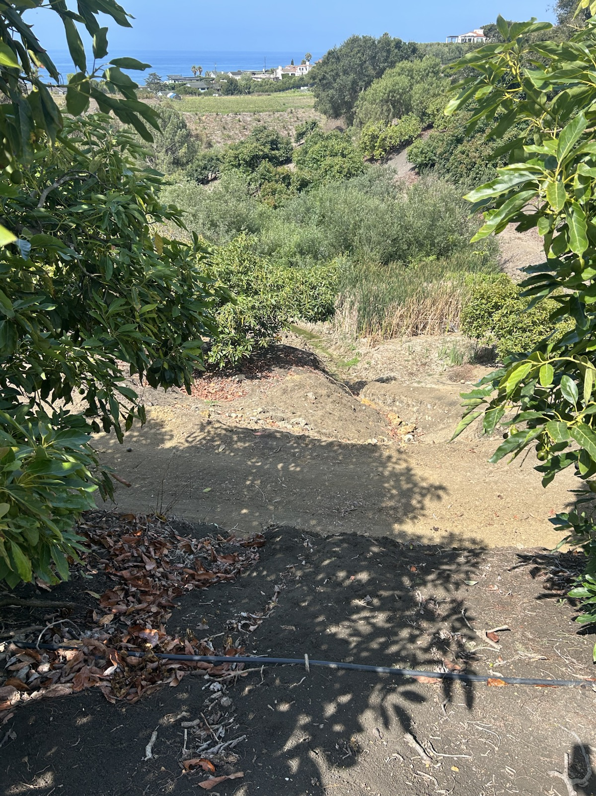
Same coastal hills, different management choices

Slide 29
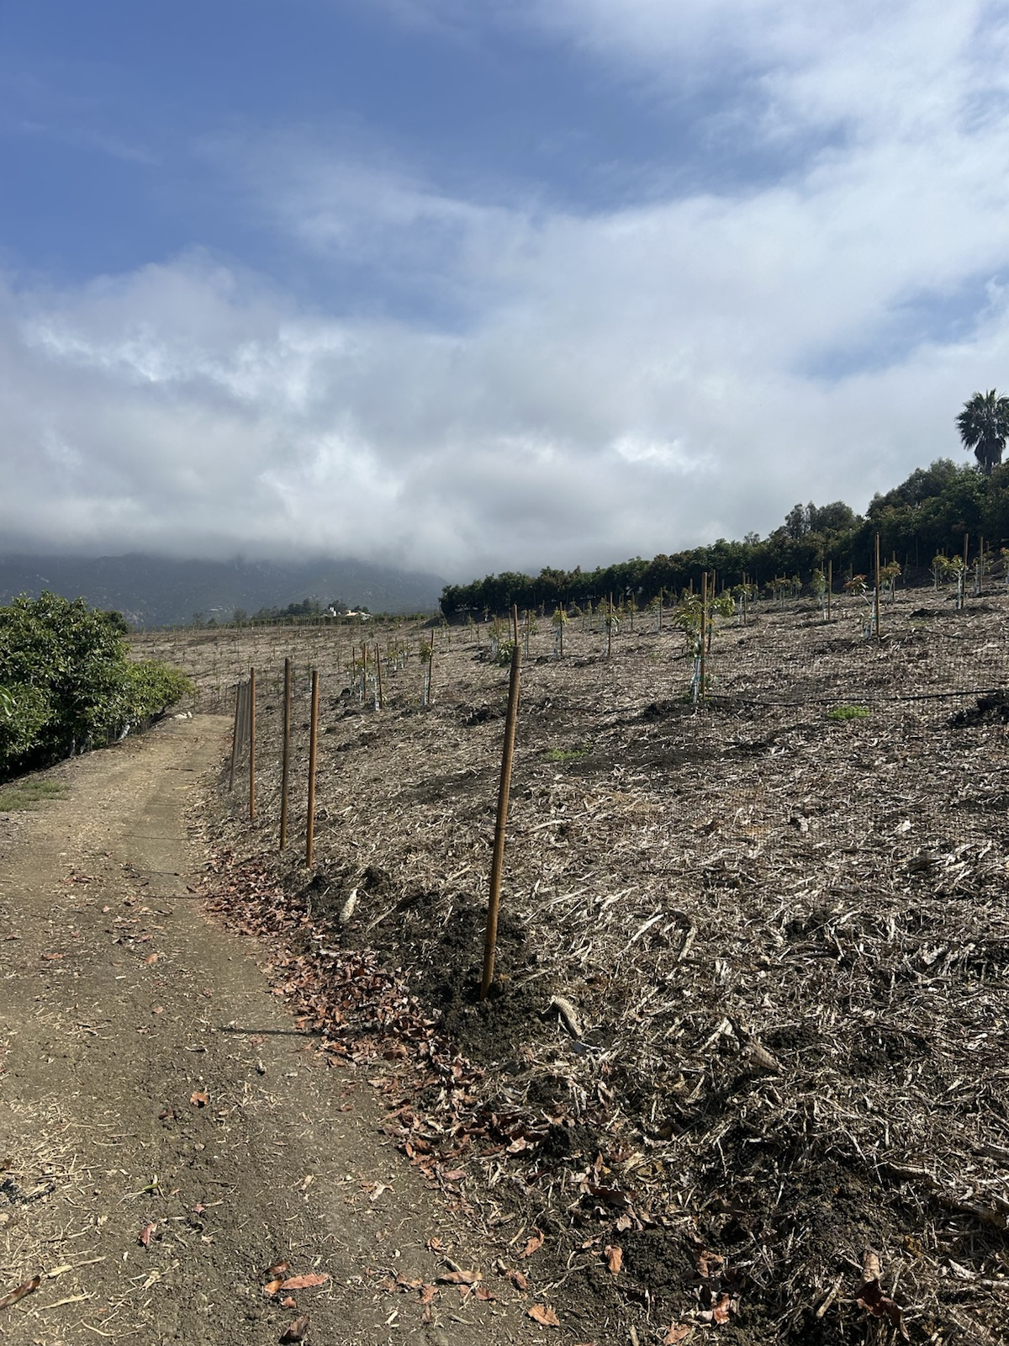
Mulch already in use — expand this

Slide 30
CALIFORNIA EVIDENCE
Outside research that backs what the visits showed

Slide 31
Cover crops in CA avocado orchards — proven benefits
UCCE (Faber / Rowe-Fish)
What Ventura growers report
• Better soil structure & less compaction
• Less erosion from wind and rain
• More organic matter & nutrient cycling
• Weed suppression + habitat for beneficials
• Better infiltration & soil moisture storage
• Rain capture → salt leaching & drought resilience
• Dramatic runoff reduction after adopting covers
• Soil OM can climb from very low baselines over years
• Mixes beat single species (e.g. triticale + faba + daikon)
• Hillside CA literature: runoff −23–77%; erosion −50–75% vs bare
Sources: UCCE Topics in Subtropics; CAC Cover Crop Panel; UC Cover Crops Resources

Slide 32
Cover crops — what’s working in coastal SoCal
• Seed after first rains (not hot/dry Oct–Nov) — watch the weather window
• Prefer winter covers on rainfall; terminate before they fight summer irrigation
• Frost risk: avoid tall early covers; seed later (often Jan) if frost-prone
• Skip clover-heavy mixes if gophers are already severe in young blocks
• Leave residue as mulch when possible; grazing OK if food-safety windows allow
• CDFA Healthy Soils funds cover crops, hedgerows, mulch, compost in orchards

Slide 33
Going organic — revenue side (CA avocados)
Market signals
What it means for Summerland
• ~10% of CA avocado crop estimated organic (2025)
• ~15% organic FOB premium vs conventional (often higher when conventional prices soften)
• U.S. organic avocado volume sales +19% vs 2023
• CA crop ~375M lbs projected (2025) — organics a retail growth driver
• Santa Barbara among top-5 avocado counties (~6,844 mapped acres, 2025)
• Premium is real but not automatic — needs certification + channel
• Index Fresh / specialty retail / DTC each price organic differently
• Pair organic path with soil practices that cut water/erosion risk
• Transition years: budget for higher weed/labor costs before premium sticks
Sources: Organic Produce Network 2025; CAC Statewide Mapping 2025; CDFA Organics Report 2023–24

Slide 34
Organic vs non-organic — revenue mechanics (what changes P&L)
Potential upside
Transition pressure points
• Market premium: CA organic avocado often carries a meaningful FOB premium (~15% recent signal)
• Brand/channel upside: organic + local story can widen access to specialty retail and DTC
• Input substitution upside: over time, better soil function can lower some purchased-input intensity
• Grant leverage: CDFA Healthy Soils can offset transition-practice costs (cover, hedgerow, mulch, compost)
• Certification + recordkeeping overhead (management time and audits)
• Weed pressure/labor often rises first before system benefits compound
• Water and labor costs remain the main coastal constraints even in organic systems
• Premium capture depends on channel fit — commodity-only routes dilute upside
Sources: CDFA Organics Report; UC organic challenges report; Klonsky UC Davis; CDFA HSP

Slide 35
Going organic — soil health & economics
Soil / system benefits
Hard truths (UC / CDFA)
• Organic systems rely on compost, cover crops, and biology instead of synthetics
• Builds organic matter and living soil — same direction as regenerative visits
• Supports California brand premium strategy (CAC business plan)
• Aligns with Apricot Lane / Wanderment / Rincon organic packing examples
• Weed management is the #1 organic production challenge statewide
• Labor & water pressure hit coastal/urban-edge farms hardest
• UC cost studies: organic profits usually need the premium to match conventional
• Cover-crop establishment often ~$40–120/acre (Klonsky / UC modeling)
Sources: UC Challenges in Organic Ag 2024; Klonsky organic vs conventional cost comparison

Slide 36
How local organic farms handle pest control
What works in SB / Ventura orchards
Implications for Summerland
• UCCE: CA avocados are usually under strong biological control — protect beneficials first
• Habitat: hedgerows, cover crops, pollinator edges (Rincon / Apricot Lane / Wanderment)
• Cultural: reduce dust on roads (dust kills predators/parasites); prune for air flow; monitor before spray
• Animals as managers: ducks for snails; chickens for fly larvae (Apricot Lane model)
• Allowed materials when needed: Bt for caterpillars; spinosad (e.g. Entrust) + NR415 oil for thrips/mites
• Don’t start with sprays — start with habitat + monitoring (PCA / UCCE Ventura)
• Tier A hedgerows & cover crops are also pest-control infrastructure, not just erosion tools
• Budget organic spray only for economic thresholds (thrips/persea mite are the usual drivers)
• Confirm every material with your organic certifier before use
Sources: UCCE Ventura avocado pest mgmt; UC IPM Avocado PMG; UC organic avocado cost study (VSBSLO); Apricot Lane regenerative practices.

Slide 37
Organic revenue strategy for Summerland (phased)
• Phase 1 (0-12 mo): adopt regenerative practices that improve margins either way (cover crop, mulch, hedgerows, irrigation discipline)
• Phase 2 (12-24 mo): run a block-level organic trial where weed pressure and harvest logistics are manageable
• Phase 3 (24+ mo): certify only if premium channels are secured (packing/retail/DTC agreements, not assumptions)
• Finance gate: track $/acre before/after by block so expansion is data-driven, not ideology-driven

Slide 38
Similar-size SoCal farms — crops that are working
Core + diversify
Portfolio lesson (from visits + research)
• Avocado remains the coastal SoCal cash core (55k+ statewide acres)
• Organic avocado + specialty (blueberry, citrus) — Fairfield Farms model
• Variety stacking (e.g. Levi’s Somis: ~240 ac, 17 avocado varieties, DTC)
• Mediterranean / lower-water add-ons: olives, figs, persimmons, dragonfruit, agave
• Subtropicals UCCE tracks: cherimoya, passionfruit, dragonfruit
• Don’t plant everything — Apricot Lane’s ~17 commercial lines signal focus
• Match crops to water (Montecito rates) and slope harvest labor
• Exotics need a packing/channel story (Rincon pack house / Tropics)
• Direct / specialty channels capture organic premium better than commodity alone
Sources: CAC Mapping 2025; Levi’s Organic; Fairfield/CA Grown; UCCE Faber; farm visits

Slide 39
Similar-size SoCal farms — operating models that work
Four working patterns
Fit for ~80-acre Ortega Ridge
• Packing hub: pack own + neighbors (Rincon) — food safety + volume
• Certified organic DTC: pick → pack → ship (Levi’s) — keep margin
• Regen lifestyle + agritourism/CSA (Wanderment / Apricot Lane)
• Dual crop organic (avocado + blueberry) with sensors & drip (Fairfield)
• Nearest peer ops: Rincon (hills + packing) & Wanderment (local regen)
• Staffing: mid-size organic avocado ranches still need a skilled crew + manager
• Sensors / moisture monitoring are now table stakes for water cost control
• Conservation grants can fund the same practices seen on visits (hedgerow, cover, mulch)
Sources: Earl’s Organic Rincon tour; farm websites; CDFA HSP eligible practices

Slide 40
Soil-fit logic (370 Ortega Ridge) → crop replacement
Site constraints from L1/L2
What this favors
• Clay to clay-loam soils; low-moderate permeability; rapid runoff risk on steeper units
• Active erosion + compaction are primary production constraints
• Salt accumulation reported; water-holding profile degraded in many areas
• Road-drainage patterning is currently a major hydrologic driver
• Perennial systems with year-round cover and minimal disturbance
• Crops that can perform with tight irrigation control and mulch-mediated evaporation reduction
• Species with proven coastal SB/Ventura production pathways (avocado, cherimoya, selected subtropicals)
• Block-by-block replacement rather than wholesale conversion
Sources: 7th Generation Design L1/L2 soil & hydrology findings; UCCE subtropicals guidance

Slide 41
Replacing low-margin lemon blocks — candidate crops
Best-fit candidates (given 370ORR soils + climate)
De-prioritize / caution
• 1) Hass/GEM avocado expansion in strongest blocks (existing operational competency)
• 2) Cherimoya in protected coastal pockets (high-value niche; SB/Ventura precedent)
• 3) Dragon fruit pilots on lower-water trial acreage (water-efficient specialty option)
• 4) Olive (oil) only on clearly mechanizable zones and with buyer/processor path secured
• Scale lemon replant without margin proof (L2 notes lemons often break-even at best)
• Broad passionfruit expansion before disease/rootstock and channel plan are solved
• Any crop requiring frequent heavy tillage on fragile clay slopes
• High-labor specialty expansion without manager bandwidth and workforce plan
Sources: 370ORR L2 report; UCCE Ventura subtropicals; UC dragon fruit publication; lemon/avocado cost studies

Slide 42
Cherimoya market deep dive (California)
Demand and channel reality
Price signals (use as directional, not guaranteed)
• UCCE: California is the only U.S. commercial producer; demand often exceeds supply in specialty channels
• Production concentrated in Santa Barbara / Ventura / San Diego coastal zones
• Most volume does not move through transparent daily spot markets; private grower/packer channels dominate
• Best channels: gourmet retail, farmers markets, premium direct programs, niche wholesale accounts
• USDA LA Terminal recently listed CA cherimoya around $79–80 per 40-lb carton (~$1.98–2.00/lb)
• UCCE historical local/specialty examples show higher direct prices when quality and ripeness control are strong
• Current online specialty retailers market cherimoya as premium fruit with substantial retail markups
• Conclusion: economics improve most when you control quality, grading, and direct channel relationships
Sources: UCCE Cherimoya pages; USDA AMS HC_FV010 LA Terminal; CCA handbook/marketing notes

Slide 43
Why cherimoya can fit 370 Ortega Ridge
Biophysical fit
Execution risks and controls
• Coastal SB climate is one of California’s best cherimoya zones (marine influence, mild winters)
• L2 already recommends trial planting zones and diversification beyond low-margin lemon blocks
• Tree-crop system aligns with low-disturbance, perennial ground-cover strategy on fragile clay slopes
• Can be placed in protected pockets while avoiding frost-prone or high wind-exposure microsites
• Labor intensity (pollination/pruning/harvest) can erode margins if scaled too fast
• Fruit quality and postharvest handling are make-or-break for repeat buyers
• Start small (2–5 acres), then scale only with signed channel demand and block-level KPI performance
• Use mixed portfolio: avocado core + cherimoya premium niche + optional dragon fruit trial
Sources: 370ORR L2 design report; UCCE cherimoya guidance; California cherimoya handbook

Slide 44
Cherimoya unit economics (directional)
Cost + yield baseline (UC Davis cost study)
Realized price scenarios (planning)
• Yield range modeled: 4,500–7,500 lb/acre
• Cash-cost breakeven: ~$1.08/lb (4,500) → ~$0.70/lb (7,500)
• Total-cost breakeven: ~$1.80/lb → ~$1.13/lb
• Low / wholesale: ~$2.00/lb → cash margin ~$0.92–$1.30/lb
• Base / direct specialty: ~$4.50/lb → cash margin ~$3.42–$3.80/lb
• High / premium: ~$5.00/lb → cash margin ~$3.92–$4.30/lb
• Key lever: raise yield + realized $/lb via QC grading & channel relationships
UC Davis cost-study breakevens (Table 3). Wholesale price aligns with USDA LA Terminal (~$1.98–2.00/lb). Farmers market direct often cited at ~$4–$5/lb (validate for today’s channel/quality).

Slide 45
Cherimoya buyers / packers to approach (SB/Ventura outreach)
Local nodes (grow + sell / seasonal availability)
Wholesale / food service distributors (LA, chef accounts)
• Rincon Tropics (Carpinteria, CA) — DTC cherimoyas; specialization + QC-driven hand pollination
• MVP Farms (Fillmore, CA) — cherimoya + passion fruit producer (supports regional specialty demand)
• Cherimoya.com (Southern CA) — sells to wholesalers & larger retailers (first-grade + seconds)
• LuckyTaro (Vernon, CA) — wholesale produce; cherimoya listed on product pages
• Melissa’s Produce (LA) — specialty distribution incl. food service line
• Outreach angle: offer small pilot volume + clear grading/ripeness protocols
Sources: Rincon Tropics; MVP Farms; Cherimoya.com; LuckyTaro; Melissa’s Produce.

Slide 46
Cherimoya pilot recommendation (12–24 months)
• Pilot size: 2–5 acres in the most protected, operationally accessible replacement lemon blocks
• Commercial design: pre-secure 2–3 buyers (specialty retail / chefs / direct box channel) before planting expansion
• Operating KPIs: net $/acre, labor hours/acre, packout %, reject %, average realized $/lb
• Go/No-Go gate: expand only if pilot beats lemon net returns and does not degrade erosion-control progress

Slide 47
Dragon fruit (pitahaya) — water-efficient specialty alternative
Why it fits Ortega Ridge constraints
Market + rollout plan
• UC ANR calls pitahaya/dragon fruit a promising water-efficient crop option for Southern CA
• Survives on minimal water, but commercial fruit set needs consistent drip irrigation
• Avoid excessive watering in poorly drained soils (root-zone pathogens)
• Trellised blocks can reduce ground disturbance and preserve mulch/cover strategy
• Current demand often exceeds supply; retail prices cited around $3–$8/lb (channel-dependent)
• Start small (1–3 acres) near infrastructure; validate variety + trellis system and packout stability
• Set targets for fruit size/brix + disease pressure; scale only with a signed direct/specialty account
Sources: UC ANR pitahaya/water-efficient resources; UC ANR marketing notes with retail price range.

Slide 48
Recommended replacement plan (next 24 months)
• Keep lemons only where returns and tree health are clearly positive; sunset weak blocks first
• Convert first replacement tranche to avocado + soil-building understory where slope/access allow
• Run 2-3 acre specialty trials (cherimoya and/or dragon fruit) near infrastructure for close management
• Treat olives as optional Tier C: pursue only with harvest/processing economics validated upfront
• Gate each expansion by block-level KPIs: net $/acre, labor hours/acre, irrigation gallons/acre, erosion score

Slide 49
Research → Summerland implications
• Organic premium (~15%) supports a phased certification path — but only with channel + weed plan
• Cover crops & hedgerows are the highest evidence-backed fixes for Ortega Ridge erosion
• CDFA Healthy Soils / Restore-type grants can underwrite Tier A practice costs
• Crop diversification should stay short-list & water-smart — not 200 varieties on day one
• Peer ops prove: packing access + DTC/specialty channels beat wholesale-only for organic

Slide 50
DECISIONS FOR SUMMERLAND
Priorities first — then how we fund and staff them

Slide 51
Steal first — Tier A
Highest leverage · start within 90 days · strongest CA research support
1. Hedgerows on roads and drainage lines (Rincon + CDFA HSP practice)
2. Cover-crop trial in avocados (UCCE-backed; winter rainfall model)
3. Cardboard + mulch on bare patches (Wanderment; HSP mulching)
4. Pollinator edge plantings (Apricot Lane / Wanderment)

Slide 52
Tier B / C — later layers
Do not let these distract from Tier A ground cover & erosion work
1. Phased organic certification if channel + weed plan can capture ~15% premium
2. Compost tea pilot (after fertility basics are in place)
3. Packing / channel for cherimoya / specialty fruit (after buyers secured)
4. Livestock later — only with a farm manager; agritourism after zoning/insurance

Slide 53
GRANT OPPORTUNITIES
Funding that matches what we saw — and what Ortega Ridge needs

Slide 54
Grant stack at a glance (Summerland-relevant)
Near-term / rolling
Next windows to watch
• Zero Foodprint Compost Connector — compost purchase rebates (CA; up to ~$20k/yr)
• NRCS EQIP — conservation cost-share (cover, hedgerow, mulch, irrigation); apply via local USDA office
• UCCE / RCD technical assistance — free help to package applications
• Zero Foodprint Restore Grant — up to $25k; reopen Fall 2026
• CDFA Healthy Soils (HSP) — producer apps via regional Block Grant Recipients (~2027)
• CDFA SWEEP — irrigation efficiency upgrades via Block Grant Recipients (~2027; up to ~$200k)
Windows move — confirm current deadlines before applying. Stack carefully (don’t double-count same compost purchase).

Slide 55
Zero Foodprint — Restore Grant
What it funds (up to $25k)
Fit for Ortega Ridge
• Cover crops, mulching, compost application, hedgerow planting, range planting
• Scored on cost per ton CO₂ sequestered (COMET Planner required)
• Technical Assistance Provider required; ZFP pays TA cost in addition to award
• Lifetime cap ~$75k across awards; additionality attestation (wouldn’t do it without grant)
• Maps directly to Tier A: hedgerows, cover crops, mulch on bare patches
• California avocado growers already pointed to this program (CAGA resource center)
• Prep now: pick 1–4 practices + acreage; draft COMET; ID UCCE/RCD TA partner
• Applications closed now → reopen Fall 2026 — get on ZFP newsletter
Sources: zerofoodprint.org/apply; CAGA Restore Grant announcement (eligible practices list).

Slide 56
Zero Foodprint — Compost Connector
How it works
Why apply for Summerland
• CA-only rebate for compost purchased from ZFP-approved CalRecycle facilities
• Up to ~$20,000 per year; fixed $/ton rebate (varies by jurisdiction funding)
• Sign agreement first — only purchases after award are eligible
• Can often stack with non–SB1383 sources (e.g. HSP/EQIP) if rules allow — ask ZFP first
• Compost is already a fertility-path item (Apricot Lane model; L2 soil rebuild)
• Lower barrier than Restore: rolling / queue-based awards while funding lasts
• Useful bridge while waiting for Fall 2026 Restore + HSP block-grant reopen
• Action: submit Compost Connector intake; identify approved local compost vendor
Sources: zerofoodprint.org/compost; Compost Connector vendor / claim rules (SB1383 jurisdiction dollars).

Slide 57
CDFA Healthy Soils + SWEEP (block-grant era)
Healthy Soils Program (HSP)
SWEEP (water + energy)
• Practices: cover crop, compost, mulch, hedgerows, reduced till — orchard-eligible
• Farmer apps currently closed; regional Block Grant Recipients launch ~2027
• On-farm awards historically up to ~$150k (cap ~$75k/practice) via Climate Bond model
• Watch CDFA HSP page for SB/Ventura BGR contacts once posted
• Irrigation scheduling, soil moisture sensors, drip upgrades, pump/VFD, fuel conversion
• Same block-grant timeline; on-farm projects historically up to ~$200k
• High relevance given Montecito-area water cost + slope irrigation control
• Do not fund the same equipment twice with EQIP + SWEEP on same parcel
Sources: CDFA OARS HSP & SWEEP block-grant pages; How to Participate PDFs (2026–27 timeline).

Slide 58
NRCS EQIP + recommended grant action plan
EQIP (always-on federal path)
90-day actions for Summerland
• Cost-share for conservation plan practices: cover, hedgerow, mulch, irrigation, compost
• Applications accepted year-round; ranked against state cutoff dates
• Work with Santa Barbara / Ventura USDA Service Center for plan + ranking
• Can complement ZFP/HSP if practices/purchases don’t double-count
• 1) Apply Compost Connector (if compost purchase is near-term)
• 2) Meet UCCE Ventura/SB + local RCD for TA + COMET dry-run
• 3) Start EQIP conservation-plan conversation for Tier A acreage
• 4) Calendar Fall 2026 Restore + watch HSP/SWEEP BGR announcements
Sources: NRCS California EQIP; UC ANR EQIP organic/transition notes; ZFP + CDFA program pages.

Slide 59
PEOPLE & PARTNERS
Who directs the work — and how UCSB / UC can help transform the farm

Slide 60
Farm leadership model — Armando + area lead
Keep Armando as the ops engine
Who could fill the lead seat
• Armando already owns daily execution (crew, harvest, logging) — don’t replace that
• Gap: someone who knows SB/Ventura avocado systems, regenerative practices, and grant/TA networks
• Role of an area lead: set weekly priorities, block trials, buyer/PCA calls — then brief Armando
• Success looks like: clear SOPs + KPIs, not two people giving conflicting field orders
• A) Hire a part-time / fractional farm manager with coastal avocado experience (best for scale)
• B) UCSB/Bren or ES student coordinator (paid) under owner + UCCE advisor oversight
• C) Hybrid: experienced consultant 1 day/week + student executes monitoring / grant paperwork
• Must speak Spanish with crew OR have a bilingual handoff plan with Armando
Ops context: Armando is daily logging/crew lead in the Summerland data pipeline; manager role is direction + systems, not replacement.

Slide 61
UCSB student pathways (practical, not theoretical)
How to plug students in
Guardrails so it works with Armando
• Env. Studies Internship (ENV S 192) — credit internship hosted on Ortega Ridge
• Bren Environmental Leadership (BEL) — paid summer team (Bren grad mentor + undergrad) with external partners
• CCBER / Edible Campus alumni — students already trained in restoration, soils, and field work
• Scope for a student lead: cover-crop monitoring, COMET/grant packets, photo plots, buyer research — not sole orchard manager
• Student reports to owner; Armando remains field authority for crew tasks
• Written weekly plan (1 page) shared with Armando before Monday start
• Pay the role (stipend) — unpaid “intern manager” fails on hills and harvest weeks
• Pair with Ben Faber / UCCE Small Farms for technical backup on avocados & practices
Sources: UCSB ES Internship Program; Bren BEL partner model (e.g. White Buffalo / Jalama projects); UCCE SB contacts.

Slide 62
Working with the university to transform the farm
Partnership models (light → deep)
Suggested 12-month ask list
• Light: UCCE advisory relationship — Faber (avos/soils/water) + Small Farms TA for trials & grants
• Medium: multi-year living-lab MOU — UCSB classes/research plots on erosion, cover crops, water, biodiversity
• Deep: formal research/education partnership (instrumented blocks, student cohorts, published outcomes)
• Regional peer: White Buffalo Land Trust (Summerland-rooted) runs living-lab regen education — explore knowledge exchange, not a takeover
• 1) Intro call: UCCE Faber + Small Farms — site walk on Tier A blocks
• 2) Post 1 paid student coordinator role (ENV S 192 / Handshake / BEL partner ask)
• 3) Draft living-lab one-pager: research questions, access rules, insurance, IP/data
• 4) Decide hire track: fractional avocado manager vs. student+consultant hybrid by Q2
Sources: UCCE Santa Barbara; UC Small Farms SLO/SB; Bren BEL; White Buffalo Land Trust living-lab model (Jalama / Summerland flagship narrative).

Slide 63
Next steps
• 1) Green-light Tier A pilots (hedgerows, cover crop, mulch, pollinator edge)
• 2) Name an area lead path for Armando (hire / student+consultant / hybrid)
• 3) Start grant pipeline (Compost Connector + EQIP now; Restore Fall 2026)
• 4) Soft-start crop replacement: map weak lemon blocks; buyer calls for cherimoya
• 5) Full citations: BIBLIOGRAPHY.md · ops memo: Farm_Visit_Operations_Summary.md

Slide 64
Bibliography (1/3) — Organic markets & economics
1. Organic Produce Network (2025). California’s 2025 organic avocado harvest could reach record-high volume.
2. CDFA State Organic Program (2024). California Agricultural Organics Report 2023–2024.
3. California Avocado Commission / Land IQ (2025). 2025 Statewide Avocado Mapping Report.
4. California Avocado Commission (2024). 2024–25 Business Plan.
5. Klonsky, K. Comparison of Production Costs… Organic and Conventional (UC Davis / NRCS).
6. UC ANR (2024). Challenges in Organic Agriculture in California.
Full URLs & notes: farm_visit_deck/BIBLIOGRAPHY.md

Slide 65
Bibliography (2/3) — Cover crops, soils & funding
7. Rowe-Fish, A. & Faber, B. (UCCE). Avocados and Cover Crops. Topics in Subtropics.
8–10. CAC cover-crop panel; UCCE Ventura cover crops; UC ANR cover-crop benefits.
11. California Avocado Growers Assoc. Resource Center (organic path + Restore Grant).
12–13. CDFA Healthy Soils Program + Incentive Grants RGA (eligible practices).
28. Zero Foodprint. Restore Grants (up to $25k; reopen Fall 2026) + Compost Connector.
29–30. CDFA SWEEP block-grant pages; NRCS California EQIP (cost-share conservation).
Full URLs & notes: farm_visit_deck/BIBLIOGRAPHY.md

Slide 66
Bibliography (3/3) — SoCal peer farms & visits
14. Earl’s Organic (2022). Farm Tour 2022: Rincon Avocados.
15. Permanent.ag. Rincon Farms profile.
16. Levi’s Organic Avocados. The Ranch (Somis) — ~240 ac, 17 varieties, DTC.
17. California Grown. Fairfield Farms — organic avocado + blueberry (Pauma Valley).
18–19. Apricot Lane Farms & Wanderment Farms websites; SB Independent Wanderment feature (2024).
20–21. UCCE Ben Faber (Ventura/SB subtropicals); UCCE Small Farms Network SLO & SB.
22. UCCE crop references: Cherimoya, Passionfruit, Dragon Fruit (water-efficient alternative).
23. UCANR lemon cost study (Ventura, 2020) + avocado cost study (Ventura/SB/SLO baseline).
24. USDA AMS / Citrus Mutual lemon price trend references (market context).
25–27. 370ORR L1/L2 soil & hydrology reports + site visits + photo archive (July 2026).
31–33. UCSB ES Internship / Bren BEL; White Buffalo Land Trust living-lab model (SB County).

