Slide 1
Peer farm visits · July 2026
Summary
Rincon Farms · Apricot Lane Farms · Wanderment Farms
A working brief for Summerland / Ortega Ridge — what to copy, what to adapt, what to leave.
Max Buford

Slide 2
Three farms at a glance
Rincon
Apricot Lane
Wanderment
Packing + avocado peer
Full regenerative system
Small regen + agritourism
• On-site packing house
• Avocados & exotics
• Wholesale + local sales
• Hillside orchard peer
• Organic & biodynamic
• ~234 acres, diverse crops
• Animals as managers
• Fertility center & tea
• Cardboard + mulch
• Olives / garden / avocados
• Animals + visitor revenue
• Friday produce boxes

Slide 3
RINCON FARMS
Closest peer · same hills, same crop, packing house

Slide 4
Rincon — what matters
• Hedgerows on roads and drainage lines — erosion control first, habitat second
• Cover crops / wildflowers under avocados — pilot with a water meter, winter rainfall window
• On-site packing for avocados & exotics — learn the channel, do not build a shed year one
• Takeaway: steal the orchard floor before you steal the packing house

Slide 5
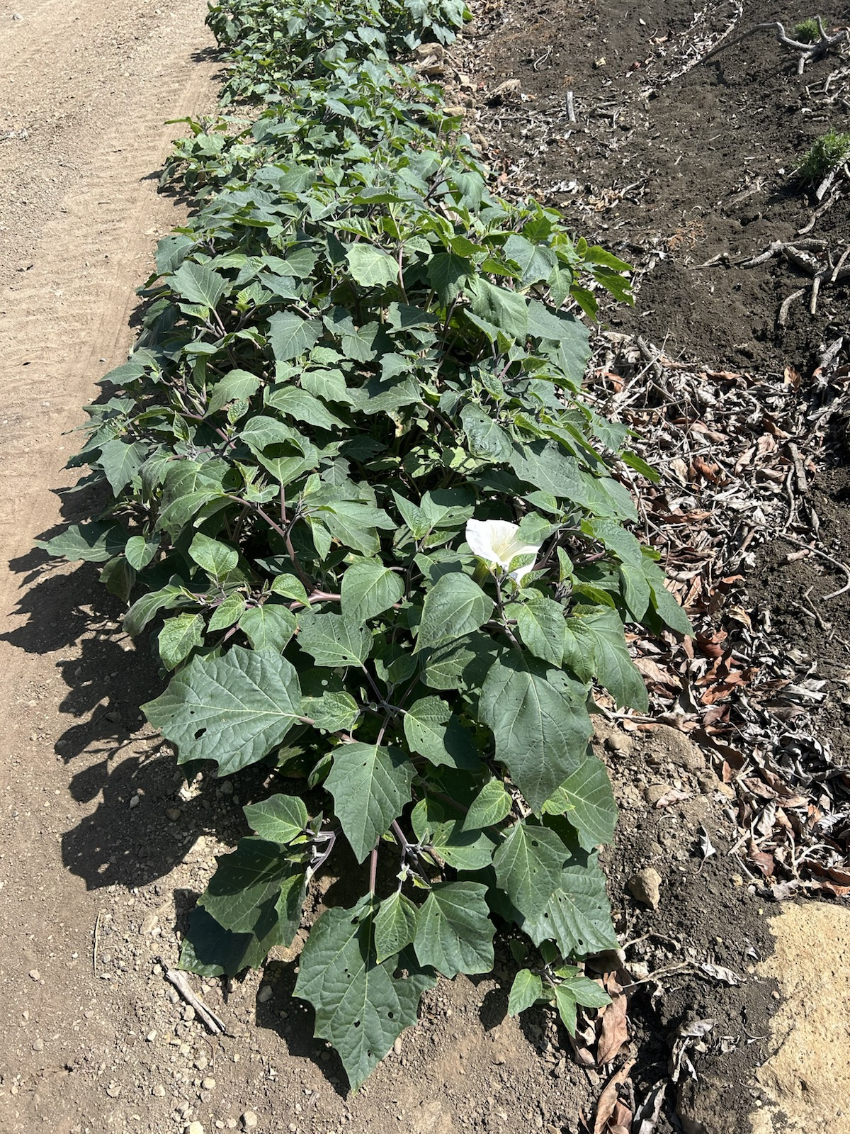
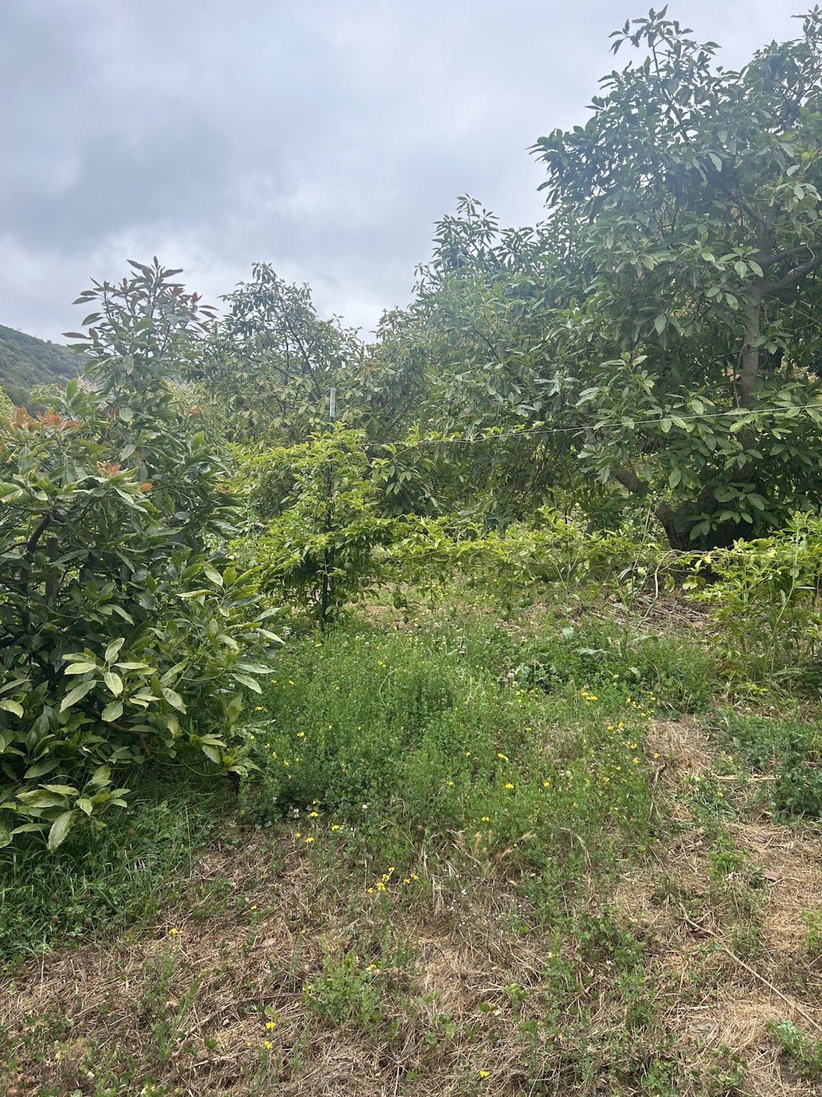
Steal these two first

Slide 6
Hass $/lb — Index Fresh vs Rincon Farms
Index Fresh = Fresh Facts mid (7/21/26) · Rincon = field price sheet (7/29–30/26) · Δ = Rincon − Index mid
Size | Index Hass | Rincon Hass | Δ Hass | Index Organic | Rincon Organic | Δ Org
32 | $1.14 | $1.30 | +$0.16 | $1.38 | $1.50 | +$0.12
36 | $1.14 | $1.30 | +$0.16 | $1.38 | $1.50 | +$0.12
40 | $1.14 | $1.30 | +$0.16 | $1.46 | $1.55 | +$0.09
48 | $1.18 | $1.32 | +$0.14 | $1.60 | $1.64 | +$0.04
60 | $0.90 | $0.90 | $0.00 | $1.46 | $1.50 | +$0.04
70 | $0.70 | $0.70 | $0.00 | $1.26 | $1.30 | +$0.04
84 | $0.54 | $0.60 | +$0.06 | $0.98 | $0.60 | −$0.38
Takeaway: Rincon quotes a premium on large Hass (32–48). Mid/small (60–70) match Index. Organic 84s are the outlier — Index still much higher than Rincon’s posted $0.60.

Slide 7
Rincon — steal, adapt, leave
Next 12–24 months at Ortega Ridge
Practice | Fit | Why / caveat
Hedgerows on roads & drainage | High | Attacks #1 erosion problem; HSP-eligible
Cover crops in avocados | High | Pilot + water monitoring; winter rainfall
Mulch on orchard floor | High | Already started at home — expand

Slide 8


Slide 9
APRICOT LANE FARMS
North-star system · copy pieces, not the campus

Slide 10
Apricot Lane — four pieces to remember
~234 acres · organic + biodynamic · ~17 commercial crop lines (visit note)
Crop discipline
Animals as managers
200+ varieties marketed; commercial focus narrowed toward ~17 lines. Diversity is brand; focus is P&L.
Livestock are laborers first. Needs fencing + a manager — later for us.
Fertility Center
Habitat edges
Vermicompost + aerated compost tea. Start with compost; tea is Tier B.
Pollinator / native margins as pest insurance — phase on ex-citrus edges, not 40 habitat acres day one.

Slide 11
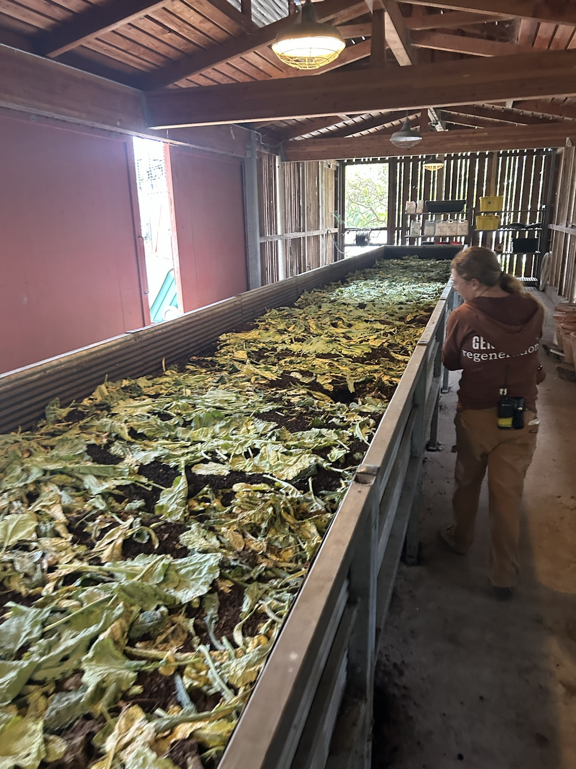
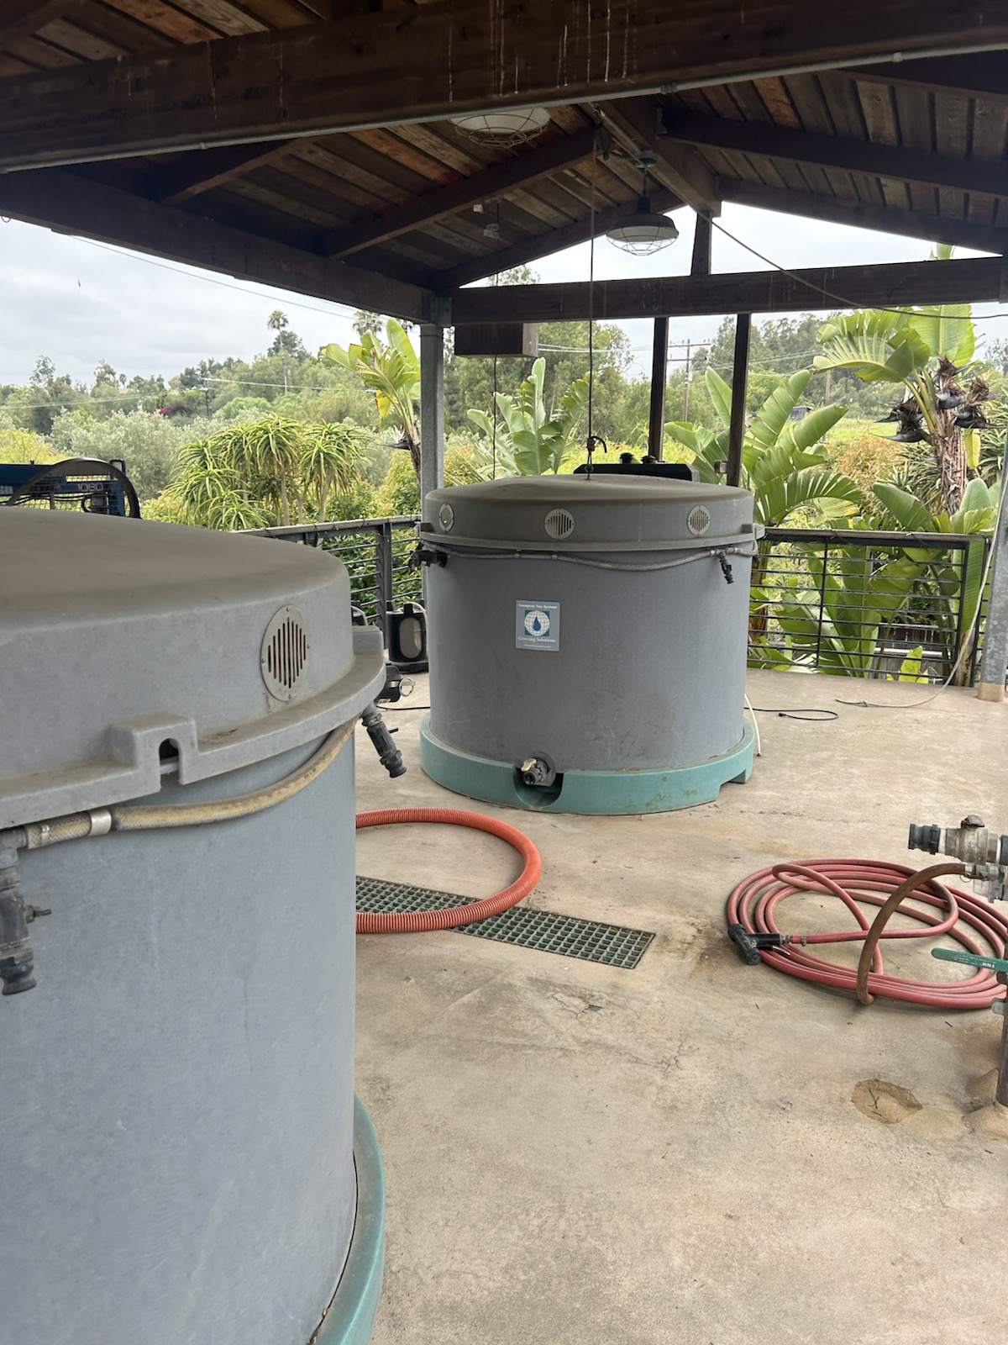
Fertility Center — copy the logic, start smaller

Slide 12
Compost tea
What it is
If we pilot
• Aerated brew of finished compost as a soil drench (or foliar)
• Stretches good compost biology across acres — not leachate from a pile
• Works only as part of compost + cover + mulch
• After ground cover and a compost source exist — not day one
• One trial block; soil drench first; no molasses unless lab-tested
• KPIs: vigor, disease notes, hours/brew, $/acre vs solid compost
Apricot Lane Growing Solutions brew · NOP / UVM food-safety notes

Slide 13
WANDERMENT FARMS
Copyable scale · ~56 acres · cardboard, boxes, optional tours

Slide 14
Wanderment — the on-ramp playbook
Same regen philosophy as Apricot Lane, thinner crew, closer to our acreage
Cardboard + mulch
Ground cover
Fastest transferable tactic. Smother weeds without herbicides on bare / eroded patches.
Same lesson as Rincon — living floor under trees, simpler kit.
Friday boxes
Agritourism
DTC without a pack house. Useful once grades and packing are real.
Real P&L for them. For us: zoning, insurance, access — after orchard floor, not instead of it.

Slide 15
Wanderment — steal, adapt, leave
Most copyable near-term playbook of the three
Practice | Fit | Why / caveat
Cardboard + mulch | High | Start on bare / eroded patches now
Ground cover under trees | High | Same as Rincon, simpler
Friday box / DTC | Medium | Once packing + grades exist
Full agritourism program | Later | Separate permit path — see Looking ahead

Slide 16
WHAT TO TAKE HOME
One through-line · one steal list

Slide 17
Steal list for Ortega Ridge
Ground cover, living edges, and a clear market channel beat bare soil + wholesale-only
Move | From | When
Hedgerows on roads & ditches | Rincon | Soon
Cover-crop trial in avocados | Rincon | Soon — winter window
Cardboard + mulch on bare ground | Wanderment | Soon
Pollinator / native edge | Apricot / Wanderment | Soon — one margin
Compost tea pilot | Apricot Lane | After compost + cover
Specialty packing / grades | Rincon | Design this year
Crop shortlist (~17 lines) | Apricot Lane | Citrus transition
Livestock / agritourism | Apricot / Wanderment | Only with a manager + permits

Slide 18
LOOKING AHEAD
CDP buildings already in permitting · organic · agritourism · UCSB help

Slide 19
What the current CDP actually is
370 Ortega Ridge Road — Agricultural Improvement Plans · 4th CDP submittal 6/15/26 · Becker Studios
Parcel
APN
Coastal
Fire
72.88 acres
AG-I-20
005-080-017
Appeals boundary
on the site
High Fire
Yes
Two scope areas — not a tour program
• Scope 1: remodel existing 2-car garage to a pool cabana + new pre-engineered metal equipment barn on slab
• Scope 2: new operations barn + office on slab, plus two prefab agricultural employee dwellings; relocate water tanks out of setback
• Main house and 45' pool are existing / not in farm-ops scope. Tennis court and part of the asphalt drive are demo’d.

Slide 20
Buildings in the CDP — numbers from the cover sheet
Net sf from A0.00 · total new development ~7,075 nsf / 7,470 gsf · grading cut 2,250 cy / fill 1,670 / export 580
Piece | Net sf | Why it matters for the farm
Equipment barn | ~3,042 | Shop + crop/equipment storage next to the motor court
Operations barn + office | ~2,778 | Working HQ — packing/crew/records, not a tasting room
Farm worker unit #1 | 640 | On-site agricultural employee housing
Farm worker unit #2 | 640 | Second unit — crew capacity, not agritourism lodging
Pool cabana (garage remodel) | ~635 | Residential amenity — do not treat as farm visitor space
Water tanks | Relocate | Three 500-gal + two 5,000-gal tanks moved out of setback

Slide 21
Constraints already on the drawings
• Coastal Commission appeals boundary crosses the property — public-facing uses get extra scrutiny
• Montecito Water District easements and laterals; 20' / 50' setbacks from Ortega Ridge Road
• High Fire Hazard; Type V-B construction; no sprinklers noted on the cover sheet
• New gated entries must meet sight-triangle / encroachment-permit rules — visitor traffic is a planning issue, not just a branding issue
• Sanitary sewer work (laterals + lift station) is in the civil set — farmworker units depend on that, not on agritourism revenue

Slide 22
ORGANIC
Certification is a USDA + California process

Slide 23
Organic — what “permitting” actually means
Two required layers (CA)
The 36-month clock
• USDA National Organic Program: pick an accredited certifier (CCOF is the usual CA avocado path)
• Submit an Organic System Plan (farm map, inputs, records) → inspection → certificate
• CDFA State Organic Program: California registration before the first organic sale
• If organic sales will exceed $5,000/year, certification is required — not optional
• Land must have had no prohibited materials for 36 consecutive months before you can sell as organic
• Start tracking inputs on day one of transition — receipts for everything that hits the grove
• During transition you cannot label, sell, or use the USDA organic seal
• After certification: annual inspection + annual CDFA registration
Sources: CAC organic grower path; CDFA SOP; UC/CCOF Ten Steps to Organic Certification (2025).

Slide 24
UCSB & UC HELP
Who to call · what to ask · what not to hand a student

Slide 25
Who to contact — and for what
Students can monitor and paper the work. They should not be the orchard manager.
Who | Contact | Ask them for
UCSB ES Internship (ENV S 192) | es.ucsb.edu/internships | Paid student coordinator: photo plots, cover-crop logs, grant packets
Bren BEL (summer team) | bren.ucsb.edu / BEL | Scoped summer project with a Bren grad mentor (erosion, water, habitat)
CCBER / Edible Campus | CCBER UCSB | Restoration + soils students who already know field work
UCCE — Ben Faber / avocados | UCCE Ventura / SB | Cover crops, irrigation, organic materials, site walk on Tier A blocks
UC Small Farms (SLO–SB) | UC ANR Small Farms | Transition TA, recordkeeping, certifier intro
White Buffalo Land Trust | whitebuffalolandtrust.org | Local living-lab peer — knowledge exchange, not a takeover

