Slide 1
WebMD
Web scraping and Data Analysis
Marcus Choi

Slide 2
Contents
Purpose
Data Extraction Method: Scrapy
Research Questions
Exploratory Data Analysis
Insights & Recommendations
Future Work

Slide 3
Purpose
Improve overall quality of life
Informed decisions when choosing medications
Prolong life expectancy with early indicators of medical conditions
Provide value and actionable insights for consumers and healthcare companies

Slide 4
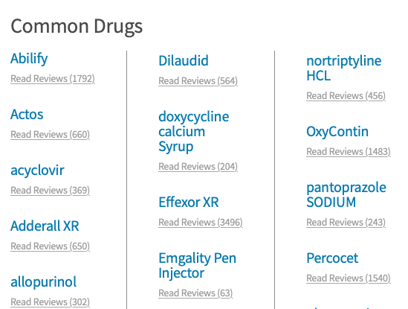
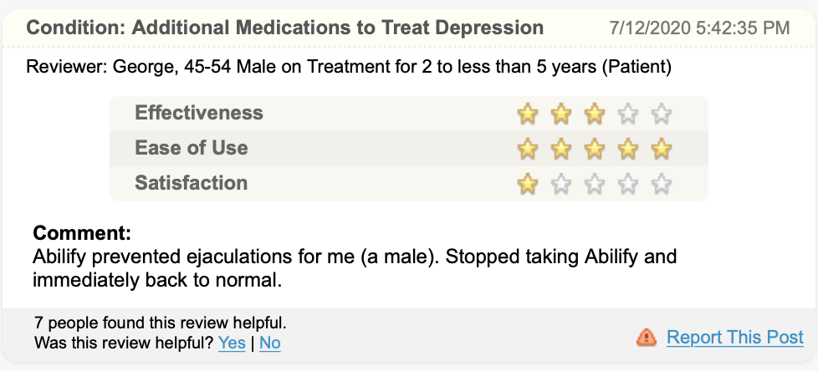
Data Extraction Method: Scrapy

Slide 5
Research Questions
Which drugs have the highest rating for effectiveness and what does the distribution look like?
Does any relationship exist between rating types?
What does the user demographics look like?
What does the distribution of comments and average effectiveness rating look like over time?

Slide 6
Exploratory Data Analysis
Variables: • 55262 Reviews and 95 Drugs
Medical Condition
Review Comment
Rating: Effectiveness
Rating: Satisfaction
Rating: Ease of Use
Reviewer (Optional)
Age
Gender
Duration

Slide 7
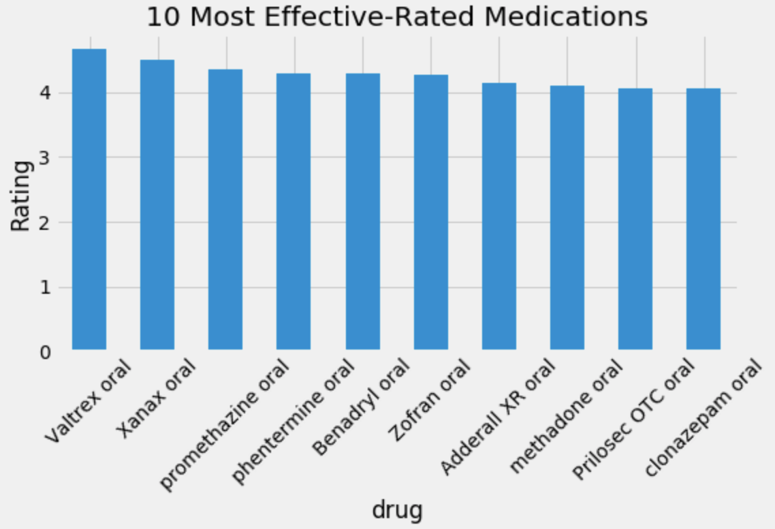
Top 10 Most Effective Rated Drugs

Slide 8
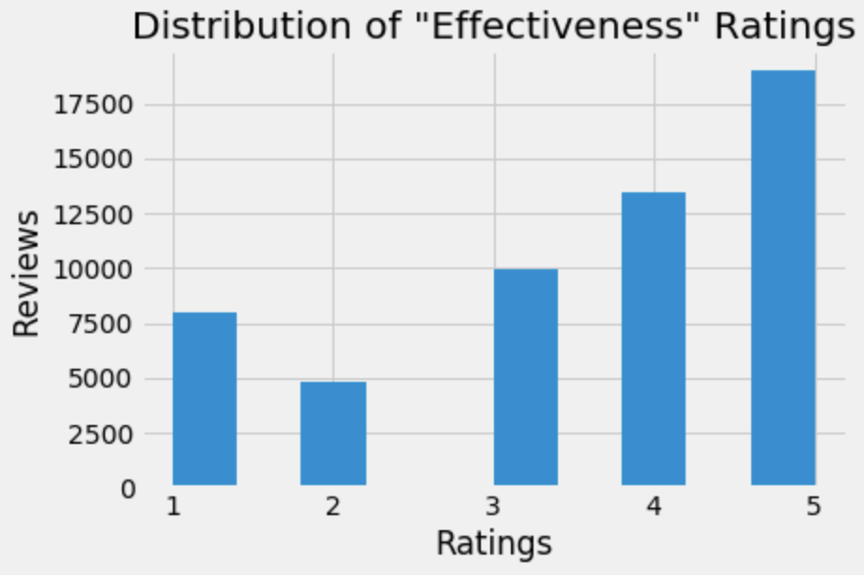
Distribution of Effectiveness Ratings

Slide 9
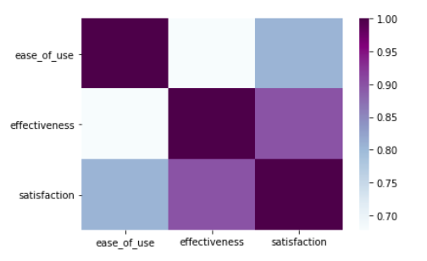
Correlation Heatmap of Ratings

Slide 10

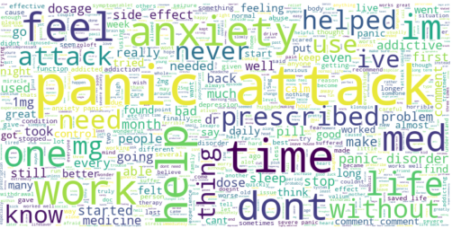
Word Cloud of Highest Effective and Satisfactory Rated Drugs
Valtrex
Xanax

Slide 11
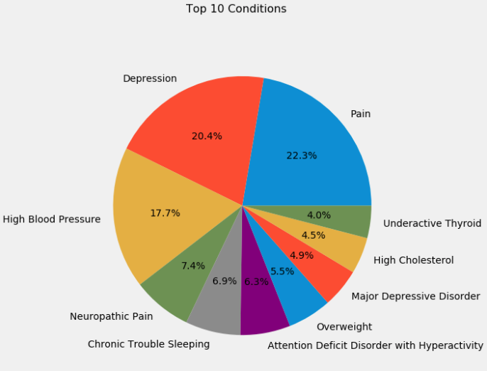
Top 10 Conditions with Most Reviews

Slide 12
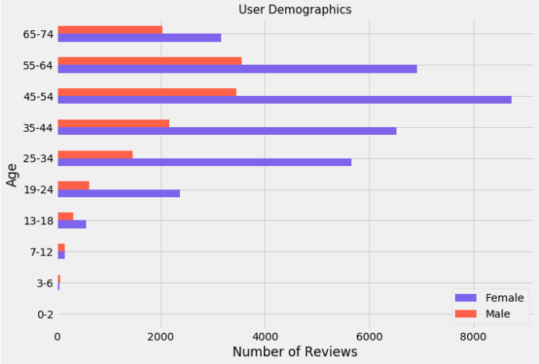
User Demographics

Slide 13
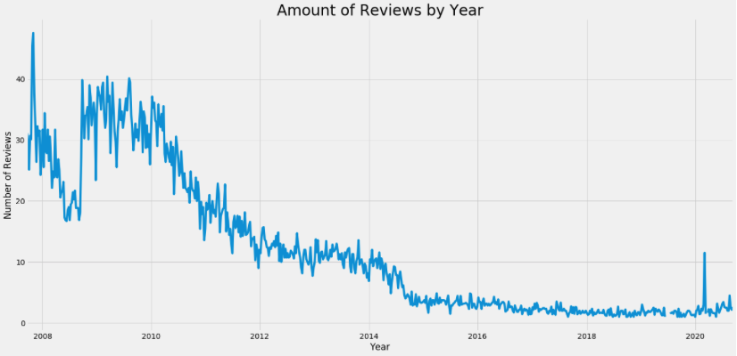
Amount of Reviews by Year

Slide 14
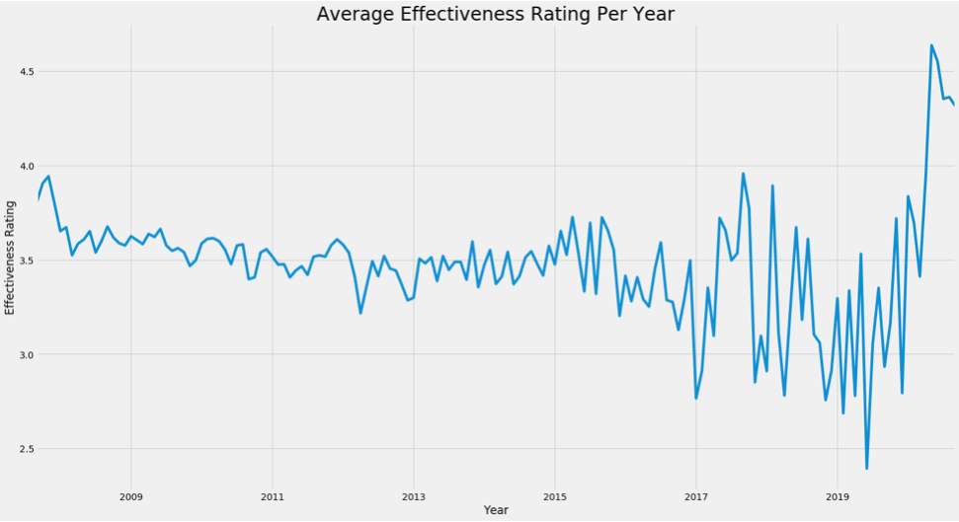
Average Effectiveness Rating by Year

Slide 15
Insights
Top 5 most effective rated drugs are: Valtrex, Xanax, Promethazine, Phentermine, and Benadryl
All above ratings 4/5
Strong correlation between the ratings
Majority of users are females in the age range of 45-54 years
Higher rates of reviews during 2007-2010 and has decreased since
Exception of 2007 and beginning of 2020
Average Effectiveness rating has dispersed since 2010

Slide 16
Future Work
Logistical regression models on ratings
Time series analysis of ratings
Cross analysis on user demographics and common drugs and conditions reviewed

