Slide 1
Heterogeneity Project Progress
1/16/23

Slide 2
Background
Interested in applying CRE to identify significantly heterogeneous subgroups with respect to a given exposure/outcome
CRE theoretically provides simple subgroup interpretation, clinical significance, and statistical significance
Previously applied authors algorithm and found very high statistical significance and low clinical significance for coefficients/simple subgroups (from algorithm’s final OLS output)
Implemented methods to estimate the CATE and p-value for each subgroup based on linear combinations of OLS estimates (most granular that was achievable was limited to variables that appeared in the final OLS, i.e. selected during rule generation)
Added bootstrapping of this estimation to diagnose the issue

Slide 3
Small SE Diagnosis
Continued to see extremely small standard errors
To diagnose, I went back and added code to estimate and bootstrap the CATEs to the authors original algorithm + ran this on their simulated dataset
Still found same issue; could be an artifact of the algorithm
From author simulated data, the 6 largest subgroups in absolute magnitude and the ”baseline” subgroup (left) with their 95% CIs.

Slide 4
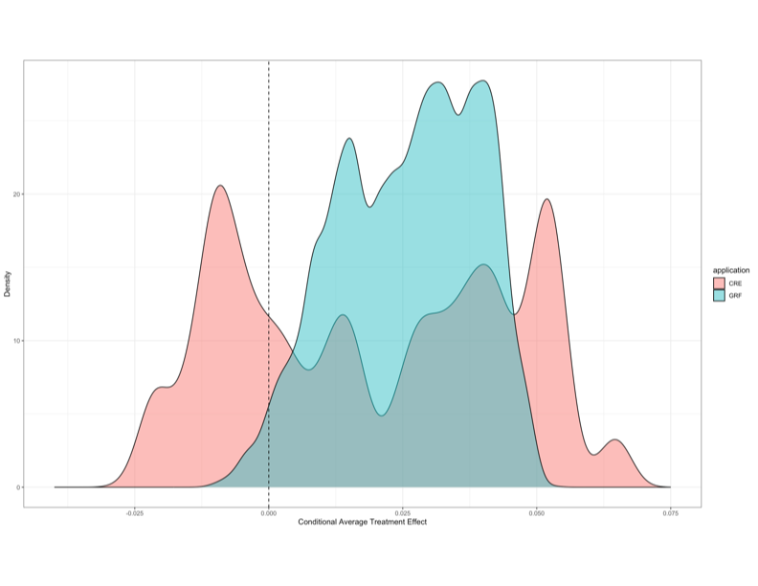
GRF Comparison
Additionally, we were interested in comparing the CRE to the GRF (causal forest) to look at differences in CATE estimation
Implemented GRF according to Shiba et. Al (same parameters) and presented results as they did (density plot of predicted CATEs on data); ”grf::causal_forest” & “grf::predict_causal_forest”
Implemented method to predict CRE CATEs as in GRF
Ran CRE and GRF on our dataset
Exposure: Drought (binary)
Outcome: Stunted growth (binary)
Covariates/Effect Modifiers (all binary):
Sex
Age
Small Birthsize
Etc.
10% of data used due to long run time (34550 observations)
Found that distribution of CATEs were not similar between the two algorithms
Density plots of the predicted CATEs from CRE and GRF with our data.

Slide 5
Summary
Summarization of GRF vs CRE:
GRF doesn’t theoretically provide interpretability of CRE, just optimizes for heterogeneity with nonparametric tree method with goal of prediction
CRE effectively uses GRF in first half of algorithm: tree method is used to generate rules and then regularization (LASSO or stability selection) used to reduce number of rules to most important
From CRE manuscript: “[HCT/GRF] can be prone to over-fitting the training data, so the results can fail to be replicable or generalizable (Strobl et al.; 2009). Also, the discovery is limited to a sub-optimal set of discovered subgroups since the recursive partitioning is often based on a greedy algorithm.”
CRE claims more stability and better interpretability of results

Slide 6
Summary cont.
Code progress:
Cleaned, commented
Added bootstrap and visualization functionality
Added CRE parameter manipulability according to paper (author CRE didn’t originally include, had hardcoded values)
Current CRE algorithm summary
Primary inputs: Exposure, Outcome, Covariates/Effect Modifiers
Outputs:
Full data OLS model summary
Full data subgroup CATEs, 95% CIs, p-values
Bootstrapped subgroup CATEs, 95% CIs, p-values
Bar plot of (n) largest bootstrapped subgroup CATEs and ”baseline” subgroup with 95% CIs
Could still refine by labeling x-axis subgroups clearly
Collapsible tree of bootstrapped subgroups with CATEs
Further work
Size of node could correspond to magnitude of effect
Color could correspond to statistical significance

