Slide 1
CSE 384 : Systems and Network Programming
Course Introduction
Syracuse University

Slide 2
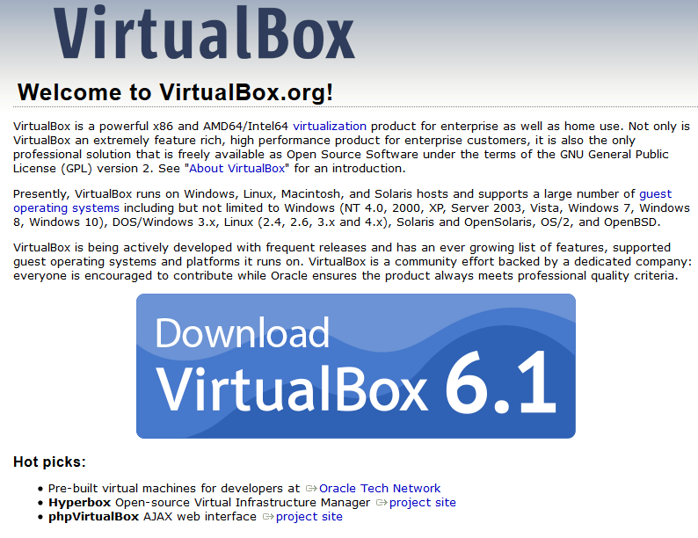
Environment Setup: Install VirtualBox
Download virtual box 6.x: https://www.virtualbox.org/
  A Hosted (type 2) Hypervisor – VMM (virtual machine monitor)
    creates and manages virtualized guest machines

Slide 3
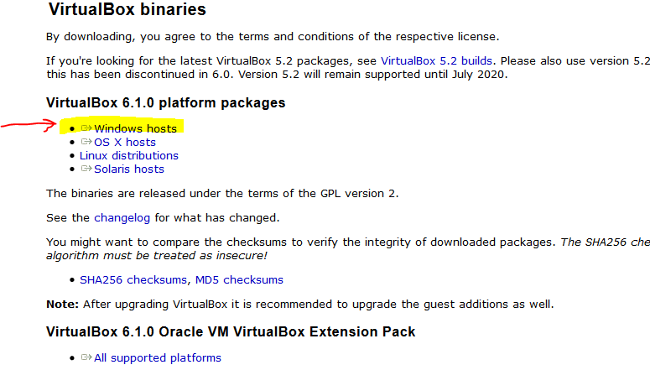
Environment setup: download for windows
Select windows host
  Download and run the installer
    Select of the default options

Slide 4
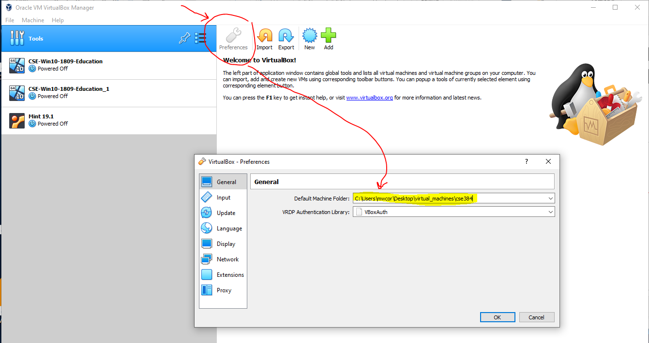
Environment setup: VM folder: Preferences

Slide 5
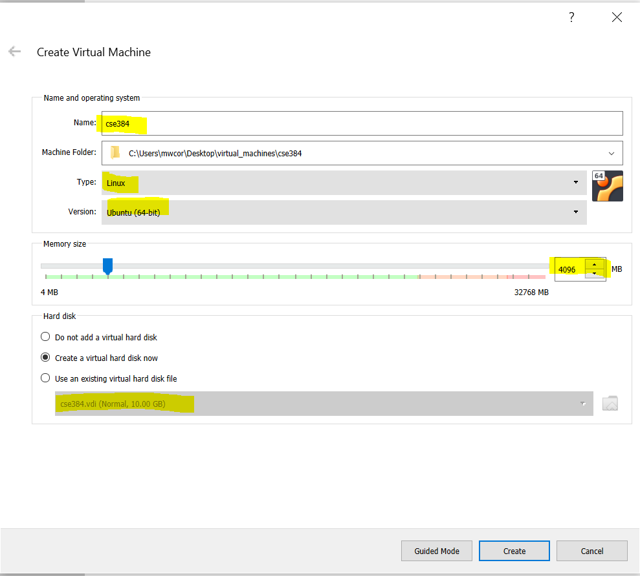
Create a VM (guest)

Slide 6
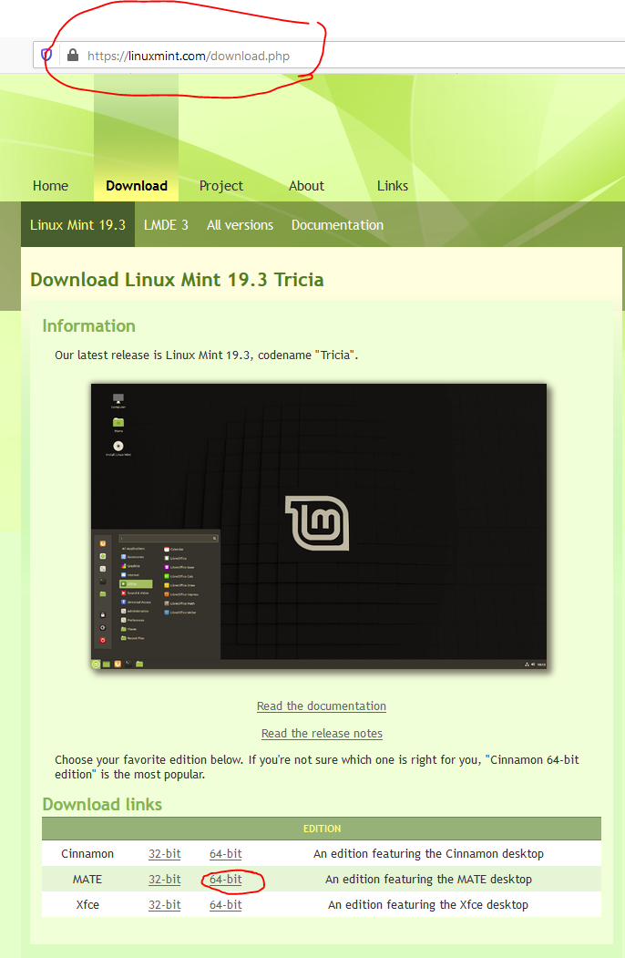
Download Mint Linux Distribution
Download link: https://linuxmint.com/download.php
A derivative Ubuntu.
  Why use Mint?
It’s popular, well known and so ways easier

Slide 7
Course Objectives
Become familiar with Unix system/paradigm
  Unix environment
      Basic Commands, general familiarity with shells

