Slide 2
Essential security related commands
id – Display user identity
chmod – Change a file's mode
umask – Set the default file permissions
su – Run a shell as another user
sudo – Execute a command as another user
chown – Change a file's owner90

Slide 3
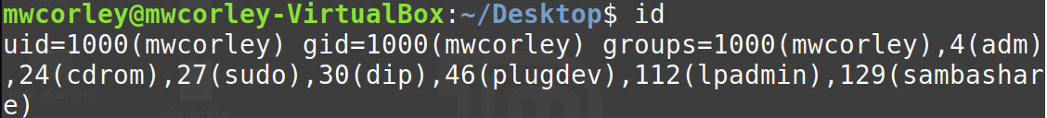
Owners, Groups, and Everyone else (the world)
user may own files and directories.
user has control over the files and directories owned
Users can, in turn, belong to a group consisting of one or more users who are granted access to files and directories by their respective owners.
an user/owner may grant some set of access rights to everybody, which in Unix terms is referred to as the world.

Slide 4
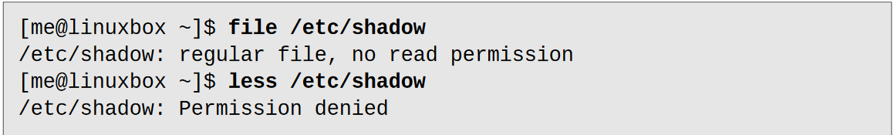
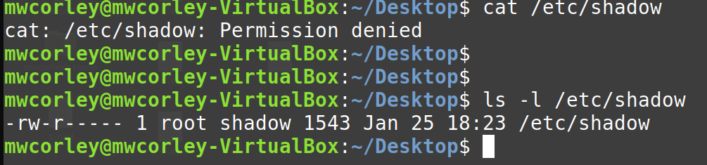
File Attributes: Read, Write, Execute Permissions

Slide 5
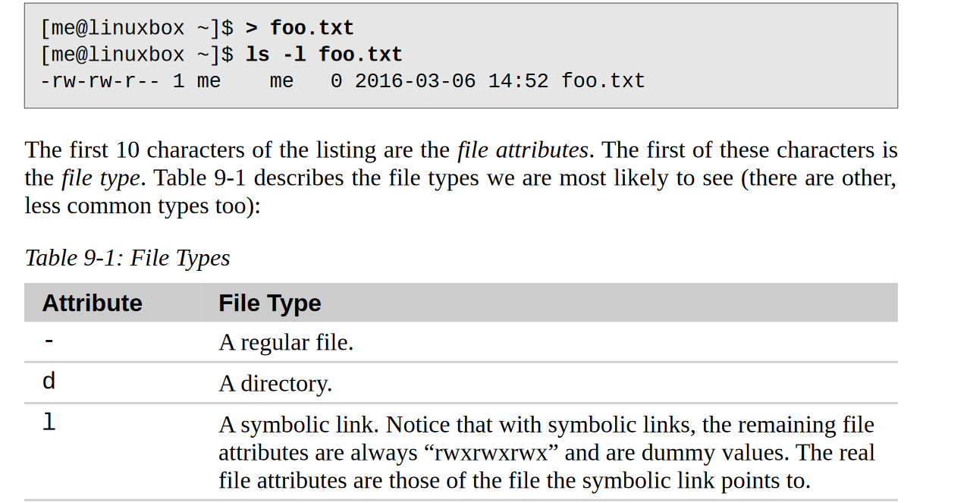
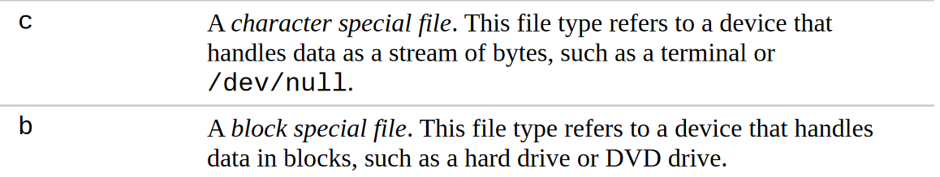

Slide 6
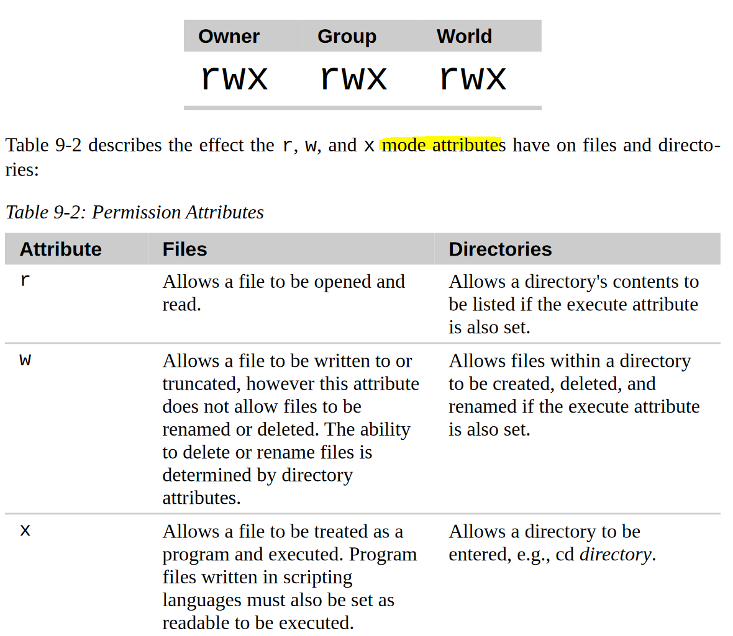

Slide 7
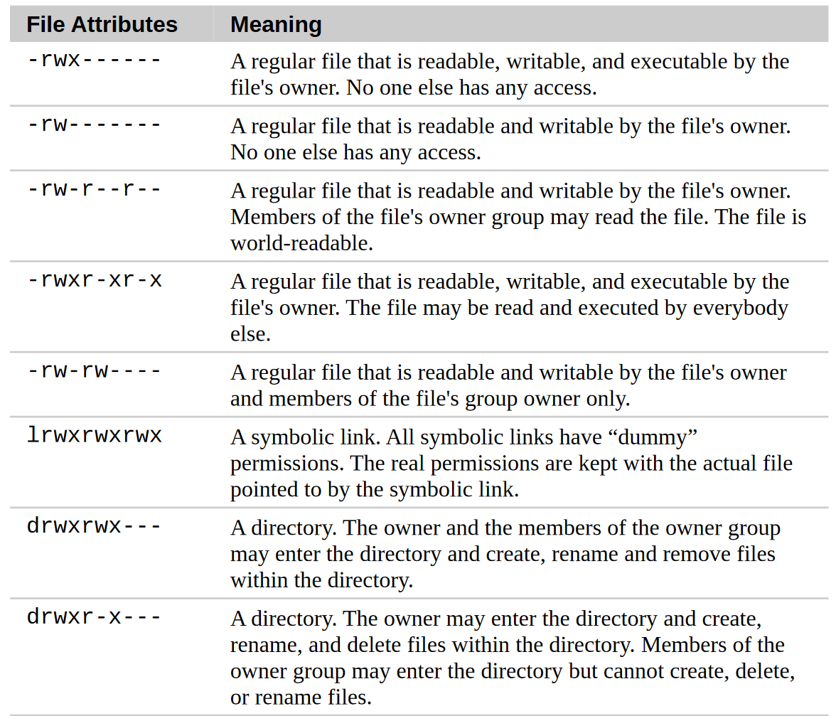

Slide 8
chmod - change the mode (permissions) of a file or directory
only the file’s owner or the superuser can change the mode of a file or direc-tory
supports two distinct ways of specifying mode changes: octal number repre-sentation, or symbolic representatio
Octal (base 8), hexadecimal (base 16)
number systems often used to express numbers on computers.

Slide 9
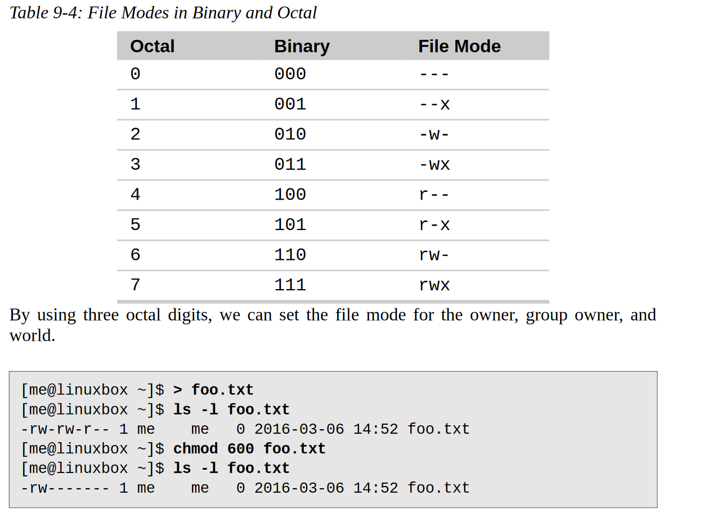

Slide 10
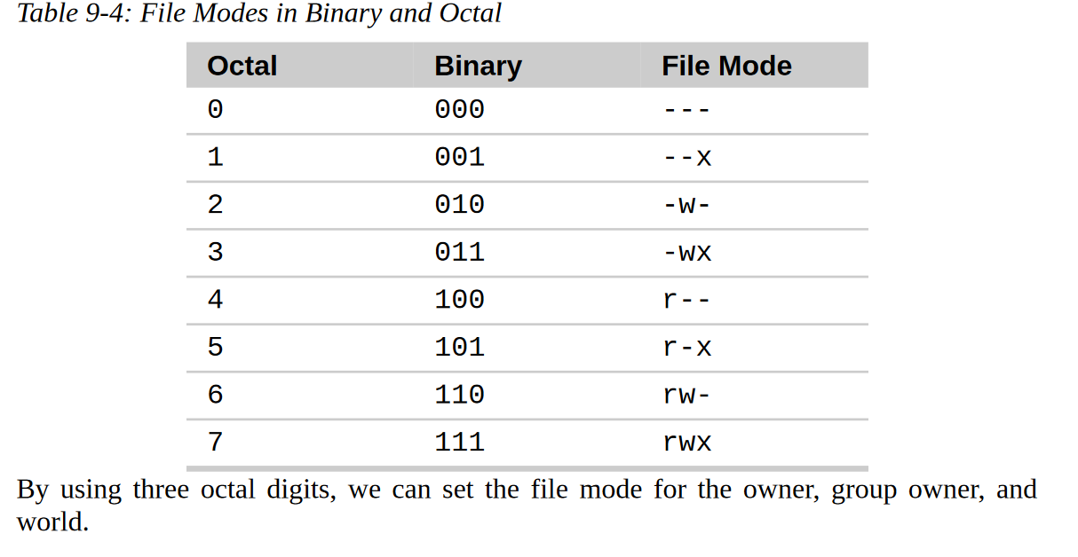
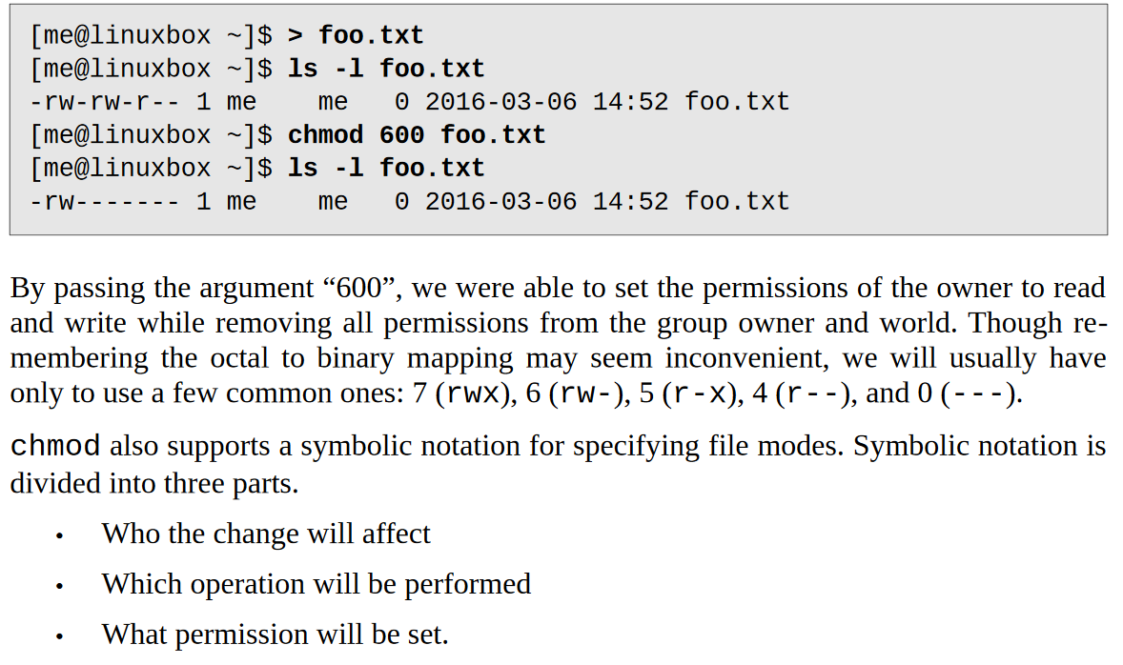

Slide 11
rwx-r--r
111010

