Slide 1
CSE 384 (Lecture 6): Common Unix Tools
Spring 2020

Slide 2
Overview
Editors
Commonly Used Tools
Editors
vi
Grep (regex)
Locate
Find
Sed
Awk
Tar
Gzip

Slide 3
Editors - create/edit text files
Vi / Vim originally written in 1976 by Bill Joy, a University of California at Berkley student who later went on to co-found Sun Microsystems
Emacs originally written in 1976 by Carl Mikkelsen, David A. Moon and Guy L. Steele Jr has over 10,000 built-in commands and its user interface allows the user to combine these commands into macros to automate work
ex - EXtended, is a line editor for Unix systems
GNU nano is a text editor for Unix-like computing systems or operating environments using a command line interface.
gedit is the default text editor of the GNOME desktop environment and part of the GNOME Core Applications.

Slide 4
VI/VIM - screen-oriented text editor
vi was originally written in 1976 by Bill Joy, a University of California at Berkley student who later went on to co-found Sun Microsystems
lightweight and fast, and always available.
Important (these days) if the system has no graphical interface
POSIX compatibility on Unix systems, requires that vi be present
$ vi file.txt
i, o, a, etc (insert mode), esc (command mode) ~, cw, dw, dNw, dd,
Ex – line editor: $:%s/expression/replacement
See vi Cheat sheet
http://www.atmos.albany.edu/daes/atmclasses/atm350/vi_cheat_sheet.pdf
Class Text: The Linux Command Line (Chapter 12)

Slide 5
Commonly used tools…
grep – search for patterns in text files
find – search for files in a directory hierarchy
locate – find files by name
AWK – (text processing language) pattern scanning and processing
sed - stream editor for filtering and transforming text
tar – (tape) archiving utility
gzip – (gnu) zip – compress and expand files

Slide 6
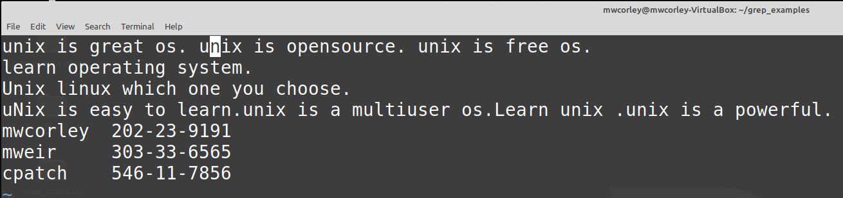
Sample test file for examples: geekfile.txt

Slide 7
Grep (G/re/p) - “global regular expression print”
searches text files for the occurrence text matching a specified regular expression and outputs any line containing a match to standard output
Regular expression
special text string for describing a search pattern. You can think of regular expressions as wildcards on steroids.
Resources / Examples
Grep
https://www.geeksforgeeks.org/grep-command-in-unixlinux/
Regex
https://www.regular-expressions.info/
See Class Text: The Linux Command Line Chapter 19

Slide 8
Grep Examples: Class Text: The Linux Command Line Chapter 19
$ grep -i "UNix" geekfile.txt
Search and match lines “UNix” string , disregard case
$ grep -ic "UNix" geekfile.txt
Like previous, but count the match occurrences
$ grep -i "^UNix" geekfile.txt
Search and match lines beginning with string “UNix”, disregard case
$ grep -i '^Unix.*os.$' geekfile.txt
Search and match lines beginning with string “UNix”, followed by any number of characters, and ending with string “os.”
$ grep '[0-9]\{3\}-\{0,1\}[0-9]\{2\}-\{0,1\}[0-9]\{4\}' geekfile.txt
Match social security numbers -- assume search applications for PII (personally identifiable information)
$ grep -H '[0-9]\{3\}-\{0,1\}[0-9]\{2\}-\{0,1\}[0-9]\{4\}' geekfile.txt
$ grep -l '[0-9]\{3\}-\{0,1\}[0-9]\{2\}-\{0,1\}[0-9]\{4\}' f*.txt

Slide 9
Common tools for locating files
Locate
Find files by name
Find
Search for files in a directory hierarchy
xargs
Build and execute command lines from standard input
Chapter 17: Searching for Files

Slide 10
Locate - find files by name
performs a rapid database search of pathnames, and outputs every name that matches a given substring
Example
find all the programs with names that begin with zip
locate bin/zip
locate zip
locate zip | grep zip$
Chapter 17: Searching for Files (Locate)

Slide 11
Find - search for files in a directory hierarchy
searches a given directory (and its subdirectories) for files based on a variety of attributes
Uses the notion of tests and actions
Examples
$ find ~ | wc -l
$ find ~ -type d | wc -l
$ find ~ -type f -name "*.c" -size +1k
$ find . -type f -name 'f*' -exec ls -l '{}' ';'
$ find . -type f -name 'f*' -ok ls -l '{}' ';'
$ find . -type f -name 'f*' -exec grep -H '[0-9]\{3\}-\{1\}[0-9]\{2\}-\{1\}[0-9]\{4\}' '{}' ';'
$ find . -type f -name 'f*' | xargs grep '[0-9]\{3\}-\{1\}[0-9]\{2\}-\{1\}[0-9]\{4\}'
Chapter 17: Searching for Files

Slide 12
Xargs
Accepts input from standard in-put and converts it into an argument list for a specified command
Example:
$ echo 'one two three' | xargs mkdir
$ echo 'one two three' | xargs rmdir
$ find ~ -type f -name 'f*' -print | xargs ls -l
$ time find ~ -type f -name 'f*' -exec grep '[0-9]\{3\}-\{1\}[0-9]\{2\}-\{1\}[0-9]\{4\}' '{}' ';'
$ time find ~ -type f -name 'f*' | xargs grep '[0-9]\{3\}-\{1\}[0-9]\{2\}-\{1\}[0-9]\{4\}'

Slide 13
Sed – Stream editor
text editing on a stream of text, either a set of specified files or standard input.
Use a single editing command (on the command line) or the name of a script file containing multiple commands
performs commands upon each line in the stream of text.
sed 's/Unix/windows/gI' geekfile.txt
cat geekfile.txt | sed '4s/unix/windows/gI’
sed 's/[Ll]inux/Unix/g' geekfile.txt > output.txt
https://mwcorley79.github.io/MikeCorley/presentations/TLCL-19.01.pdf#page=325

Slide 14
AWK - interpreted programming language
AWK is an interpreted programming language, specially designed for text processing. Named after the authors (Alfred Aho, Peter Weinberger, and Brian Kernighan).
Typical uses
Producing formatted text reports,
Performing arithmetic operations,
Performing string operations, and many more.
Tutorial: https://www.tutorialspoint.com/awk/awk_overview.htm

Slide 15
Tar and gzip,
Class text (Chapter 18) – Archiving and Backup
https://mwcorley79.github.io/MikeCorley/presentations/TLCL-19.01.pdf#page=258

Slide 16
Processes
Class Text: (Chapter 10)
https://mwcorley79.github.io/MikeCorley/presentations/TLCL-19.01.pdf#page=134

Slide 17
Scripting: What is a Shell Anyway?
The shell is a program that takes keyboard commands and passes them to the operating system to carry out.
Source: The Linux Command Line, Fifth edition, page 2
The shell is the command interpreter in an operating system such as Unix or GNU/Linux, it is a program that executes other programs.
Source: https://www.tecmint.com/different-types-of-linux-shells/
The shell is both an interactive command language and a scripting language, and is used by the operating system to control the execution of the system using shell scripts
Source: https://en.wikipedia.org/wiki/Shell_script

Slide 18
Background
Bourne Shell (sh): Steven Bourne – 1977
AT&T Bell Labs for V7 UNIX, remains a useful shell today
introduced control flows, loops, and variables into scripts, providing a more functional language to interact with the operating system (both interactively and noninteractively).
C Shell (csh): Bill Joy 1978
A graduate student at the University of California, Berkeley, developed for Berkeley Software Distribution (BSD) UNIX systems
A key design objectives for the C shell was to create a scripting language that looked similar to the C language.
Introduced command history
This material found at: https://developer.ibm.com/tutorials/l-linux-shells/

Slide 19
Background
Tenex C shell (tcsh): Ken Greer, 1983
Carnegie Mellon University
backward-compatible with csh, but improved its overall interactive features.
Korn shell (ksh): David Korn, 1983
use as a scripting language in addition to being backward-compatible with the original Bourne shell.
Bourne-Again Shell (BASH): Brian Fox, 1989
an open source GNU project intended to replace the Bourne shell
A superset of the Bourne shell
incorporated features from the Korn and C shells
One of the most widely used shells
This material found at: https://developer.ibm.com/tutorials/l-linux-shells/

Slide 20
Writing Shell Scripts (Overview)
We’ve covered the first 9+ chapters of the Linux Command Line
We’ve discussed many of the basic commands for navigating, and managing a Linux system.
foundational ideas including, Files, I/O redirection and pipelines, a
handful of the important tools to accomplish useful work.
However, using the shell by supplying command lines (one a time). Granted this is useful,
By joining our tools together into programs of our
own design, the shell can carry out complex sequences of tasks all by itself. We can enable
it to do this by writing shell scripts.
Writing Shell Scripts
http://linuxcommand.org/lc3_writing_shell_scripts.php#contents

Slide 21
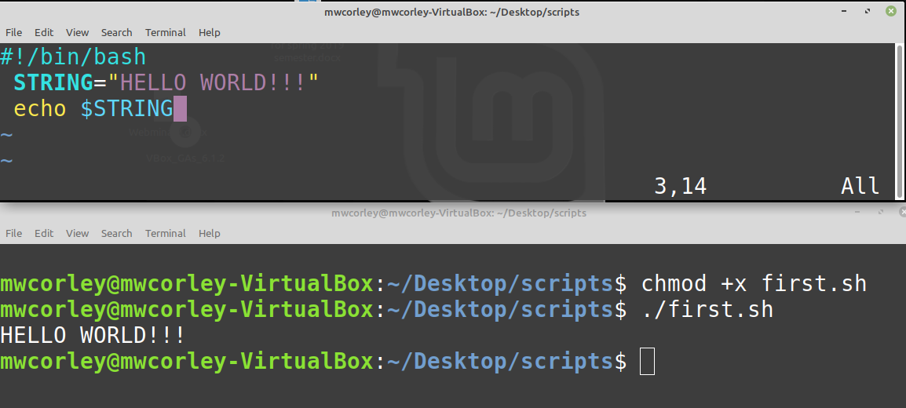
First BASH script: first.sh

Slide 22
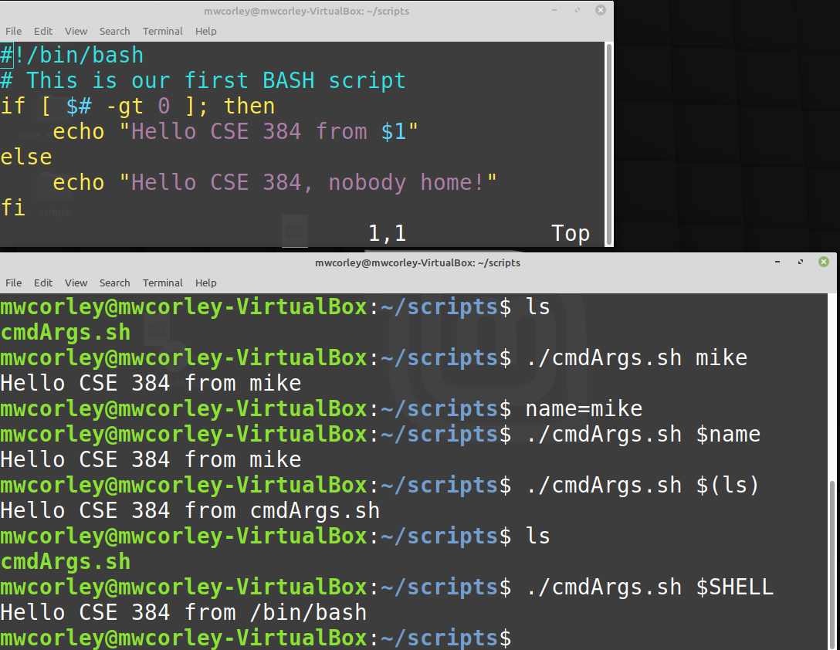
First script with command line arg

Slide 23
w
Bash Scripting Tutorials
LinuxConfig.org - 15 interesting examples

