Slide 1
Lecture 5: CSE 384 (System and Network Programming)
The Linux Command Line, Fifth Internet Edition
Chapters 6-10

Slide 2
Overview
I/O Redirection
STDIN, STDOUT, STDERR
Concept Overview
Examples
Disposing Output
/dev/null
Pipelines
Concept Overview
Examples

Slide 3
I/O Redirection: based on page 54 of the online version the Linux CommandLine
redirect the input and output of commands to and from files
connect multiple commands together into powerful command pipelines
In keeping with the Unix (Linux) model, everything is a file….
programs (such as ls) send output to a file called standard output: called stdout
Status (error) messages to another file called standard error: stderr
by default, both stdout/stderr are linked to the screen and not saved into a disk file.
Many programs take input from yet another file: stdin (called standard in)
By default stdin is connected to the keyboard
Redirection allows us to change where output (stdout/stderr) goes (e.g. the screen), and where input (stdin) comes from (e.g. the keyboard)

Slide 4
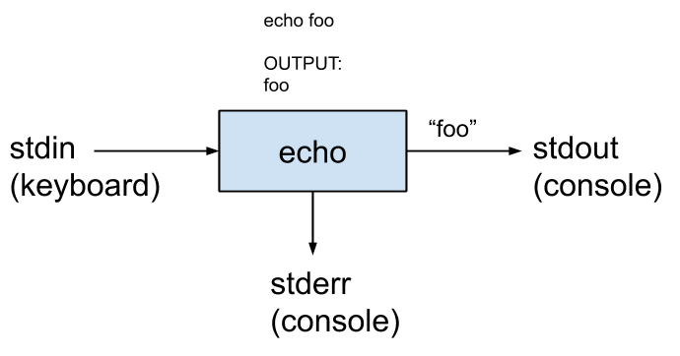
stdin, stdout, stderr
In python: “print”
In Java: “System.out.print”
In C: “printf’
fprintf(stderr)
In C++ “std::cout”
std::cerr
0
1
2
https://github.com/kennyyu/bootcamp-unix/wiki/stdin,-stdout,-stderr,-and-pipes

Slide 5
STDIN, STDOUT, and STDERR are files…
Operating systems (under the hood), are often a tables with indices that point to resources.
Files (and other resources) are often referenced using descriptors (integer numbers) that serve as a handle to the resources.
STDIN == file descriptor 0
STDOUT = file descriptor 1
STDERR = file descriptor 2

Slide 6
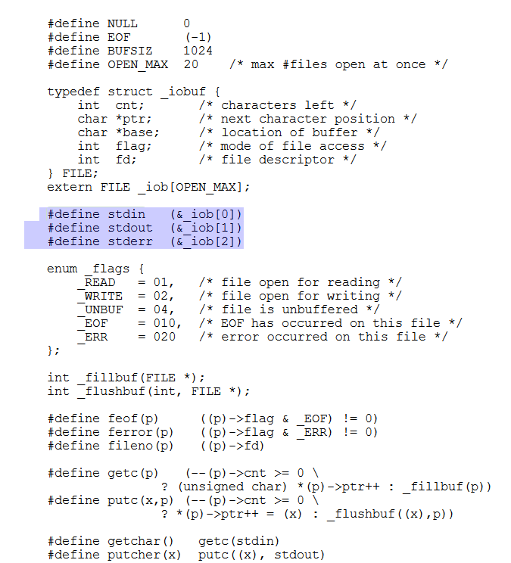
What are files anyway?
Original UNIX “FILE” concept implementation by Ritchie
Source: The C Programming Language 2nd Edition , page 176

Slide 7
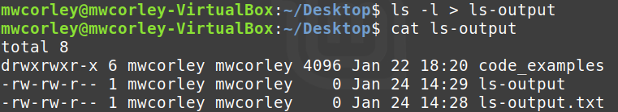
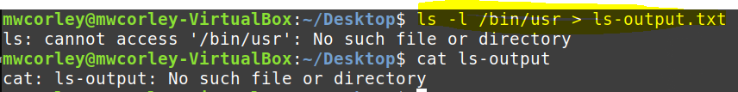
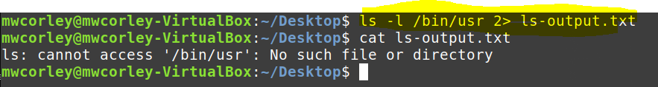
Examples

Slide 8
Examples
Redirect STDOUT
ls -l /usr/bin > ls-output.txt
ls -l /usr/bin 1> ls-output.txt
Redirect STDERR
[me@linuxbox ~]$ ls -l /bin/usr > ls-output.txt
What happened?
Zero length! The destination file is always rewritten from the beginning.
[me@linuxbox ~]$ ls -l /bin/usr 2> ls-error.txt
[me@linuxbox ~]$ > ls-output.txt
using the redirection operator with no command preceding it will truncate an ex-isting file or create a new, empty file.
[me@linuxbox ~]$ ls -l /usr/bin >> ls-output.txt
[me@linuxbox ~]$ ls -l /usr/bin >> ls-output.txt
append redirected output to a file instead of overwriting the file

Slide 9
Examples
Redirecting Standard Output and Standard Error to One File
[me@linuxbox ~]$ ls -l /bin/usr > ls-output.txt 2>&1
Using this method, we perform two redirections.
First we redirect standard output to the file ls-output.txt
then we redirect file descriptor 2 (standard error) to file descriptor 1 (standard output) using the notation 2>&1.
[me@linuxbox ~]$ ls -l /bin/usr &> ls-output.txt
Streamlined notation &> in (modern BASH implementations) to redirect both standard output and standard error to the file
append the standard output and standard error streams to a single file
[me@linuxbox ~]$ ls -l /bin/usr &>> ls-output.txt

Slide 10
Disposing Output (/dev/null) (page 58)
Sometimes its appropriate to disregard output from a command, we just want to throw it away.
error and status messages.
[me@linuxbox ~]$ ls -l /bin/usr 2> /dev/null
Often called the bit bucket
Old Unix concept and because of its universality
The old Unix joke: If I want to ignore this lecture, you might say that you’re sending everything I say to /dev/null

Slide 11
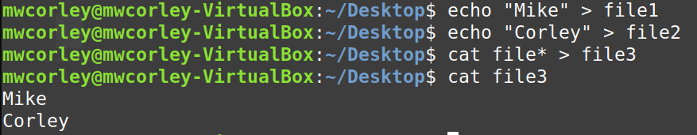
Redirecting STDIN (page 59)
Consider the Unix cat program – Concatenate Files
The cat command reads one or more files and copies them to standard output (note wildcard expand is sorted order)
Now run cat with no file arguments (assumes stdin)
[me@linuxbox ~]$ cat
the quick brown fox jumped over the lazy dog.
Type Ctrl-d (i.e., hold down the Ctrl key and press “d”)
to tell cat that it has reached end of file (EOF) on stdin

Slide 12
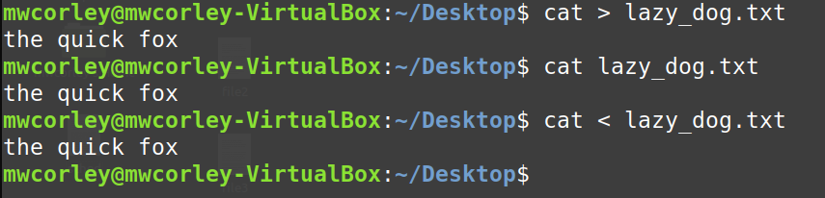
Redirecting STDIN
Now run cat with no arguments again….
[me@linuxbox ~]$ cat
Type: the quick brown fox jumped over the lazy dog.
Type Ctrl-d (signal EOF)
Using the < redirection operator
the source of stdin changed from the keyboard to the file lazy_dog.txt. We see that the result is the same as passing a single file

Slide 13
Pipelines
read data from stdin and send to stdout is utilized by a shell feature called pipelines.
Using the pipe operator | (vertical bar)
standard output of one command can be piped into the standard input of another.
command1|command2
[me@linuxbox ~]$ ls -l /usr/bin | less

Slide 14
Pipe (|) Versus Redirection (>) - page 62
The Difference Between > and |
the redirection operator connects a command with a file
command1 > file1 -> echo “hello” > temp
the pipeline operator connects the output of one command with the input of a second command
command1 | command2 -> ls -l /usr/bin | less
Be carful when you are learning about pipelines
What does command1 > command2
Answer: sometimes something really bad.
# cd /usr/bin
# ls > less
Notice the # indicates root, (wiped out the less program)

Slide 15
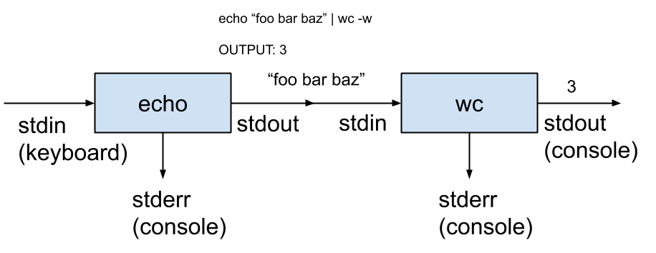
Pipeline (concept)
Source: https://github.com/kennyyu/bootcamp-unix/wiki/stdin,-stdout,-stderr,-and-pipes

Slide 16
Tee command
[me@linuxbox ~]$ ls /usr/bin | tee ls.txt | grep zip
ls
tee
grep
stdin
stdout
stdin
stdout
stderr
stdout
stderr
Console
Console

Slide 17
Filters - piping command together
https://mwcorley79.github.io/MikeCorley/presentations/TLCL-19.01.pdf#page=86 (The Linux Command Line, William Shotts)
sort (page 62) --
uniq (unique) -- removes duplicates
wc (word count)
grep (page 63)
head and tail (page 64)
tee

Slide 18
Chapter 7: The Shell – Expansion and substitution
Expansion
arithmetic
Brace
Parameter (shell variables)
Substitution
Quoting
https://mwcorley79.github.io/MikeCorley/presentations/TLCL-19.01.pdf#page=86

Slide 19
Chapter 8: Keyboard shortcuts
https://mwcorley79.github.io/MikeCorley/presentations/TLCL-19.01.pdf#page=86
Command history
Completion
script

Slide 20
Chapter 9: Permissions
https://mwcorley79.github.io/MikeCorley/presentations/TLCL-19.01.pdf#page=86
id – Display user identity
chmod – Change a file's mode
umask – Set the default file permissions
su – Run a shell as another user
sudo – Execute a command as another user
chown – Change a file's owner Permissions
chgrp – Change a file's group ownership
passwd – Change a user's pass

Slide 21
umask
controls the default permissions given to a file when it is created.
octal notation to express a mask of bits to be removed from a file's mode attributes.

Slide 22
chmod examples
chmod g+rx a.out
- give the group read + execute permissions
chmod g+rwx,o-x a.out
- give the group read + write + execute permissions, take way execute for the world
chmod u+rwx,g+rx,o-rwx a.out == chmod 750
Give the owner full access (rwx), the group (rx), take away all access to the world

Slide 23
Special permissions: setuid, setgid, sticky bit
setuid bit (octal 4000).
When applied to an executable file,it sets the effective user ID from that of the real user (the user actually running the program) to that of the program's owner.
chmod u+s program
setgid bit (octal 2000), which, like the setuidbit, changes the effective group ID from the real group ID
sticky bit (octal 1000)
prevents users from deleting or renaming files unless the user is either the owner of the directory, the owner of the file, or the superuser
often used to control access to a shared directory, such as /tmp.

Slide 24
Essential security related commands
id – Display user identity
chmod – Change a file's mode
umask – Set the default file permissions
su – Run a shell as another user
sudo – Execute a command as another user
chown – Change a file's owner90

Slide 25
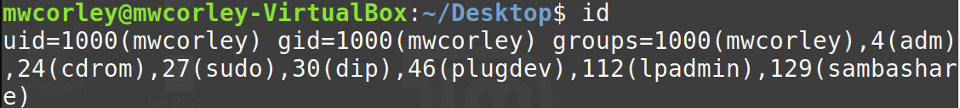
Owners, Groups, and Everyone else (the world)
user may own files and directories.
user has control over the files and directories owned
Users can, in turn, belong to a group consisting of one or more users who are granted access to files and directories by their respective owners.
an user/owner may grant some set of access rights to everybody, which in Unix terms is referred to as the world.

Slide 26
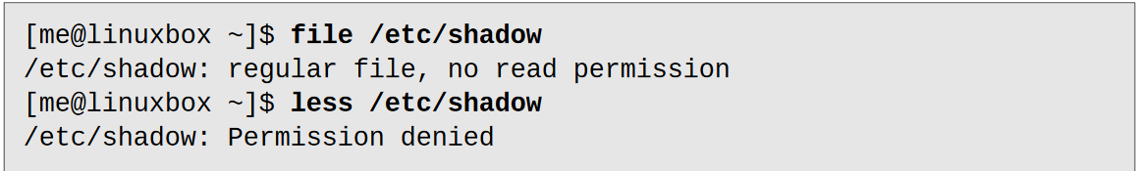
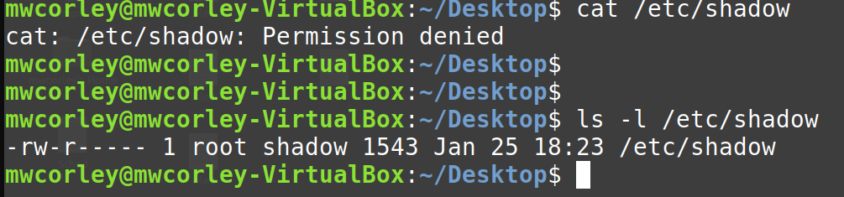
File Attributes: Read, Write, Execute Permissions

Slide 27
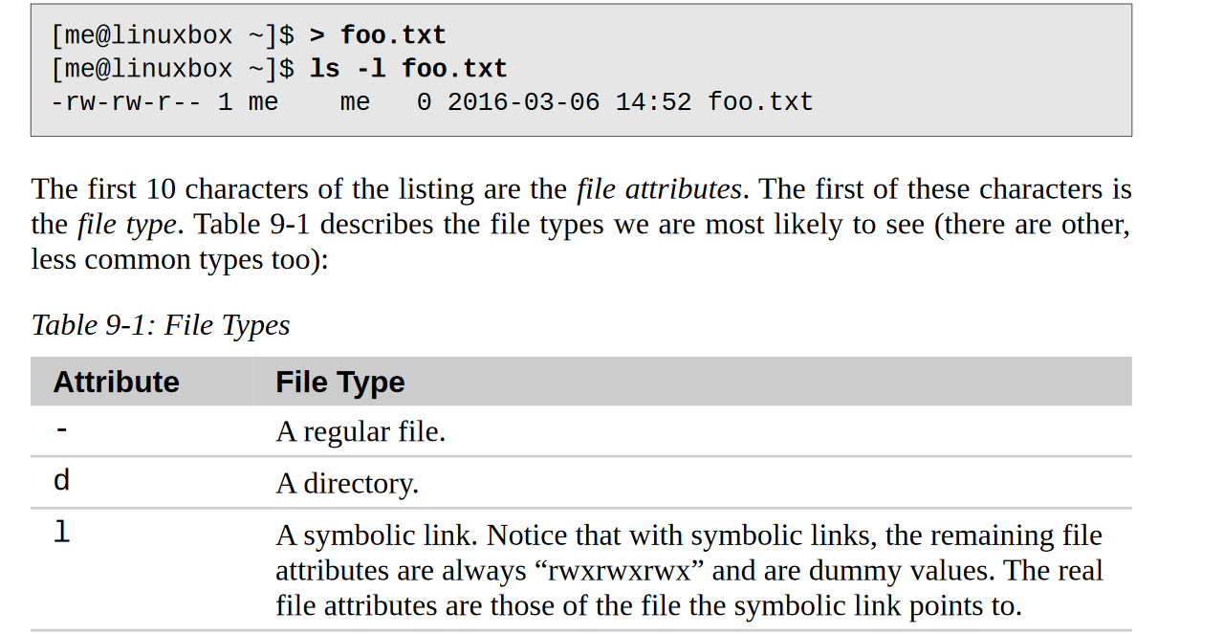
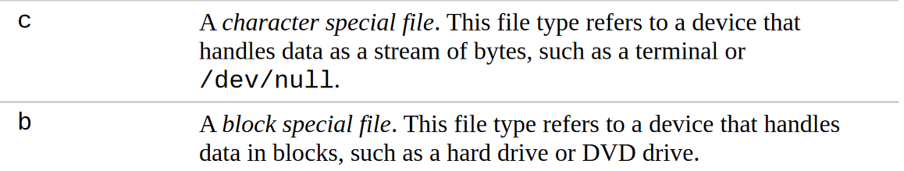

Slide 28
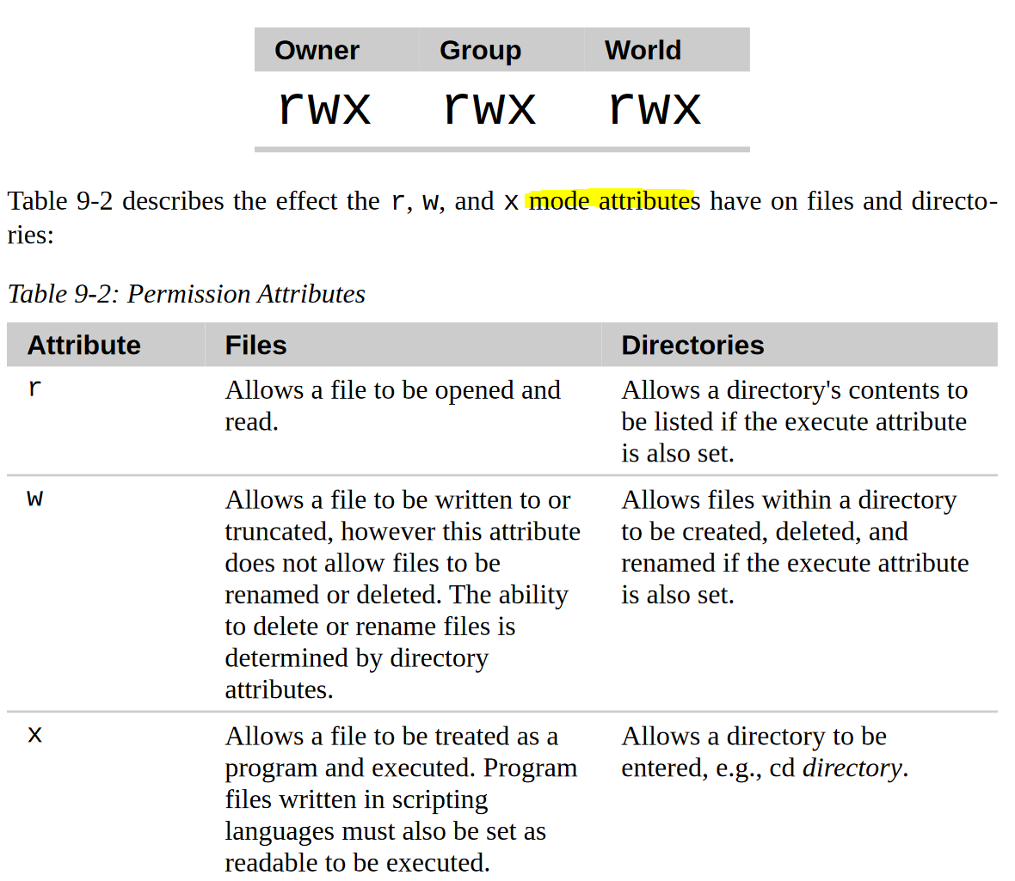

Slide 29
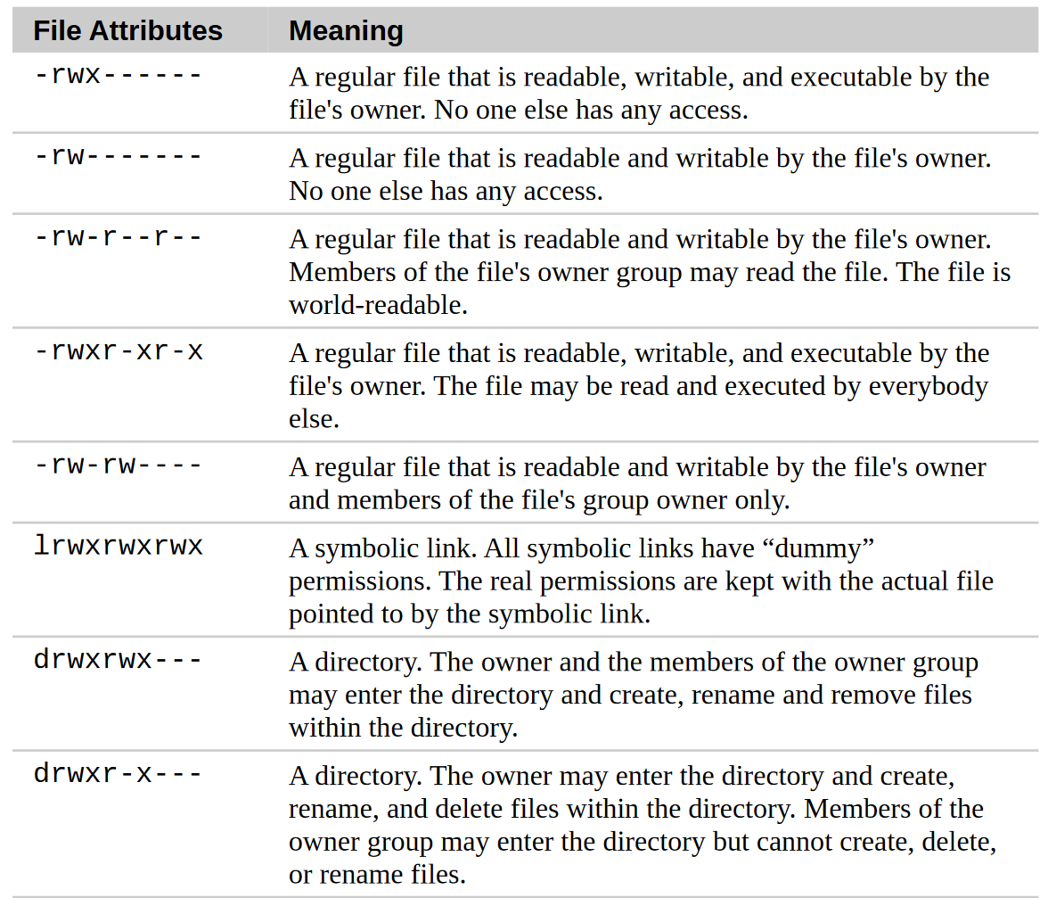

Slide 30
chmod - change the mode (permissions) of a file or directory
only the file’s owner or the superuser can change the mode of a file or direc-tory
supports two distinct ways of specifying mode changes: octal number repre-sentation, or symbolic representatio
Octal (base 8), hexadecimal (base 16)
number systems often used to express numbers on computers.

Slide 31
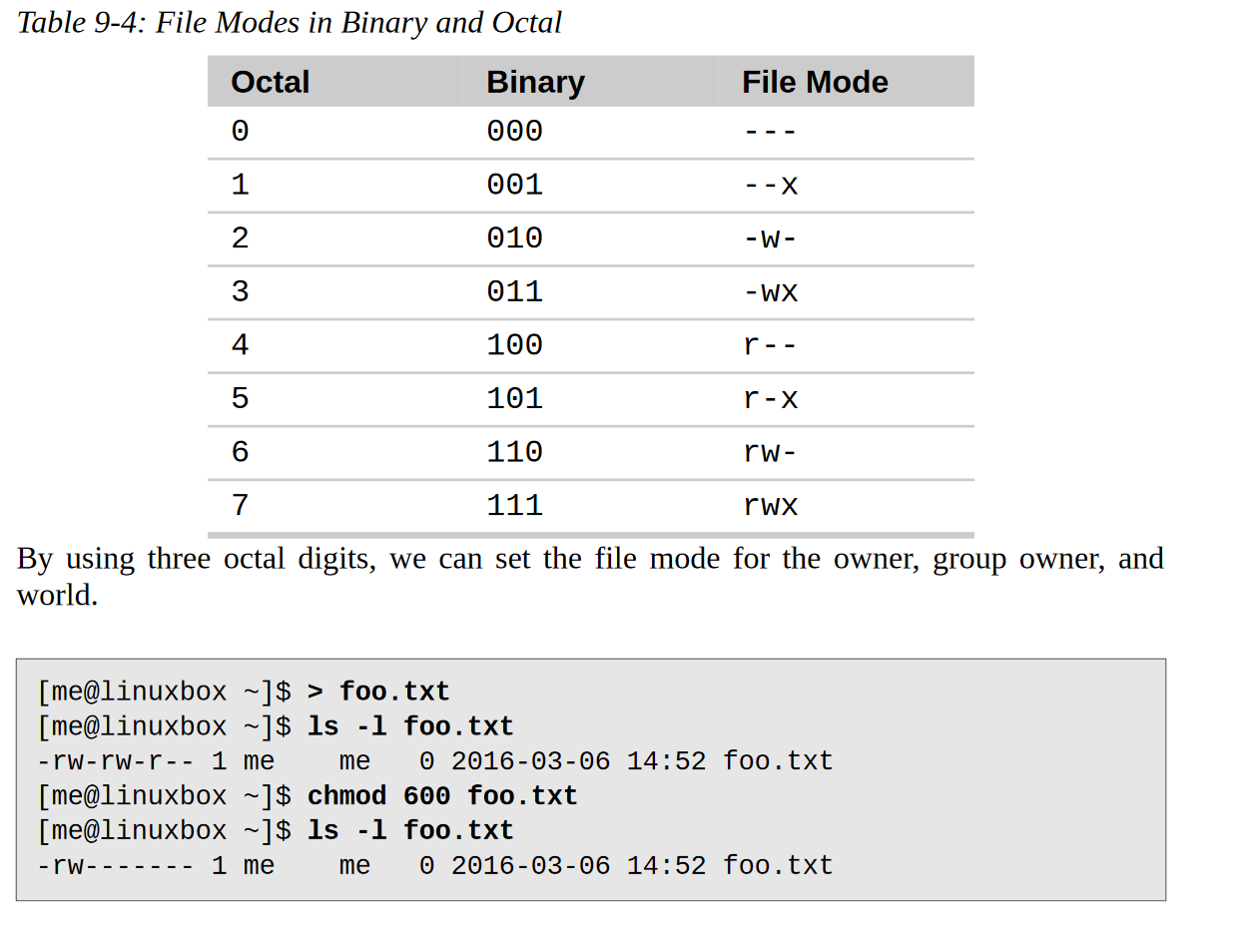

Slide 32
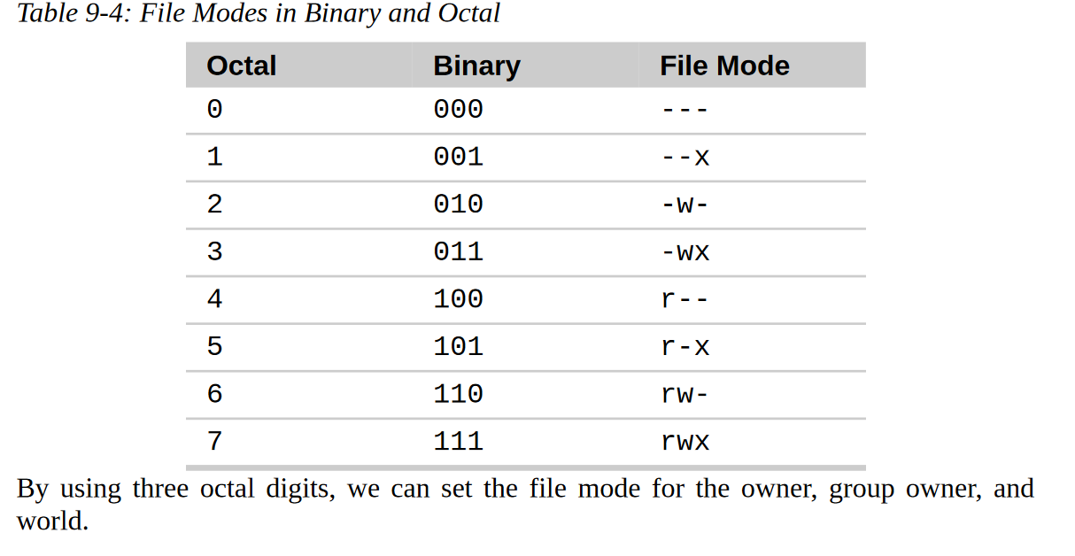
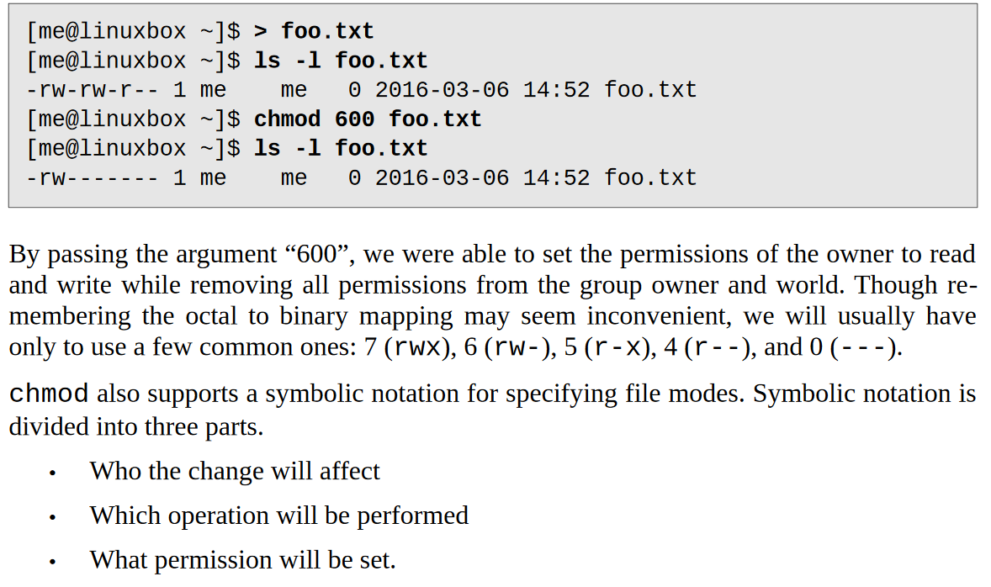

Slide 33
rwx-r--r
111010

Slide 34
chmod examples

Slide 35
chown

Slide 36
SU and SUDO

