Slide 1
CSE 384 (Lecture 7): Common Unix Tools and Shell Scripting
Spring 2020

Slide 2
Overview
Editors
Commonly Used Tools
Editors
vi
Grep (regex)
Locate
Find
Sed
Awk
Tar
Gzip

Slide 3
Editors - create/edit text files
Vi / Vim originally written in 1976 by Bill Joy, a University of California at Berkley student who later went on to co-found Sun Microsystems
Emacs originally written in 1976 by Carl Mikkelsen, David A. Moon and Guy L. Steele Jr has over 10,000 built-in commands and its user interface allows the user to combine these commands into macros to automate work
ex - EXtended, is a line editor for Unix systems
GNU nano is a text editor for Unix-like computing systems or operating environments using a command line interface.
gedit is the default text editor of the GNOME desktop environment and part of the GNOME Core Applications.

Slide 4
VI/VIM - screen-oriented text editor
vi was originally written in 1976 by Bill Joy, a University of California at Berkley student who later went on to co-found Sun Microsystems
lightweight and fast, and always available.
Important (these days) if the system has no graphical interface
POSIX compatibility on Unix systems, requires that vi be present
$ vi file.txt
i, o, a, etc (insert mode), esc (command mode) ~, cw, dw, dNw, dd,
Ex – line editor: $:%s/expression/replacement
See vi Cheat sheet
http://www.atmos.albany.edu/daes/atmclasses/atm350/vi_cheat_sheet.pdf
Class Text: The Linux Command Line (Chapter 12)

Slide 5
Commonly used tools…
grep – search for patterns in text files
find – search for files in a directory hierarchy
locate – find files by name
AWK – (text processing language) pattern scanning and processing
sed - stream editor for filtering and transforming text
tar – (tape) archiving utility
gzip – (gnu) zip – compress and expand files

Slide 6
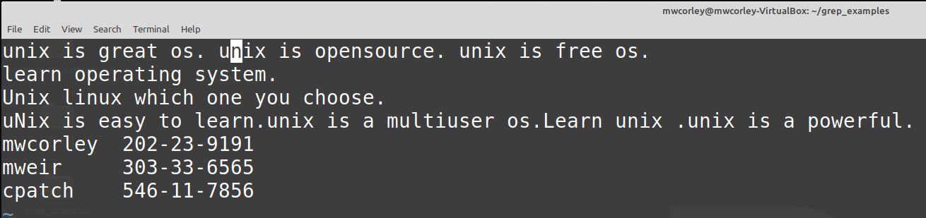
Sample test file for examples: geekfile.txt

Slide 7
Grep (G/re/p) - “global regular expression print”
searches text files for the occurrence text matching a specified regular expression and outputs any line containing a match to standard output
Regular expression
special text string for describing a search pattern. You can think of regular expressions as wildcards on steroids.
Resources / Examples
Grep
https://www.geeksforgeeks.org/grep-command-in-unixlinux/
Regex
https://www.regular-expressions.info/
See Class Text: The Linux Command Line Chapter 19

Slide 8
Grep Examples: Class Text: The Linux Command Line Chapter 19
$ grep -i "UNix" geekfile.txt
Search and match lines “UNix” string , disregard case
$ grep -ic "UNix" geekfile.txt
Like previous, but count the match occurrences
$ grep -i "^UNix" geekfile.txt
Search and match lines beginning with string “UNix”, disregard case
$ grep -i '^Unix.*os.$' geekfile.txt
Search and match lines beginning with string “UNix”, followed by any number of characters, and ending with string “os.”
$ grep '[0-9]\{3\}-\{0,1\}[0-9]\{2\}-\{0,1\}[0-9]\{4\}' geekfile.txt
Match social security numbers -- assume search applications for PII (personally identifiable information)
$ grep -H '[0-9]\{3\}-\{0,1\}[0-9]\{2\}-\{0,1\}[0-9]\{4\}' geekfile.txt
$ grep -l '[0-9]\{3\}-\{0,1\}[0-9]\{2\}-\{0,1\}[0-9]\{4\}' f*.txt

Slide 9
Common tools for locating files
Locate
Find files by name
Find
Search for files in a directory hierarchy
xargs
Build and execute command lines from standard input
Chapter 17: Searching for Files

Slide 10
Locate - find files by name
performs a rapid database search of pathnames, and outputs every name that matches a given substring
Example
find all the programs with names that begin with zip
locate bin/zip
locate zip
locate zip | grep zip$
Chapter 17: Searching for Files (Locate)

Slide 11
Find - search for files in a directory hierarchy
searches a given directory (and its subdirectories) for files based on a variety of attributes
Uses the notion of tests and actions
Examples
$ find ~ | wc -l
$ find ~ -type d | wc -l
$ find ~ -type f -name "*.c" -size +1k
$ find . -type f -name 'f*' -exec ls -l '{}' ';'
$ find . -type f -name 'f*' -ok ls -l '{}' ';'
$ find . -type f -name 'f*' -exec grep -H '[0-9]\{3\}-\{1\}[0-9]\{2\}-\{1\}[0-9]\{4\}' '{}' ';'
$ find . -type f -name 'f*' | xargs grep '[0-9]\{3\}-\{1\}[0-9]\{2\}-\{1\}[0-9]\{4\}'
Chapter 17: Searching for Files

Slide 12
Xargs
Accepts input from standard in-put and converts it into an argument list for a specified command
Example:
$ echo 'one two three' | xargs mkdir
$ echo 'one two three' | xargs rmdir
$ find ~ -type f -name 'f*' -print | xargs ls -l
$ time find ~ -type f -name 'f*' -exec grep '[0-9]\{3\}-\{1\}[0-9]\{2\}-\{1\}[0-9]\{4\}' '{}' ';'
$ time find ~ -type f -name 'f*' | xargs grep '[0-9]\{3\}-\{1\}[0-9]\{2\}-\{1\}[0-9]\{4\}'

Slide 13
Sed – Stream editor
text editing on a stream of text, either a set of specified files or standard input.
Use a single editing command (on the command line) or the name of a script file containing multiple commands
performs commands upon each line in the stream of text.
sed 's/Unix/windows/gI' geekfile.txt
cat geekfile.txt | sed '4s/unix/windows/gI’
sed 's/[Ll]inux/Unix/g' geekfile.txt > output.txt
https://mwcorley79.github.io/MikeCorley/presentations/TLCL-19.01.pdf#page=325

Slide 14
AWK - interpreted programming language
AWK is an interpreted programming language, specially designed for text processing. Named after the authors (Alfred Aho, Peter Weinberger, and Brian Kernighan).
Typical uses
Producing formatted text reports,
Performing arithmetic operations,
Performing string operations, and many more.
Tutorial: https://www.tutorialspoint.com/awk/awk_overview.htm

Slide 15
Wait! What is a Shell again ?
The shell is a program that takes keyboard commands and passes them to the operating system to carry out.
Source: The Linux Command Line, Fifth edition, page 2
The shell is the command interpreter in an operating system such as Unix or GNU/Linux, it is a program that executes other programs.
Source: https://www.tecmint.com/different-types-of-linux-shells/
The shell is both an interactive command language and a scripting language, and is used by the operating system to control the execution of the system using shell scripts
Source: https://en.wikipedia.org/wiki/Shell_script

Slide 16
Background
Bourne Shell (sh): Steven Bourne – 1977
AT&T Bell Labs for V7 UNIX, remains a useful shell today
introduced control flows, loops, and variables into scripts, providing a more functional language to interact with the operating system (both interactively and noninteractively).
C Shell (csh): Bill Joy - 1978
A graduate student at the University of California, Berkeley, developed for Berkeley Software Distribution (BSD) UNIX systems
A key design objectives for the C shell was to create a scripting language that looked similar to the C language.
Introduced command history
This material found at: https://developer.ibm.com/tutorials/l-linux-shells/

Slide 17
Background
Tenex C shell (tcsh): Ken Greer, 1983
Carnegie Mellon University
backward-compatible with csh, but improved its overall interactive features.
Korn shell (ksh): David Korn, 1983
used as a scripting language in addition to being backward-compatible with the original Bourne shell.
Bourne-Again Shell (BASH): Brian Fox, 1989
an open source GNU project intended to replace the Bourne shell
A superset of the Bourne shell
incorporated features from the Korn and C shells
One of the most widely used shells
This material found at: https://developer.ibm.com/tutorials/l-linux-shells/

Slide 18
Writing Shell Scripts (Overview)
We’ve covered the first 9+ chapters of the Linux Command Line
We’ve discussed many of the basic commands for navigating, and managing a Linux system.
foundational ideas including, Files, I/O redirection and pipelines, a
handful of the important tools to accomplish useful work.
However, using the shell by supplying command lines (one a time). Granted this is useful,
By joining our tools together into programs of our
The shell can carry out complex sequences of tasks with the command line alone, but shell scripts unlock the power of the Linux system.
Writing Shell Scripts
http://linuxcommand.org/lc3_writing_shell_scripts.php#contents

Slide 19
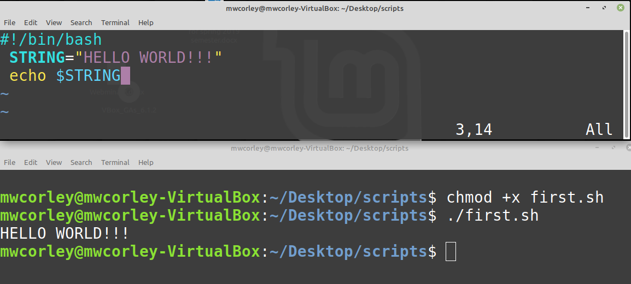
First BASH script: first.sh

Slide 20
Setting up your environment
Consider putting your scripts in local bin folder: ~/bin and adding that to your PATH variable: export PATH=~/bin:"$PATH“
Update the interactive shell by sourcing it. $ . .bashrc
Cause the shell to re-read the .bashrc
.bashrc is shell script that runs when BASH is started
initializes the interactive shell session
A second, and better option to update the PATH variable from .bashrc (or the .profile )
If your don’t set your PATH, then no problem, you’ll just have to proceed every script/exe with “./ “ as in ./script_name.sh

Slide 21
Shebang (#!) - or the “bang” line
The #! syntax is used in scripts to indicate an interpreter for execution under UNIX / Linux operating systems.
Most script starts with the following line: #!/bin/interpreter
absolute path to the interpreter need to run the program
For BASH scripts
#!/bin/bash
Python
#!/usr/bin/python
https://bash.cyberciti.biz/guide/Shebang

Slide 22
How does #! Work?
#! - human readable magic number consisting of the byte string 0x23 0x21
The kernel uses the exec() family of functions (system calls) to determine whether the executable file to be executed is a script (interpreted) or a binary
Need to set the execute bit for exec() to work
exec() replaces a process image with a new process image: consider a shell: fork() -> new process -> exec(new process, process image) -> child process
Exec() reads the magic number of executable file, if the “#!” is present the executable present after #! Is run instead
Run: xxd (hexdump) somescript, man exec, man fork

Slide 23
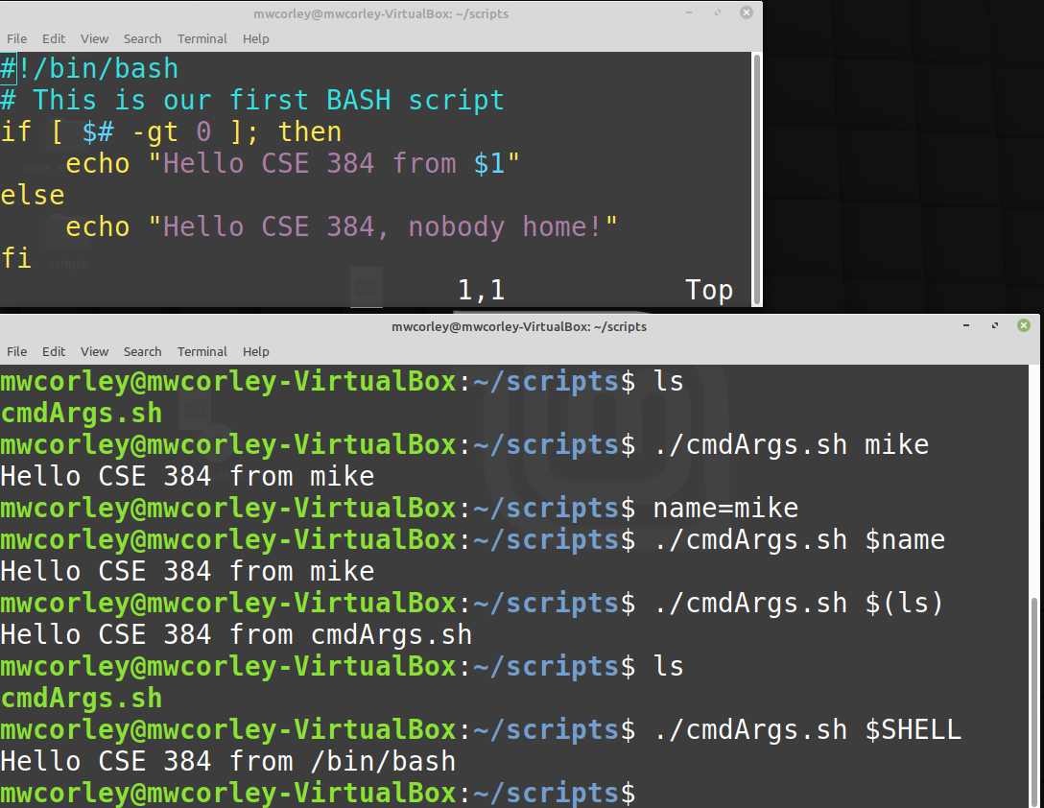
First script with command line argument

Slide 24
Special variables to be aware of… (demoSpecialVars1.sh)
$0 - The name of the Bash script.
$1, $2, $3,… - user (command line) arguments supplied to the Bash script.
$# - number arguments supplied to the Bash script.
$@ - All the arguments supplied to the Bash script.
When quoted expand to separate strings
$* - All the arguments supplied to the Bash script
When quoted expand to single string
$? - The exit status of the most recently run process.
$$ - The process ID of the current script.
$USER - The username of the user running the script.
$HOSTNAME - The hostname of the machine the script is running on.
$SECONDS - The number of seconds since the script was started.
$RANDOM - Returns a different random number.
$LINENO - Returns the current line number in the Bash script.
Source: https://ryanstutorials.net/bash-scripting-tutorial/bash-variables.php
https://www.bogotobogo.com/Linux/linux_shell_programming_tutorial3_special_variables.php

Slide 25
BASH If Statement: (demoIf.sh)
if [ <some test> ] then <commands> fi
Tests
brackets ( [ ] ) reference to the command test.
All of the operators that test supports can be used in the if statement
Sets exit status of 0 (true) or 1 (false) depending on
the evaluation of EXPR.
Run man test to see all of the possible operators
http://linuxcommand.org/lc3_man_pages/testh.html
Source: https://ryanstutorials.net/bash-scripting-tutorial/bash-if-statements.php

Slide 26
Bash Functions: (demoFunctionsLoops.sh)
functions don’t allow return a values
return value is the exit status of the last statement executed in the function,
0 for success
non-zero decimal number in the 1 - 255 range for failure
return status can be specified by using the return keyword
assigned to the variable $?.
return statement terminates the function. You can think of it as the function’s exit status.
See example
Source: https://linuxize.com/post/bash-functions/
Source https://ryanstutorials.net/bash-scripting-tutorial/bash-loops.php

Slide 27
BASH arrays: (demoArrays.sh)
There a number of ways to declare an use arrays, this is one way..
distro=("redhat" "debian" "gentoo" "ubuntu" "mint")
Source: https://www.cyberciti.biz/faq/finding-bash-shell-array-length-elements/

Slide 28
Examples: examples.tar.gz
readExample.sh
demo BASH keyboard input and output
demoSpecialVars.sh
Demonstrate $@,
demoFunctionsLoops.sh
Demo BASH loops, functions and return values
demoArrays.sh
A quick little array demo
demoMenu.sh
Demonstrate to create menu prompt with case statement
demoCountWords.sh
Test various commands with in a shell script
GetLectures.sh
Demonstrate reading URLs from the text file, and downloading (curl) content from the web

