Slide 1

Introduction to
Linux
Augustine Abaris
Research Computing Services
Information Services & Technology

Slide 2
Topics for Today
Research Computing Services
Linux Overview
Linux Interaction - Shell and Commands
I/O redirection (pipes, etc.)
Navigating the file system
Processes and job control
Editors
Creating and Running Code

Slide 3
Linux

Slide 4
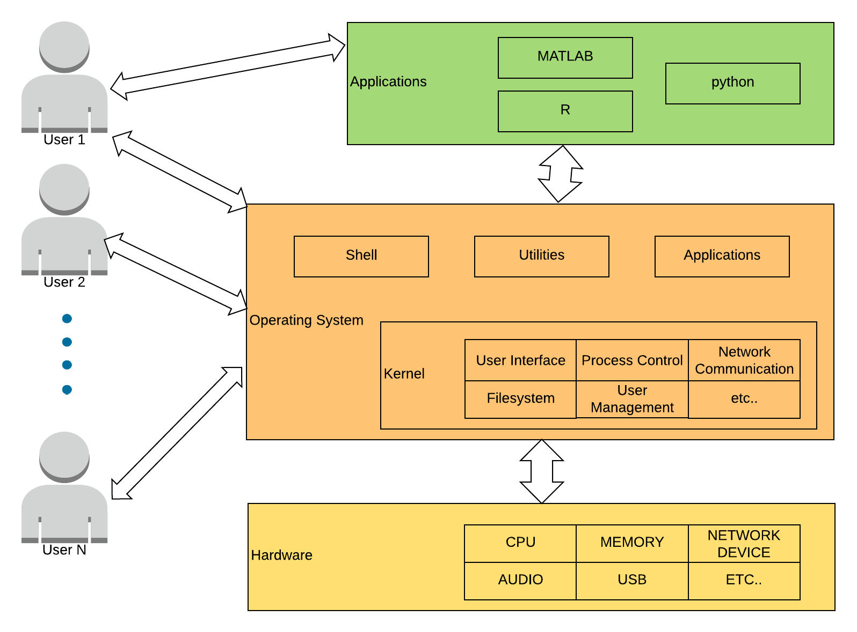
What is an operating system?

Slide 5
What is Linux?
Operating System
Originated in early-90s
Free
Open Source

Slide 6
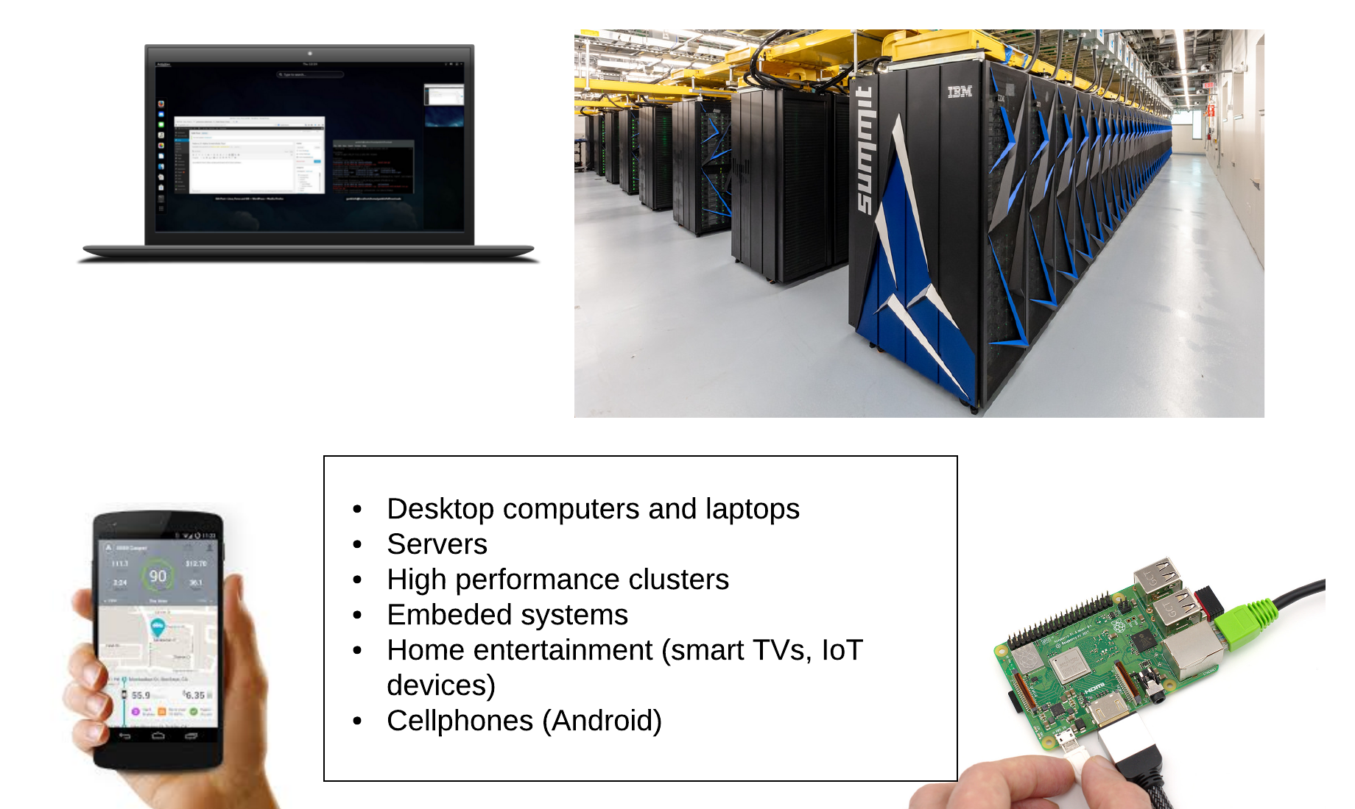
Where is Linux?

Slide 7

Why Linux
The most common OS used
by BU researchers when working on a server or computer cluster
Free and open-source.
Powerful for research datacenters
Personal for desktops and phones
Universal
Community (and business) driven.

Slide 8
Connecting
Let’s use Linux

Slide 9


Local System
Remote Server

Slide 10
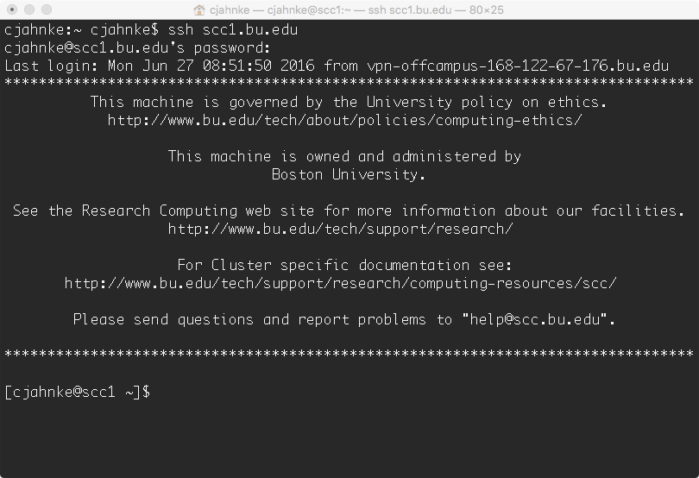
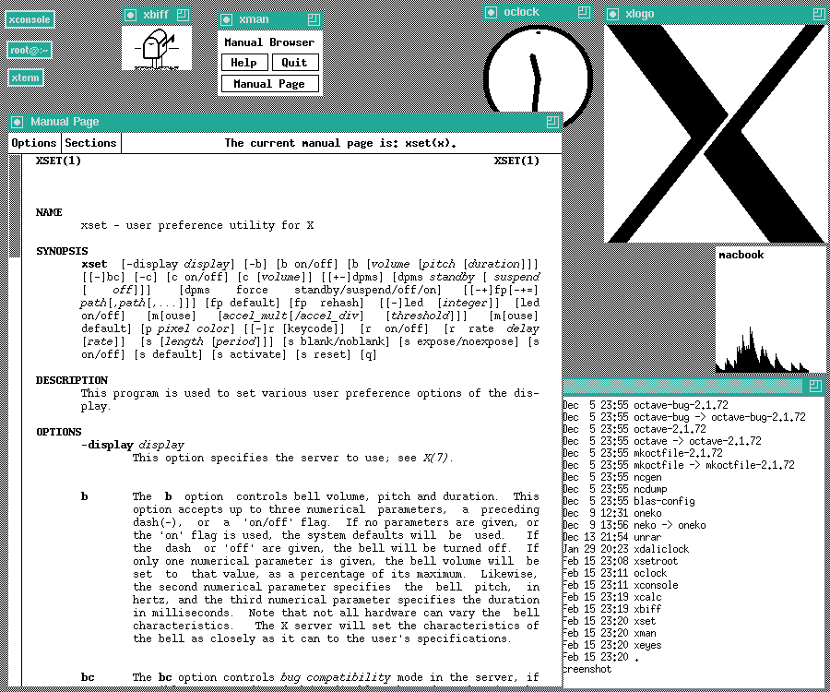
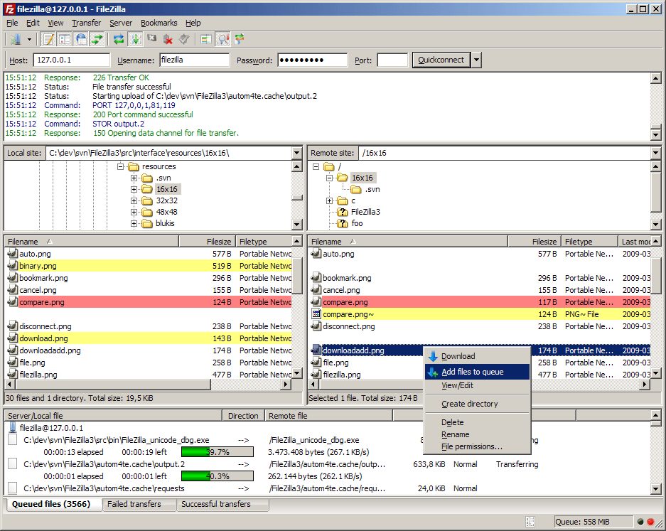
Connection Protocols and Software
Remote Connections:
Secure SHell
(SSH)
Remote Graphics:
X-Windowing
(X, X-Win)
Data Transfer:
Secure File Transfer Protocol (SFTP)
Other protocols too, but let’s start with these.

Slide 11
Connecting from Different Platforms
 | SSH | X-Win | SFTP
Microsoft Windows |  | MobaXterm https://mobaxterm.mobatek.net
Apple macOS | Terminal (Built in) | XQuartz https://www.xquartz.org | Cyberduck https://cyberduck.io
Linux | Terminal (Built in) | X11 (Built in) | Various (Built in)
SCC Help: http://www.bu.edu/tech/support/research/system-usage/getting-started
Notes:
Filezilla: https://filezilla-project.org/ (cross-platform, open-source)
Cyberduck: https://cyberduck.io (macOS native, drag-and-drop)

Slide 12

Microsoft Windows
You need software that emulates an “X” terminal and
that connects using the “SSH” Secure Shell protocol.
Recommended: MobaXterm
  Download: http://mobaxterm.mobatek.net/
Alternatives:
  SSH/X-Windows: X-Win32
  https://www.bu.edu/tech/services/support/desktop/distribution/xwindows/
  SFTP: Filezilla
  https://filezilla-project.org/
SCC Help: http://www.bu.edu/tech/support/research/system-usage/getting-started/connect-ssh

Slide 13


Apple macOS
Built in!
Apple macOS is built on Darwin -- a derivative of 4.4BSD-Lite2 and FreeBSD
SSH: Terminal
  Built in to macOS
  Applications > Utilities > Terminal
X-Windows: XQuartz
  Download: https://www.xquartz.org/
  Note: This install requires a logout.
SFTP: Your choice
  Filezilla: https://filezilla-project.org/ (Cross-platform, open-source)
  Cyberduck: https://cyberduck.io (macOS native, drag-and-drop)
  Many others
SCC Help: http://www.bu.edu/tech/support/research/system-usage/getting-started/connect-ssh

Slide 14


Linux
SSH: Terminal
  Built in to Linux
  Applications > System > Terminal
X-Windows: X11
  Built in to Linux
  Use your package manager.
SFTP: Your choice
  Usually has one Built in.
  Alternate: Filezilla (https://filezilla-project.org/)
SCC Help: http://www.bu.edu/tech/support/research/system-usage/getting-started/connect-ssh

Slide 15
Connecting
Use your Shared Computing Cluster account if you have one.
Tutorial accounts if you need one.
  Username: tuta[1-20]
  Password: VizTut[1-20]
Tutorial credentials blocked for print.
This box disappears during presentation
[local_prompt]$ ssh username@scc1.bu.edu username@scc1.bu.edu’s Password:
[username@scc1 ~]$

Slide 16
Get supplementary files
At the command prompt, type the following:
[username@scc1 ~]$ cd ~
[username@scc1 ~]$ tar xf /scratch/linux-materials.tar
[username@scc1 ~]$ ls
c data haystack scripts

Slide 17

Linux Interaction
Shell, Prompt, Commands and System Use

Slide 18
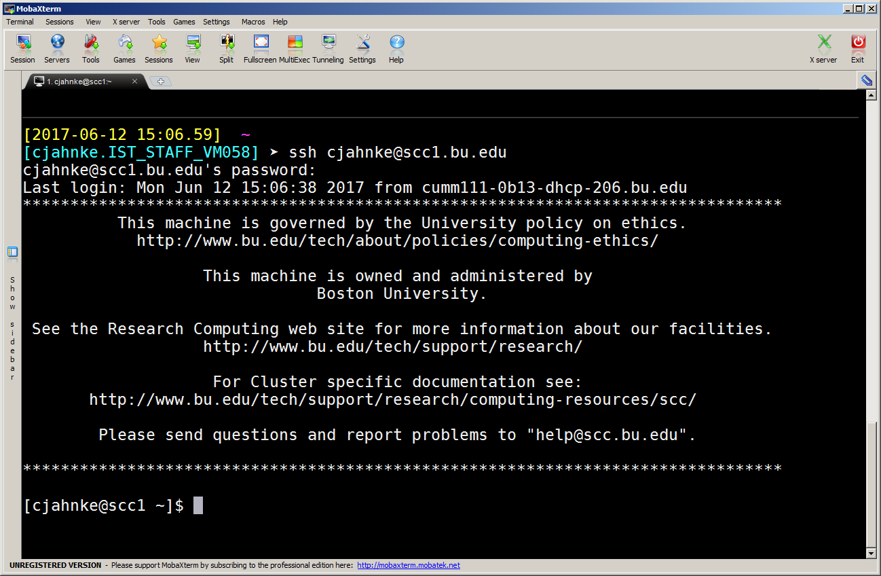
Linux: The Shell
Program that interprets commands and sends them to the OS
Provides:
  Built-in commands
  Programming control structures
  Environment variables
Linux supports multiple shells.
  The default on SCC is Bash.
“Bash” = “Bourne-again Shell”
(GNU version of ~1977 shell written by Stephen Bourne)

Slide 19
Linux: The “prompt”
Your Username
Current Directory
[username@scc1 ~]$
The System Name
Input
( In Linux “ ~ ” is a shorthand for your home directory. )

Slide 20
Linux: Command Basics
Command: Command/program that does one thing
Options: Change the way a command does that one thing
  Short form: Single-dash and one letter e.g. ls -a
  Long form: Double-dash and a word e.g. ls --all
Argument: Provides the input/output that the command interacts with.
For more information about any command, use man or info (e.g. “man ls”)
[username@scc1 ~]$ command --option argument

Slide 21
Commands: Hands-On
After you connect, type
  whoami # my login
  hostname # name of this computer
  echo “Hello, world” # print characters to screen
  echo $HOME # print environment variable
  echo my login is $(whoami) # replace $(xx) with program output
  date # print current time/date
  cal # print this month’s calendar
  shazam # bad command

Slide 22
Commands: Hands-On Options
Commands have three parts; command, options and arguments/parameters.
Example: cal –j 3 1999. “cal” is the command, “-j” is an option (or switch), “3” and “1999” are arguments/parameters.
What is the nature of the prompt?
What was the system’s response to the command?
[username@scc1 ~]$ cal -j 3 1999

Slide 23
Commands
“Small programs that do one thing well”
The Unix Programming Environment, Kernighan and Pike
… at its heart is the idea that the power of a system comes more from the relationships among programs than from the programs themselves. Many UNIX programs do quite trivial things in isolation, but, combined with other programs, become general and useful tools.

Slide 24
Commands: Selected text processing utilities
awk Pattern scanning and processing language
cat Display file(s)
cut Extract selected fields of each line of a file
diff Compare two files
grep Search text for a pattern
head Display the first part of files
less Display files on a page-by-page basis
sed Stream editor (esp. search and replace)
sort Sort text files
split Split files
tail Display the last part of a file
tr Translate/delete characters
uniq Filter out repeated lines in a file
wc Line, word and character count
Just a few of the commands for text processing

Slide 25
Variables and Environment Variables
Variables are named storage locations.
  USER=augustin
  foo=“this is foo’s value”
“Environment variables” are variables used and shared by the shell
  For example, $PATH tells the system where to find commands.
Environment variables are shared with programs that the shell runs.

Slide 26
Bash variables
To create a new variable, use the assignment operator ‘=‘
The foo variable can be printed with echo
To make $foo visible to programs run by the shell (i.e., make it an “environment variable”), use export:
[username@scc1 ~]$ foo=“this is foo’s value”
[username@scc1 ~]$ echo $foo
this is foo’s value
[username@scc1 ~]$ export foo

Slide 27
Environment Variables
To see all currently defined environment variable, use printenv:
[username@scc1 ~]$ printenv
HOSTNAME=scc1
TERM=xterm-256color
SHELL=/bin/bash
HISTSIZE=1000
TMPDIR=/scratch
SSH_CLIENT=168.122.9.131 37606 22
SSH_TTY=/dev/pts/191
USER=cjahnke
MAIL=/var/spool/mail/cjahnke
PATH=/usr3/bustaff/cjahnke/apps/bin:/usr/local/bin:/bin:/usr/bin:/usr/local/sbin:/usr/sbin:/sbin
PWD=/usr3/bustaff/cjahnke/linux-materials
LANG=C
MODULEPATH=/share/module/bioinformatics:/share/module/chemistry
SGE_ROOT=/usr/local/ogs-ge2011.11.p1/sge_root
HOME=/usr3/bustaff/cjahnke

Slide 28
Command History and Command Line Editing
Try the history command
Choose from the command history using the up ↑ and down ↓ arrows
To redo your last command, try !!
To go further back in the command history try !, then the number as shown by history (e.g., !132). Or, !ls, for example, to match the most recent ‘ls’ command.
What do the left ← and right → arrow do on the command line?
Try the <Del> and <Backspace> keys

Slide 29

Help with Commands
Type
  date –-help
  man date
  info date
BASH built-ins
  A little different from other commands
  Just type the command ‘help’
  Or ‘man bash’
Yes, you can always Google it.

Slide 30
On using ‘man’ with ‘less’
The man command outputs to a pager called less, which supports many ways of scrolling through text:
  Space, f # page forward
  b # page backward
  < # go to first line of file
  > # go to last line of file
  / # search forward (n to repeat)
  ? # search backward (N to repeat)
  h # display help
  q # quit help

Slide 31
I/O Redirection

Slide 32
I/O redirection with pipes
Many Linux commands print to “standard output”, which defaults to the terminal screen. The ‘|’ (pipe) character can be used to divert or “redirect” output to another program or filter.
  w # show who’s logged on
  w | less # pipe into the ‘less’ pager
  w | grep ‘tuta’ # pipe into grep, print lines containing ‘tuta’
  w | grep –v ‘tuta’ # print only lines not containing ‘tuta’
  w | grep ‘tuta’ | sed s/tuta/scholar/g
  # replace all ‘tuta’ with ‘scholar’

Slide 33
More examples of I/O redirection
Try the following (use up arrow to avoid retyping each line):
  w | wc # count lines
  w | cut –d ‘ ’ –f1 | sort # sort users
  w | cut –d ‘ ’ –f1 | sort | uniq # eliminate duplicates
We can also redirect output into a file:
  w | cut –d ‘ ’ –f1 | sort | uniq > users
Note that ‘awk’ can be used instead of ‘cut’:
  w | awk ‘{print $1;}’ | sort | uniq > users
Quiz:
  How might we count the number of distinct users currently logged in? For extra credit, how can we avoid over-counting by 2? (Hint: use ‘tail’.)

Slide 34
The Filesystem

Slide 35
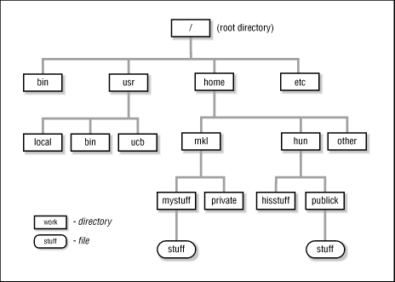
The Linux File System
The structure resembles an upside-down tree
Directories (a.k.a. folders) are collections of files and other directories.
Every directory has a parent except for the root directory.
Many directories have subdirectories.

Slide 36
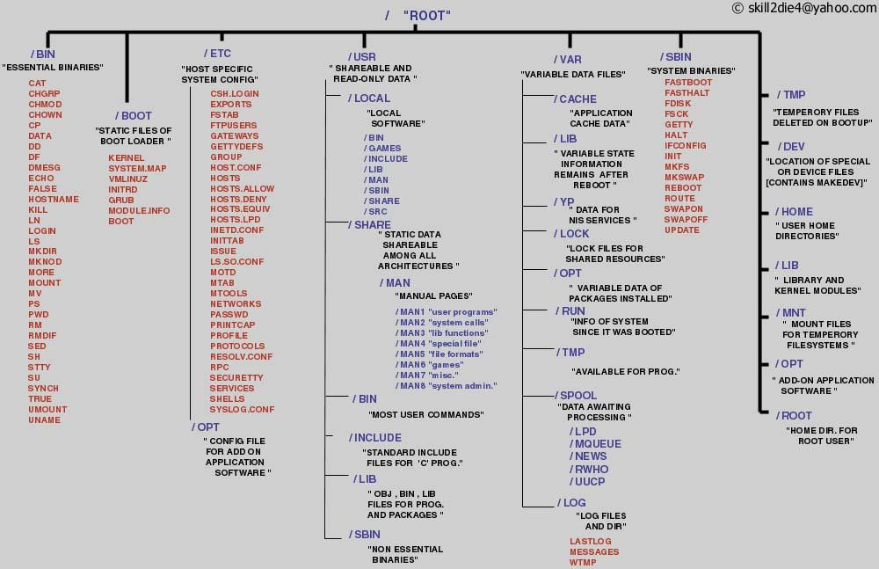

Slide 37
Navigating the File System
Essential navigation commands:
  pwd print current directory
  ls list files
  cd change directory

Slide 38
Navigating the File System
We use pathnames to refer to files and directories in the Linux file system.
There are two types of pathnames:
  Absolute – The full path to a directory or file; begins with /
  Relative – A partial path that is relative to the current working directory; does not begin with /

Slide 39
Navigating the File System
Special characters interpreted by the shell for filename expansion:
  ~ your home directory (e.g., /usr1/tutorial/tuta1)
  . current directory
  .. parent directory
  * wildcard matching any filename
  ? wildcard matching any character
  TAB try to complete (partially typed) filename

Slide 40
Navigating the File System
Examples:
  cd /usr/local Change directory to /usr/local/lib
  cd ~ Change to home directory (could just type ‘cd’)
  pwd Print working (current) directory
  cd .. Change directory to the “parent” directory
  cd / Change directory to the “root”
  ls –d pro* Listing of only the directories starting with “pro”

Slide 41
The ls Command
Useful options for the “ls” command:
  ls -a List all files, including hidden files beginning with a “.”
  ls -ld * List details about a directory and not its contents
  ls -F Put an indicator character at the end of each name
  ls –l Simple long listing
  ls –lR Recursive long listing
  ls –lh Give human readable file sizes
  ls –lS Sort files by file size
  ls –lt Sort files by modification time (very useful!)

Slide 42
Some Useful File Commands
cp [file1] [file2] copy file
mkdir [name] make directory
rmdir [name] remove (empty) directory
mv [file] [destination] move/rename file
rm [file] remove (-r for recursive)
file [file] identify file type
less [file] page through file
head -n N [file] display first N lines
tail -n N [file] display last N lines
ln –s [file] [new] create symbolic link
cat [file] [file2…] display file(s)
tac [file] [file2…] display file in reverse order
touch [file] update modification time
od [file] display file contents, esp. binary

Slide 43
Manipulating files and directories
Examples:
  cd # The same as cd ~
  mkdir test
  cd test
  echo ‘Hello everyone’ > myfile.txt
  echo ‘Goodbye all’ >> myfile.txt
  less myfile.txt
  mkdir subdir1/subdir2 # Fails. Why?
  mkdir -p subdir1/subdir2 # Succeeds
  mv myfile.txt subdir1/subdir2
  cd ..
  rmdir test # Fails. Why?
  rm –rf test # Succeeds

Slide 44
Symbolic links
Sometimes it is helpful to be able to access a file from multiple locations within the hierarchy. On a Windows system, we might create a “shortcut.” On a Linux system, we can create a symbolic link:
  mkdir foo # make foo directory
  touch foo/bar # create empty file
  ln –s foo/bar . # create link in current dir.

Slide 45
Finding a needle in a haystack
The find command has a rather unfriendly syntax, but can be exceedingly helpful for locating files in heavily nested directories.
Examples:
  find ~ -name bu –type d # search for “bu” directories in ~
  find . –name my-file.txt # search for my-file.txt in .
  find ~ -name ‘*.txt’ # search for “*.txt” in ~
Quiz:
  Can you use find to locate a file called “needle” in your haystack directory?
  Extra credit: what are the contents of the “needle” file?

Slide 46
Processes & Job Control

Slide 47
Processes and Job Control
As we interact with Linux, we create numbered instances of running programs called “processes.” You can use the ‘ps’ command to see a listing of your processes (and others!). To see a long listing, for example, of all processes on the system try:
To see all the processes owned by you and other members of the class, try:
[username@scc1 ~]$ ps -ef
[username@scc1 ~]$ ps -ef | grep tuta

Slide 48
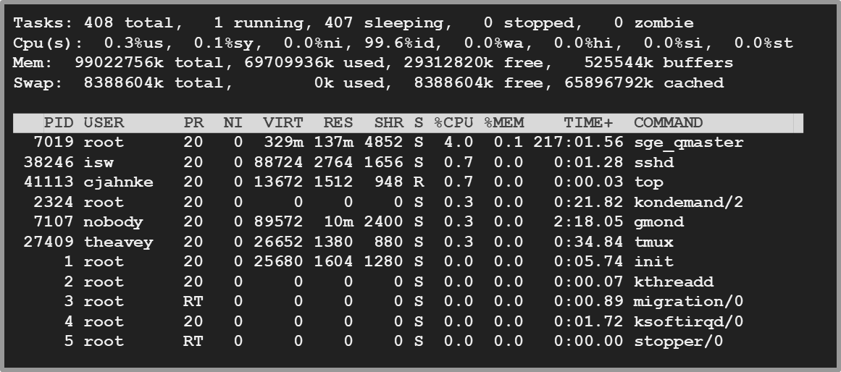
Processes and job control
Use “top” to see active processes.
(refreshes every 2 seconds)

Slide 49
Foreground/background
Thus far, we have run commands at the prompt and waited for them to complete. We call this running in the “foreground.”
Use the “&” operator, to run programs in the “background”,
  Prompt returns immediately without waiting for the command to complete:
[username@scc1 ~]$ mycommand &
[1] 54356
[username@scc1 ~]$
← process id

Slide 50
Process Control Practice
Let’s look at the “countdown” script, in your scripts folder for practice
Make the script executable with chmod:
First, run it for a few seconds, then kill with Control-C.
[username@scc1 ~]$ cd ~/scripts
[username@scc1 ~]$ cat countdown
[username@scc1 ~]$ chmod +x countdown
[username@scc1 ~]$ ./countdown 100
100
99
98
^C
← Ctrl-C = (^C)

Slide 51
Process control
Now, let’s try running it in the background with &:
The program’s output is distracting, so redirect it to a file:
[username@scc1 ~]$ ./countdown 60 &
[1] 54355
[username@scc1 ~]$
60
59
[username@scc1 ~]$ countdown 60 > c.txt &
[1] 54356
[username@scc1 ~]$

Slide 52
Process control
Type ‘ps’ to see your countdown process.
Also, try running ‘jobs’ to see any jobs running in the background from this bash shell.
To kill the job, use the ‘kill’ command, either with the five-digit process id:
  kill 54356
Or, you can use the job number (use ‘jobs’ to see list) with ‘%’:
  kill %1

Slide 53
Backgrounding a running job with C-z and ‘bg’
Sometimes you start a program, then decide to run it in the background.
[username@scc1 scripts]$ ./countdown 200 > c.out
^Z
[1]+ Stopped ./countdown 200 > c.out
[username@scc1 scripts]$ bg
[1]+ ./countdown 200 > c.out &
[username@scc1 scripts]$ jobs
[1]+ Running ./countdown 200 > c.out &
[username@scc1 scripts]$
← Ctrl-Z = (^Z)

Slide 54
Editors

Slide 55
Regular expressions
Many Linux tools, such as grep and sed, use strings that describe sequences of characters. These strings are called regular expressions.
Here are some examples:
  ^foo # line begins with “foo”
  bar$ # line ends with “bar”
  [0-9]\{3\} # 3-digit number
  .*a.*e.*i.*o.*u.* # words with vowels in order*

Slide 56
File Editors
gedit
  Notepad-like editor with some programming features (e.g., syntax highlighting). Requires X-Windows.
nano
  Lightweight editor. Non-Xwindows.
emacs
  Swiss-army knife, has modes for all major languages, and can be customized. Formerly steep learning curve has been reduced with introduction of menu and tool bars. Can be used under Xwindows or not.
vim
  A better version of ‘vi’ (an early full-screen editor). Very fast, efficient. Steep learning curve. Popular among systems programmers. Terminal or X-Windows.

Slide 57
“Hello, world” in C
cd to “~/c”, and read hello.c into your editor of choice.
Modify the text on the printf line between “[“ and “]” and save the file.
Produce an executable file called “hello” by compiling the program with gcc:
Run the program at the command line:
Optional: modify countdown script to run hello program
[username@scc1 ~]$ gcc –o hello hello.c
[username@scc1 ~]$ ./hello

Slide 58
Questions?

