Slide 1
Lecture 1:
Introduction to *NIX (Unix,Linux) and shell

Slide 2
A few words about this class
Mostly getting familiar with Unix, C, C++, and programming under Unix and Unix variant
Not much of theory or profound principles.
Well there will be some but we don’t have to be too philosophical

Slide 3
Setting Up the Environment
Natively running a Ubuntu
Setting up a Ubuntu over VirtualBox (for any other native OS)
Installation will be covered in the next lecture
Last-resort solution
On MacOS, run terminal there
Web terminal: www.webminal.org/terminal
With caveat:
There will be some differences in syntax and other stuff.
It is your responsibility to make it work for assignments and class activities.

Slide 4
Class Activities (i.e., Exercises)
You are expected to do the required activities on your own.
But TA will help you a little bit.
You need to be persistent, poking around, try out things, you can do web search if you want.
Each activity will give you a fixed amount of time. You must finish it within that time.

Slide 5
Outline
Unix operating systems
Terminal and shell
Unix file systems

Slide 6
Unix
The term Unix refers to any Unix-like systems such as Linux, Solaris, Mac OS, BSD, etc.
1969: UNiplexed Information and Computing Service
1971: V1 (60 commands)
1973: V3 (Pipe, C language)
1976: V6 (rewritten in C, base for BSD)
1979: V7 (Licensed, portable)

Slide 7
Linux
Written in 1991 by Linus Torvalds
2001: Linux Kernel v. 2.4
Most popular Unix variant
Free with GNU license
Ported to many different hardware platforms

Slide 8
Free BSD
1993: FreeBSD (focuses on PCs)
1993: NetBSD (focuses on portability)
1996: OpenBSD (focuses on security)
Free with BSD license

Slide 9
Mac OS X
Based on 4.4 BSD-Lite
Built its own GUI on top of BSD base
You know the rest!

Slide 10
Unix Philosophy
Small is beautiful
Easy to understand
Easy to maintain
Efficient
Reuse
Make each program (commands) simple and do one thing well
Complex functionality can be achieved by combining commands.

Slide 11
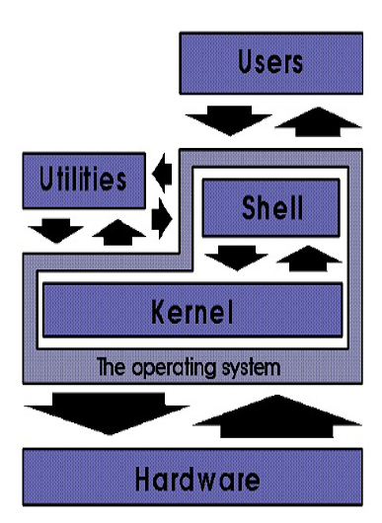
A brief overview of OS
Shell: interpreter between the
kernel and the user
Utilities: compilers, commands,
others

Slide 12
Outline
Unix operating systems
Terminal and shell
Unix file systems

Slide 13
Terminal and Shell
Open a terminal
Ctrl+Alt+T
Terminal gives you a shell
What is a shell program?
That’s the one which prints out the prompt and wait for a user input in terminal
A command interpreter that translates the user’s commands for the Kernel to carry out the user’s commands.

Slide 14
Why would I want to use terminal
We want to learn how to program using only keyboard
It gives us access to more advanced features
A GUI is after all a “wrapper” for command line
In overall, it makes you a more advanced programmer, system administrator, scientist, engineering, etc.

Slide 15

Types of Shell
There are varieties of shell programs.
C shell (csh)
Developed by BSD Unix
Bourne shell (sh)
Developed by Unix System V; compact and simple
Korn shell (ksh)
Developed by David Korn; extended Bourne shell
Turbo shell (tsh)
Enhanced csh
GNU shell (bash)
Most advanced and default for Ubuntu users
And more…..
Which Shell I am using:
Type
The echo command will display what it was told to.

Slide 16
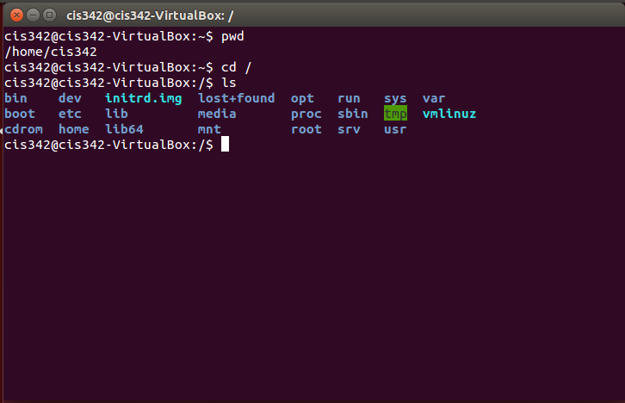
Shell Commands
Type “ls”
ls: list directory

Slide 17
Some special characters
/: path separator
/home/cis342
\: remove the special meaning of the character following
cd cis342/Good\ Student
Wildcard characters
ls *: display all files
ls c*: display all files starts with c
ls *c*: display all files that has a c
Note that * can be empty character
ls ?c?: display all files start with any single character, then c, and ends with any single character.
ls c[ih]: match any one character within [..]
ls c[ih]*: match any one character within […] and any following chracter(s).

Slide 18
Some special characters
; : command separator
ls –F; cd Documents
ls –F; cd Documents; ls; cd ..
More later
(): command group
>, <, >> : redirections.
|: pipe

Slide 19
Shell Commands: Format
All commands in terminal has
The command itself, and
Parameters
cd ~
cd /
cd /home/cis342

Slide 20
Shell Commands: Getting Help
Some commands can take a parameter
“-h” or “--help”
For example,
gcc –help
You can also get the manual page for a command
Try “man ls”

Slide 21
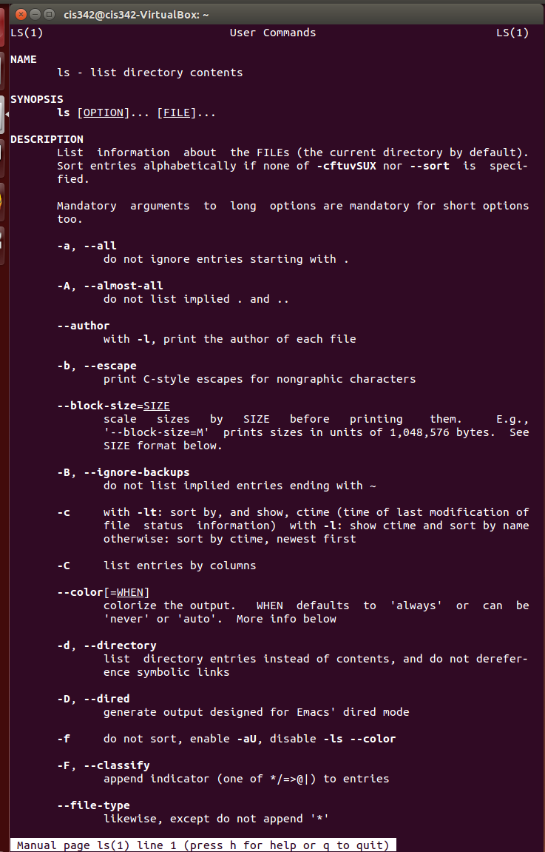
Read the man page carefully

Slide 22
Outline
Unix operating systems
Terminal and shell
Unix file systems

Slide 23
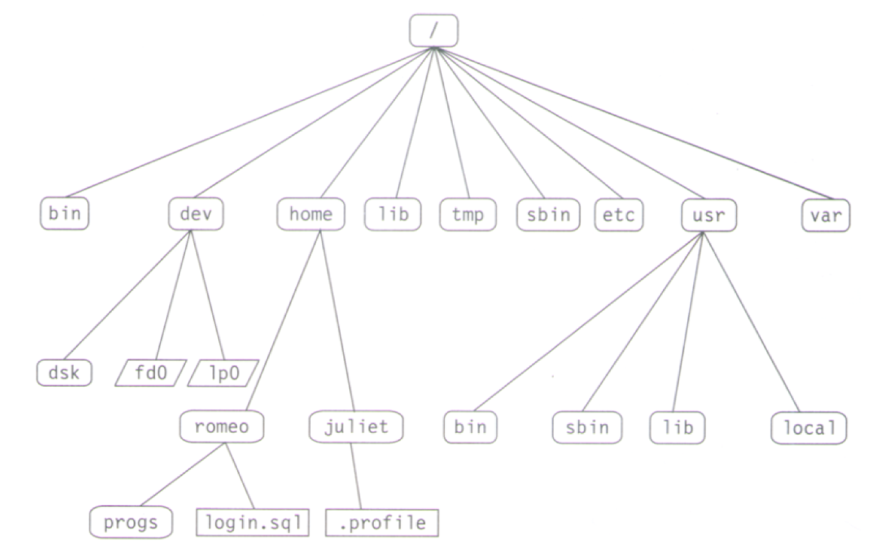
File System View

Slide 24
Ubuntu File System Directory (More detail)
Directories and files starting with a period are hidden.
This means “ls” would not do it
ls –a would display these
These files are usually used by a program, a command, a shell, etc.
We will discuss these later.

Slide 25
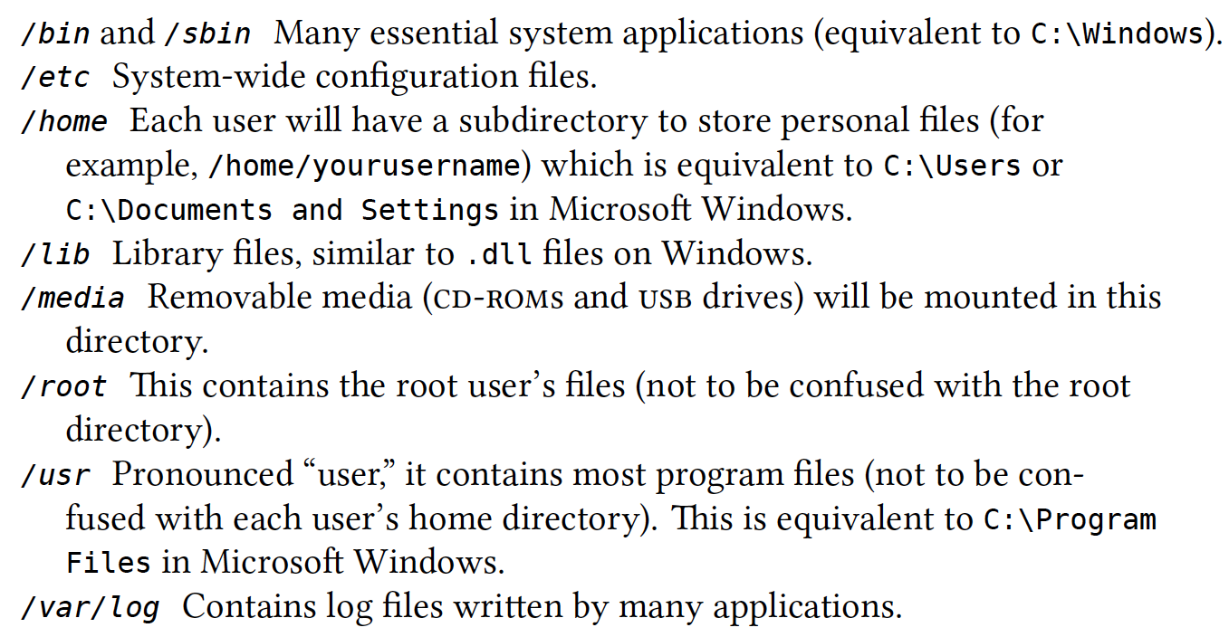
Ubuntu File System Directory (More detail)
From Ubuntu manual

Slide 26
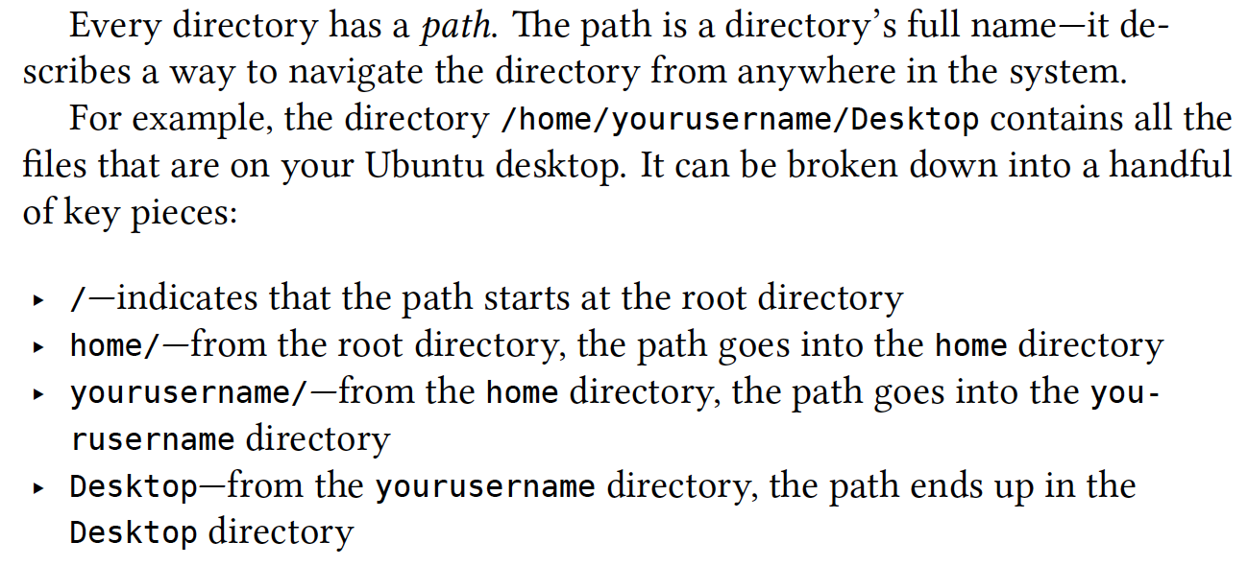
Ubuntu File System Directory (More detail)
From Ubuntu manual

