Slide 1
CSE 384 Lecture 8
Introduction to C/C++
Spring 2020

Slide 2
C Language (Background)
C Programming Language
Originally developed in 1972 by Dennis Ritchie
AT&T Bell Labs as a systems programming language
Unix (and Linux) operating system written in C.
high-level (imperative/procedure) language, designed to give the programmer a lot of control while still emphasizing portability
Before C, operating systems were often written in assembly languages tied specific machine architectures, greatly limiting portability.
1973: Ritchie and Ken Thompson rewrote Unix in C
Unix and C Language became extremely successful.
There are used everywhere today in 2020!

Slide 3
C Language: Background (cont.)
1978: Brian Kernighan and Dennis Ritchie published “The C Programming Language” (2nd edition 1988)
American National Standards Institute (ANSI) C89 standard: ANSI C
1990: the International Organization for Standardization (ISO) adopted ANSI C (with a few minor modifications): C90
1999: the ANSI released C99.
adopted many features which had already made their way into compilers as extensions (or had been implemented in C++)
2011: C11
2018: C18 (latest C standard)
Source: https://www.learncpp.com/cpp-tutorial/introduction-to-cplusplus/

Slide 4
C++ Programming Language (background)
1979: C++ (C plus plus)
developed by Bjarne Stroustrup, AT&T Bell Labs as an extension to C
1998: standardized by ISO committee, with major updates C++11, C++14, C++17
C++20 in works
Modern C++ is a very powerful and expressive (federation) of language: a multi-paradigm programming language
Imperative/procedural (its C Language roots )
Objected-oriented - classes (encapsulation and information hiding, inheritance, aggregation, composition, dynamic type binding and polymorphism)
Generic – templates (specialization, custom processing policies), functional template metaprogramming
Standard Template Library (STL) - Data structure containers, algorithms, functions, and iterators

Slide 5
C++ Programming Language (background)
Although C and C++ have evolved independently, there remains a high degree of compatibility.
C is essentially a subset of the C++
In this class we intend to use both C and C++.
The intent is to use aspects of C++ to facilitate the use of C libraries and functions needed for system programming on Linux.
The challenge with using C++ is that is a complex language. As mentioned earlier, although it is very expressive, but you have to know concepts about the object model to use it effectively, which could be an entire course unto itself (see Dr. Fawcett’s previous SU graduate course on Object-oriented Design using C++: https://ecs.syr.edu/faculty/fawcett/handouts/webpages/cse687.htm)
And his recent github site: Modern C++ story here: https://jimfawcett.github.io/CppStory_Prologue.html
The intent is to help you gain a foundational working model, and the proficiency to perform system programming tasks in C and C++.
Nice reference https://www.learncpp.com/cpp-tutorial/introduction-to-cplusplus/

Slide 6
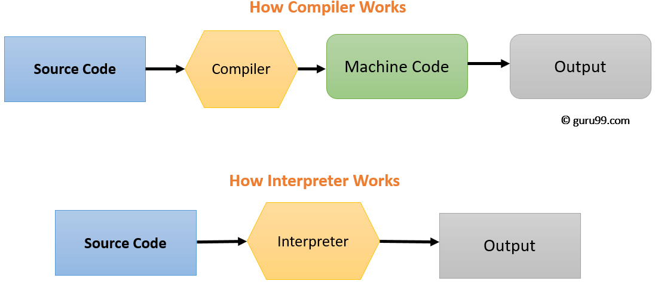
C/C++ Programming: First things first…
C and C++ are compiled languages (unlike interpreted languages such as Python, JavaScript, and BASH scripting etc.)
Compiled means that source code is (translated/compiled) into native machine code which can be executed directly on the hardware.
Scripting languages are NOT compiled, but rather depend on require an interpreter (another program) to run the instructions.
Image Source: https://www.guru99.com/difference-compiler-vs-interpreter.html

Slide 7
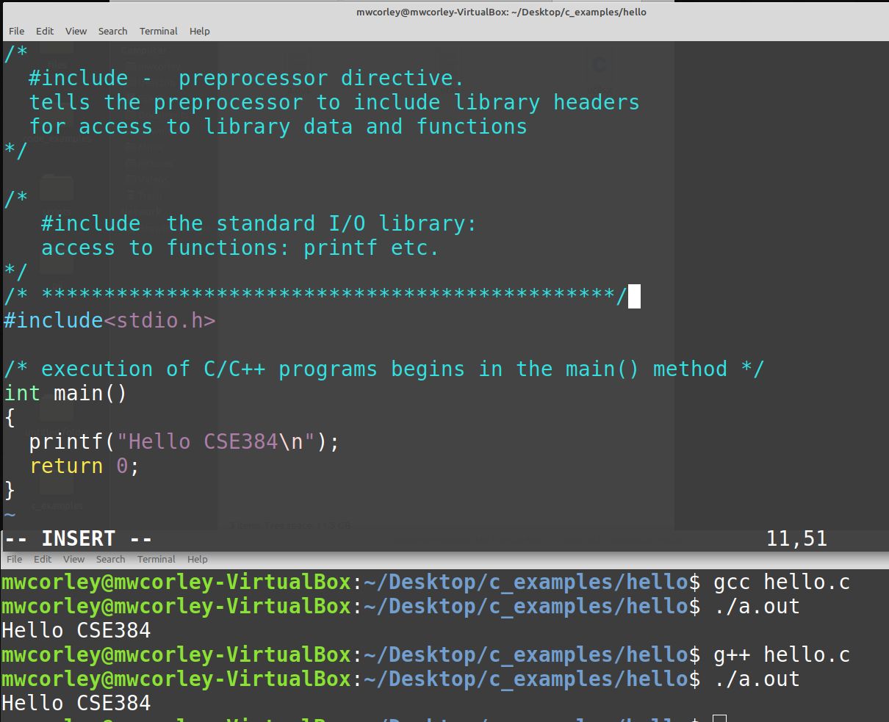
First C program
hello.c

Slide 8
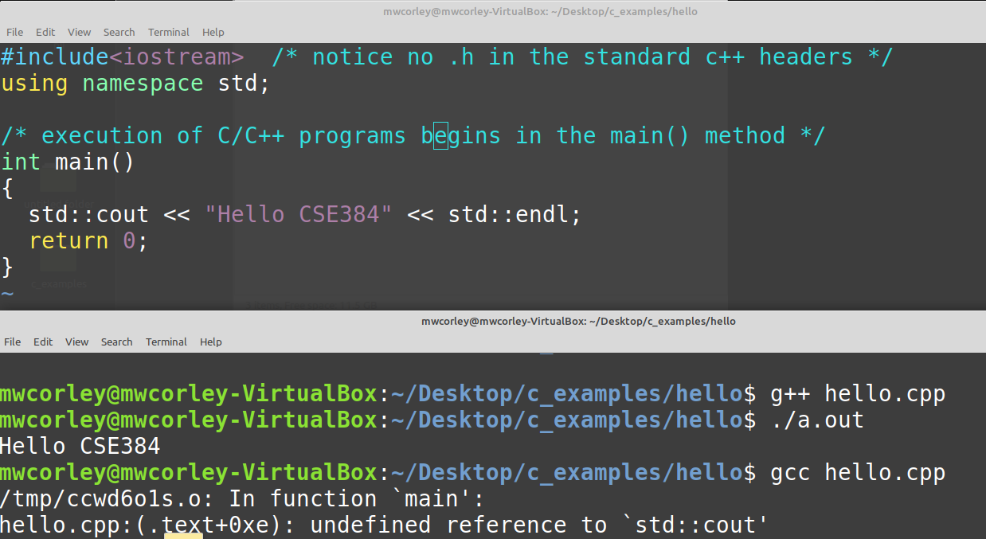
First C++ program
hello.cpp

Slide 9
#include …
A processor directive for including library (headers) in your program
think of import in python: same (conceptual) idea
Basically the same process in C and C++
In C, all headers end in .h (header):
e.g. #include <stdio.h>, #include “stack.h”
In C++ only “user include” headers end in .h:
#include <iostream>, #include “stack.h”
Notice: standard C++ headers omit the “.h” in the include directive
Standard includes: <iostream>, <stdio.h>, etc.
Compiler (preprocessor) searches standard include paths: /usr/include etc.
User includes
search the user specified header path: include “./myheaders/string.h”

Slide 10
Separate compilation
Library interface:
“declarations” of types of functions go into a header file (.h file)
This provides interface to the library
“definitions” (implementation) of functions and types go into separate .c/.cpp file.
This is a essentially the definition of a package (sometimes in older speak its called a module)
Packages give us a necessary strategy for organizing and managing system structure.
This a basic construct for partitioning the system and achieving reuse
Is it imperative to use good package structure in your design for your system to be successful. We will see examples of this throughout the semester. See the Package example included in the lecture8 c_examples

Slide 11
BooksCollection Package (structure example)
Books Collection
package
Books.h
BookCollection interface
Books.cpp
executive.cpp
#include Books.h
Define/implement
BookCollection
#include Books.h
Use BookCollection
* The executive (client) simply uses the package to achieve requirements

Slide 12
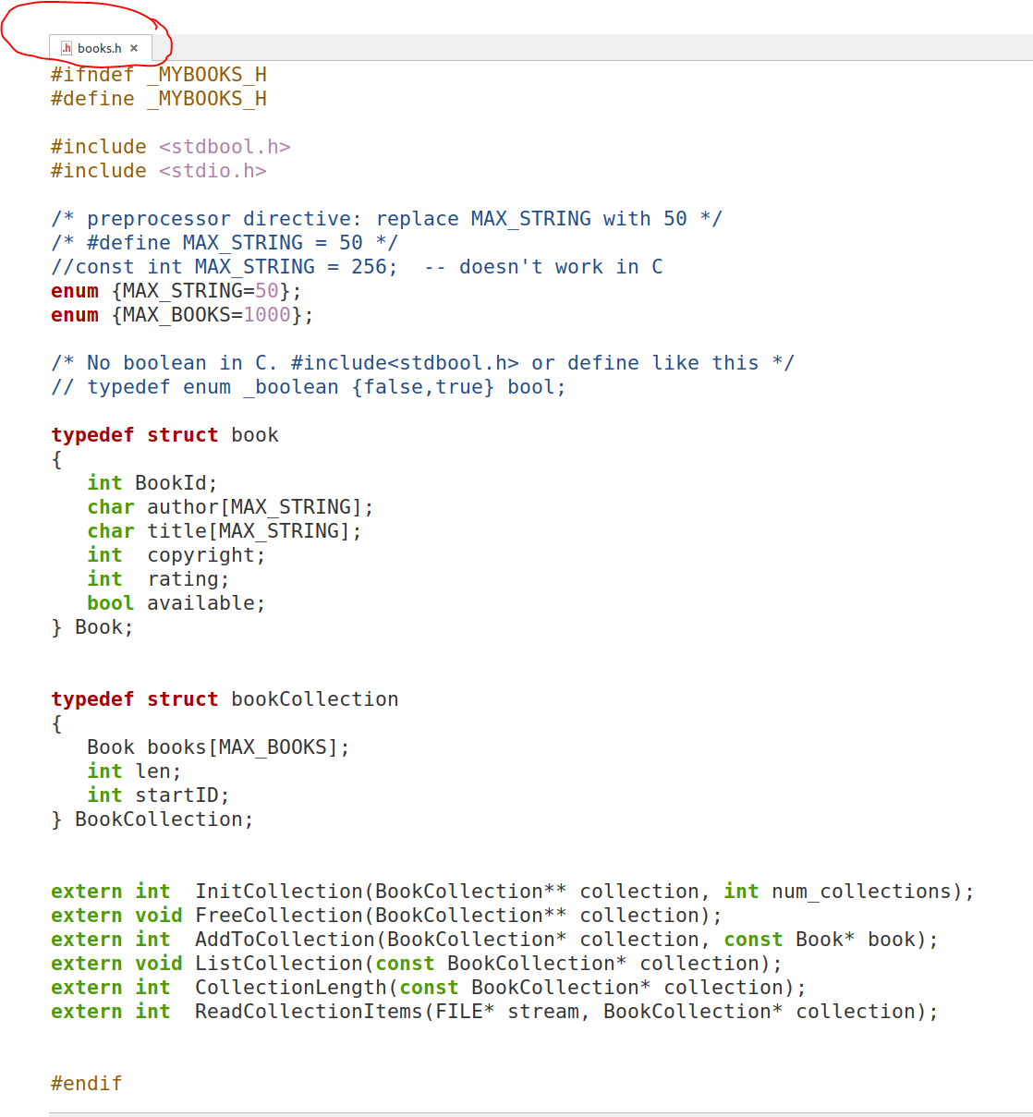
Books.h Header file (interface) declares Books data and functions

Slide 13
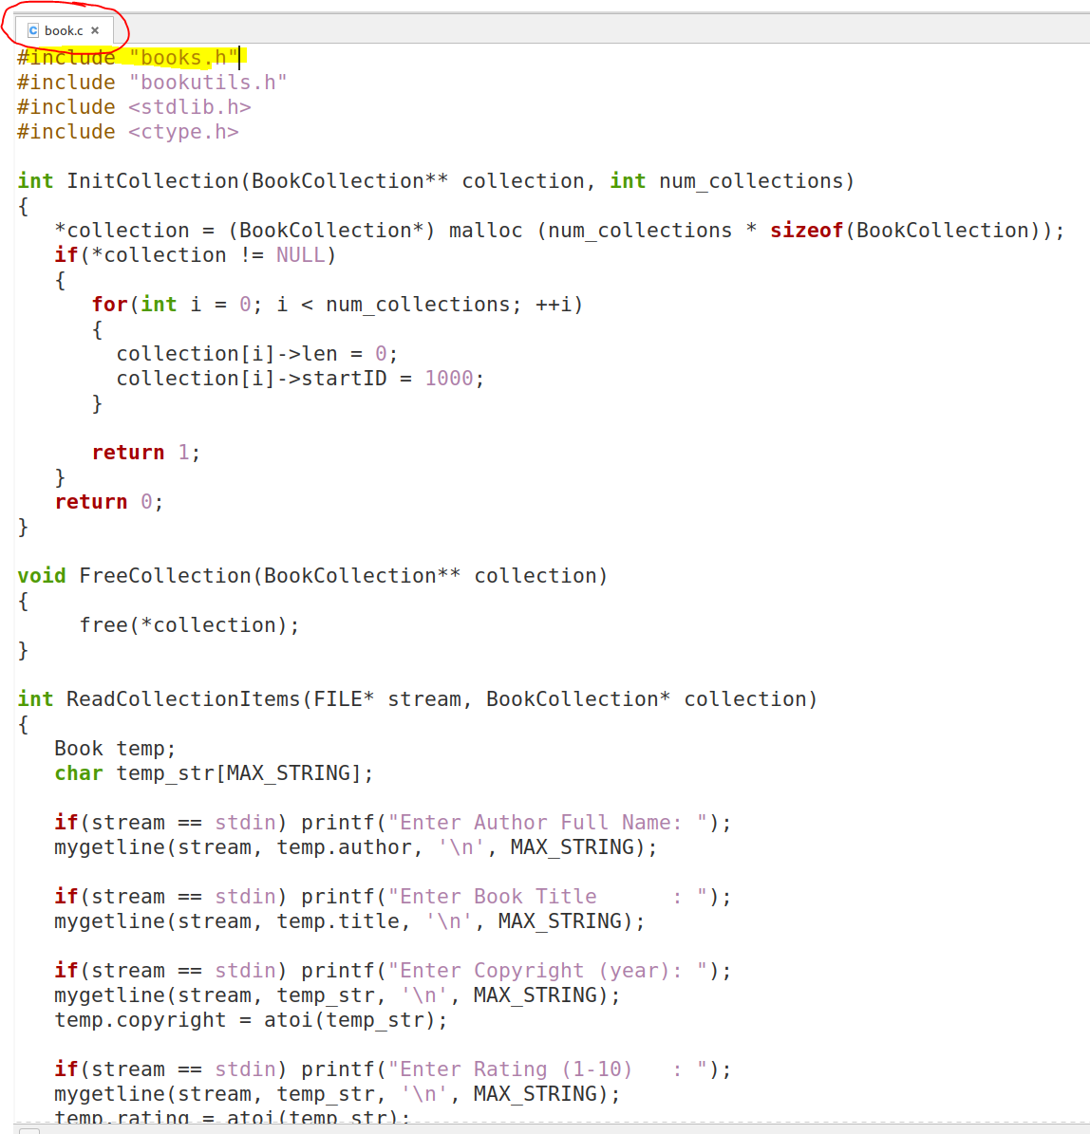
Books.c defines (implements) Books data and functions

Slide 14
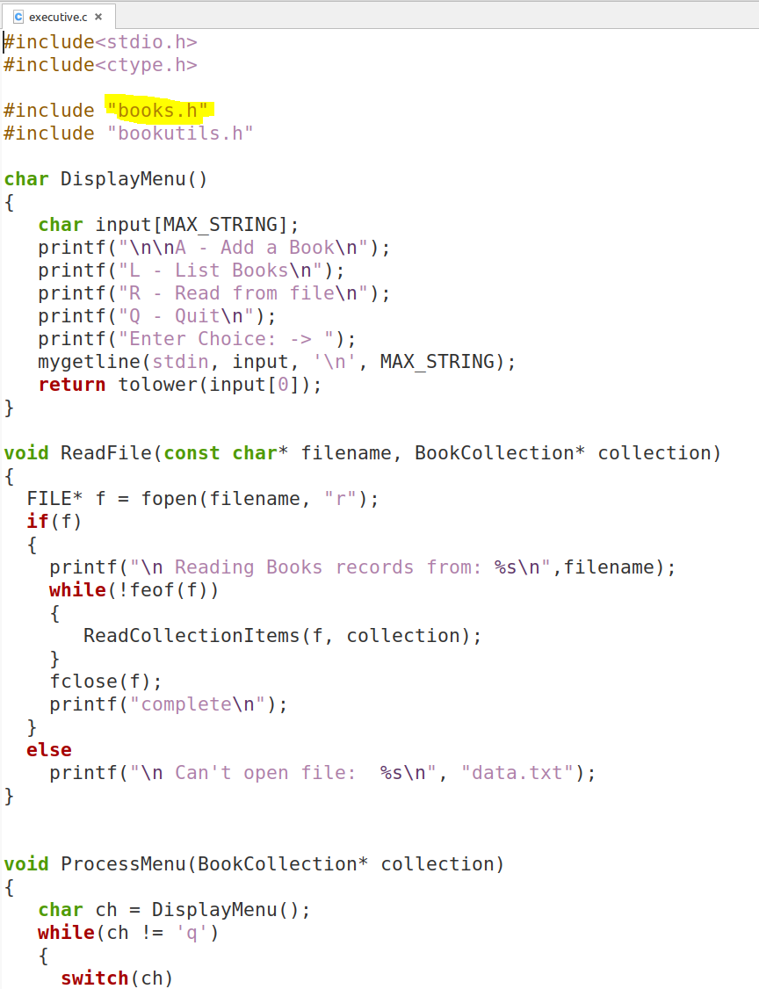
Executive.c (the client application) uses the services of the Books package (implements) Books data and functions

Slide 15

C/C++ Compilation and compute/memory models
C and C++ Language Comparison
Dr. Fawcett’s notes from CSE 687: Object-oriented Design (Spring 2019)
Compilation, computation, and memory models
Dr. Fawcett’s notes from CSE 687: Object-oriented Design (Spring 2019)
Program Memory Layout

Slide 16
Examples
lecture 8 (tarball): lecture8_examples.tar.gz
C Examples: see folder: c_examples
C++ Examples: see folder: cpp_examples
Note: fort the C++ examples you will get a C++ compiler.
For Mint (Unbunu), open terminal (bash shell) and type the command -> sudo apt-get install g++

