Slide 1
Potential Outline for Western Snow Conference (WSC) Presentation
Introduction to Marcell + project outline
MEF maps, background from hydrologic connectivity paper, NSF grant gial outline (forest, frost, flow)
Research Setup
Grid maps, elevation profiles
Initial accumulation season results
Snow accumulation trends by zone, north vs. south slopes (see slide 3)
Snow and LAI correlations (see slide 4 )
Snow and soil frost relationships, north vs. south slopes (see slides 5, 7-8)
Snow and Soil moisture/temperature (see slides 6-8)
Continued work – two more snow seasons!

Slide 2
Please feel free to comment/draw/etc. on these slides if there are comments or questions you have.
In general, I have made annotations in blue to help direct you to interesting features that Xue and I have noticed in the data. I have also made annotations in red in places where it isn’t clear what is going on in the data or there are strange inconsistencies between sensor and manual data.
There is also a (slightly wordy) summary on the final slide.
Thank you!

Slide 3
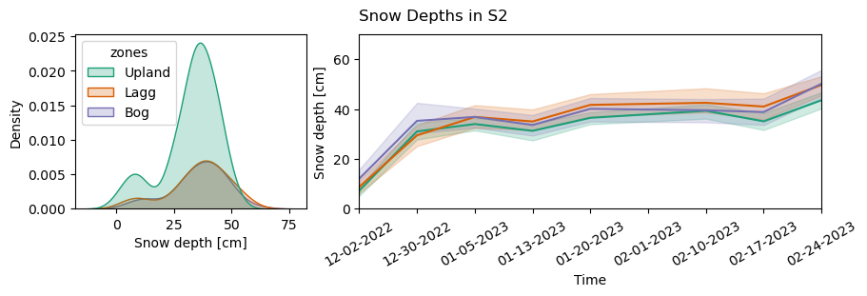
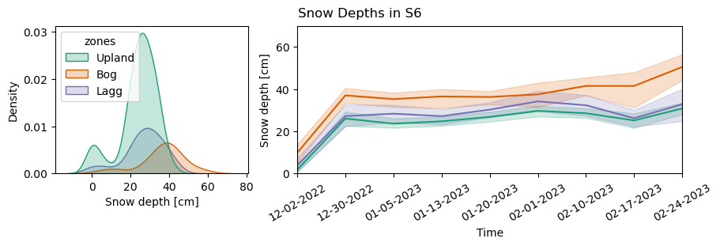
Snow accumulation trends by zone, north vs. south slopes
No change in accumulated snow between any zones in S2 (matches the results of the ANOVA test on LAI)
Increase in accumulated snow in the Bog in S6 (matches the results of the ANOVA test on LAI)

Slide 4
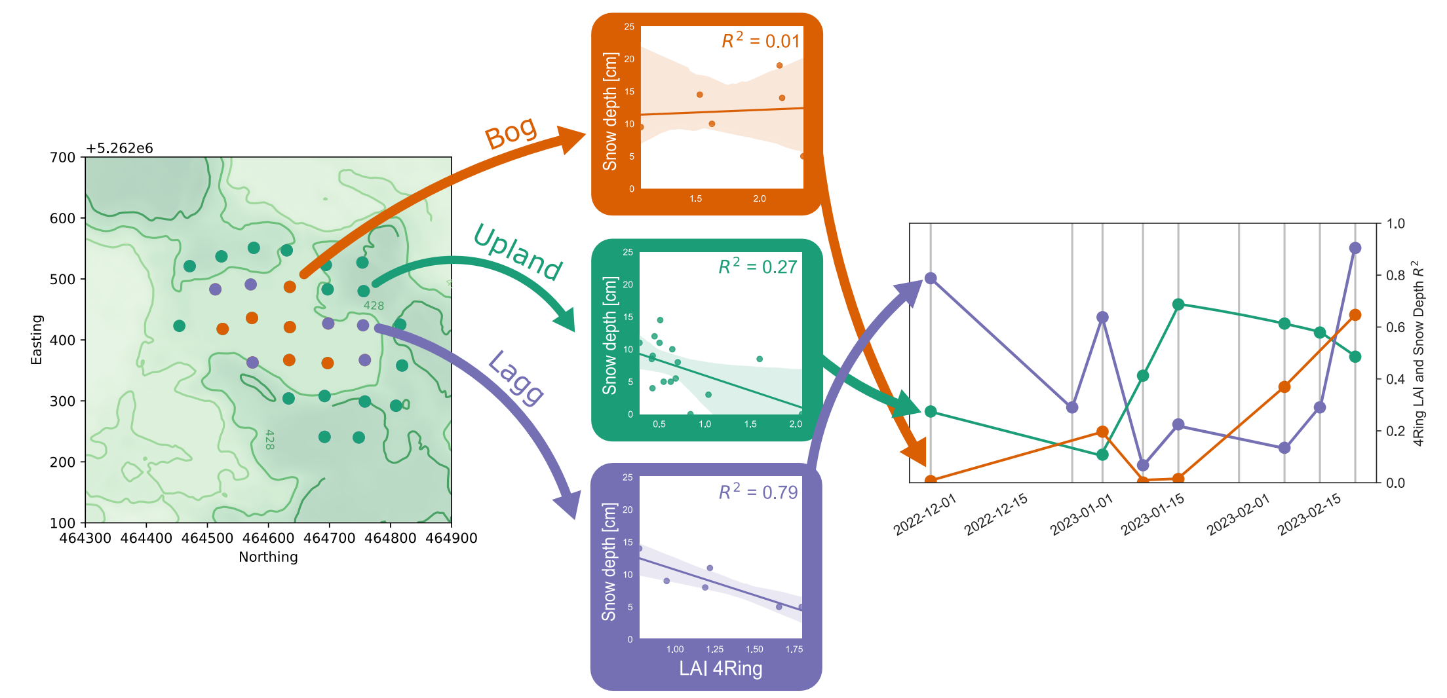


Snow and LAI correlations
All zones seem to be showing the highest correlation between LAI and snow depth during the initial accumulation phase and beginning of the melt phase.

Slide 5
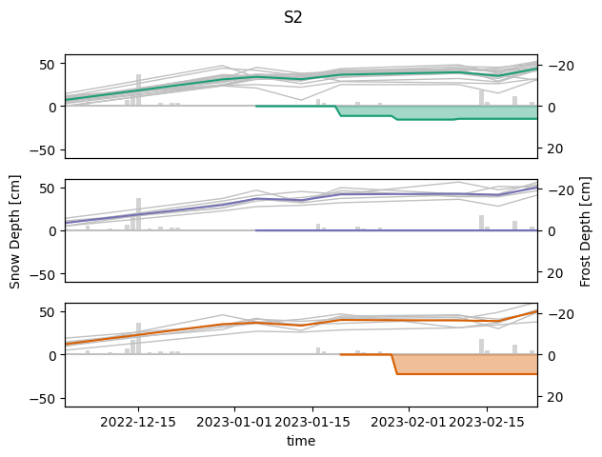
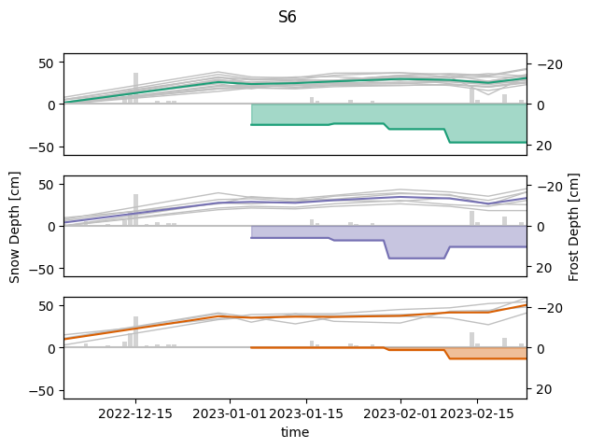

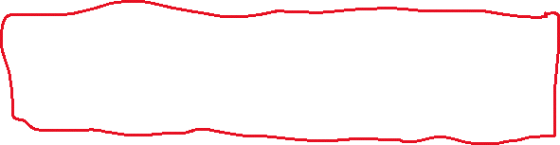
Snow and soil frost relationships, north vs. south slopes
With the understanding that more snow → less frost, based on the similar snow profiles in all three zones in S2 we would expect to see similar frost profiles too.
S6 seems to be showing textbook relationships between snow/frost, but S2 is not.
Upland
Upland
Lagg
Lagg
Bog
Bog

Slide 6
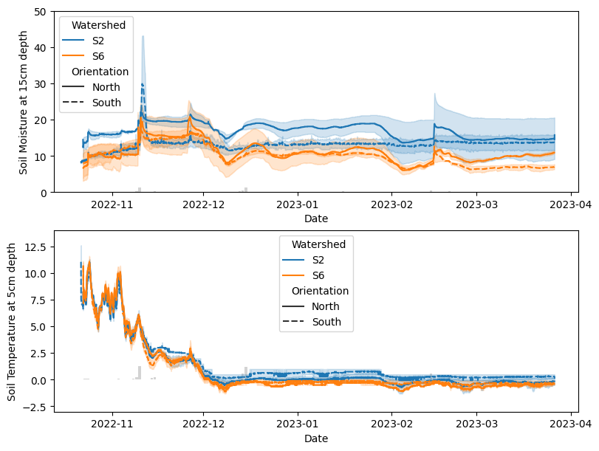

Snow, Soil moisture and temperature
Zone-averaged soil moisture is slightly higher in S2 than in S6 and in both watersheds the north slope seems to maintain slightly higher moisture conditions.
Zone averaged soil temperature is consistent across zones, S2 might be warmer than S6.
If frost were solely temperature dependent this would imply we should see consistent frost depth everywhere?
So why are the S2 frost depths so out of the ordinary?

Slide 7
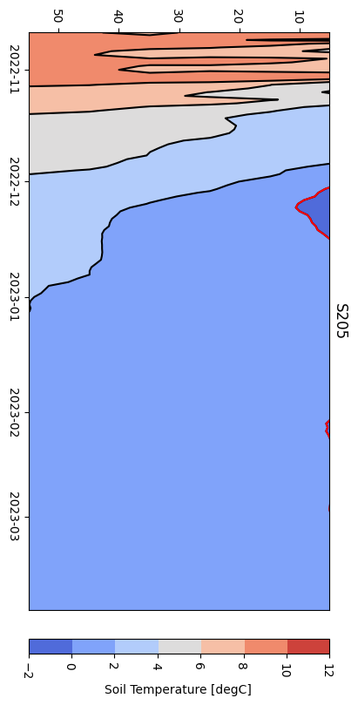
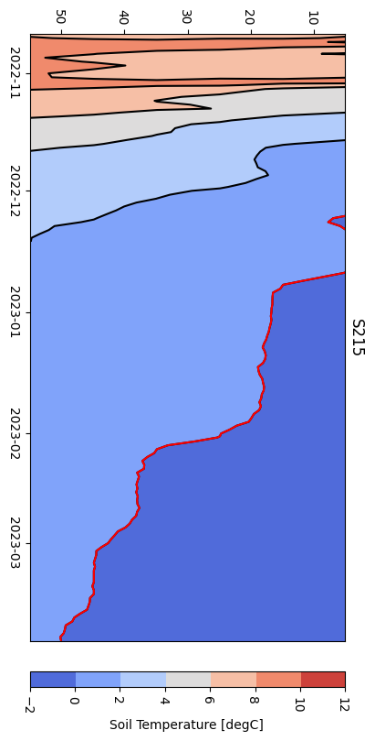
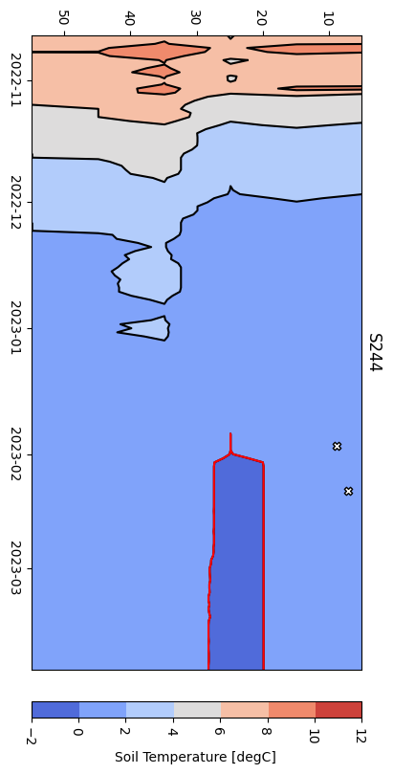
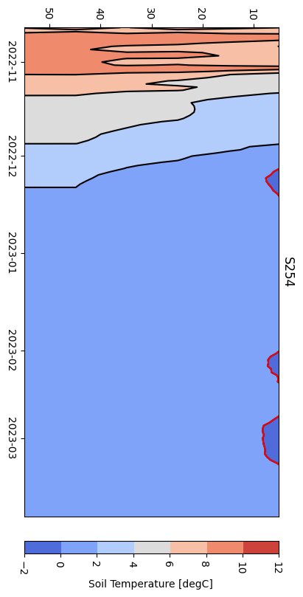

Vertical X-axis – Time, Horizontal Y-axis – Soil Depth, Red Line – 0deg C line (proxy for frost depth)
White and black markers show the data from manual frost measurements, no markers means zero frost detected
Upland
Slope/Lagg
Slope/Lagg
Upland
North
South
Huge inconsistencies between soil temperature and manual frost depth measurements in S2
There seem to be more frost forming on the slopes/lagg than the upland and there may be more frost forming on the North slope

Slide 8
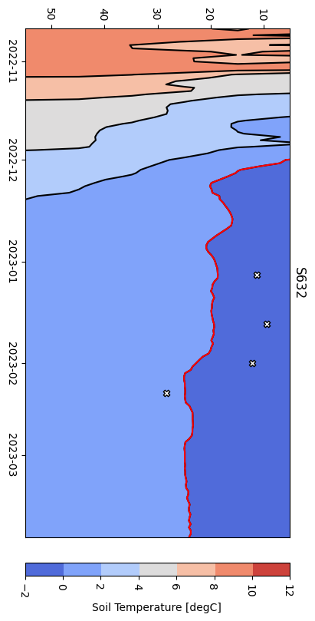
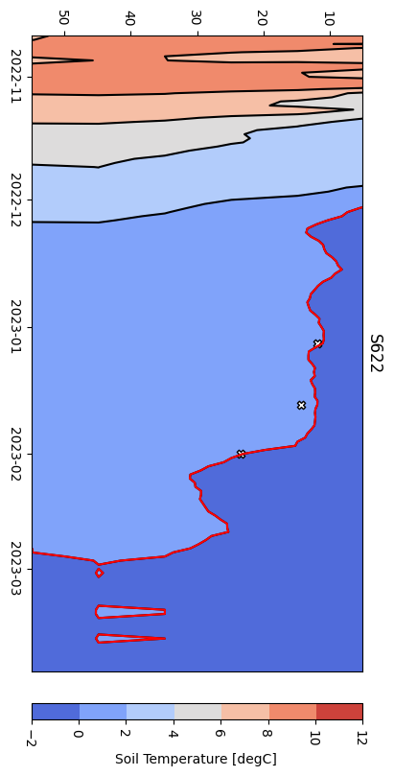
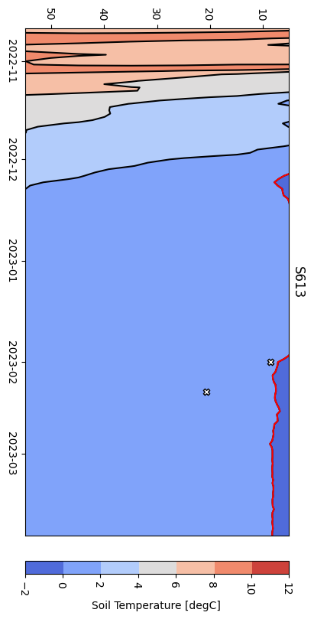
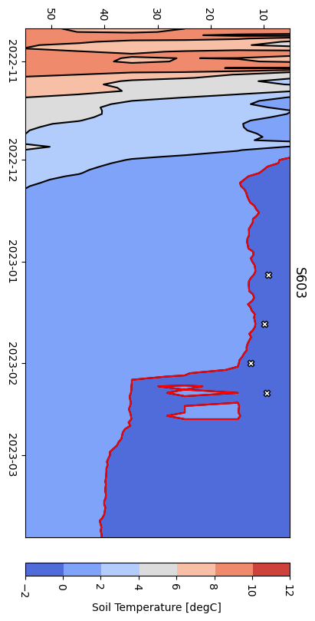
Vertical X-axis – Time, Horizontal Y-axis – Soil Depth, Red Line – 0deg C line (proxy for frost depth)
White and black markers show the data from manual frost measurements, no markers means zero frost detected
Upland
Slope/Lagg
Slope/Lagg
Upland
North
South
There seem to be no consistencies between the zones, but there may be more frost forming on the North slope

Slide 9
Snow Accumulation
(Slide 3)
In S2 snow is accumulating equally across all three zones, whereas in S6 there is clear increase in snow accumulation in the bog compared to the lagg and uplands.
Snow and LAI
(Slide 4)
LAI acts as a stronger control on snow depth during periods of accumulation and melt but is not strongest in one zone over another (at least in S2, still processing S6)
Snow and Frost
(Slides 5, 7-8)
Frost depths in S6 are extremely consistent across the temperature sensors and manual measurements and show the expected inverse relationship between snow and frost depth.
Results in S2 are muddier. Homogeneous snow depths would imply homogeneous frost depths, but manual measurements show no frost in the lagg compared to some in the bog and uplands. Sensor data estimates no frost in the uplands but some on the slopes and in the lagg.
Snow and Soil
(Slides 6-8)
Soil temperature is consistent across all zones and watersheds while soil moisture is slightly higher in S2 and on the north slopes in each watershed.
Soil temperature also estimates that soil frost should be deeper on the north slopes compared to the south slopes, particularly in S6.

