Slide 1
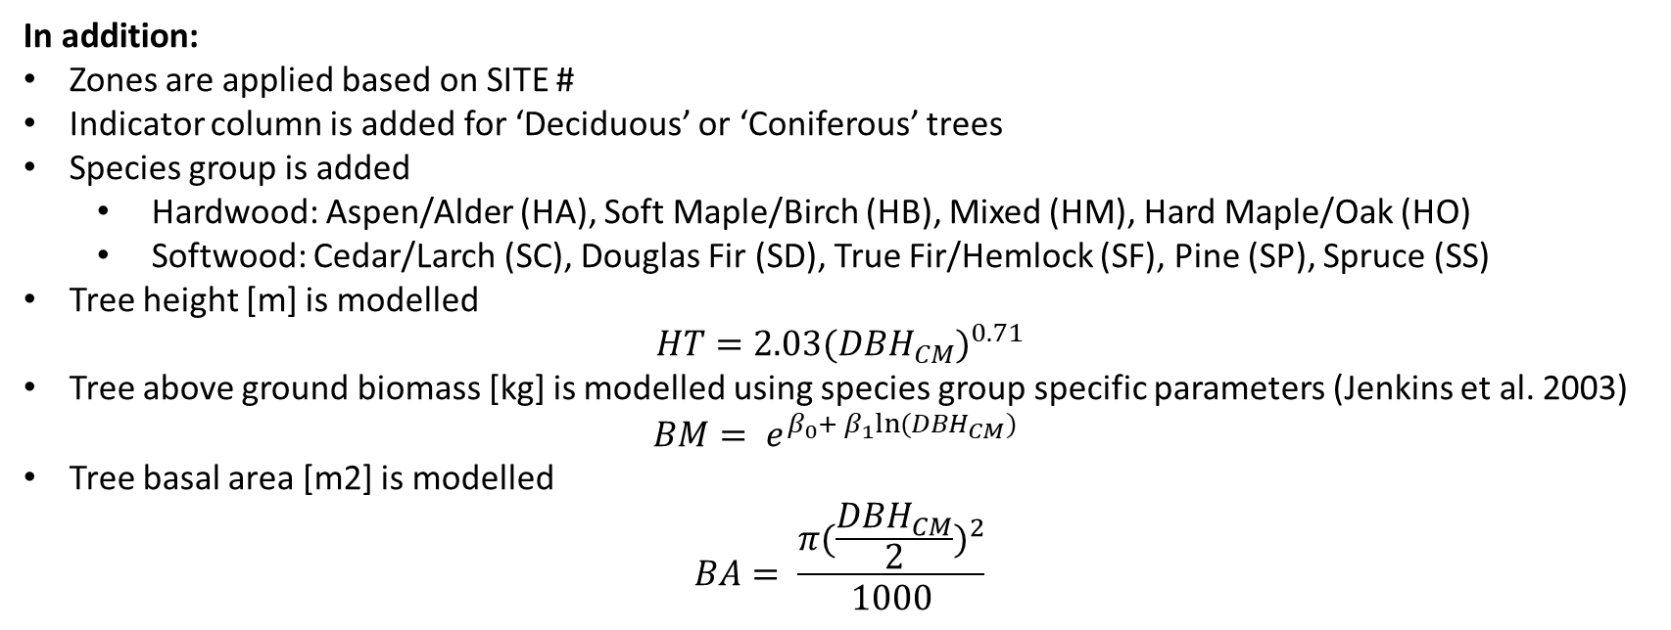
SITE COMMON_NAME SPECIES DIST_FT DIST_M DBH_IN DBH_CM CC NORTHING EASTING
<chr> <chr> <chr> <dbl> <dbl> <dbl> <dbl> <chr> <dbl> <dbl>
1 S200 Quaking Asp… Populu… 18.5 5.64 14.8 37.5 Dom 464471 5262521
2 S200 Sugar Maple Acer s… 12.9 3.93 6.30 16 Int 464471 5262521
3 S200 Sugar Maple Acer s… 11.9 3.63 8.27 21 Dom 464471 5262521
4 S200 Sugar Maple Acer s… 12.4 3.78 5.12 13 Int 464471 5262521
5 S200 Sugar Maple Acer s… 23.7 7.22 4.33 11 Co 464471 5262521
6 S200 Sugar Maple Acer s… 24 7.32 8.66 22 Co 464471 5262521
In addition:
Zones are applied based on SITE #
Indicator column is added for ‘Deciduous’ or ‘Coniferous’ trees
Species group is added
Hardwood: Aspen/Alder (HA), Soft Maple/Birch (HB), Mixed (HM), Hard Maple/Oak (HO)
Softwood: Cedar/Larch (SC), Douglas Fir (SD), True Fir/Hemlock (SF), Pine (SP), Spruce (SS)
Tree height [m] is modelled
$$HT=2.03{(DBH_{CM})}^{0.71}$$
Tree above ground biomass [kg] is modelled using species group specific parameters (Jenkins et al. 2003)
$$BM= e^{β_{0}+ β_{1}ln⁡(DBH_{CM})}$$
Tree basal area [m2] is modelled
$$BA= \frac{π{(\frac{DBH_{CM}}{2})}^{2}}{1000}$$

Slide 2
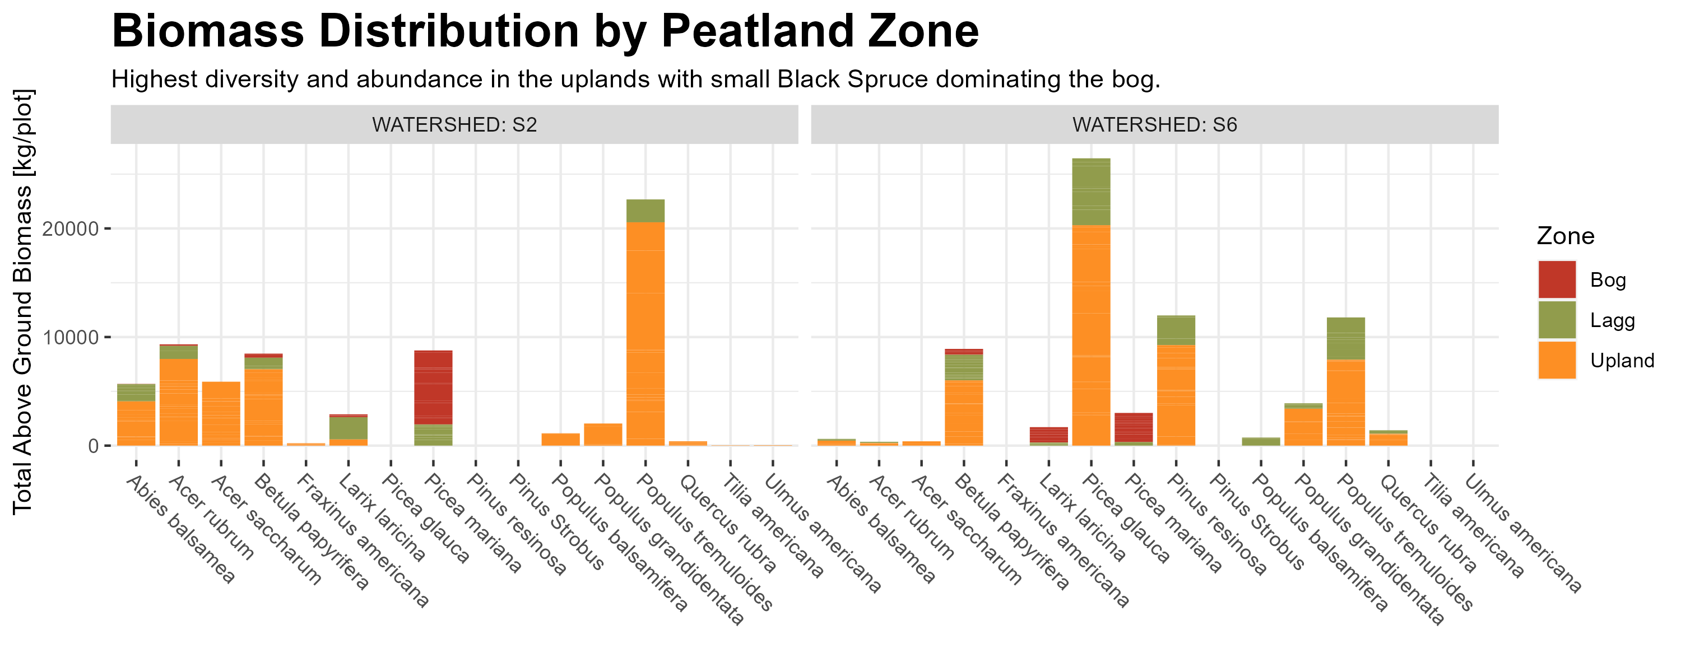

Slide 3
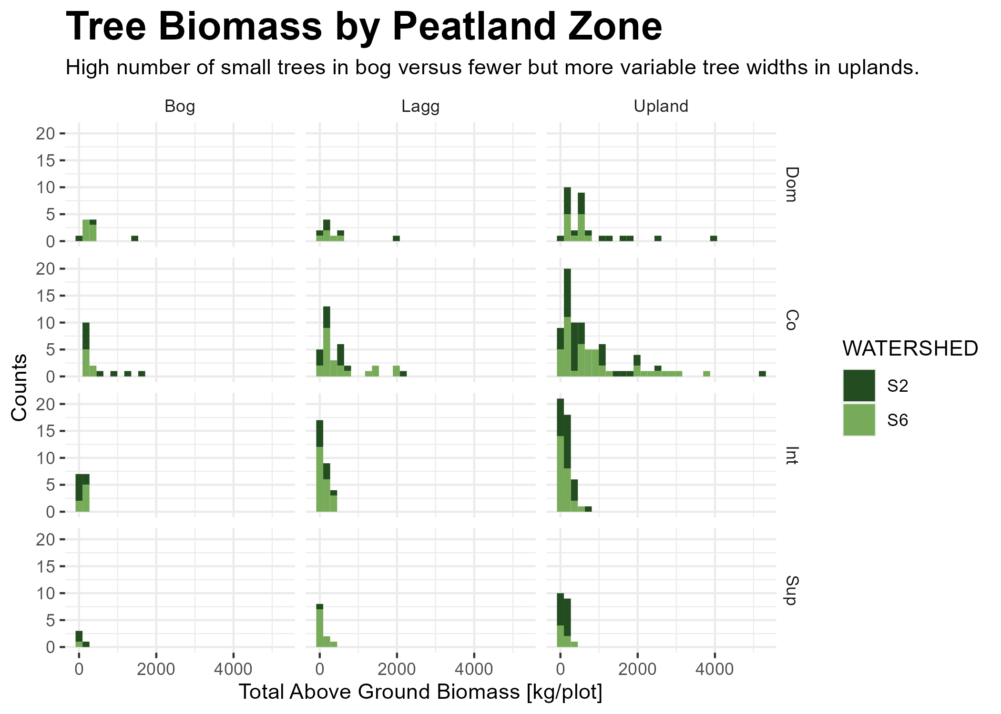

Slide 4
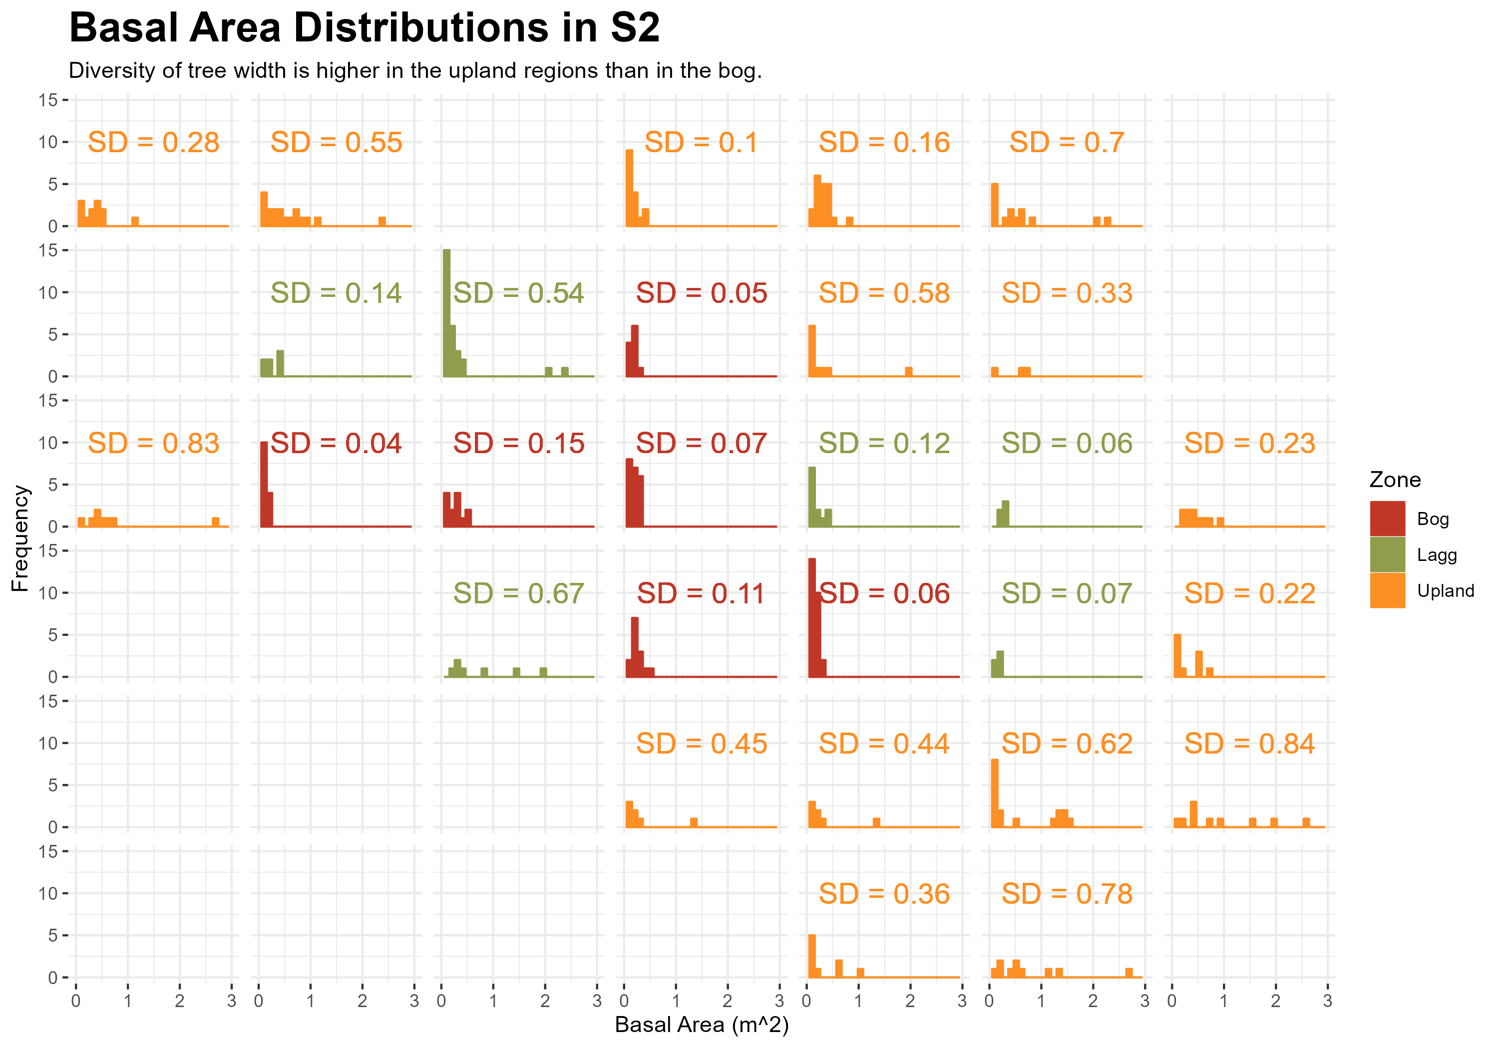

Slide 5
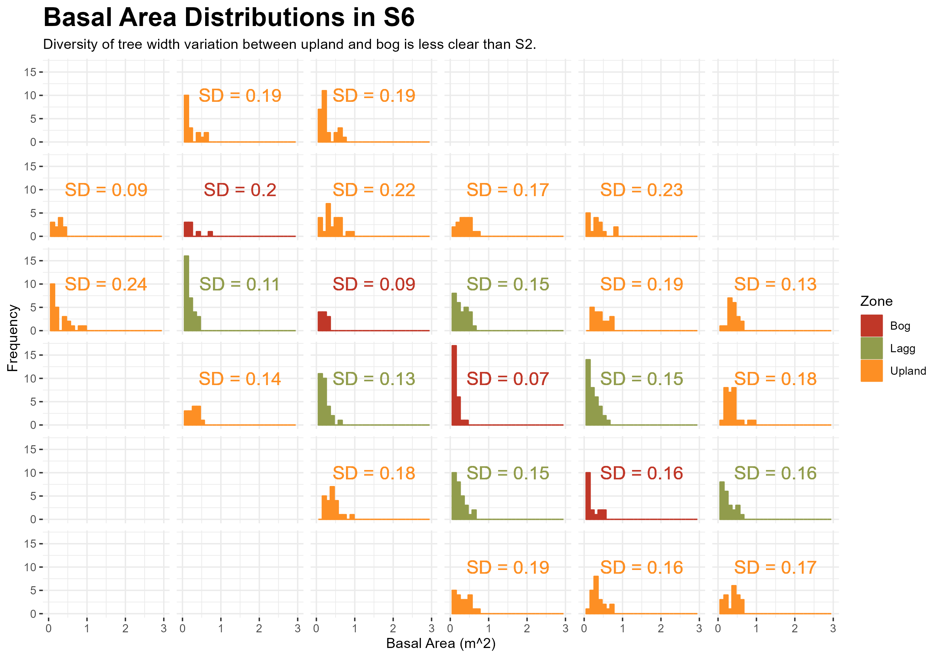

Slide 6
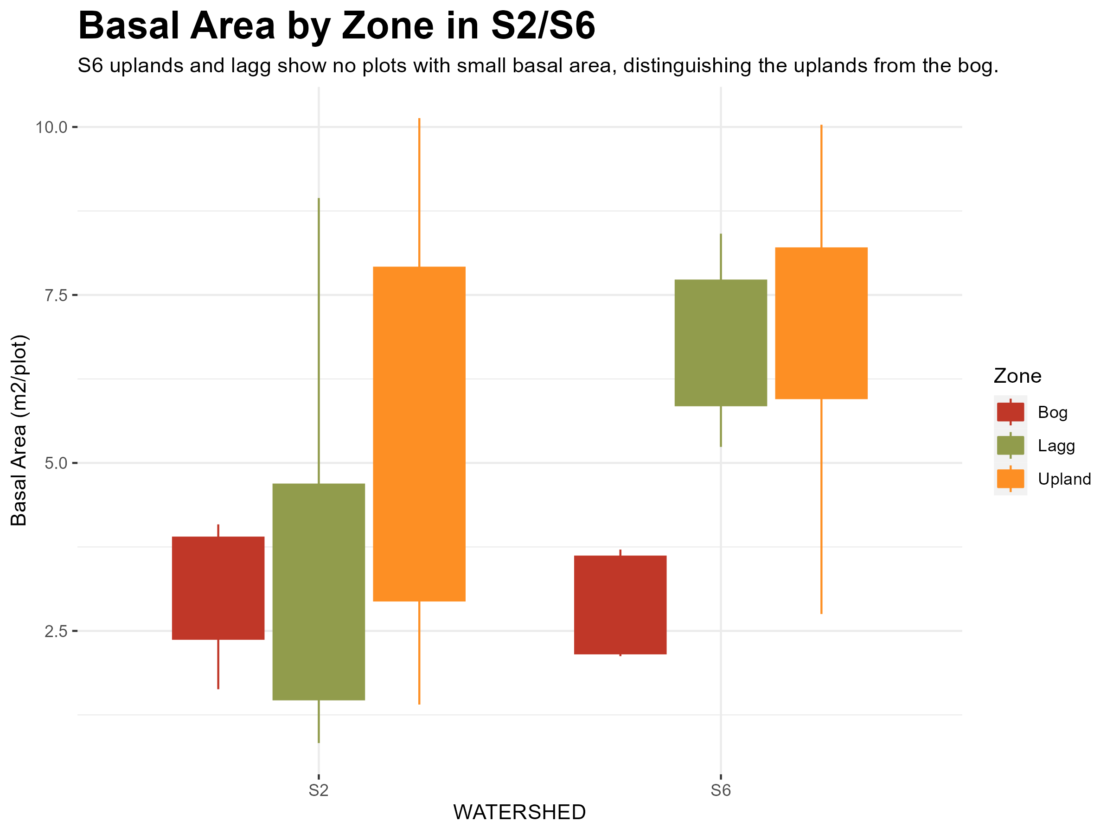

Slide 7

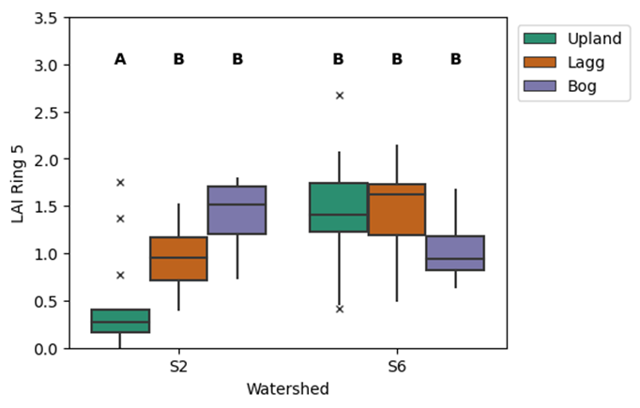

Slide 8
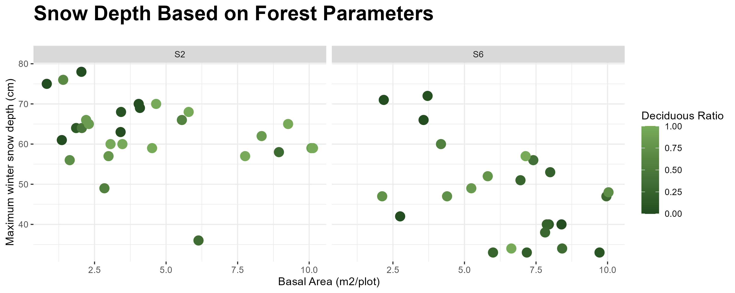
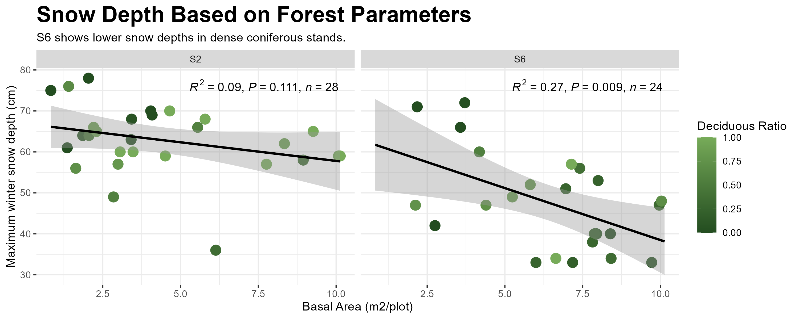
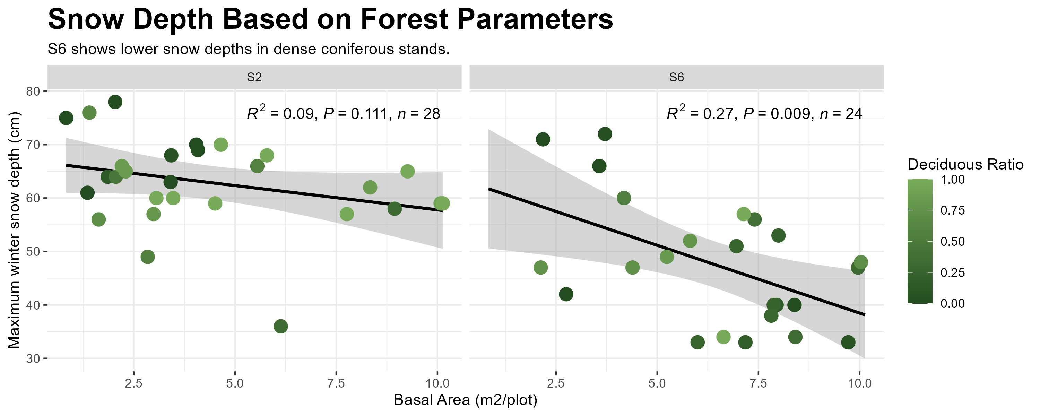

Slide 9
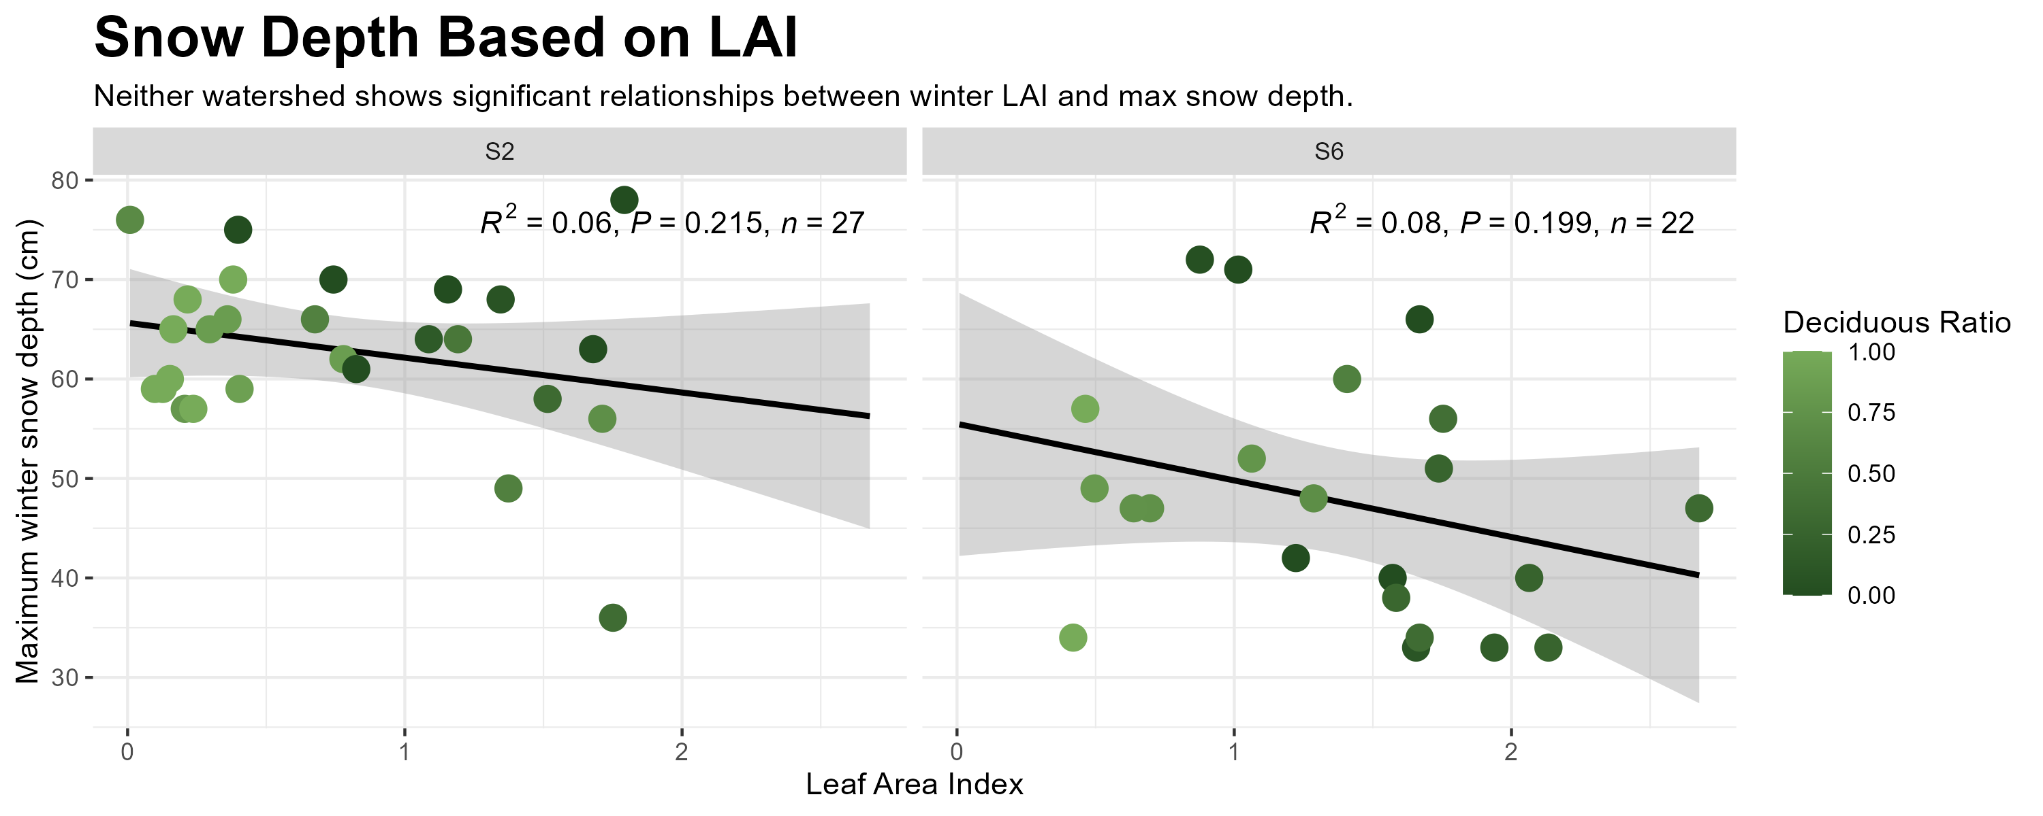

Slide 10
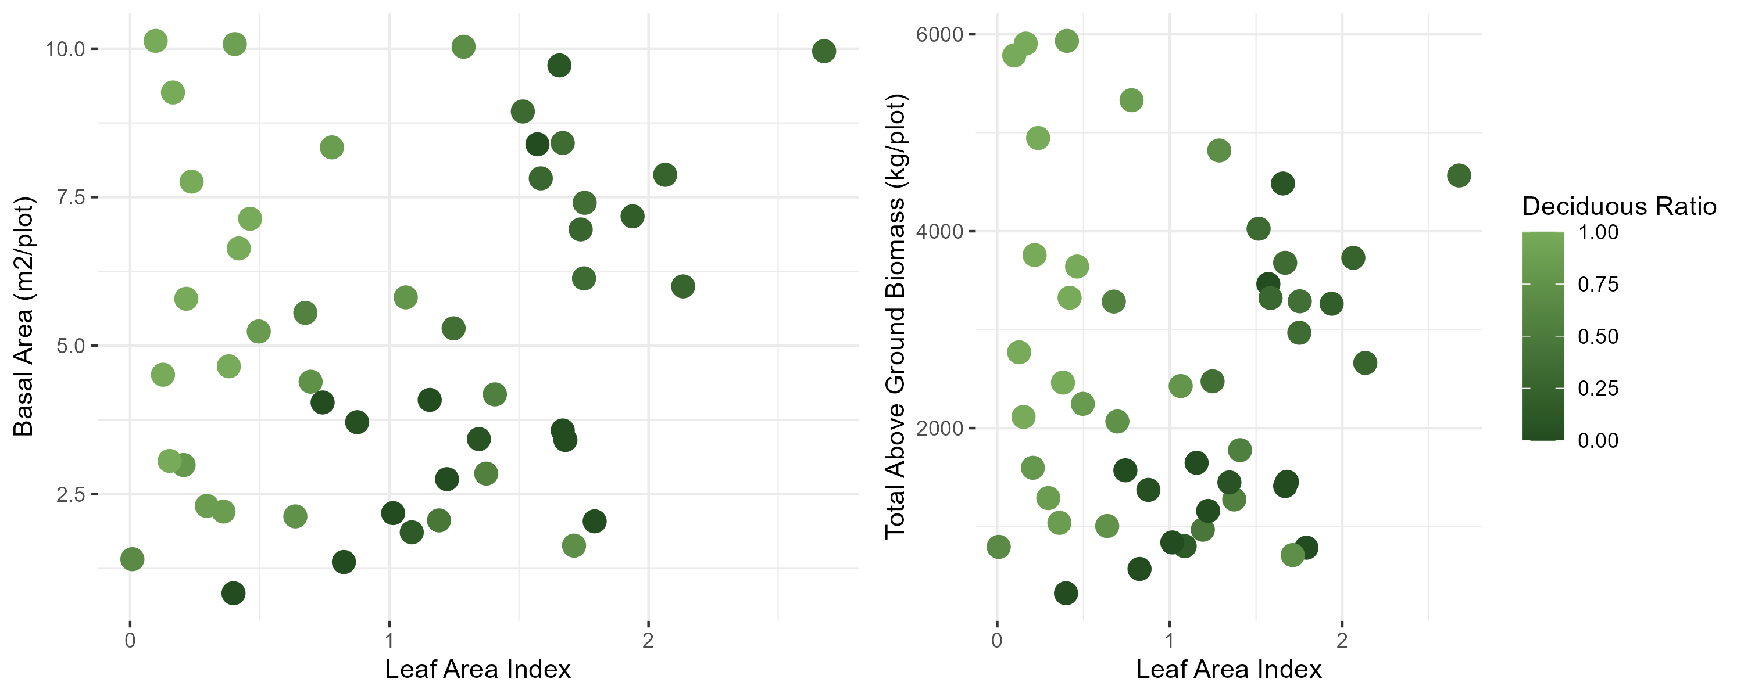

Slide 11
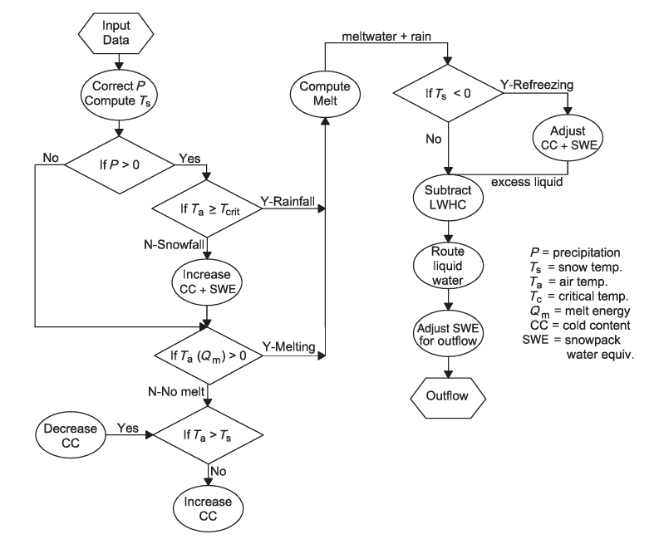
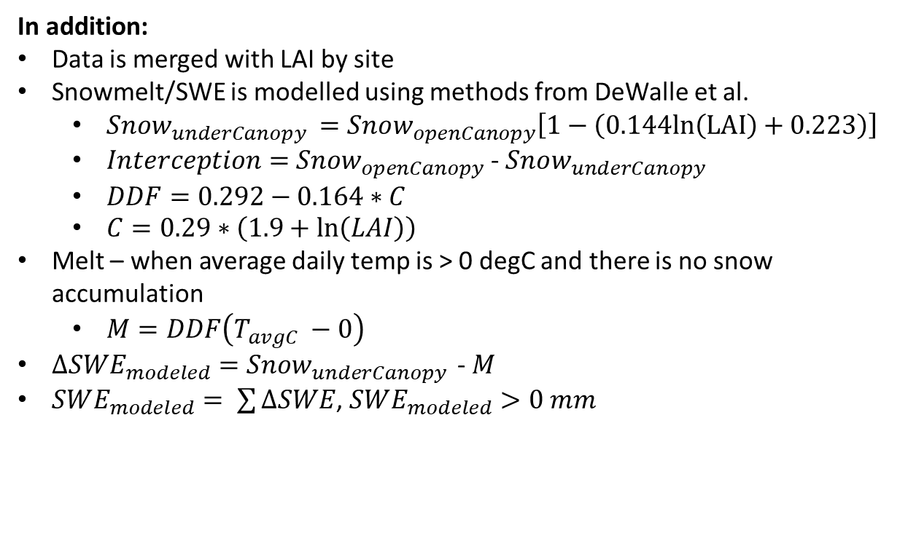
index time northing easting depths zones stakes aspect slope watershed
0 2022-12-02 464644.0 5262240.0 NaN NaN NaN NaN NaN S6
1 2022-12-02 464644.0 5262449.0 5.5 Upland S655 259.7 6.629 S6
2 2022-12-02 464644.0 5262658.0 8.0 Upland S654 350.3 1.924 S6
3 2022-12-02 464644.0 5262867.0 NaN NaN NaN NaN NaN S6
4 2022-12-02 464644.0 5263076.0 NaN NaN NaN NaN NaN S6
In addition:
Data is merged with LAI by site
Snowmelt/SWE is modelled using methods from DeWalle et al.
$Snow_{underCanopy }=Snow_{openCanopy}\left[1−\left(0.144ln\left(LAI\right)+0.223\right)\right]$
$Interception=$ $Snow_{openCanopy}$ - $Snow_{underCanopy }$
$DDF=0.292−0.164∗C$
$C=0.29∗\left(1.9+\ln\left(LAI\right)\right)$
Melt – when average daily temp is > 0 degC and there is no snow accumulation
$M=DDF\left(T_{avgC} −0\right)$
$∆SWE_{modeled}=$ $Snow_{underCanopy }$ - $M$
$SWE_{modeled}= \sum{∆SWE}$, $SWE_{modeled}>0 mm$

Slide 12
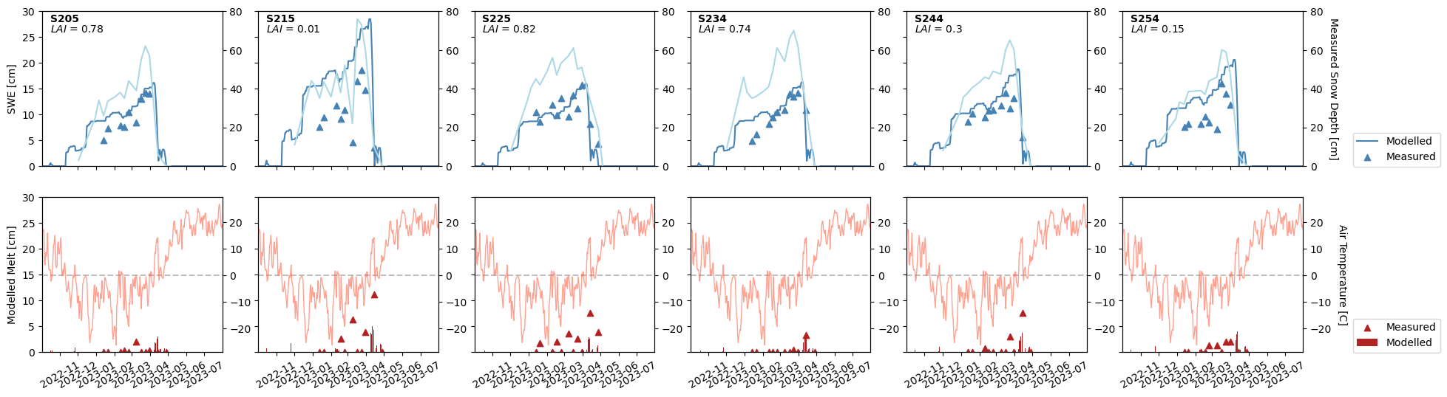

Slide 13
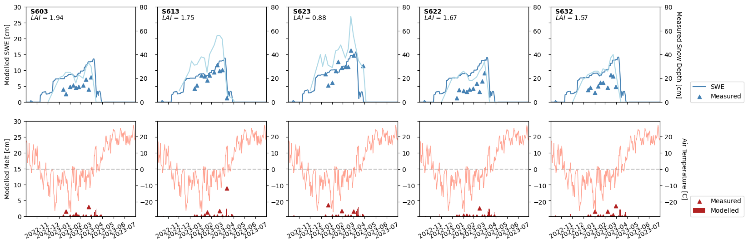

Slide 14
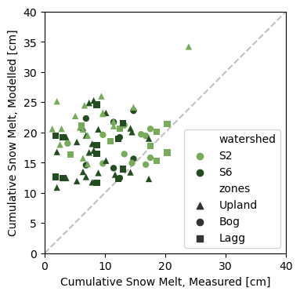

Slide 15
