Slide 1
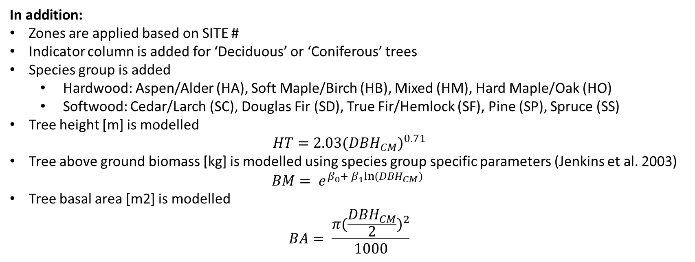
SITE COMMON_NAME SPECIES DIST_FT DIST_M DBH_IN DBH_CM CC NORTHING EASTING
<chr> <chr> <chr> <dbl> <dbl> <dbl> <dbl> <chr> <dbl> <dbl>
1 S200 Quaking Asp… Populu… 18.5 5.64 14.8 37.5 Dom 464471 5262521
2 S200 Sugar Maple Acer s… 12.9 3.93 6.30 16 Int 464471 5262521
3 S200 Sugar Maple Acer s… 11.9 3.63 8.27 21 Dom 464471 5262521
4 S200 Sugar Maple Acer s… 12.4 3.78 5.12 13 Int 464471 5262521
5 S200 Sugar Maple Acer s… 23.7 7.22 4.33 11 Co 464471 5262521
6 S200 Sugar Maple Acer s… 24 7.32 8.66 22 Co 464471 5262521
In addition:
Zones are applied based on SITE #
Indicator column is added for ‘Deciduous’ or ‘Coniferous’ trees
Species group is added
Hardwood: Aspen/Alder (HA), Soft Maple/Birch (HB), Mixed (HM), Hard Maple/Oak (HO)
Softwood: Cedar/Larch (SC), Douglas Fir (SD), True Fir/Hemlock (SF), Pine (SP), Spruce (SS)
Tree height [m] is modelled
$$HT=2.03{(DBH_{CM})}^{0.71}$$
Tree above ground biomass [kg] is modelled using species group specific parameters (Jenkins et al. 2003)
$$BM= e^{β_{0}+ β_{1}ln⁡(DBH_{CM})}$$
Tree basal area [m2] is modelled
$$BA= \frac{π{(\frac{DBH_{CM}}{2})}^{2}}{1000}$$

Slide 2
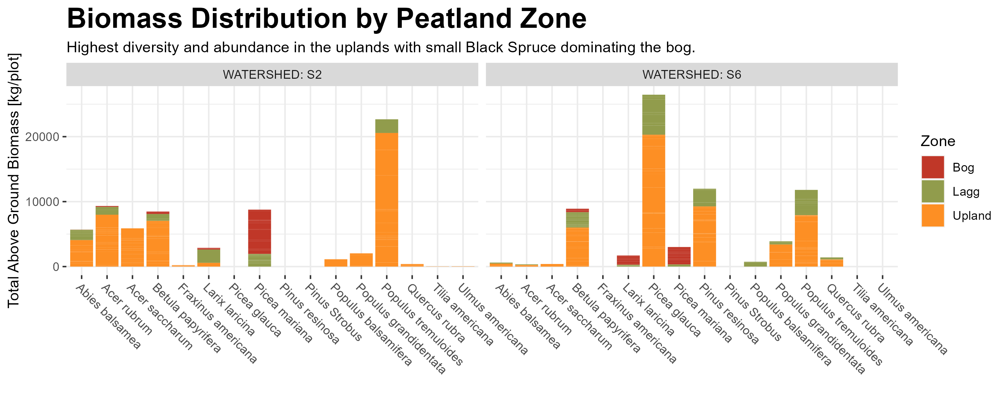

Slide 3
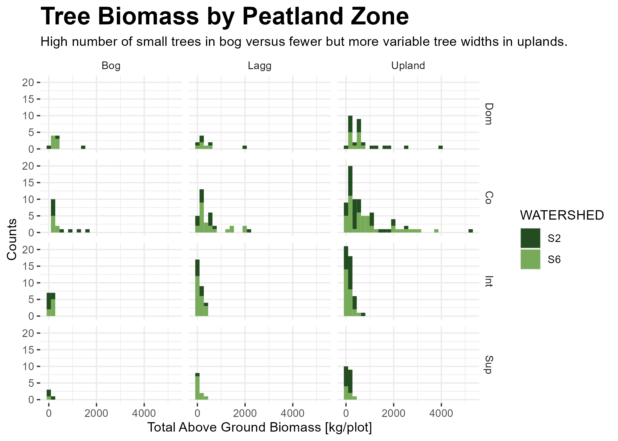

Slide 4
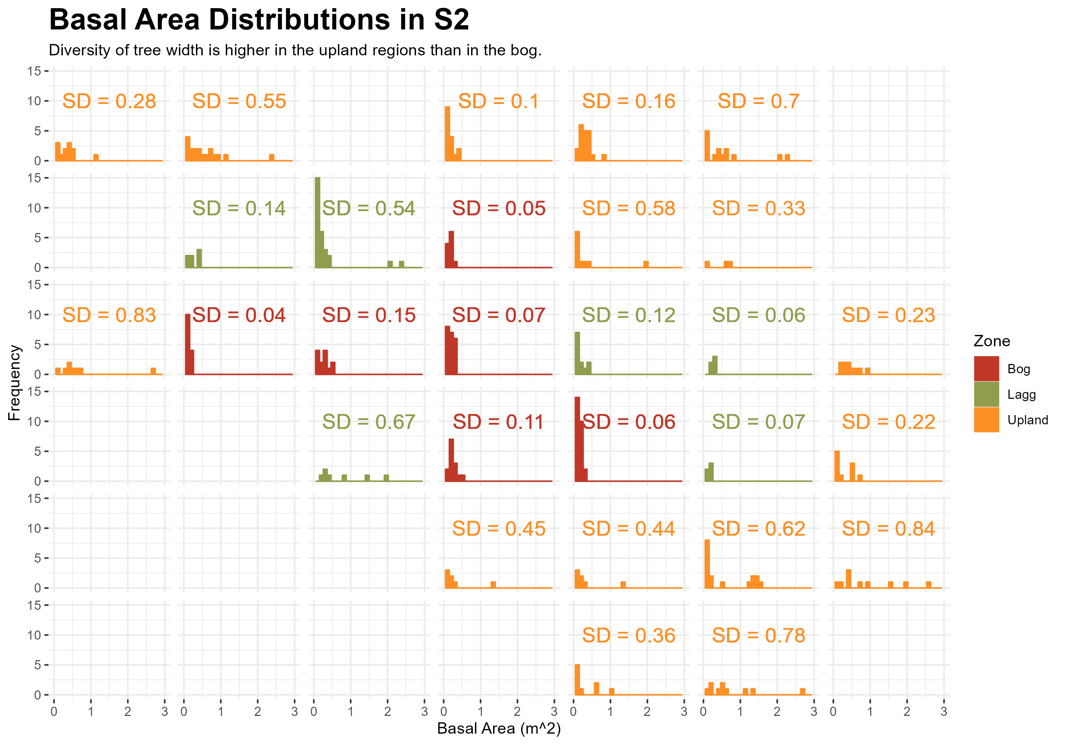

Slide 5
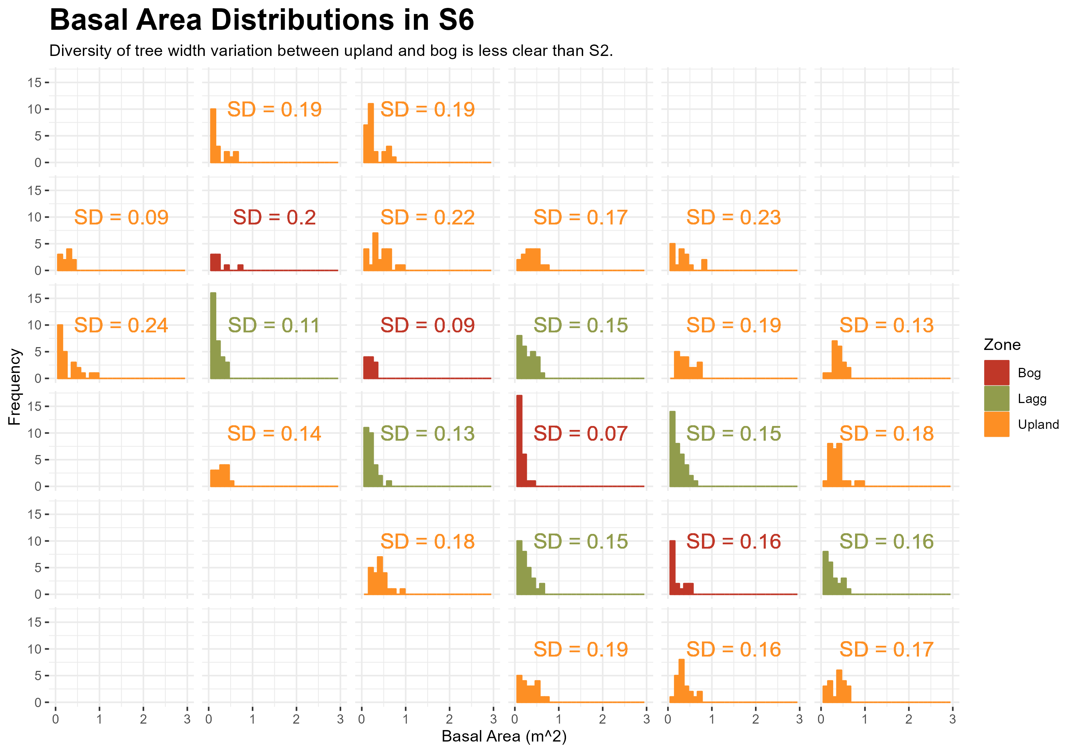

Slide 6
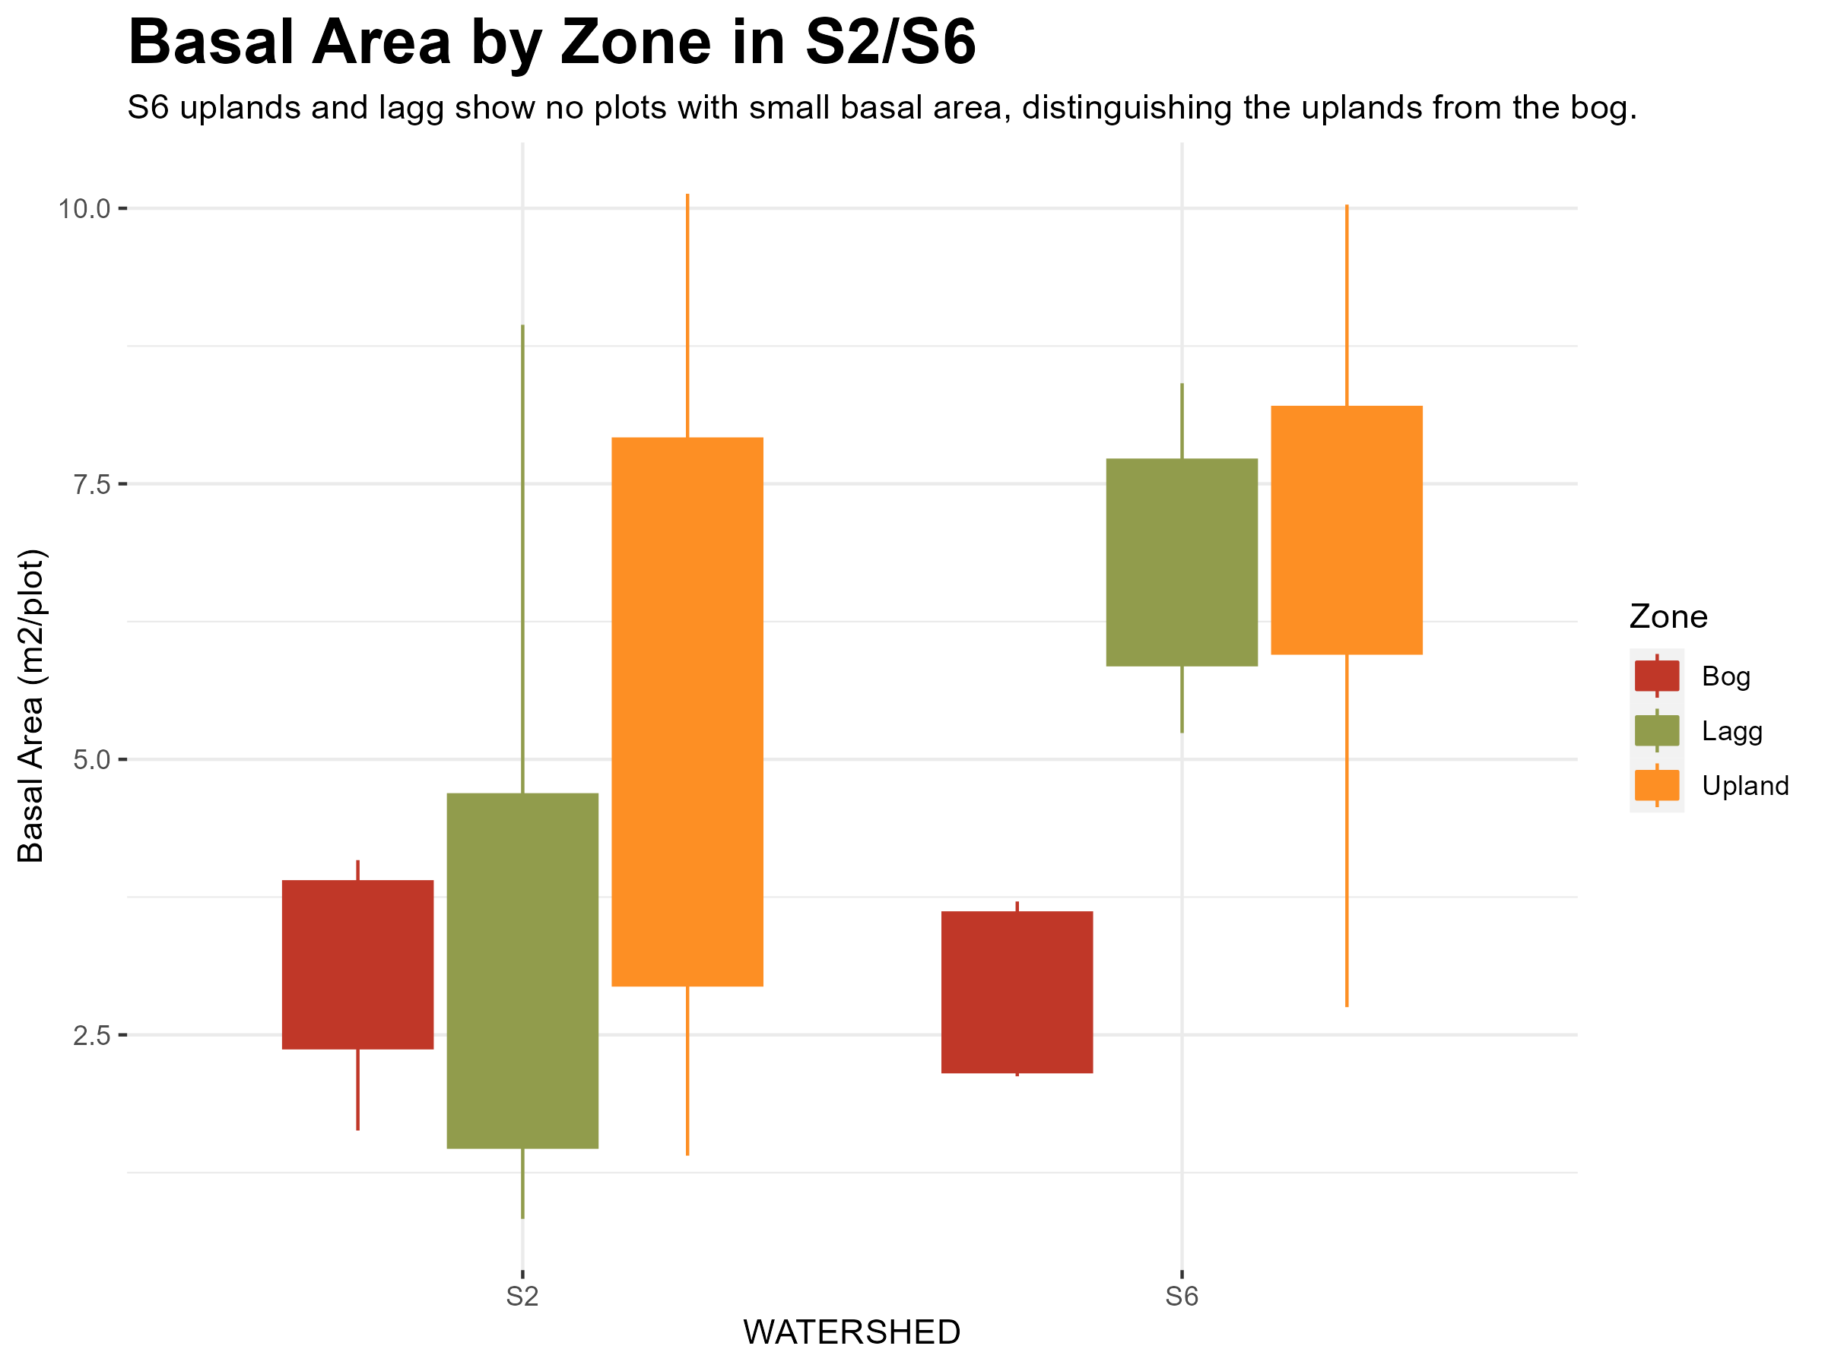

Slide 7

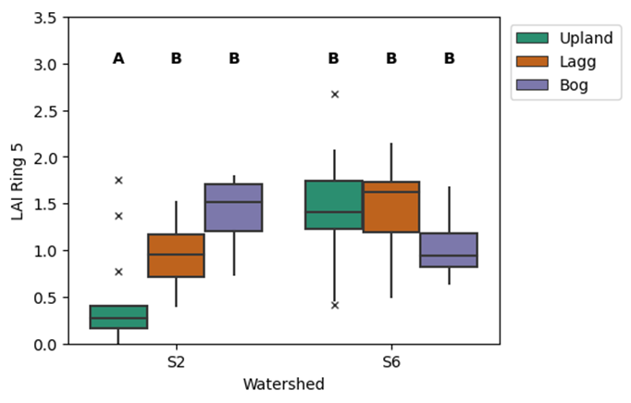

Slide 8
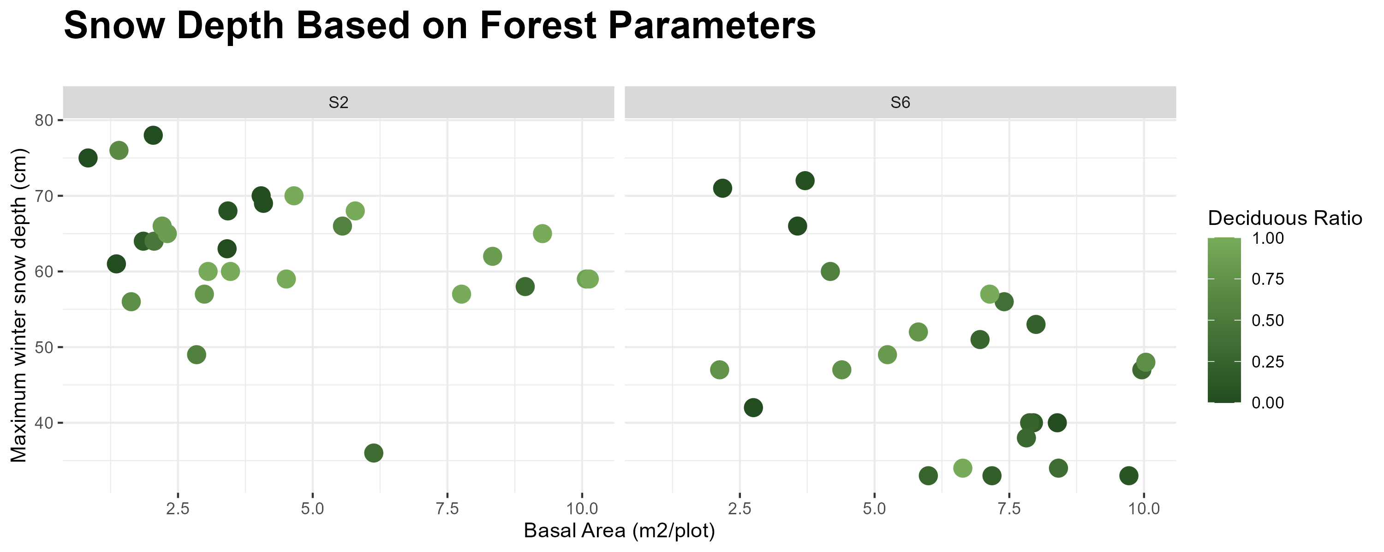
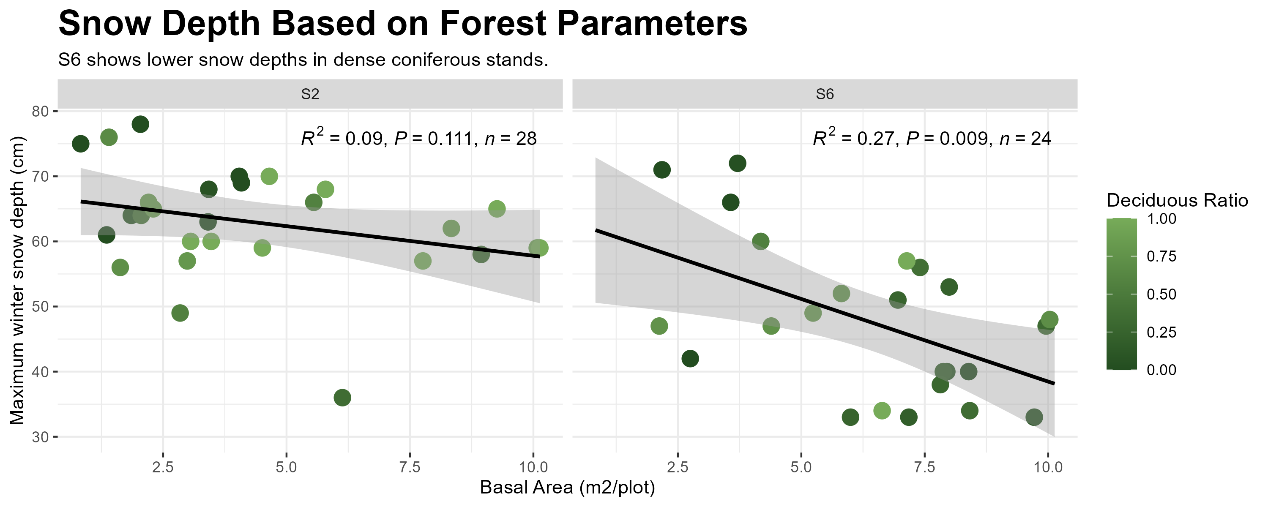
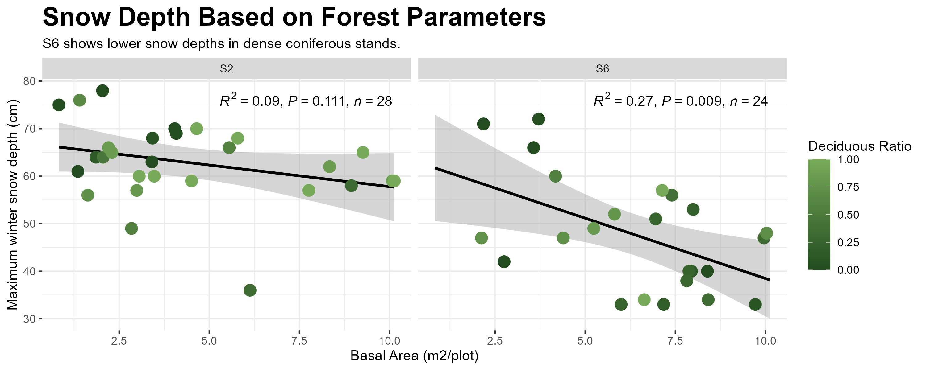

Slide 9
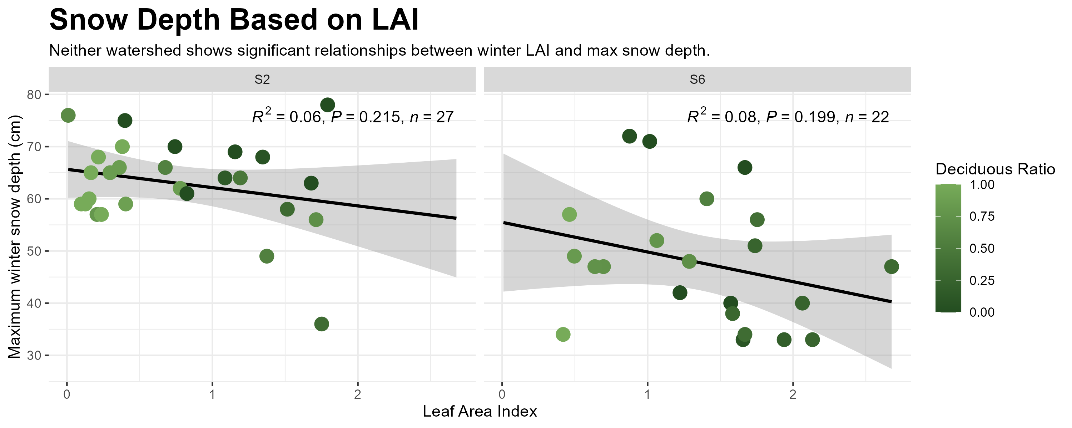

Slide 10
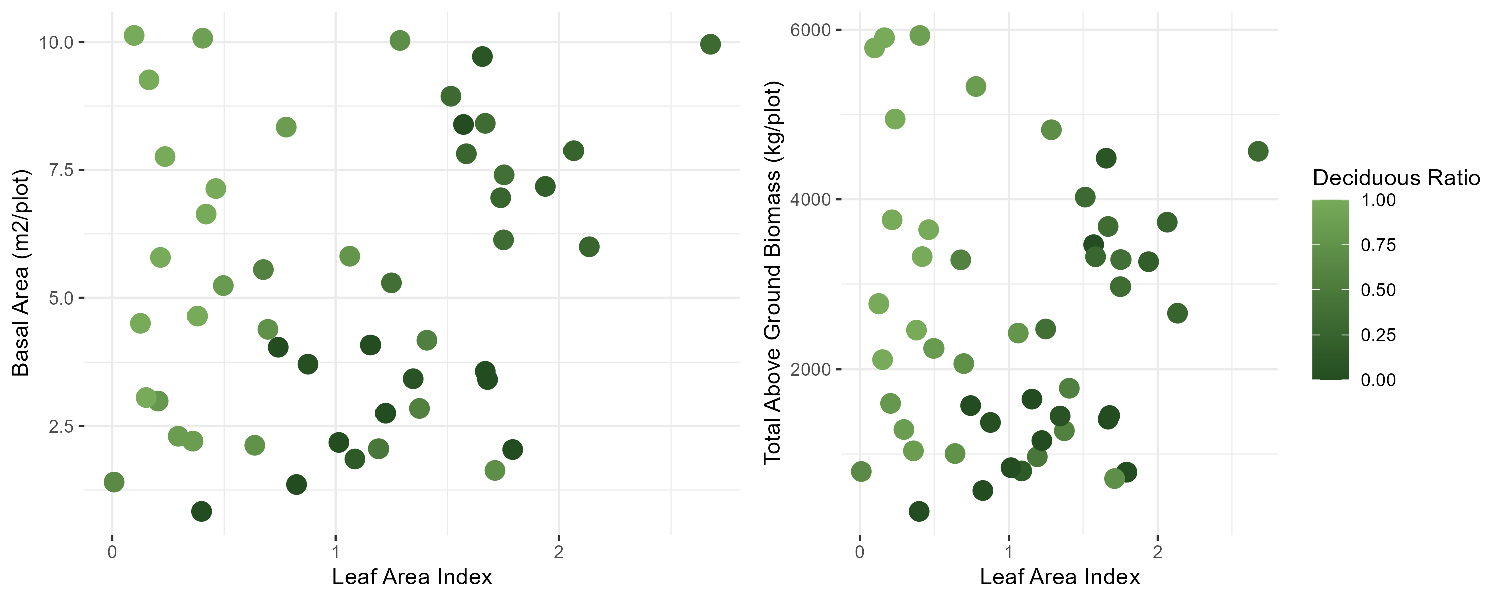

Slide 11
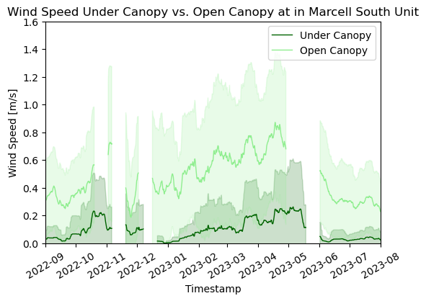
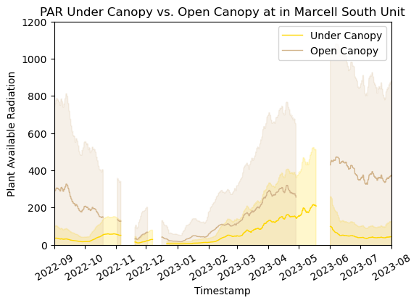

Slide 12
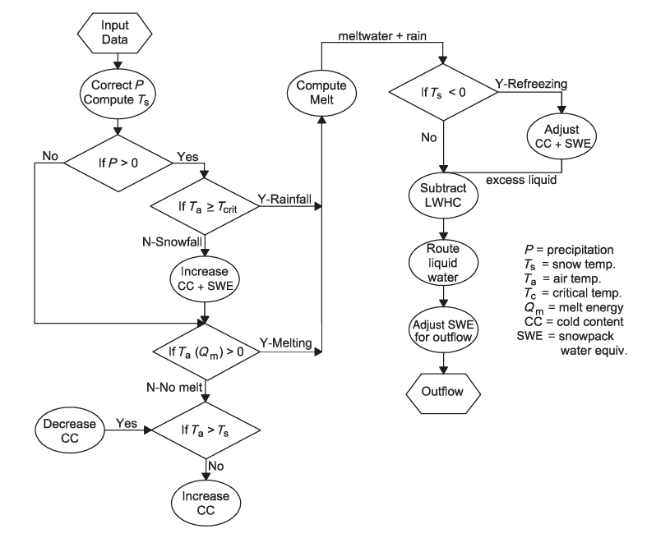
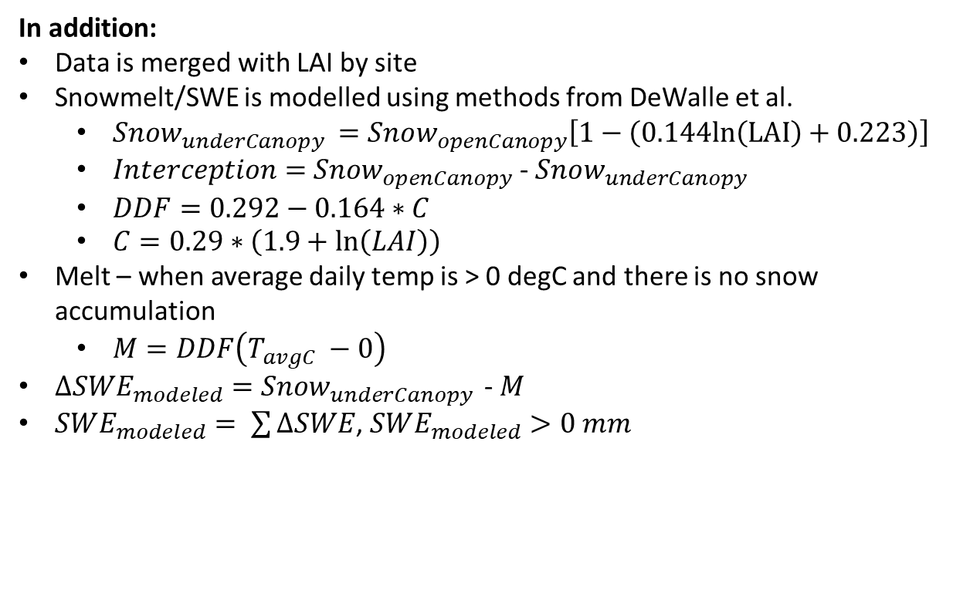
index time northing easting depths zones stakes aspect slope watershed
0 2022-12-02 464644.0 5262240.0 NaN NaN NaN NaN NaN S6
1 2022-12-02 464644.0 5262449.0 5.5 Upland S655 259.7 6.629 S6
2 2022-12-02 464644.0 5262658.0 8.0 Upland S654 350.3 1.924 S6
3 2022-12-02 464644.0 5262867.0 NaN NaN NaN NaN NaN S6
4 2022-12-02 464644.0 5263076.0 NaN NaN NaN NaN NaN S6
In addition:
Data is merged with LAI by site
Snowmelt/SWE is modelled using methods from DeWalle et al.
$Snow_{underCanopy }=Snow_{openCanopy}\left[1−\left(0.144ln\left(LAI\right)+0.223\right)\right]$
$Interception=$ $Snow_{openCanopy}$ - $Snow_{underCanopy }$
$DDF=0.292−0.164∗C$
$C=0.29∗\left(1.9+\ln\left(LAI\right)\right)$
Melt – when average daily temp is > 0 degC and there is no snow accumulation
$M=DDF\left(T_{avgC} −0\right)$
$∆SWE_{modeled}=$ $Snow_{underCanopy }$ - $M$
$SWE_{modeled}= \sum{∆SWE}$, $SWE_{modeled}>0 mm$

Slide 13
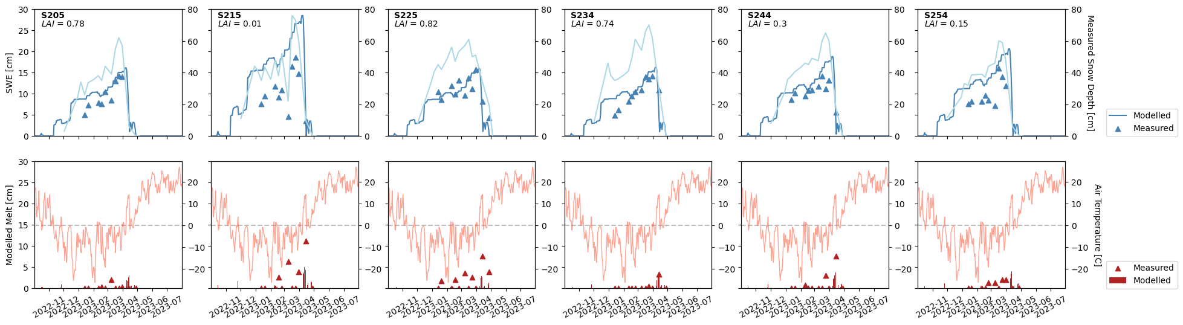

Slide 14
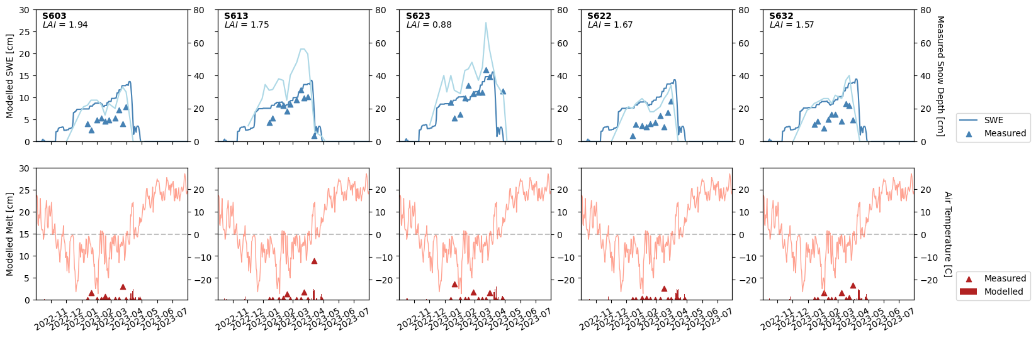

Slide 15
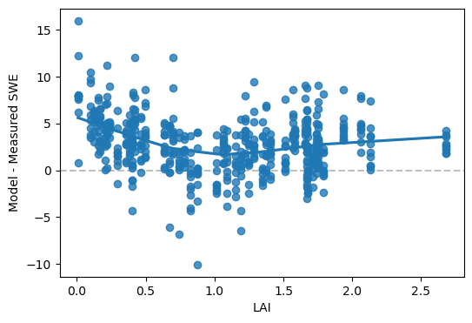
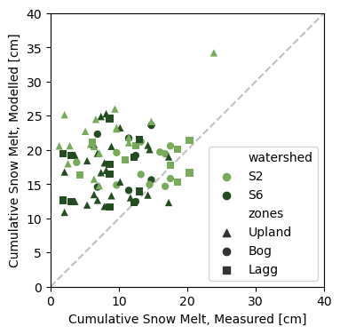
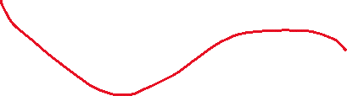



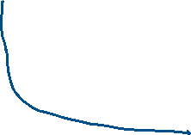
Idea #1: Proportion of Coniferous trees dependent accumulation curve
Idea #2: Modify the curve to account for less throughfall (more interception) at low LAI

Slide 16
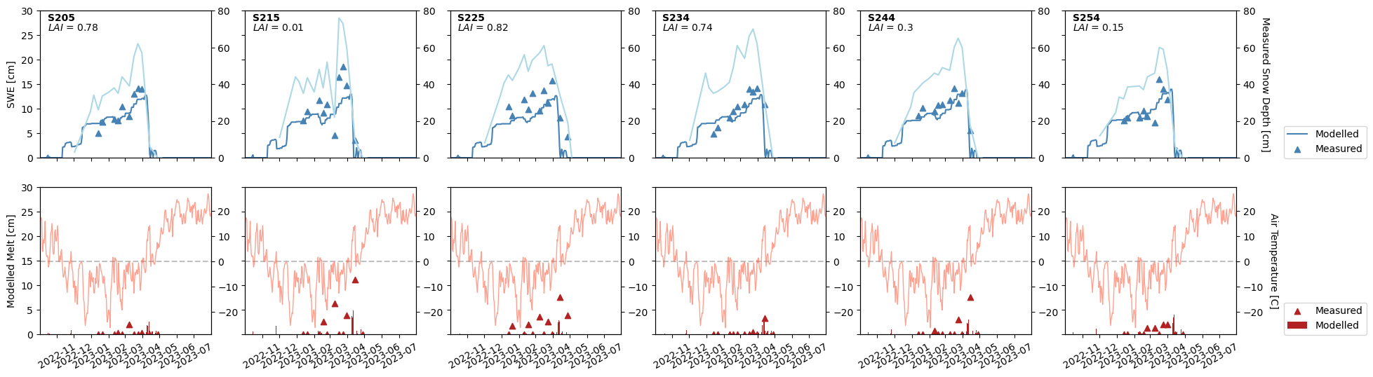
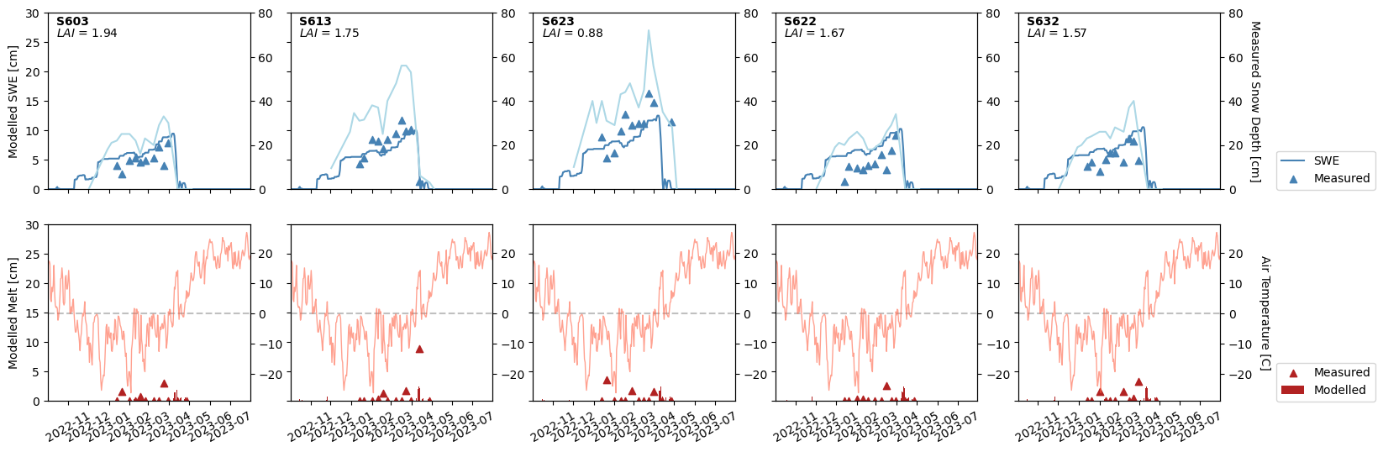
Using un-log transformed interception equation:

Slide 17
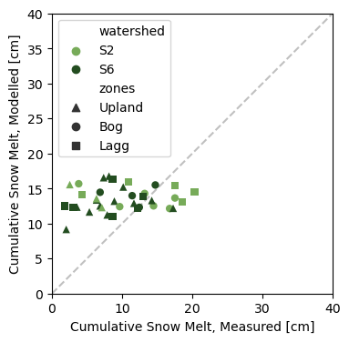
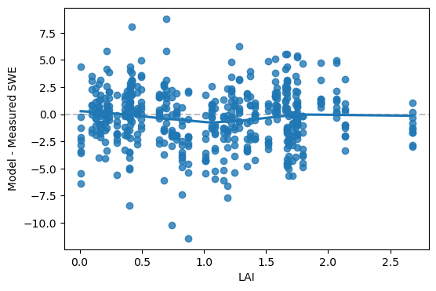
Residuals are now centered on 0, however, there is still a slight shift in the variance across LAI – now under estimating for mid-range LAI
Can we modify the constants in the interception model to make this EVEN better?
Then what:
Clean the Snow/SWE data from S2 to use instead of GR if possible
Use the new SWE and melt models to estimate melt into the soil and compare this to the measured melt and the soil water volume from the moisture sensors
Match daily scale NWI from model to daily soil moist data
Compare the moisture across sites where frost was and wasn’t present when melt occurred
Look at lateral flow off of the slopes compared to soil moisture/frost relationships

Slide 18
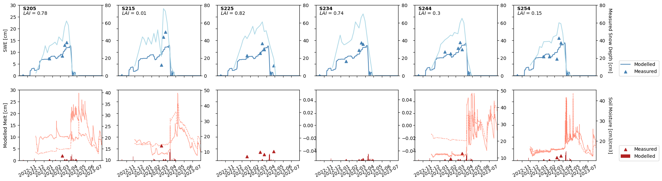

Slide 19
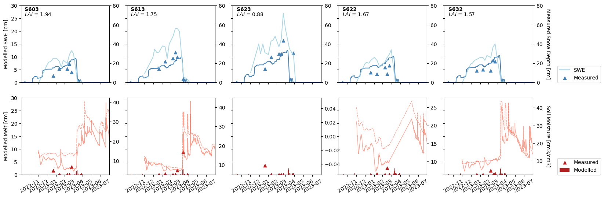

Slide 20
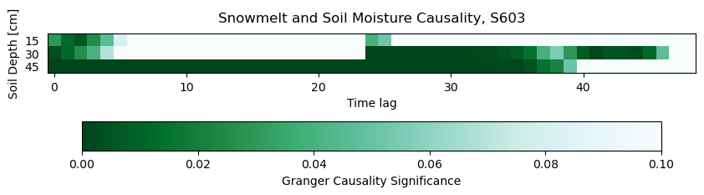
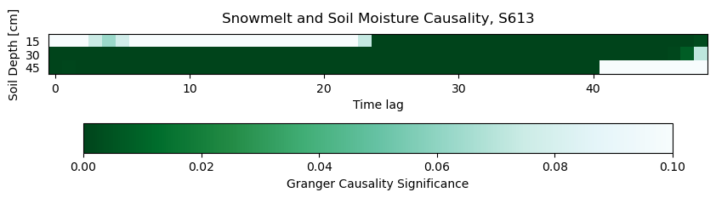
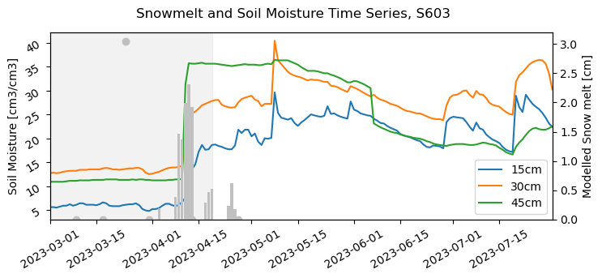
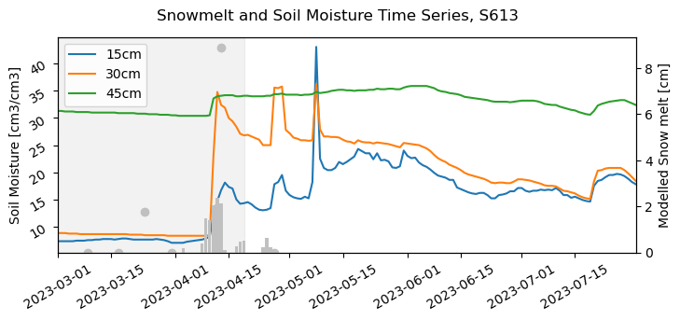

Slide 21
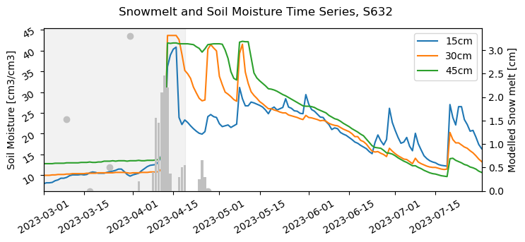
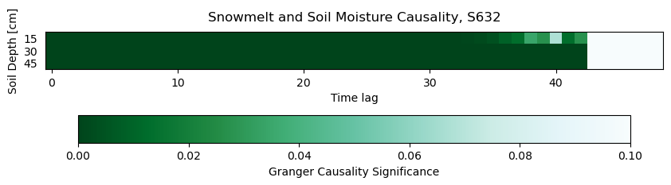

Slide 22
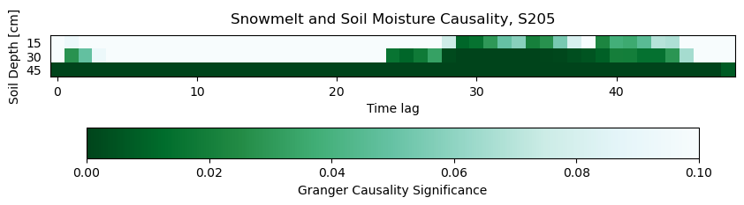
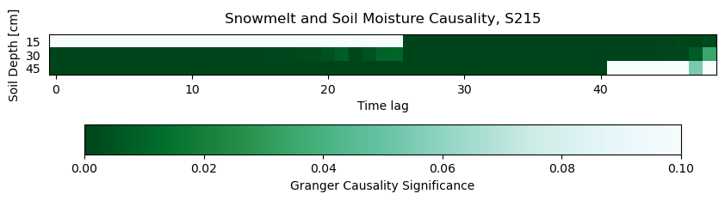
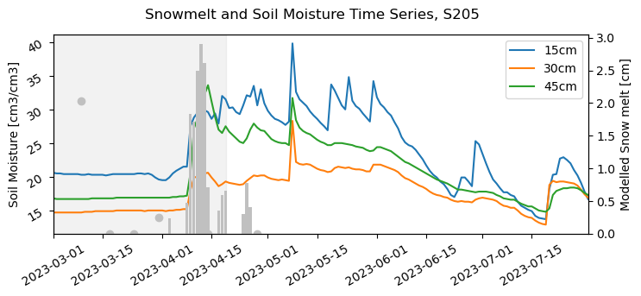
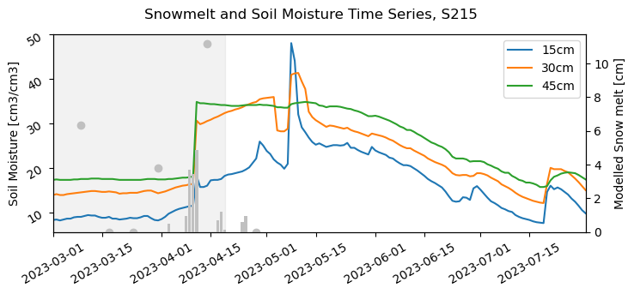

Slide 23
