Slide 1
Potential Outline for Western Snow Conference (WSC) Presentation
Introduction to Marcell + project outline
MEF maps, background from hydrologic connectivity paper, NSF grant gial outline (forest, frost, flow)
Research Setup
Grid maps, elevation profiles
Initial accumulation season results
Snow accumulation trends by zone, north vs. south slopes (see slides 2-)
Snow and LAI correlations (see slides )
Snow and soil frost relationships, north vs. south slopes (see slides )
Snow and Soil moisture/temperature (see slides )
Continued work – two more snow seasons!

Slide 2
Please feel free to comment/draw/etc. on these slides if there are comments or questions you have.
In general, I have made annotations in blue to help direct you to interesting features that Xue and I have noticed in the data. I have also made annotations in red in places where it isn’t clear what is going on in the data or there are strange inconsistencies between sensor and manual data.
Thank you!

Slide 3
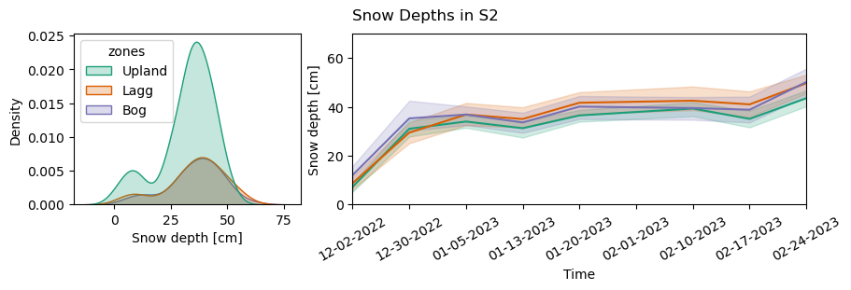
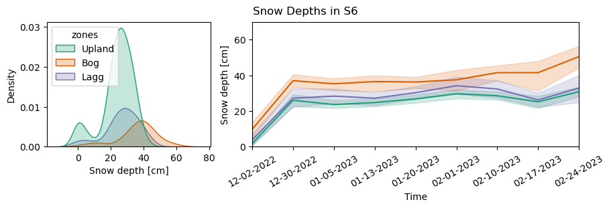
Snow accumulation trends by zone, north vs. south slopes
No change in accumulated snow between any zones in S2 (matches the results of the ANOVA test on LAI)
Increase in accumulated snow in the Bog in S6 (matches the results of the ANOVA test on LAI)

Slide 5
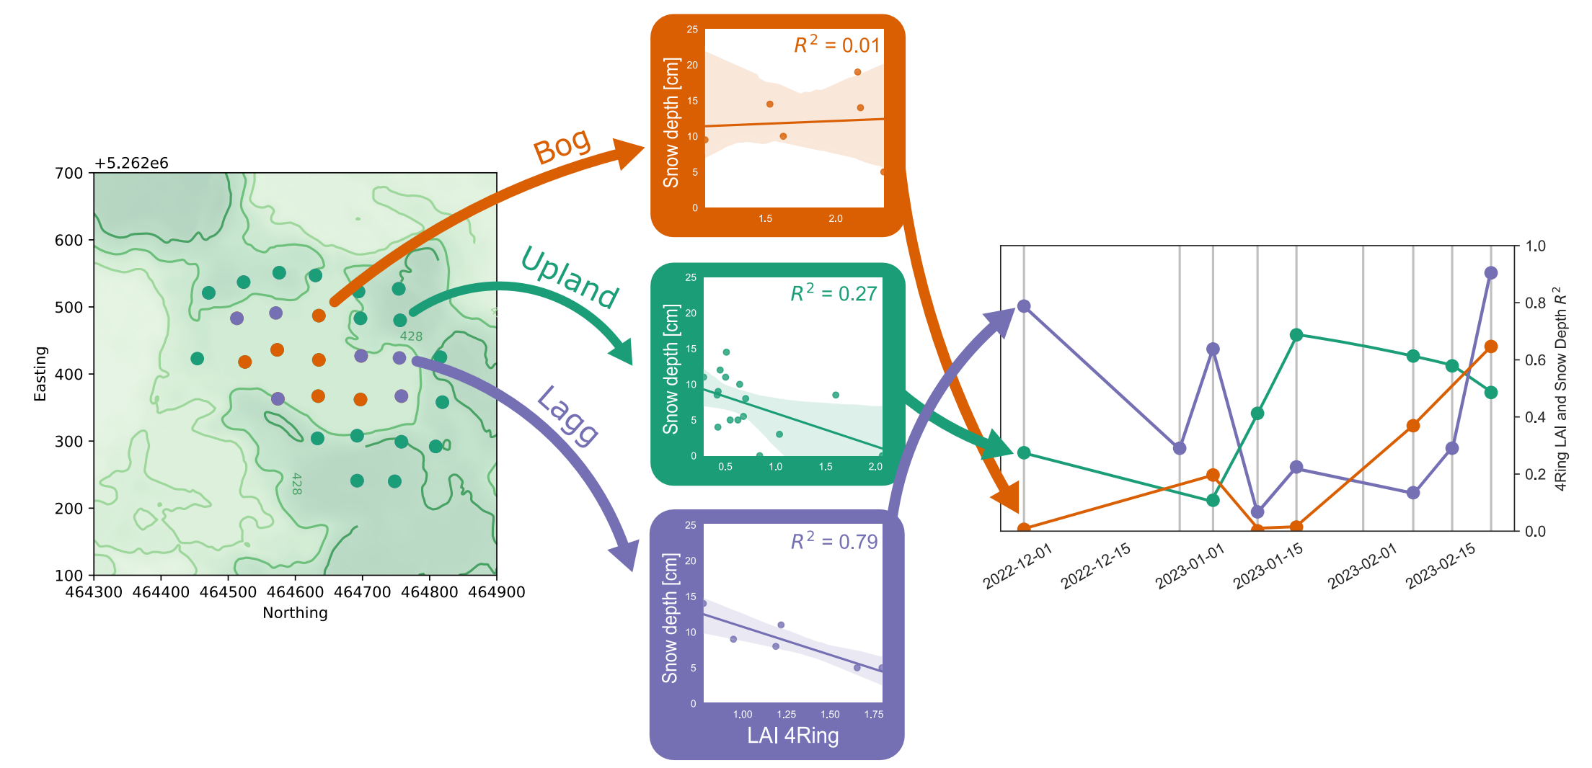
Snow and LAI correlations

Slide 6
Snow and soil frost relationships, north vs. south slopes

Slide 7
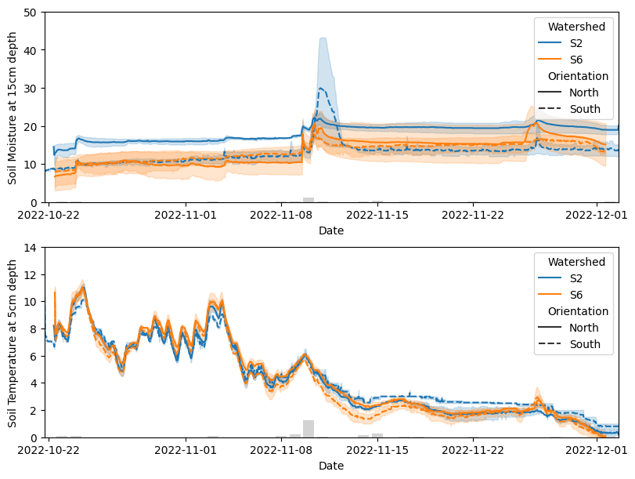
Snow, Soil moisture and temperature

Slide 8
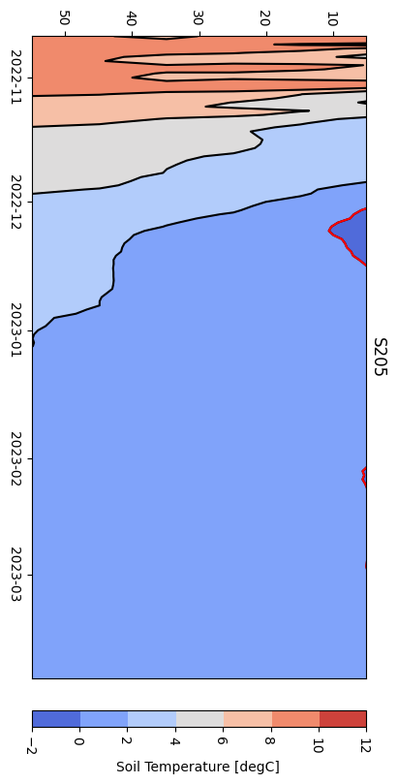
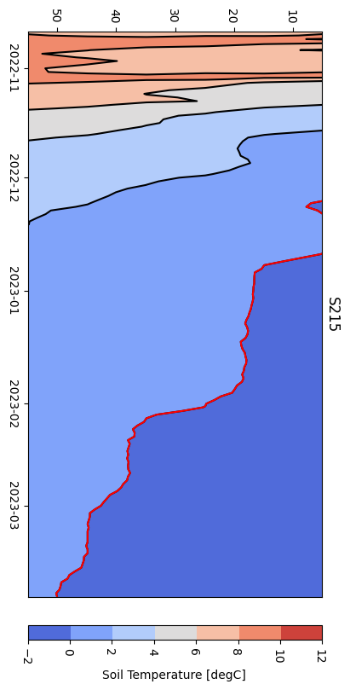
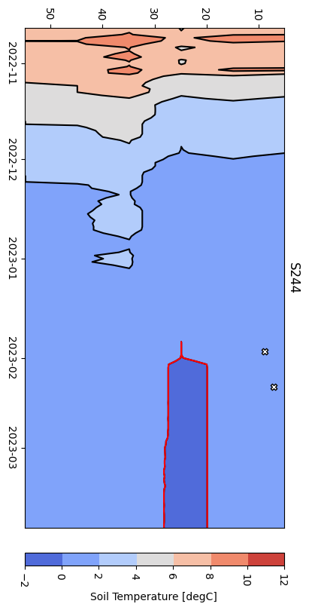
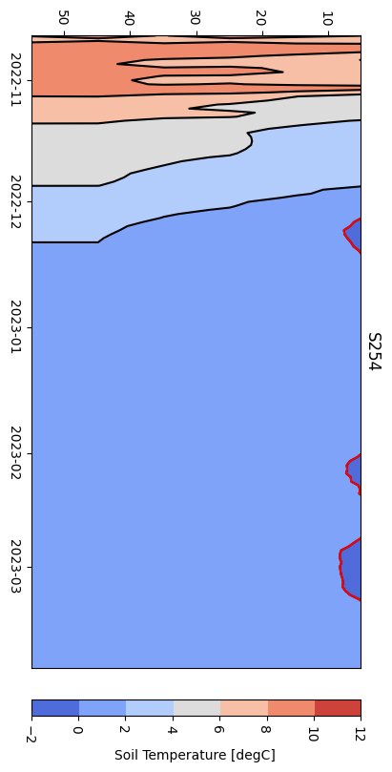


Vertical X-axis – Time, Horizontal Y-axis – Soil Depth, Red Line – 0deg C line (proxy for frost depth)
White and black markers show the data from manual frost measurements, no markers means zero frost detected
Upland
Slope/Lagg
Slope/Lagg
Upland
Huge inconsistencies between soil temperature and detected frost depth in S2
There seem to be no consistencies between the zones, but there may be more frost forming on the south slope

Slide 9
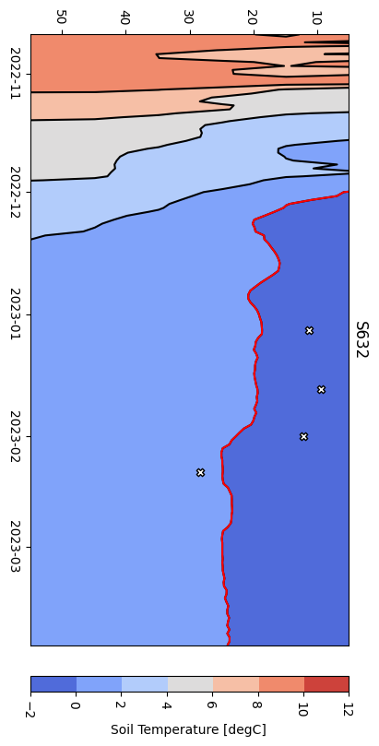
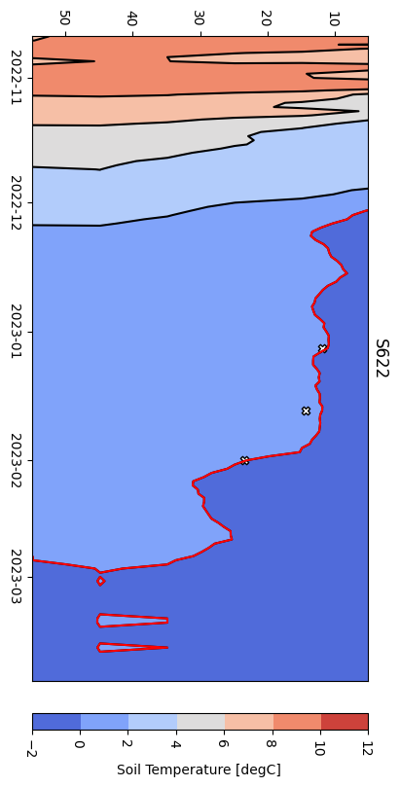
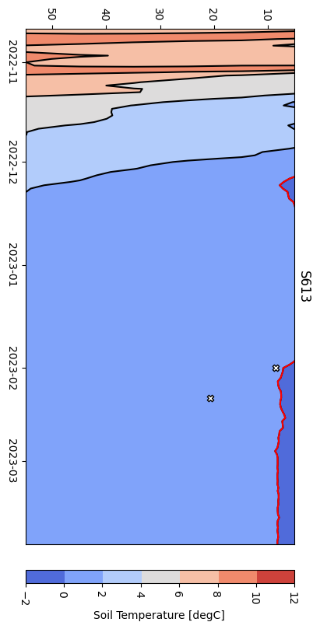
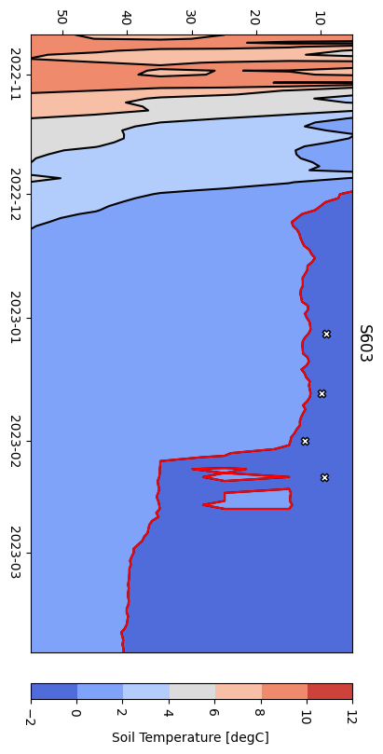

Vertical X-axis – Time, Horizontal Y-axis – Soil Depth, Red Line – 0deg C line (proxy for frost depth)
White and black markers show the data from manual frost measurements, no markers means zero frost detected
Upland
Slope/Lagg
Slope/Lagg
Upland
There seem to be no consistencies between the zones, but there may be more frost forming on the south slope

