Slide 1
Who ends up with U.S. weapons, and what patterns emerge in their distribution over time?
“Since 1950, the U.S. has been the largest global arms supplier—this project models how those exports spread across allies and conflict zones using data from the SIPRI Arms Transfer Database.”
Lucas Rayder, Nicholas Thornton, Michael Dunlap

Slide 2
About Our Data
Source: SIPRI Arms Transfers Database, maintained by the Stockholm International Peace Research Institute, which has tracked major conventional arms transfers since 1950.
Scope: Includes 29,507 observations covering 257 countries or entities from 1950 to 2023.
Structure: Each record represents a transaction between a supplier and a recipient, describing the flow, type, and value of transferred weapons.
Key variables:
  Recipient and supplier
  Order year and delivery year
  Weapon designation and description
  Status (new or second-hand)
  TIV (Trend Indicator Value): SIPRI’s standardized measure of transfer value
Missing data: Limited to dissolved states or unreported deliveries, handled through selective filtering to maintain consistency.
Notes:
The data come from the SIPRI Arms Transfers Database, maintained by the Stockholm International Peace Research Institute since 1950.
It includes nearly 30,000 observations across 257 countries or entities, providing a detailed picture of global transfers.
Key features: supplier, recipient, weapon type, delivery year, and a measure of value called TIV (Trend Indicator Value).
Note that some missing values come from dissolved countries or incomplete delivery records.
Overall, this is one of the most comprehensive and credible global datasets for arms transfers.

Slide 3
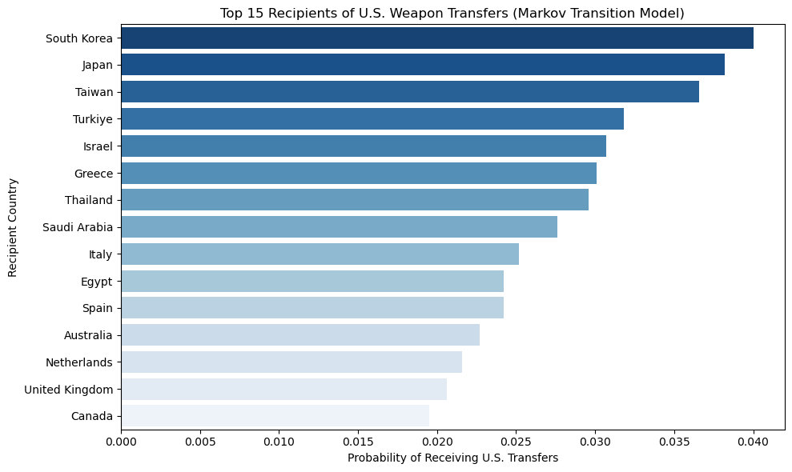
Top Recipients of U.S. Weapons Transfers
Notes:
Highlight that the top recipients include South Korea, Japan, Taiwan, and Turkey.
These reflect the U.S.’s long-term alliances in Asia and NATO.
Emphasize that the probabilities are derived from a Markov transition model, representing the likelihood of transfers between countries.
Note that Asia and Europe dominate the top of the distribution, suggesting strategic and defense-based trade relationships.

Slide 4
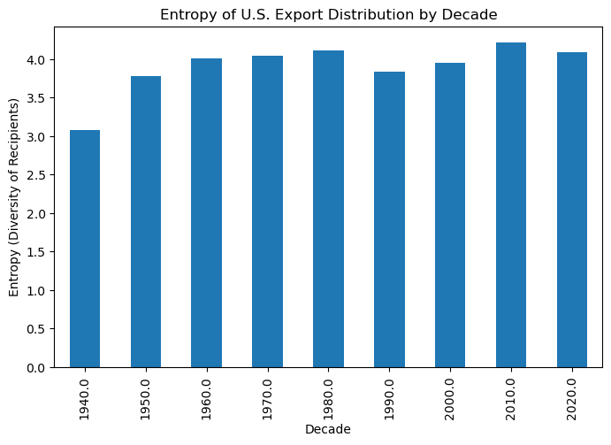
Entropy of U.S. Export Distribution
Notes:
Explain entropy as a measure of diversity in exports — higher entropy means more evenly distributed exports.
The trend shows that the diversity of U.S. export partners has grown gradually over time.
Mention how earlier decades were dominated by a few Cold War allies, while recent decades show broader export networks.
This indicates increasing global reach and diversification of U.S. arms trading relationships.

Slide 5
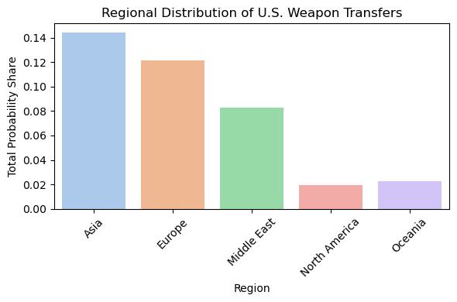
Regional Distribution of Weapon Transfers
Notes:
This chart shows how U.S. exports are distributed by region.
The largest shares go to Asia and Europe, followed by the Middle East.
North America and Oceania account for relatively small portions.
Point out that this aligns with global security alliances and defense agreements — reinforcing that weapons flow toward areas of strategic interest or instability.

Slide 6
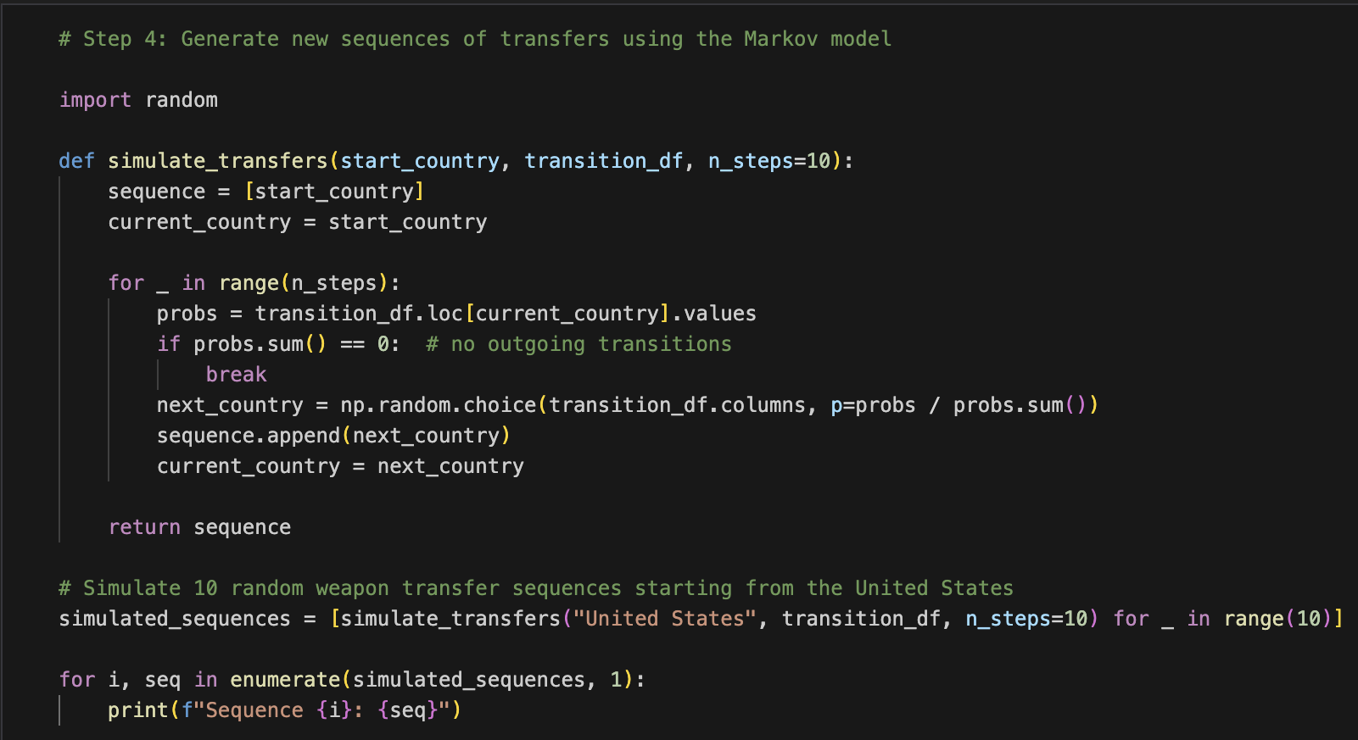
Using the Model
Sequence 1: ['United States', np.str_('Germany'), np.str_('Greece'), np.str_('Spain'), np.str_('Bolivia’)]
Sequence 8: ['United States', np.str_('Iraq'), np.str_('Jordan'), np.str_('Lebanon'), np.str_('Pakistan'), np.str_('Iran'), np.str_('Houthi rebels (Yemen)*')]
Notes:
Explain that the Markov model allows simulation of potential transfer “paths” based on historical probabilities.
For example, one simulated sequence might go from the U.S. to Germany to Greece to Spain to Bolivia — showing how weapons could flow across regions over time.
These sequences are not predictions but plausible pathways illustrating how arms circulation can spread.
This helps visualize complex networks and the indirect reach of U.S. arms exports.

Slide 7
Conclusion
The U.S. primarily exports weapons to long-standing allies in Asia, Europe, and the Middle East.
Patterns of transfers reflect strategic and military partnerships more than geographic proximity.
Despite data limitations, the Markov model effectively captures realistic global transfer dynamics.
Notes:
Summarize key takeaways:
The U.S. exports primarily to long-term allies, especially in Asia and Europe.
Some recipient countries no longer exist or appear infrequently, showing dataset complexity.
The model captures realistic trade dynamics, but not real-time political context.
Conclude that U.S. export patterns reflect both historical alliances and evolving global defense interests.

Slide 8
Further Research
How do global conflicts or policy shifts (e.g., sanctions, wars) alter transfer probabilities?
Could weapon type or technology level reveal different regional dynamics?
How might incorporating temporal or political event data improve model accuracy over time?
Notes:
Suggest three directions:
Incorporate political or conflict data (like sanctions or wars) to explain sudden changes in export patterns.
Differentiate results by weapon type — for example, aircraft vs. small arms.
Explore temporal modeling — adding time-based effects to capture changing alliances and policies.
Emphasize that these steps could make the model more predictive and relevant to modern geopolitical analysis.

Slide 9
Any Questions?

