Slide 1
Lancaster County Adult Detention Facility
Census Trend Analyses
Aug 18th , 2026
© HDR 2025, all rights reserved.

Slide 2
Agenda
01
Project Overview and Data Scope
02
Estimated Population Growth Overview
03
Current State Analysis: Jul 24 – May 26
04
Census Model: Jul 24 – May 26
05
Census Model Methodology Review

Slide 3
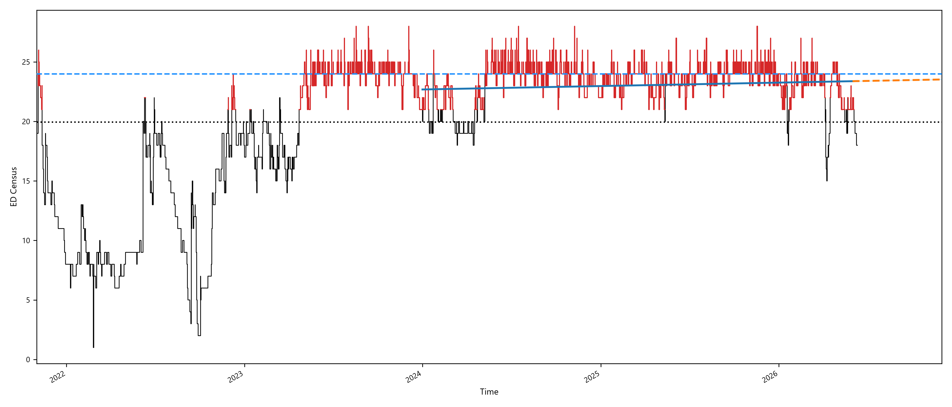
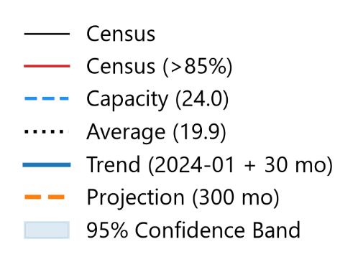
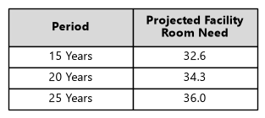
Lancaster County Adult Detention Facility
Census Analyses
3

