Slide 1
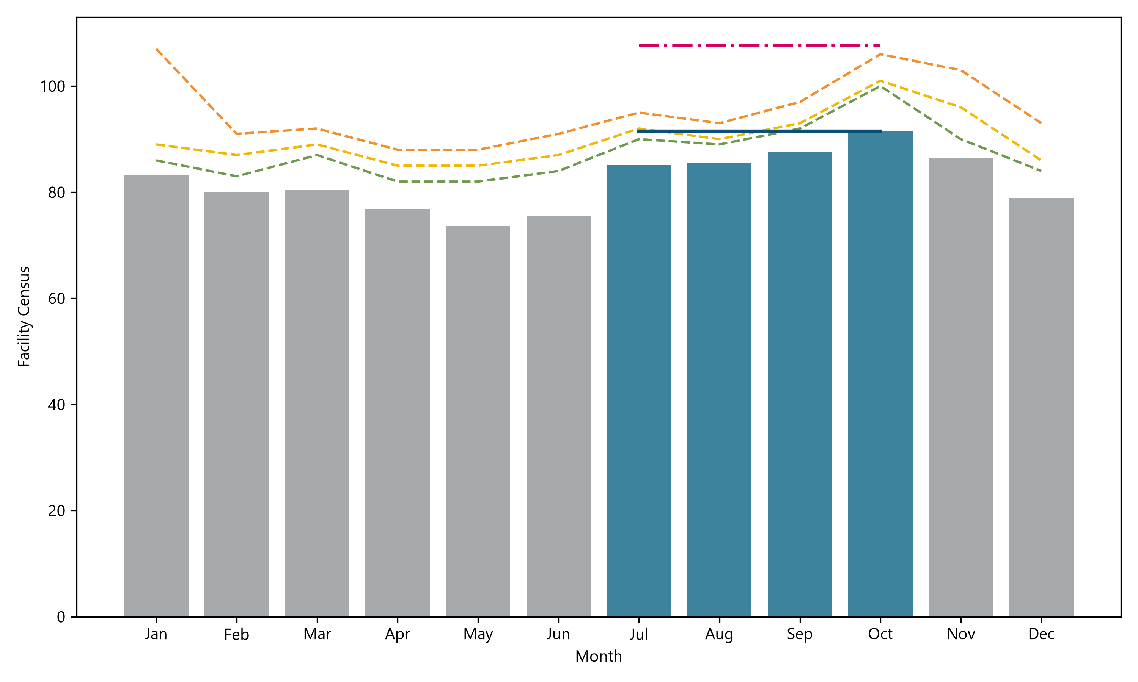

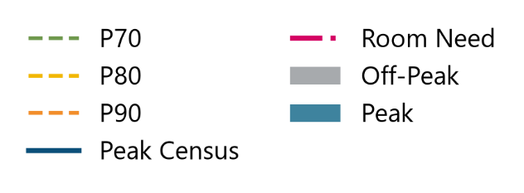
Lancaster County Adult Detention Facility
Census Analyses
.
1

