Slide 1


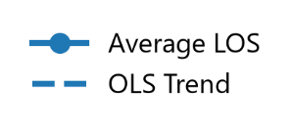
Lancaster County Adult Detention Facility
Length-of-Stay Analysis
.
1

