Slide 1

Green Pace
Security Policy Presentation
Developer: Mark Webster
CS 405 – Professor Alhwaiti
08/17/2022

Slide 2
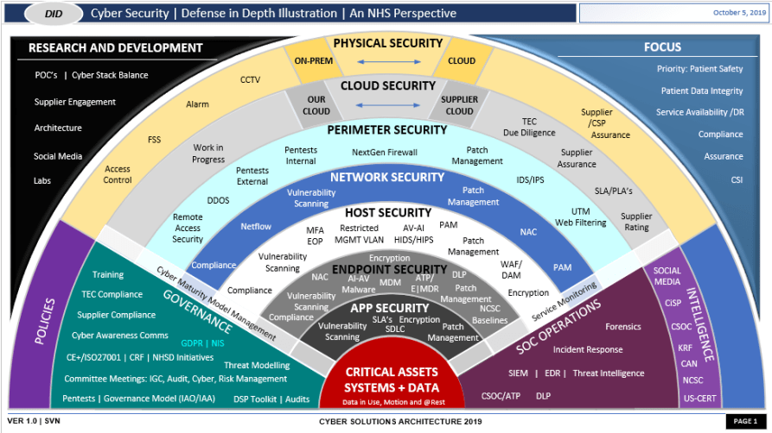
OVERVIEW: DEFENSE IN DEPTH
Overview
Green Pace's security policy was needed to create a uniform approach to secure coding and testing among our developers. The guide covers rules for dealing with common errors and vulnerabilities in C++ development that can lead to security problems.
Writing secure code is only one part of our defense-in-depth approach, as we combine many layers of security, including automated testing, physical and digital barriers safeguarding our system, and encryption to bring more complete approach.

Slide 3
THREATS MATRIX
Threat Matrix
Likely STD-002-CPP STD-004-CPP | Priority STD-001-CPP STD-008-CPP STD-005-CPP
Low priority STD-007-CPP | Unlikely STD-003-CPP STD-009-CPP STD-010-CPP STD-006-CPP
The most likely and higher priority threats are the ones we want to deal with immediate, as they are the most common and can have higher remediation costs.
The lower priority and unlikely threats have lower remediation costs and are less probable.

Slide 4
10 PRINCIPLES
Coding Principles
1. Validate Input Data
2. Heed Compiler Warnings
3. Architect and Design for Security Policies
4. Keep It Simple
5. Default Deny
6. Adhere to the Principle of Least Privilege
7. Sanitize Data Sent to Other Systems
8. Practice Defense in Depth
9. Use Effective Quality Assurance Techniques
10. Adopt a Secure Coding Standard

Slide 5
CODING STANDARDS
Coding Standards
1. Always use parameterized statements where available.
2. Guarantee that storage for strings has sufficient space for character data and the null terminator.
3. Ensure that unsigned integer operations do not wrap.
4. Use pointers to const when referring to string literals.
5. Free dynamically allocated memory when no longer needed.
6. Minimize the scope of variables and functions.
7. Utilize try-catch blocks to handle all exceptions that may occur during code execution.
8. Assertions should be used as both preconditional, intrafunction, and postconditional checks as often as possible.
9. Strive for logical completeness.
10. Treat relational and equality operators as if they non-associative.

Slide 6
ENCRYPTION POLICIES
Encryption Standards
Encryption at rest -- how data is encrypted as it is written into storage and decrypted as it is read out it. It is a means to protect stored data on disk. When Green Pace stores any sensitive data on its servers, we should be encrypting it. If any malicious actors are able to access the data while it is stored, they cannot read it without the key.
Encryption at flight -- encryption of data that is being transmitted across networks. If malicious actors find a way through to our data, we want it to be gibberish without the right keys. Always-on encryption should be our standard when moving data.
Encryption in use – allows accessing and performing tasks with encrypted data. This ensures that data is encrypted at every possible stage. While previous ways to do this involved trusted hardware execution environments, there are new types of software solutions that provide access environments. There are also newer types of encryption like homomorphic encryption which allow computation and data sharing on ciphertext data as though it were plaintext.

Slide 7
TRIPLE-A POLICIES
Our authentication policy is in place to confirm the identity of someone trying to access our system. While commonly a username and password schema is used, we can use 2FA, geolocation, et cetera to build stronger “locks” on our gates.
Authorization refers to what a user can access once they are in our system. In general, we want the principle of least privilege to apply: users only get access to what they need to perform a given task.
Accounting allows us to track and log what users are doing – what they access, modify, and download – in order to form a complete picture of system activity. This is especially useful for breach cases, as we can pinpoint weaknesses and see what the breach exposed.

Slide 8

Unit Testing
ResingWithNegativeNumberThrowsError

Slide 9
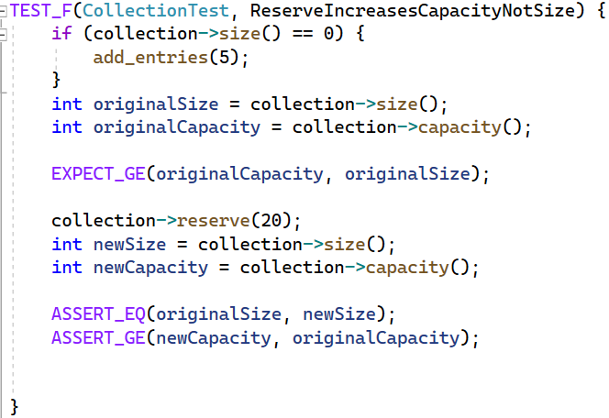
Unit Testing
ReserveIncreasesCapacityNotSize

Slide 10
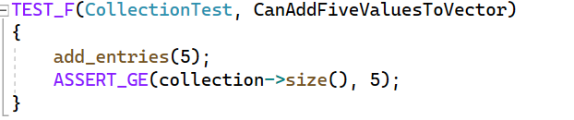
CanAddFiveValuesToVector

Slide 11
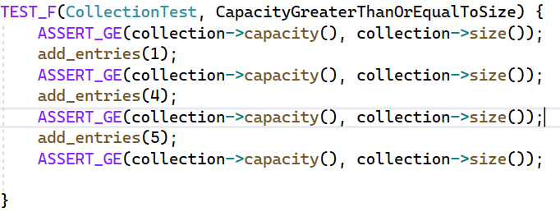
CapacityGreaterThanOrEqualToSize

Slide 12
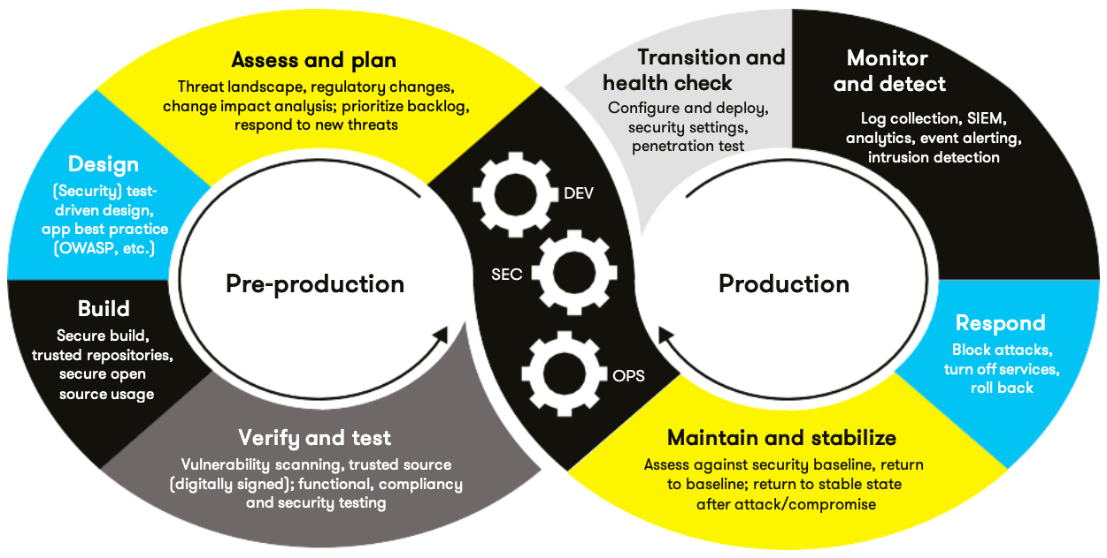
TOOLS
DevSecOps and Tools
  The DevSecOps pipeline place security as a focus during the traditional development process. Like development of a product itself, securing a product never ends. We want it to be a focus from the beginning and continue after a product is deployed.
  For static code analysis, ParaSoft C/C++ is the gold standard. It can catch many errors and vulnerabilities in code so that our team can fix them. We also used CppCheck during the project, which can be integrated into the IDE and run automatically.
  Often we want to put our system under stress to check its performance at scale. WebLOAD can be used to run automatic load testing to see how the system fares. It can be deployed during the initial test phase, as well as our maintain and stabilize.
  We also want to test our security often. We can do this using MetaSploit, which helps automate the penetration testing process. It allows us to write a wide variety of tests and pressure our system's defensive measures with a large range of tricks and exploits to ensure we've designed a good foundation.

Slide 13
RISKS AND BENEFITS
Cost-Benefit Analysis
When dealing with security, we want to start as early as possible. Usage of threat modeling in our design process will help us plan code that can be as secure as possible. A possible downside is the time cost and specialized information deficit that may exist among dev staff. Writing secure code requires either more upfront knowledge or enhanced training, and both can take our developers away from actually writing code. There is also a greater time cost incurred by writing and test code to ensure security. While somethings can be automated, the initial time cost of setting up those systems can increase development timelines. However, getting ahead of possible problems far outweighs putting off security. One breach can cost the company far more than implementing security from Day One.

Slide 14
RECOMMENDATIONS
Unanswered Questions
    What happens if deficient code is found?
    What is the road-map for automating our processes?
    How do we intend to scale security from our guide to all developer teams?
    Do we have a consistent style guide?
    What flexibility do we need to have in order to ensure that secure coding incorporates all types of projects?

Slide 15
Going Forward
Identify deficiencies in secure coding during hiring, or make sure that interviewee expresses willingness to expand his or her knowledge in this department
Code reviews should focus on security as well, not just functionality
Unit testing alongside writing code
Implementing container checking in CI pipeline
Put enforcement policies into writing and actionability

Slide 16
REFERENCES
Sources
10 Best Penetration Testing Tools to Use in 2022 [Updated]. (2022, August 9). Techgeekbuzz.Com. https://www.techgeekbuzz.com/blog/best-penetration-testing-tools/
Times, S. D. (2022, February 16). A guide to DevSecOps tools. SD Times. https://sdtimes.com/security/a-guide-to-devsecops-tools-2/
Vijayan, J. (2021, June 19). 6 DevSecOps best practices: Automate early and often. TechBeacon. https://techbeacon.com/security/6-devsecops-best-practices-automate-early-often

