Slide 1

Explore the Ames Housing Dataset Analysis

Slide 2
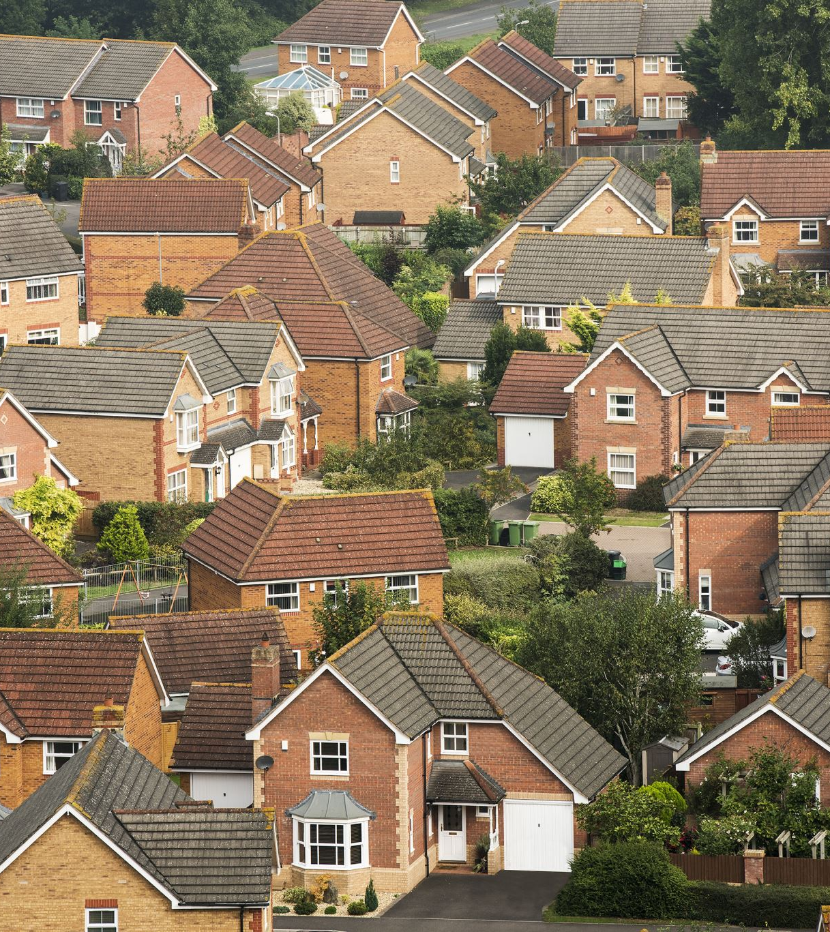
Overall Summary of Analysis:
Correlation with Sale Price:
-The Overall Quality (OverallQual) was found to have a strong positive correlation (0.79) with the SalePrice. This suggests that better quality homes tend to have higher sale prices. Factors like construction quality, materials used, and overall finishes likely influence this.
-Age of the home (Age) showed a negative correlation (-0.52) with sale price. This implies that older homes may not command as high a sale price compared to newer homes, which may have more modern features and construction techniques.

Slide 3
2. Box Plot Analysis:
Overall Quality (OverallQual): Homes with higher overall quality generally have higher sale prices. Homes with poor quality tend to have much lower sale prices.
Kitchen Above Ground (KitchenAbvGr): The number of kitchens above ground has a weak negative correlation with sale price. While having more kitchens could be desirable, this feature doesn't have a strong influence on the final sale price. This could indicate that other factors like the size and functionality of the home outweigh the number of kitchens.

Slide 4
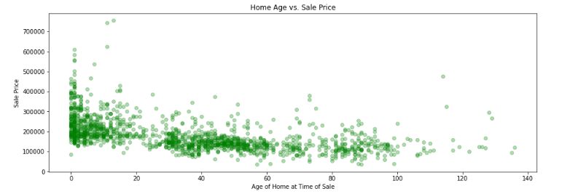
3. Home Age vs. Sale Price:
The scatter plot analysis showed that as homes age, their sale prices tend to decrease, with some exceptions for well-maintained and historically significant homes. This could suggest that newer homes often fetch higher prices, likely due to modern features and amenities.

