Slide 1
PROPOSAL / FISCAL COMPLIANCE SAAS
Compliance Reconciliation
Console
A full-stack build proposal for an automated compliance platform: memory-stable parsing of 500+ MB fiscal XML, a 170+ rule reconciliation engine, and multi-tenant analytical dashboards.
LIVE DEMO michaelwegter.com/work-samples/full-stack-developer-python-fastapi
Michael Wegter / michaelwegter.com

Slide 2
THE PROBLEM
You have the spec. You need someone who can build the hard parts.
The brief is mature: a finished spec, a field-level parsing reference, a design prototype, six milestones with written definitions of done. The risk is not discovery. It is execution on the two pieces that break naive implementations.
500+ MB fiscal XML
170+ reconciliation rules
Multi-tenant + the stakes
A full-accounting SAF-T file for a mid-size company runs 200 to 600 MB. Load the whole tree and the process dies. Memory has to stay flat across tens of thousands of repeating elements.
Debit/credit balances, control totals, VAT, invoice sequence, period boundaries, orphan references. Wrong results in a compliance product carry audit and regulatory weight. Testing is non-optional.
Every client account fully isolated, enforced and proven at the API level. Fixed-price across 6 milestones means scope and the definition of done have to be tight up front.

Slide 3
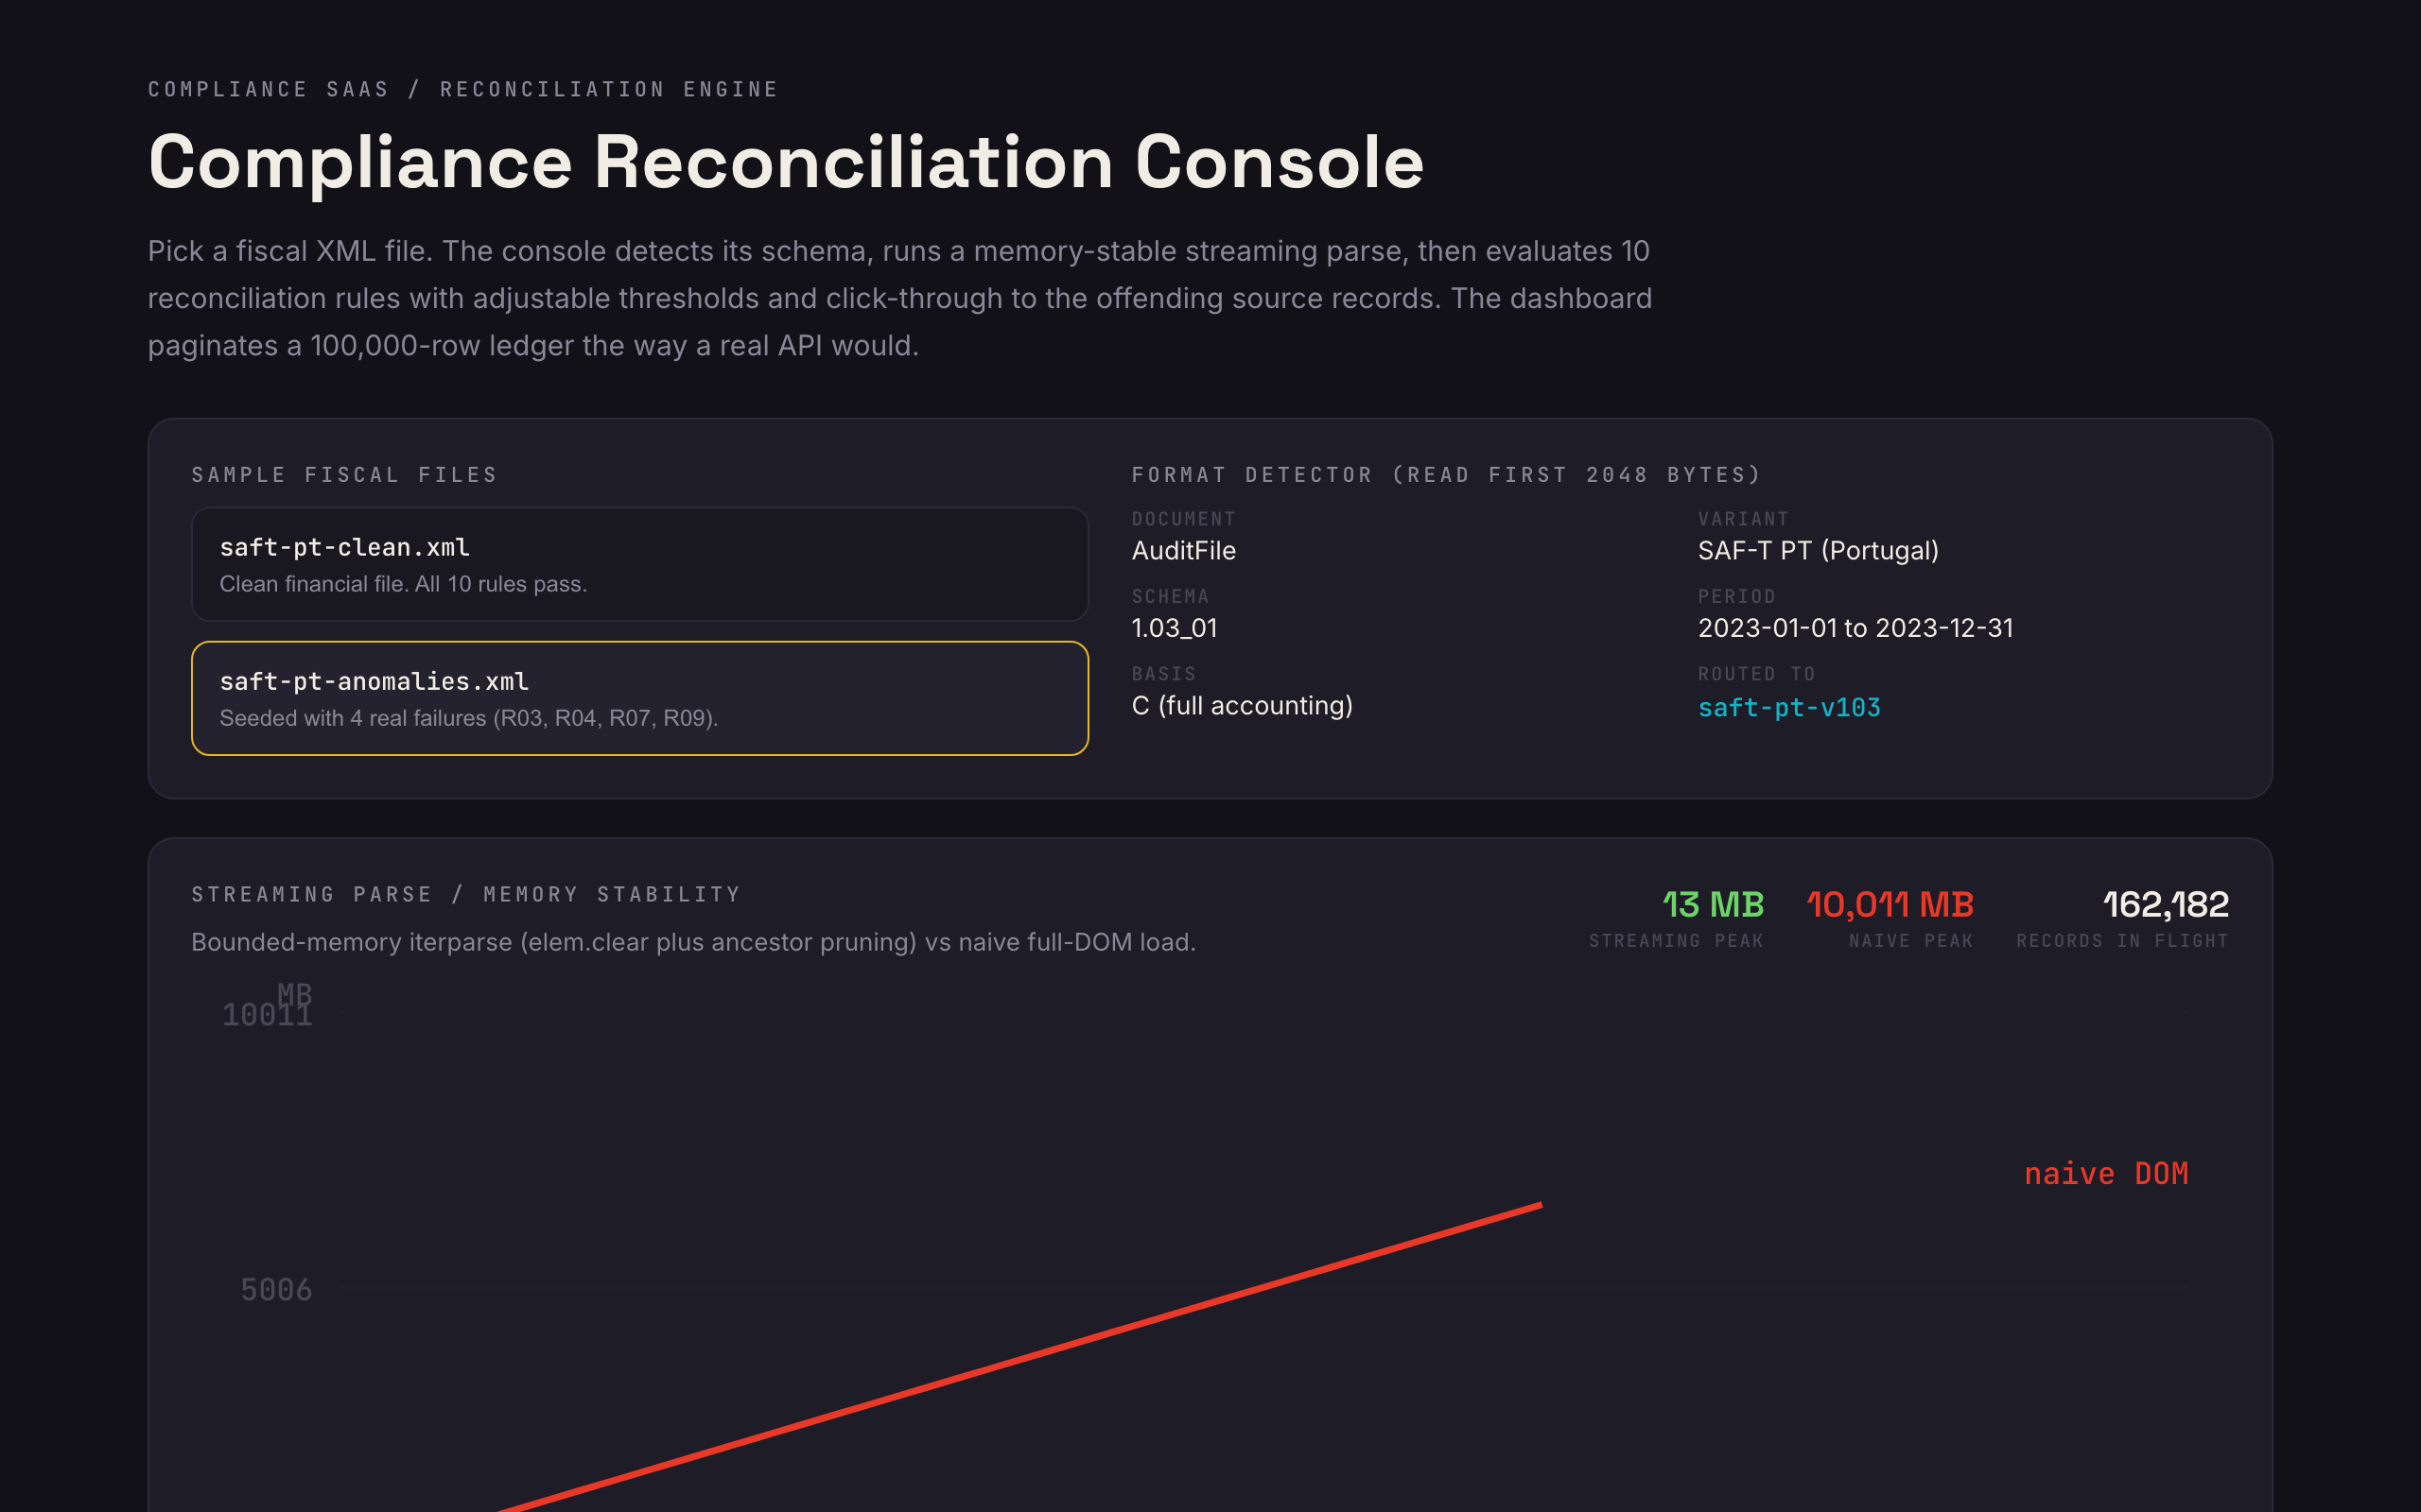
THE LIVE DEMO / THE DIFFERENTIATOR
I built a working proof of the core. Click it.
Pick a SAF-T fixture and the console:
detects document type, period, schema version from the file header
runs a bounded-memory streaming parse with a live memory-stability chart
evaluates 10 rules (R01-R10) with thresholds and drill-down to source transactions
paginates a 100,000-row ledger the way a real API would, with CSV export
OPEN THE DEMO
michaelwegter.com/work-samples/full-stack-developer-python-fastapi

Slide 4
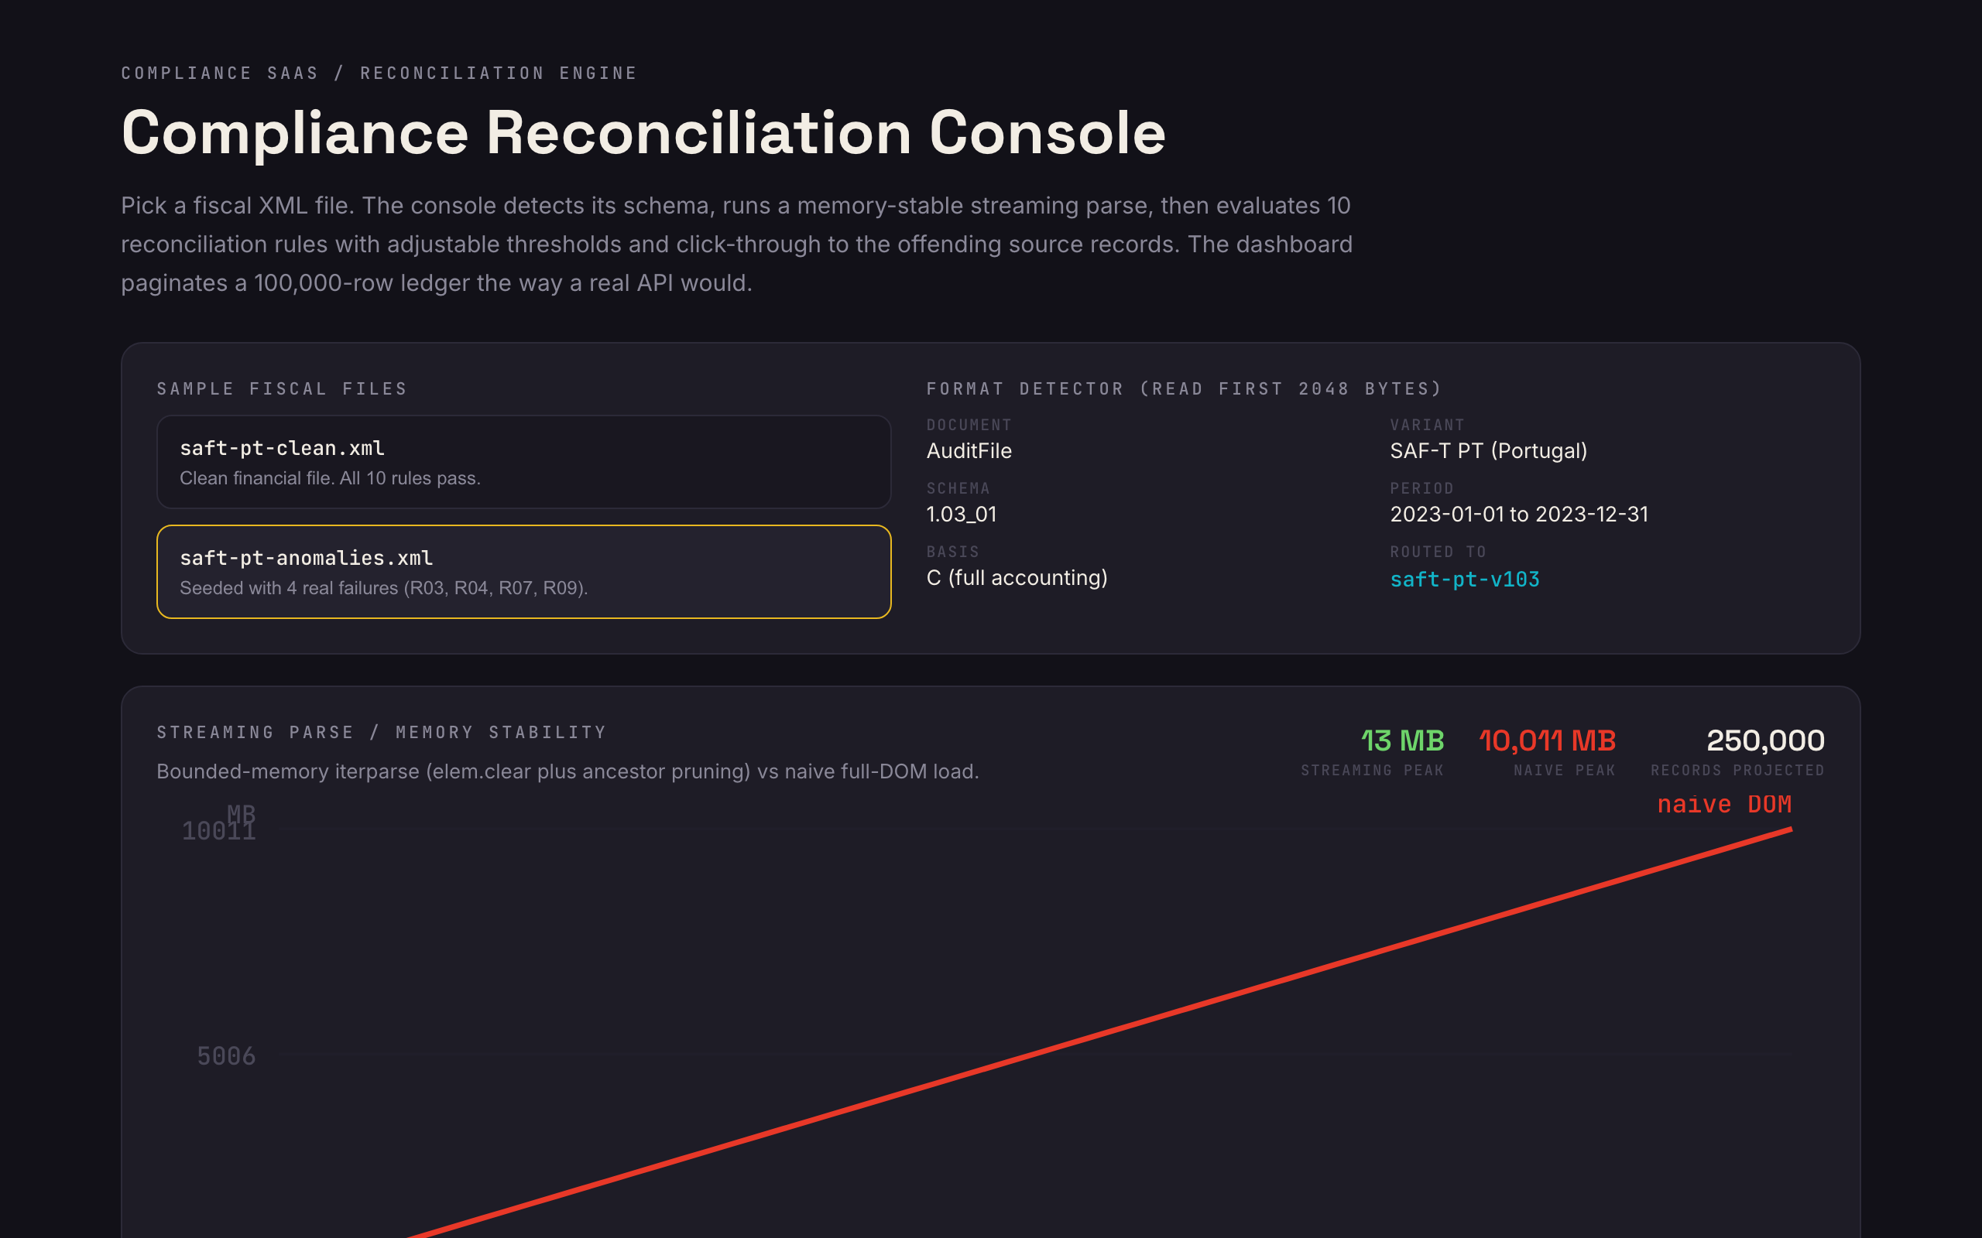
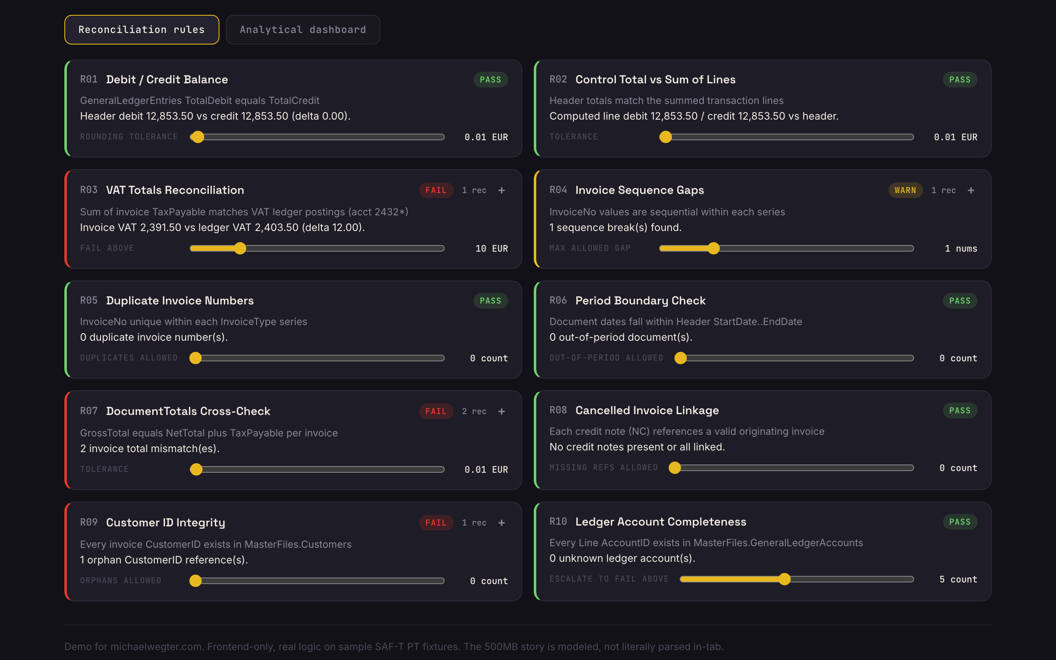
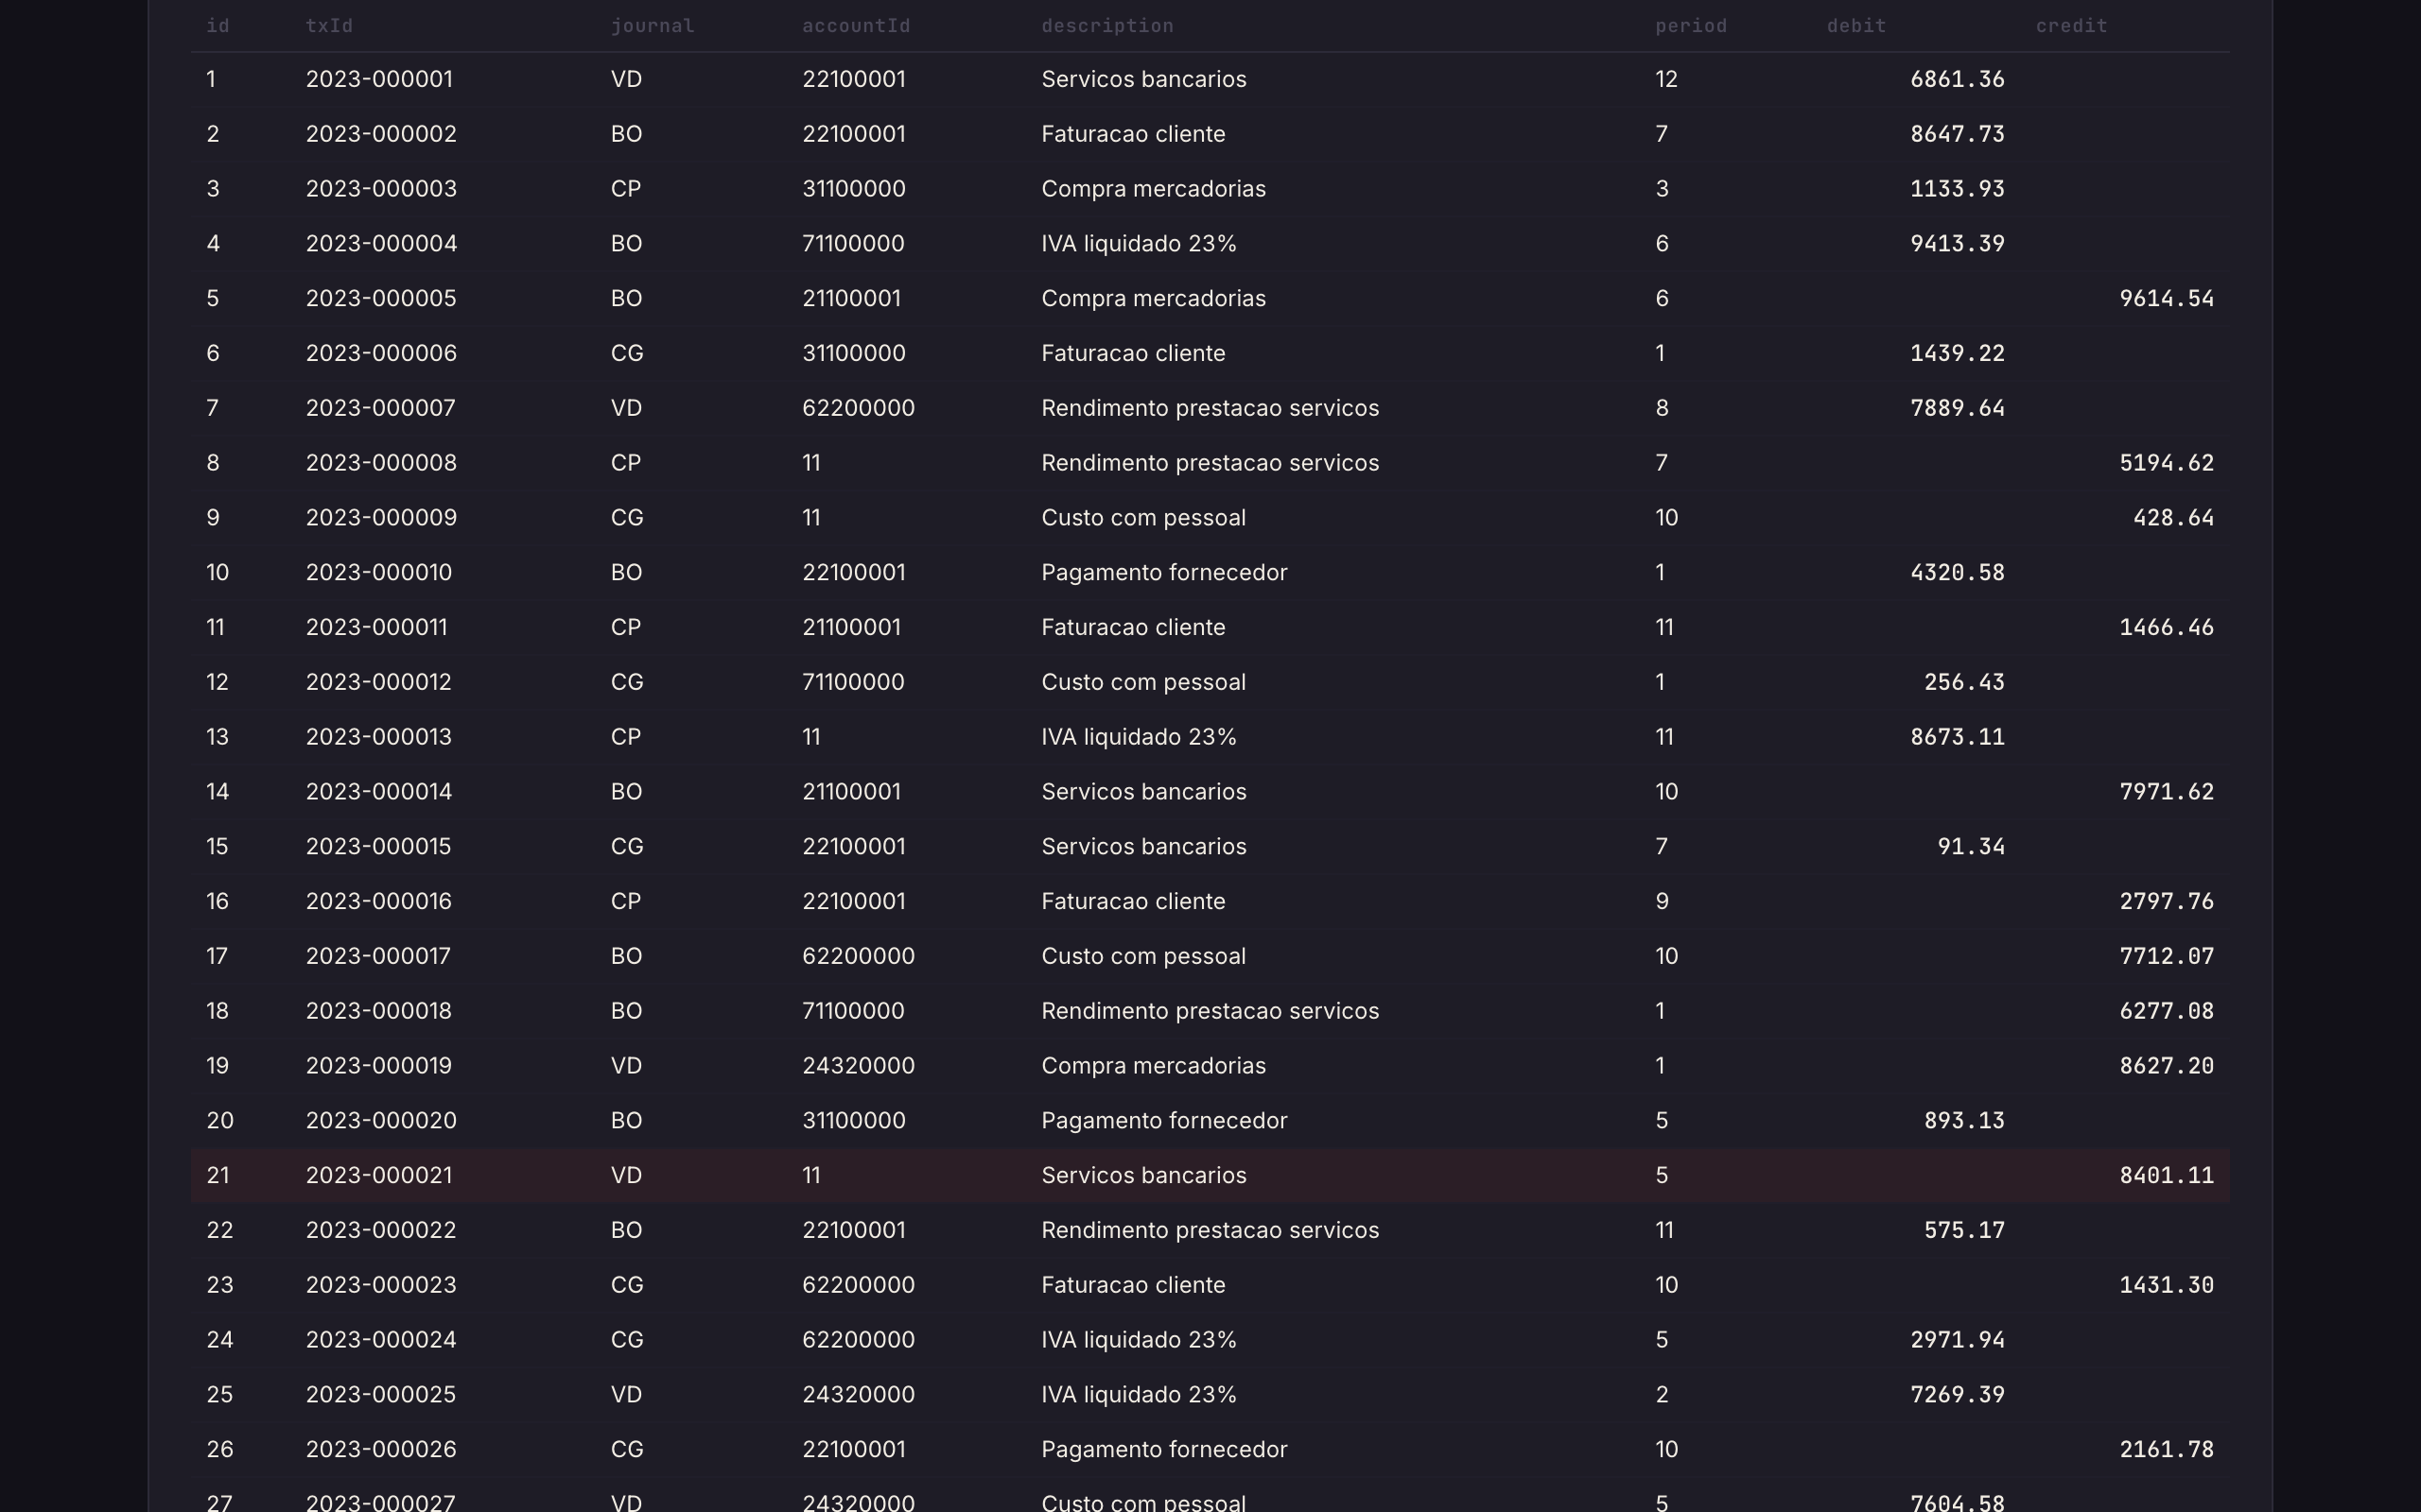
DEMO PROOF / THREE THINGS IT PROVES END TO END
Detect and parse, reconcile, then analyze
01 STREAMING PARSE
02 RULES + DRILL-DOWN
03 DASHBOARD AT SCALE
Bounded-memory iterparse vs naive full-DOM load, charted live as records climb.
Pass / warn / fail per rule, adjustable thresholds, click through to offending rows.
100k-row server-side-style pagination, anomaly chart, one-click CSV export.
Honest note: the demo runs the real algorithm on smaller fixtures and visualizes memory behavior at scale. It is the exact approach the Milestone 2 proof of concept proves on real 500 MB files.

Slide 5
REQUIRED ANSWER / Q1
Largest structured file in production, and memory management
I have processed multi-hundred-MB structured exports in production where loading the full tree was never an option. The production pattern is event-driven streaming with lxml, never a full parse.
for ev, elem in iterparse(f, events=('end',), tag='Transaction'):
process(elem)
elem.clear()
while elem.getprevious() is not None:
del elem.getparent()[0]
500 MB file ->
80-120 MB
peak memory
vs 600-800 MB for a full etree.parse(). Records stream to PostgreSQL or S3 in batches. The demo chart visualizes exactly this.
This is also the Milestone 2 payment gate: a FastAPI endpoint that streams a 500+ MB file through iterparse in a Celery task and returns a measured memory profile (tracemalloc / psutil RSS) before the rest proceeds.

Slide 6
REQUIRED ANSWER / Q2
Tenant isolation in FastAPI + PostgreSQL, at four layers
All four enforced, and all four tested. Not assumed.
LAYER 1 / JWT CLAIM
LAYER 2 / QUERY FILTER
A tenant_id claim, decoded by a FastAPI dependency into a tenant context that every data route requires. No context, no table access.
A tenant-scoped SQLAlchemy session auto-appends tenant_id == ctx.tenant_id to every select, update, and delete. No route can forget it.
LAYER 3 / POSTGRES RLS
LAYER 4 / API TESTS
Row-Level Security keyed on SET LOCAL app.current_tenant, defense in depth. SET LOCAL is safe under PgBouncer transaction pooling.
Two seeded tenants; every endpoint asserts tenant A cannot read or modify tenant B, even with manipulated tokens. ruff + bandit catch raw SQL.

Slide 7
THE APPROACH / 6 MILESTONES, FIXED-PRICE
How I would build the real thing
M1
M2
M3
Foundation
Parse PoC (gated)
Rules engine
FastAPI + React/TS + PostgreSQL scaffold, auth behind the Supabase/Auth0 adapter, multi-tenant base.
Format detector + lxml iterparse on a real 500+ MB file with a measured memory profile. Payment gate.
170+ documented rules, configurable thresholds, pass/warn/fail, drill-down to source transactions.
M4
M5
M6
Async + storage
Dashboard
Billing + hardening
Celery heavy/light queues on Redis, job lifecycle + status polling, S3 or Azure Blob, PDF embedded-XML.
Charts, anomaly/trend analysis, 100k-row server-side pagination, Excel and PDF export.
Stripe trials, plans, proration, webhooks, cancellation. Final coverage, static analysis, release.
Every milestone: golden-file tests against pre-validated fixtures, 70%+ coverage on business logic, zero critical static findings, a Monday written update, and a milestone-close demo call on a pre-agreed script.

Slide 8
WHY MICHAEL
Built audit-grade software before, end to end
2.5 yrs
6 months
Current
Sole developer and SME on a 60k-LOC internal platform at U.S. Bank serving 600 users a month, where correctness was never optional.
Led that platform's migration to Azure Cloud as main rep, among the first apps the bank moved. Comfortable owning infra.
Full-stack on an Optum healthcare project (Angular + .NET + PostgreSQL, onion architecture, strict Agile). Multi-tenant rigor is daily work.
Let's lock Milestone 1.
I welcome the payment gate and the paid probation task: send a real XML file and a REST contract and I will return the parsed response. Open the demo: michaelwegter.com/work-samples/full-stack-developer-python-fastapi

