Slide 1
PROPOSAL FOR
Full-Stack E-Commerce Backend
LIVE DEMO
Click and try it now
michaelwegter.com/demos/ orschell-excavating-e-commerce-full/
Node.js + TypeScript + PostgreSQL
Auth / Catalog / Inventory / Orders / REST API / Admin CMS
Admin: admin@orschellsupply.com / Admin1234! Customer: demo@customer.com / Demo1234!
michaelwegter.com
Michael Wegter
$1,700 | Fixed Price | 2.5 to 3 weeks

Slide 2
YOUR PROJECT
Backend features you need built
🔐 User authentication + accounts
📦 Product catalog management
JWT roles, register/login, order history, bcrypt passwords
Admin CMS: CRUD, pricing, SKU, categories, featured flag
📊 Inventory tracking
🛒 Order processing workflows
Per-SKU stock, LOW/OUT-OF-STOCK alerts, atomic decrements on order
Cart persistence, checkout, 4-step status pipeline, customer history
💳 Payment gateway integration
🔌 REST API development
Stripe-ready checkout form (mocked + labeled in demo)
22 typed Express endpoints, input validation, error handling
⚡ Performance optimization
🗄️ Database improvements
Indexed queries, WAL mode, connection pooling (pg-pool in prod)
Normalized schema, FKs, CHECK constraints, Postgres-compatible
All 8 requirements traceable to working features in the live demo.

Slide 3

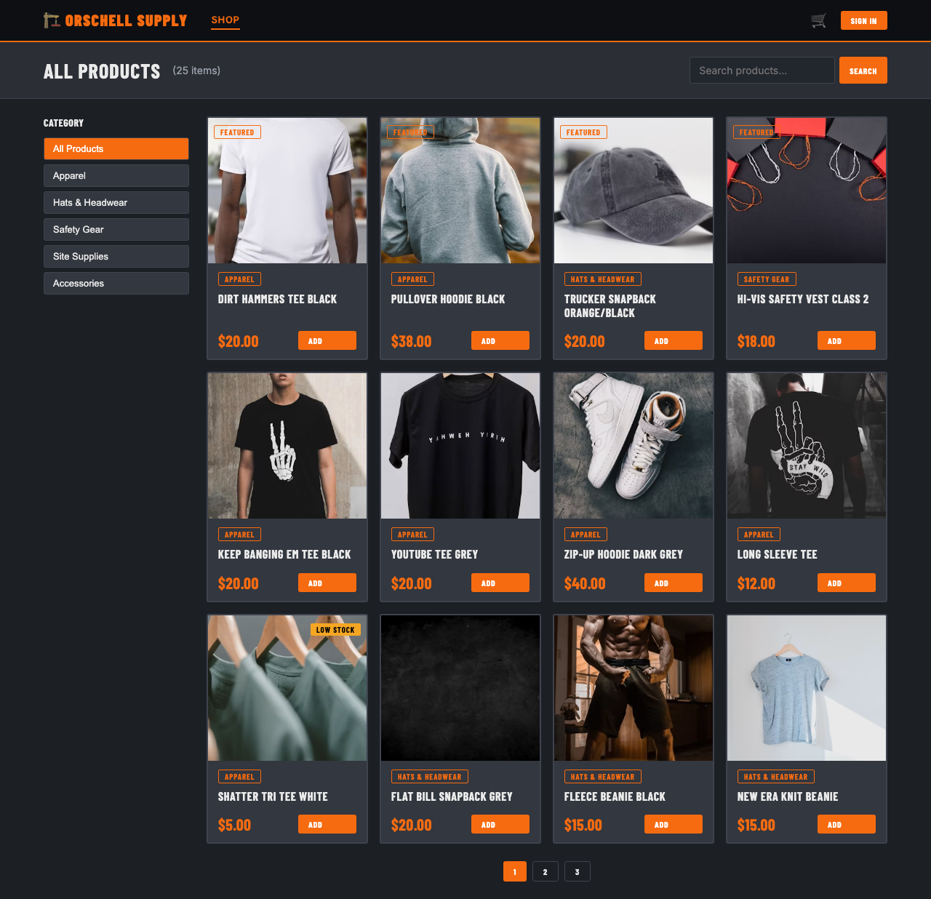

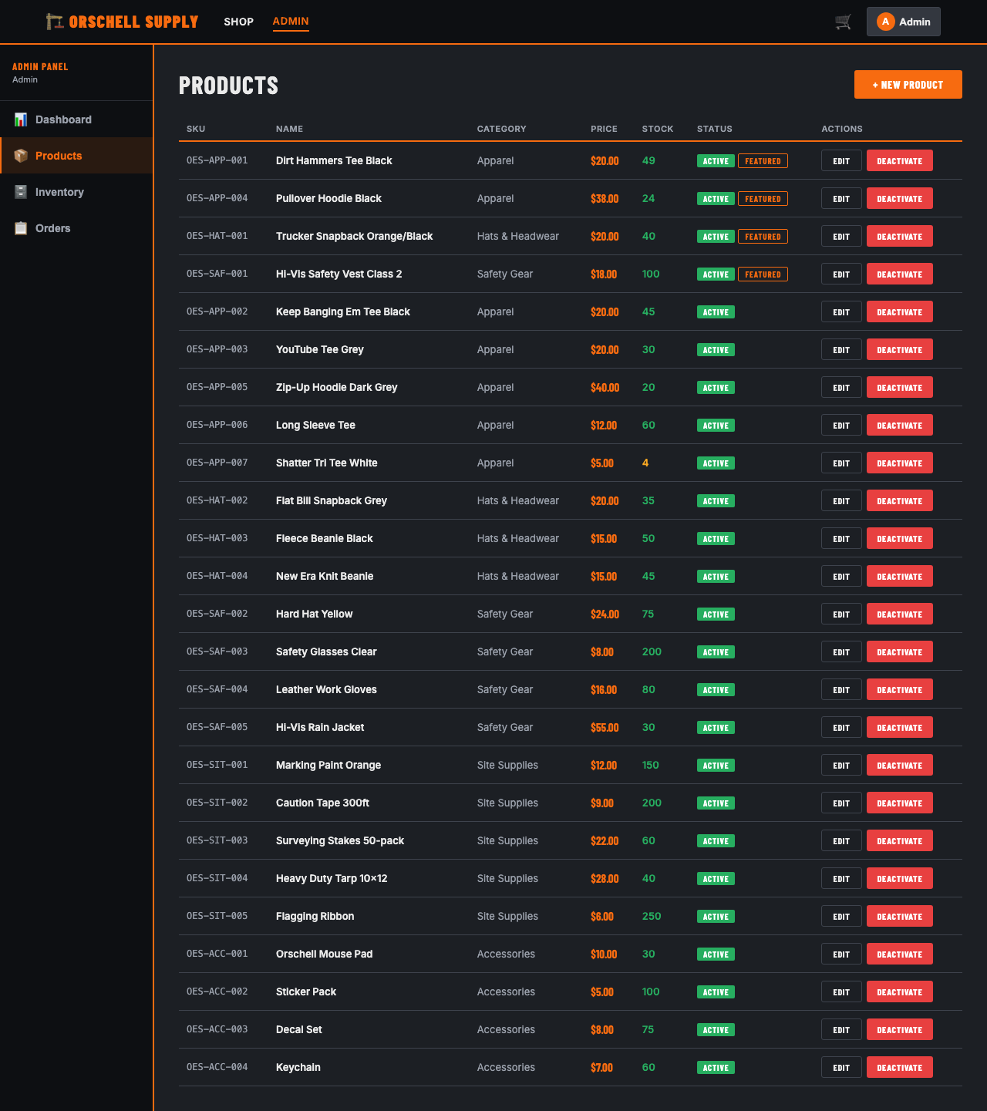
LIVE DEMO
Built before submitting this proposal
Home / Hero
Shop / Product Catalog
michaelwegter.com/demos/orschell-excavating-e-commerce-full/
Admin Dashboard
Admin Product CMS

Slide 4
TECH STACK
Your exact stack. Zero ramp-up.
Backend (as specified)
Frontend
Node.js 22 (LTS) TypeScript (strict) Express 4 (REST router) PostgreSQL schema (SQLite in demo; pg + pg-pool in prod) JWT authentication (jsonwebtoken) bcrypt password hashing
Vite 5 + React 18 + TypeScript React Router 6 (SPA routing) Recharts (admin analytics) Axios (typed API client)
Database design
Production path
Normalized: users, products, categories, inventory, cart_items, orders, order_items FKs, CHECK constraints, covering indexes WAL journal mode; Postgres-identical SQL
Swap node:sqlite -> pg + pg-pool Schema unchanged (no SQLite-isms) Add Stripe SDK for payment gateway Rate limiting, helmet, CORS hardening

Slide 5
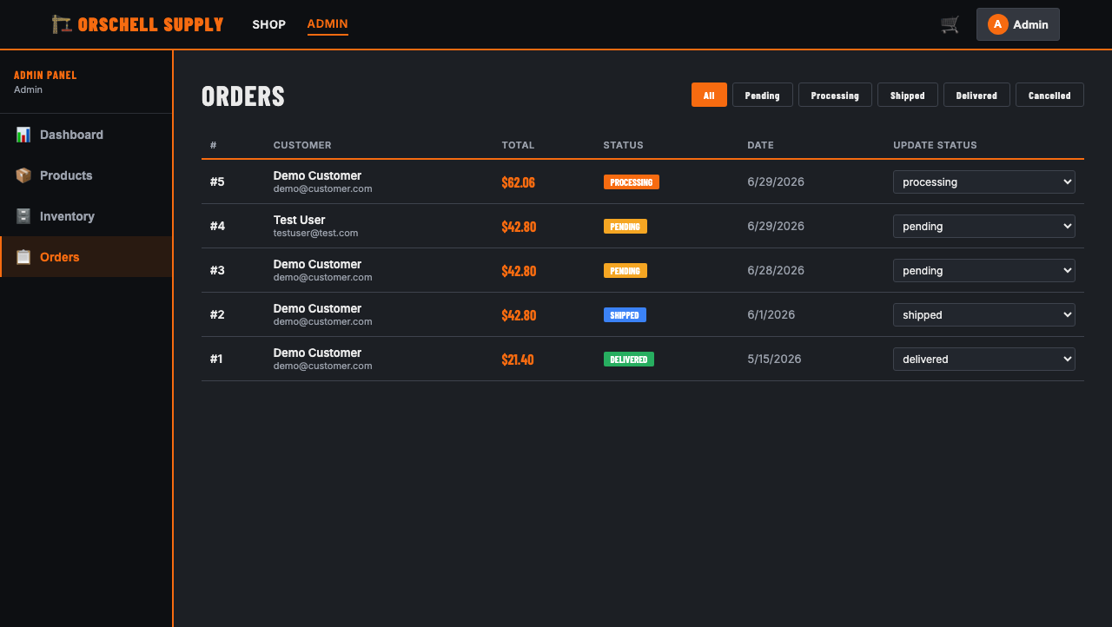
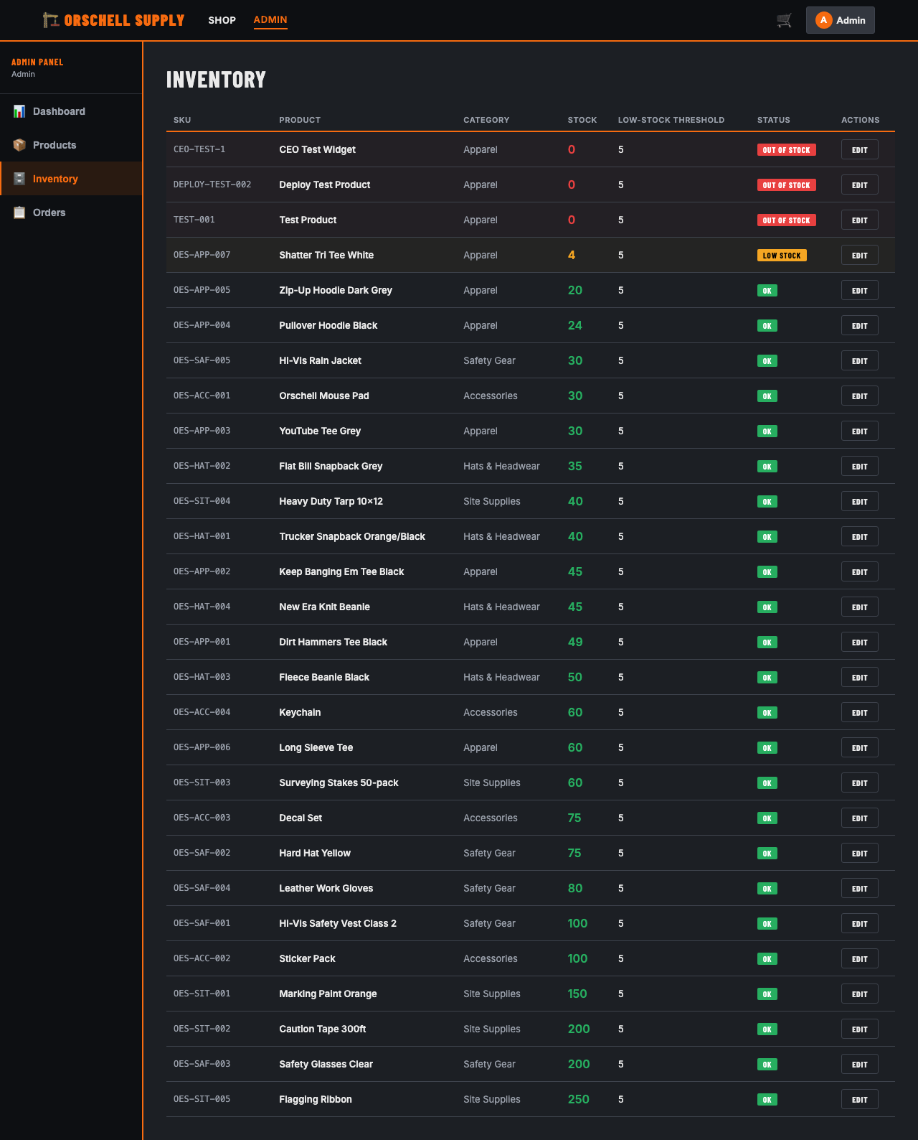
ADMIN CMS
Full catalog + inventory + order management
Dashboard: Revenue KPIs + 30-day chart
Products: CRUD (create / edit / deactivate)
Orders: Status pipeline (Pending -> Delivered)
Inventory: Stock levels + inline edit

Slide 6
DELIVERY PLAN
2.5 to 3 weeks | $1,700 fixed price
Audit + Foundation
Week 1
Review existing codebase. Set up Postgres, migrate schema, wire JWT auth, stub remaining endpoints. TypeScript strict mode throughout.
Core features
Week 2
Product catalog API, inventory decrement, cart persistence, full order pipeline. Admin CMS endpoints. Stripe integration if approved.
Performance + QA
Week 3
Query analysis, indexes, connection pooling, rate limiting, input validation. Integration tests. Frontend wiring. Documented handoff.
$1,700 fixed | All 8 features | Node.js + TypeScript + PostgreSQL | Documented handoff

Slide 7
WHY ME
Shipped it before. Can own it fast.
U.S. Bank / TDAAS (2.5 years)
Optum RHRP 4 (current)
Became sole developer and SME on a React + Python + SQL internal platform within months. 60k+ LOC. Led the Azure Cloud migration. If something broke, I fixed it, usually within 10 minutes.
Angular + .NET/C# + PostgreSQL enterprise project. Onion architecture, strict Agile. 150+ story points delivered. Go-to for AI-assisted development. Contract started April 2026.
TypeScript + Node.js daily
Full-stack portfolio
TypeScript is my primary backend language. The 22-endpoint API here was written without scaffolding, strict mode throughout, fully typed request/response interfaces.
Multiple shipped apps at michaelwegter.com: gallery planner, SEO analyzer, Spotify/Apple Music tools. Code at github.com/mwegter95. Same quality as what you just saw in the demo.

Slide 8
NEXT STEP
If the demo looks close to what you're building, I'd love a short call to walk through your existing codebase and nail down a delivery plan.
Michael Wegter
michaelwegter.com | github.com/mwegter95
Live demo:
michaelwegter.com/demos/orschell-excavating-e-commerce-full/
Admin: admin@orschellsupply.com / Admin1234! Customer: demo@customer.com / Demo1234!

