Slide 1
AgriPro Operations Console
Full-Featured AI-Powered Procurement Operations Platform
michaelwegter.com/demos/agripro/
Proposal by Michael Wegter | github.com/mwegter95

Slide 2
The Problem
Spreadsheets driving multi-state ops
No visibility across teams
Field inspections, lab results, and procurement approvals live in disconnected spreadsheets and email threads across states.
Procurement, quality, warehouse, and management each work in silos. No shared source of truth, no audit trail, no escalation path.
Manual document processing
Zero governance
Lab certificates are read by hand, re-keyed into spreadsheets. OCR extraction, classification, and anomaly flags do not exist today.
No approval gate enforces quality standards before a lot moves to warehouse. Anomalous values can slip through undetected.

Slide 3
The Approach
M1
Core Operational Spine
Weeks 1-8
Authenticated RBAC, procurement campaigns, field inspection records, 6-stage approval pipeline, search and filtering, audit logs, mobile layout, admin portal.
M2
AI and Quality Layer
Weeks 9-12
Production OCR on lab cert ingestion, document classification, configurable anomaly detection, warehouse allocation, document management, notifications, role dashboards with PDF and Excel export.
M3
Hardening and Delivery
Weeks 13-16
Unit and E2E test suite (Vitest + Playwright), technical documentation, Docker + Nginx deploy, CI/CD pipeline, knowledge transfer, 30-day post-launch stabilization.

Slide 4
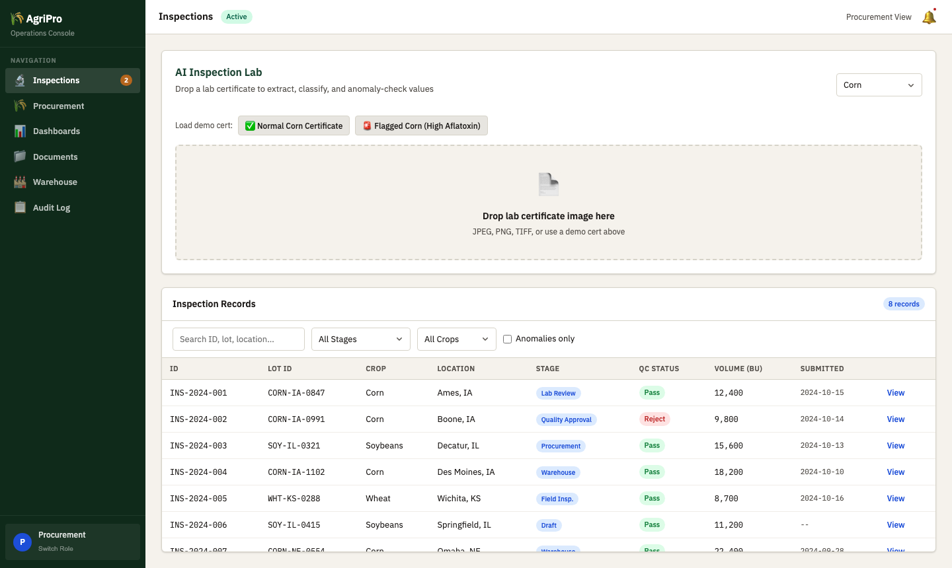
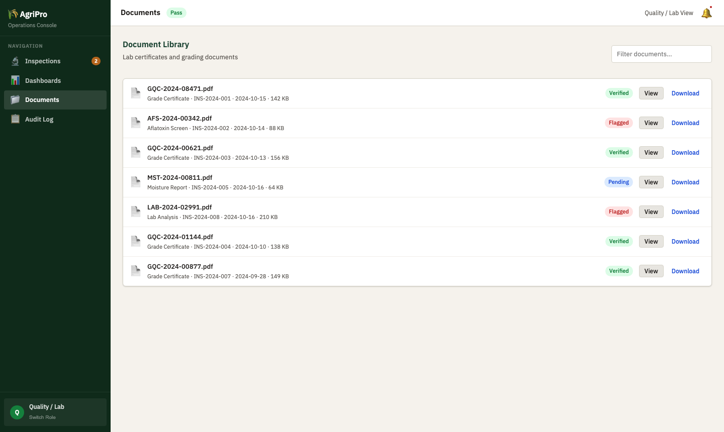
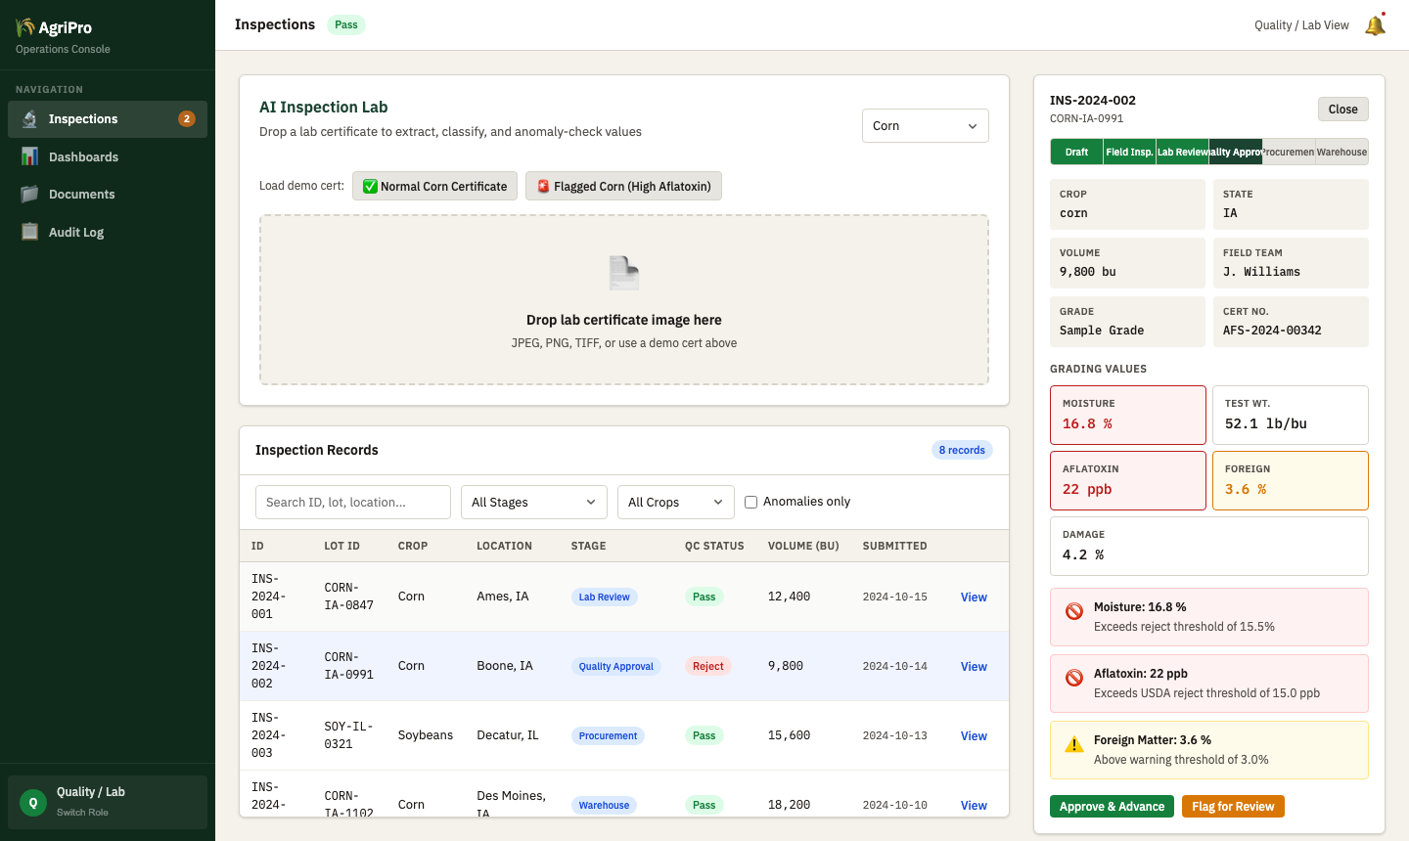
The Live Demo
michaelwegter.com/demos/agripro/
What you can do right now:
Log in as any of 4 roles Drop a grain cert to trigger OCR Watch anomaly flags fire in real time Approve / Flag / Reject inspections Export a dashboard PDF or Excel file
OCR Certificate Scanner
Anomaly Detection

Slide 5
Requirement Coverage
R1
Secure auth + RBAC
Live Demo
R9
Role-aware dashboards
Live Demo
R2
Procurement campaigns
Live Demo
R10
PDF and Excel export
Live Demo
R3
Field inspection workflows
Live Demo
R11
Notifications + reminders
Rich Mock
R4
Lab testing + quality grading
Live Demo
R12
Audit logs
Rich Mock
R5
Multi-stage approval workflows
Live Demo
R13
Mobile-responsive
Live Demo
R6
Warehouse allocation
Rich Mock
R14
OCR for lab certs
Live Demo
R7
Document management
Rich Mock
R15
Intelligent classification
Live Demo
R8
Search and filtering
Live Demo
R16
Anomaly detection
Live Demo

Slide 6
Why Michael Wegter
Sole developer, 600-user internal platform
AI in real production workflows
Full-stack, cloud-native, and deployment-ready
At U.S. Bank I owned TDAAS within months and kept a 60,000-line React/Python/SQL/Java platform running for 600 users per month. If something broke, I fixed it, often within 10 minutes.
I use GitHub Copilot and Azure OpenAI in daily delivery. At Optum I am the team go-to for AI-assisted development. The OCR, classification, and anomaly detection in this demo are the same class of AI I ship at work.
React, Angular, Python, .NET/C#, Java, SQL, PostgreSQL, Docker, Kubernetes, CI/CD. I led the TDAAS Azure Cloud migration as the main technical rep, among the first apps the bank moved. I own the full stack.
150+ story points delivered at Optum (current) | 6-month Azure migration lead at U.S. Bank | Full portfolio: michaelwegter.com | github.com/mwegter95

Slide 7
Scope, Timeline, and Next Step
Production Tech Stack
Timeline (Indicative)
Frontend: React 18 (or Angular per preference) + Vite
Weeks 1-8
M1: Core spine, RBAC, inspection + approval pipeline
Backend: Python (FastAPI) or Node.js
Database: PostgreSQL with Row-Level Security for RBAC
Weeks 9-12
M2: AI layer, OCR, anomaly detection, dashboards
OCR: Tesseract + cloud fallback (AWS Textract / Azure DI)
Weeks 13-16
M3: Hardening, testing, documentation, deploy
AI: OpenAI or Azure OpenAI for classification, anomaly scoring
Deploy: Docker + Nginx, CI/CD (GitHub Actions or similar)
Day 1+
30-day post-launch stabilization included
Export: jsPDF + SheetJS (or server-side Puppeteer)
Next Step
Try the live demo: michaelwegter.com/demos/agripro/ Happy to walk through it together and talk about your timeline, stack preferences, and budget. Contact: github.com/mwegter95

