Slide 1
Michael Wegter
PROPOSAL / UPWORK
ABA Services Website,
Design and Development
A warm, trustworthy clinic site that families can scan in ten seconds.
LIVE DEMO
https://michaelwegter.com/work-samples/aba-services-website
MICHAEL WEGTER / PROPOSAL / ABA SERVICES WEBSITE
01 / 08

Slide 2
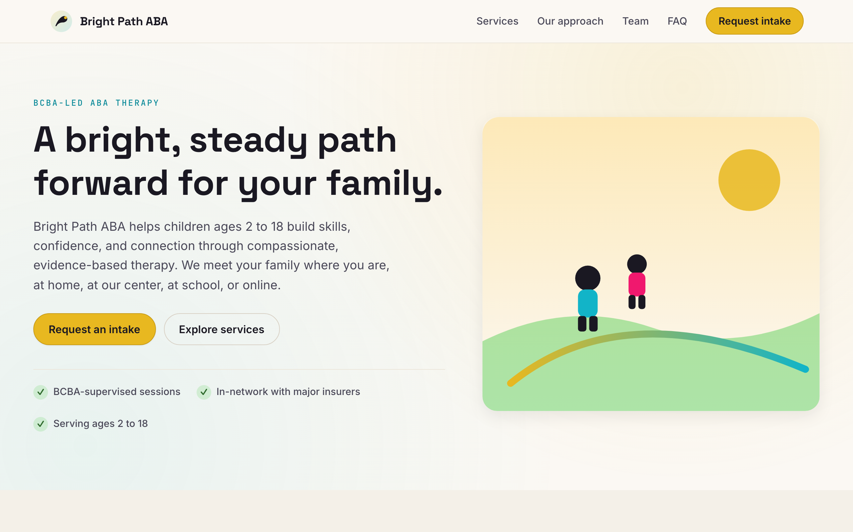
THE DEMO AT A GLANCE
One link. Real interactions. Built for this posting.
CLICK FIRST
Open a service card
Each card expands to show age range and what to expect.
THEN TRY
The intake form
Inline validation, accessible labels, privacy note above submit.
LIVE DEMO
michaelwegter.com/work-samples/aba-services-website
MICHAEL WEGTER / PROPOSAL / ABA SERVICES WEBSITE
02 / 08

Slide 3
REQUIREMENTS I ADDRESSED
Every line in your posting maps to a screen.
REQ
WHAT YOU ASKED FOR
WHERE IT LIVES IN THE DEMO
R1
Professional ABA website
Entire single-page demo
R2
Visually appealing, communicates values
Hero, services strip, warm palette
R3
User-friendly
Anchor nav, accessible form, FAQ accordion
R4
Communicates services clearly
Services explorer cards with age ranges
R5
Design and dev integrated
One artifact, one developer, one timeline
R6
Graphic design elements
Custom SVG logo, hero illustration, icons
MICHAEL WEGTER / PROPOSAL / ABA SERVICES WEBSITE
03 / 08

Slide 4
HOW THE FORM RESPECTS HIPAA
The marketing form is not a clinical intake.
Practical guidance, not legal advice. The pattern below is what most ABA clinics ship.
+
Collect only routing info.
Name, email, phone, and a service interest dropdown. No free-text medical history field.
+
Tell parents not to share PHI.
A visible note above the submit button steers them to a secure channel for diagnosis details.
+
Route real intake through a HIPAA-eligible channel.
EHR patient portal, or a form provider that signs a Business Associate Agreement.
+
Treat the marketing site as marketing.
Fast, accessible, and low scope. The clinical work lives where it is regulated to live.
MICHAEL WEGTER / PROPOSAL / ABA SERVICES WEBSITE
04 / 08

Slide 5
FRAMEWORKS AND RECENT WORK
Senior full-stack, 4 years shipping real software.
FRAMEWORKS I WORK IN
RECENT WORK
Daily delivery
Real systems, in production
FRONT END
React, Vite, Angular, vanilla JS, TypeScript
Optum RHRP 4
Current contract. Angular plus .NET. 150+ story points delivered. Team's go-to for AI-assisted development.
BACK END
Flask, Python, .NET / C#, Java
U.S. Bank TDAAS
DATA
PostgreSQL, SQL Server, SQLite
2.5 years sole developer and SME. React plus Python plus SQL, 60k LOC, 600 users a month. Led six month Azure migration.
SHIP IT
Docker, GitHub Actions, Azure, Playwright
michaelwegter.com
This demo: plain HTML, CSS, and JS, shipped same-origin from my portfolio.
Personal apps and work samples gallery. Bright Path ABA mock was built for this posting.
MICHAEL WEGTER / PROPOSAL / ABA SERVICES WEBSITE
06 / 08

Slide 6
KICKOFF QUESTIONS
Three things I would ask on a call.
01
Page count and structure
Single scrolling page or a 5 to 7 page site? My recommendation is the latter; the demo shows the single-page version for speed.
02
CMS need
Do you want to edit copy yourselves after launch? If yes, I would add a small headless CMS. If not, a static build is cheaper to maintain.
03
Brand assets
Do you have a logo, color direction, or photography? If not, I can propose a small visual direction before I build.
MICHAEL WEGTER / PROPOSAL / ABA SERVICES WEBSITE
07 / 08

Slide 7
Michael Wegter
NEXT STEP
Open the demo,
then let's talk.
LIVE DEMO
https://michaelwegter.com/work-samples/aba-services-website
PORTFOLIO
michaelwegter.com / Michael Wegter
MICHAEL WEGTER / PROPOSAL / ABA SERVICES WEBSITE
08 / 08

