Slide 1
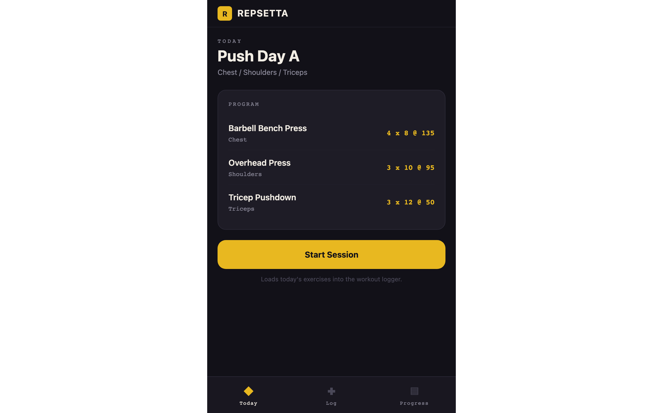
PROPOSAL // HYBRID MOBILE APP DEVELOPER
Repsetta
A working strength-training tracker,
built before saying a word about it.
One React Native codebase for iOS, Android, and web.
Backed by a real Flask API. Click it and it works.
michaelwegter.com/work-samples/repsetta-fitness
Michael Wegter // Full-stack engineer // React Native, Expo, NativeWind, Flask

Slide 2
THE PROBLEM
You are building the heart of a fitness product, and you need it shipped right.
The capture loop is everything
One codebase, two stores
A long-term, steady partner
Logging sets, reps, and weight with a clean rest timer is the screen your users touch every single session. If it is slow or clumsy, the product fails quietly.
You want React Native or Flutter so iOS and Android ship together, without the quality dropping or the team doubling.
Under 30 hours a week for 6+ months. You need someone reliable who owns the work and does not need babysitting.

Slide 3
THE APPROACH
How I would build the real thing
01
One React Native + NativeWind codebase
02
Grow from the loop outward
Every feature ships to iOS and Android at once. No separate native teams, no drift between platforms.
Guided programs feed a fast logging screen with the rest timer, then a progress dashboard that earns the next session.
03
I own the backend too
04
Steady, autonomous delivery
The demo's Flask API proves it. I handle the data model, the endpoints, and the app together, not half a feature.
Under 30 hrs/week for the long haul, fully overlapping Central and Pacific hours, strong async updates.

Slide 4
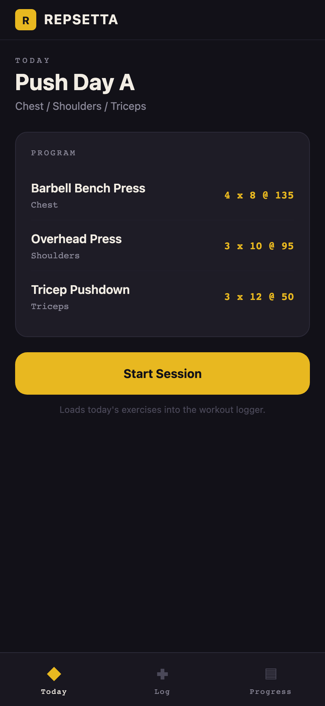
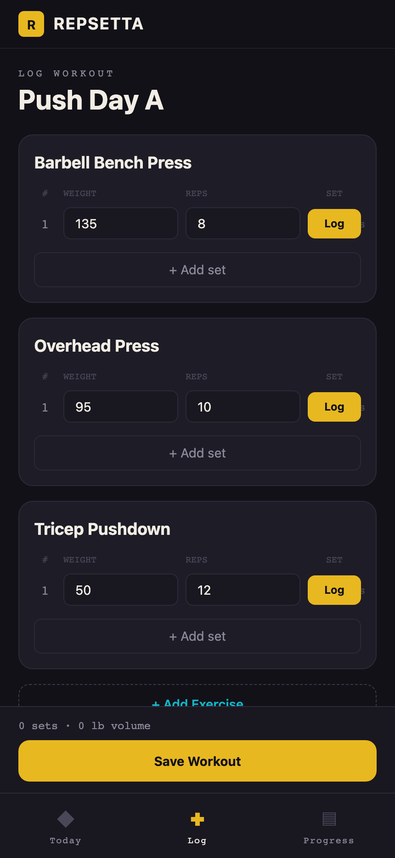

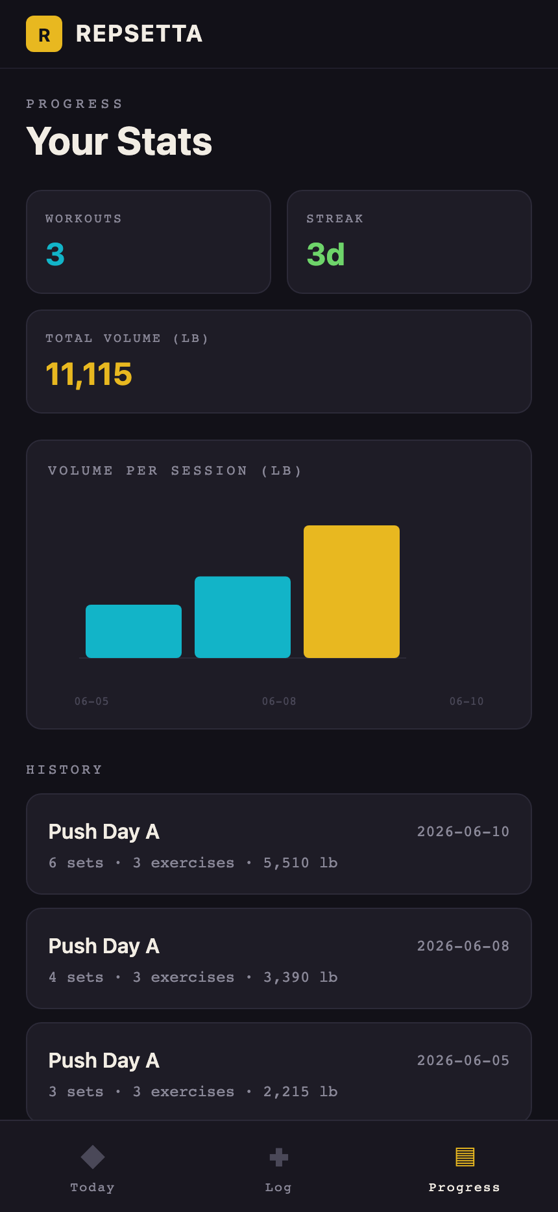
THE LIVE DEMO // THIS IS THE DIFFERENCE
It is real. Click it.
A real React Native app, not a slideshow. Open Today's program, log sets with reps and weight, the rest timer counts down between sets, Save persists to a Flask backend on my own infrastructure, and it shows up in Progress with a volume chart.
Try it live: michaelwegter.com/work-samples/repsetta-fitness
App runs directly at michaelwegter.com/demos/repsetta-fitness/
TODAY
LOG
REST
PROGRESS
One codebase. iOS, Android, and the web build above. Backed by a real API.

Slide 5
REQUIREMENT COVERAGE
Everything you asked for, mapped
WHAT YOU NEED
WHERE
HOW
Mobile dev, iOS + Android, one codebase
DEMO
Single Expo + React Native app targets both stores and the web build.
React Native / Flutter (hybrid)
DEMO
Built in React Native + NativeWind. Flutter and Cordova noted for tradeoffs.
High-quality, user-friendly app
DEMO
Polished UI and real rest-timer UX on a clean dark theme.
Backend / API integration
DEMO
Live Flask API on my own infrastructure persists every saved workout.
Health & wellness domain
DEMO + Q
App mirrors how lifters log, rest, and track. Honest domain framing answered.
Certifications
ANSWERED
Straight answer: no fitness cert, engineering depth and a working app instead.
Under 30 hrs/wk, 6+ months
ANSWERED
Comfortable at that pace for the long term.
Location (Vegas / Twin Cities)
ANSWERED
Upfront: US-based, fully overlapping Central & Pacific hours, strong async.

Slide 6
WHY MICHAEL
Ships full-stack, owns it, moves fast
~2.5 yrs
150+ pts
Full-stack
SOLE DEVELOPER & SME
CURRENT CONTRACT
APP AND API TOGETHER
Ran a React + Python platform at U.S. Bank serving 600 users a month. If something broke, I could usually fix it within ten minutes.
Delivering on an Angular and .NET engagement as my team's go-to for AI-assisted development, in strict Agile.
React/Angular front ends, Python/.NET/Java back ends, SQL/PostgreSQL, Docker, CI/CD. I own the whole feature, not half of it.

Slide 7
SCOPE, TIMELINE, NEXT STEP
Let's start with what matters most to you
ENGAGEMENT
Long-term partner, under 30 hours a week, 6+ months. Steady and autonomous.
NEXT STEP
Click the demo, then tell me which features come first.
RATE
$50 to $85 per hour, a mix of experience and value. Strong value against the field.
If it looks like the right direction, I would love to shape a plan around your priorities. Low pressure.
FIRST 30 DAYS
michaelwegter.com/work-samples/repsetta-fitness
Lock the data model and core logging loop, ship it to TestFlight and an Android build, and agree on the next feature slice.

