Slide 1
PROPOSAL FOR UPWORK
AI Customer Support Chatbot
LIVE DEMO
michaelwegter.com/demos/ai-chatbot-for-customer-support/
In-browser RAG chatbot with FAQ knowledge base, live order lookup,
human escalation, and admin dashboard. Zero recurring AI cost.
Michael Wegter | Full-Stack Developer | United States
MICHAEL WEGTER / AI CUSTOMER SUPPORT CHATBOT / PROPOSAL
1 / 9

Slide 2
THE PROBLEM
Your small team is manually answering the same questions every day
Repetitive volume
Business-hours only
Orders, shipping, returns. Same 20 questions, every day, from every customer.
Customers waiting until 9am ET for answers they could get in seconds.
Agent capacity
Integration gaps
Your team's time goes to tickets a bot could close, not the ones that need a human.
Fragmented stack: website, help desk, order system. No unified first-line response.
MICHAEL WEGTER / AI CUSTOMER SUPPORT CHATBOT / PROPOSAL
2 / 9

Slide 3
THE SOLUTION
SupportAI: a fully in-browser AI chatbot, zero recurring cost
The AI model runs in the customer's browser using WebAssembly. No OpenAI. No Anthropic. No monthly token bill.
Your FAQ knowledge base stays in a JSON file your team can edit without developer help.
📚
RAG Knowledge Base
📦
Order Lookup
20+ FAQ entries retrieved by semantic similarity. Bot cites sources. Grounded answers, not hallucinations.
Parses order numbers from chat. Queries your API (mock in demo). Returns status, carrier, ETA.
🙋
Human Escalation
⚙️
Admin Dashboard
Business-hours routing (9am to 6pm ET). Ticket confirmation. Zendesk handoff with full chat context.
Add/edit FAQ entries. Analytics: deflection rate, top queries, escalations. Maintainable without a developer.
MICHAEL WEGTER / AI CUSTOMER SUPPORT CHATBOT / PROPOSAL
3 / 9

Slide 4
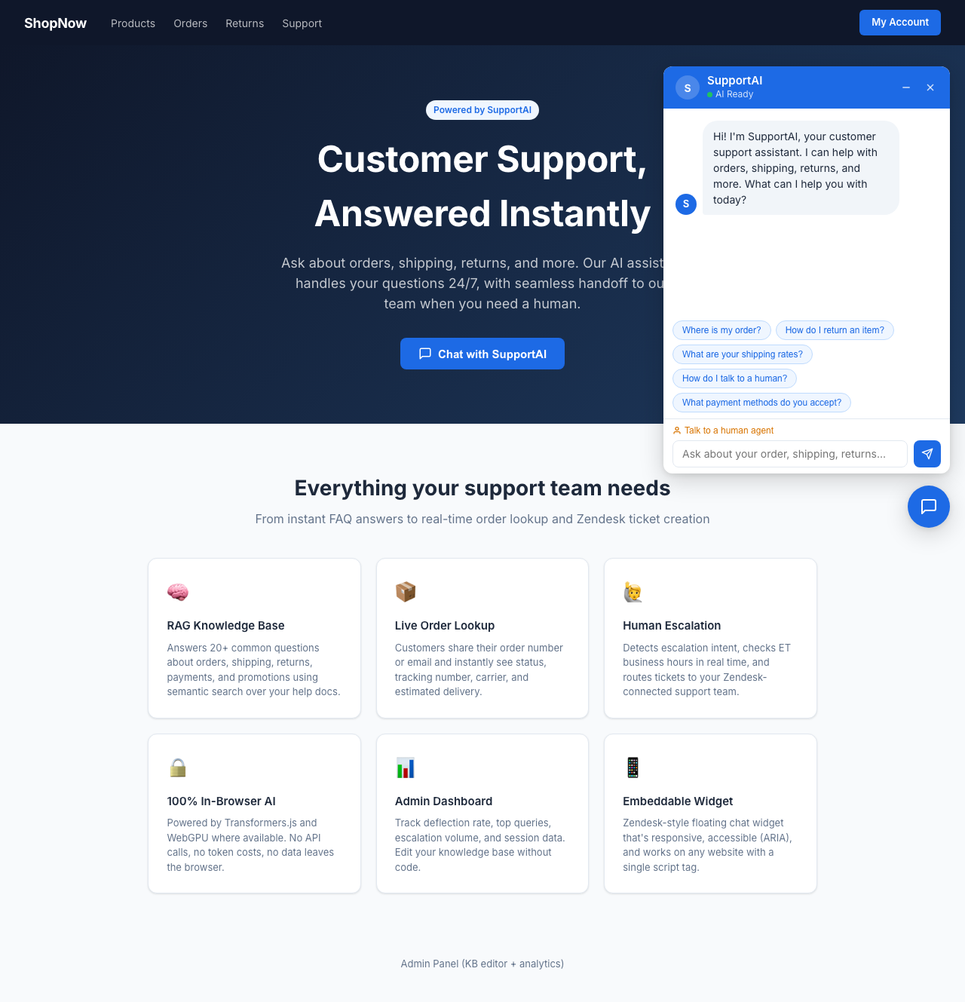
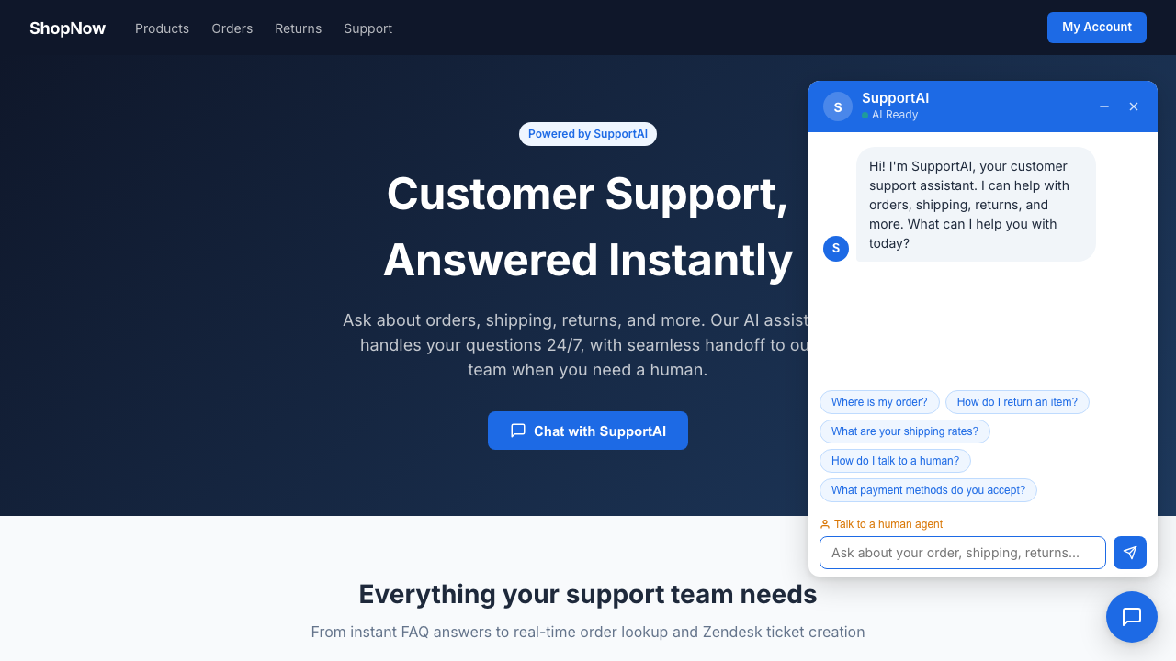
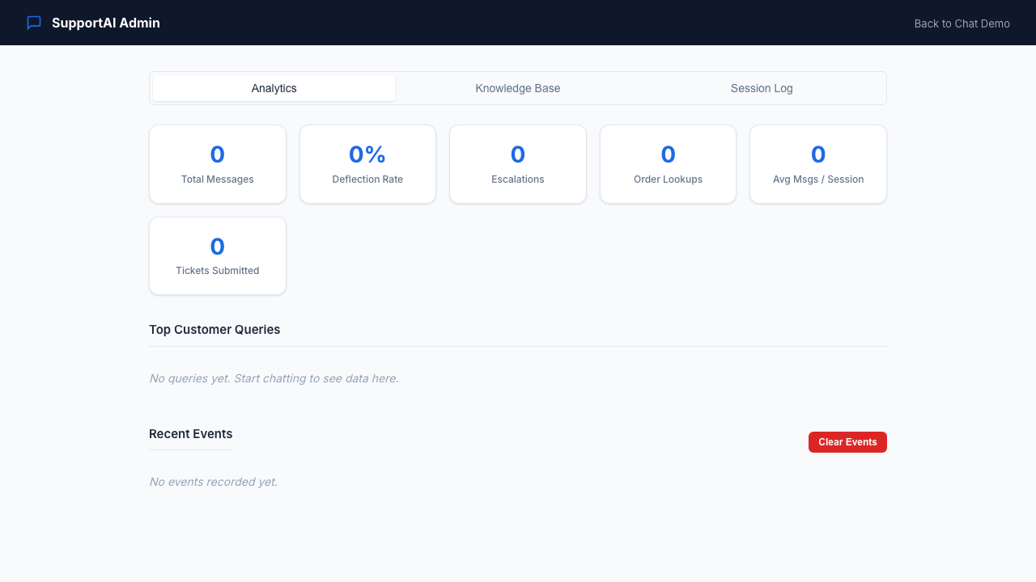
LIVE DEMO
Built for this proposal. Click it yourself.
https://michaelwegter.com/demos/ai-chatbot-for-customer-support/
Hero: 4 live features on first paint
Chat UI with quick actions + source citations
Admin: analytics + KB editor
MICHAEL WEGTER / AI CUSTOMER SUPPORT CHATBOT / PROPOSAL
4 / 9

Slide 5
ARCHITECTURE
In-browser RAG pipeline: no backend required
1
2
3
4
User Input
Retrieval
Generation
Response
>
>
>
Customer types a message in the chat widget
Transformers.js embeddings rank top-3 FAQ chunks by semantic similarity
Qwen2.5-0.5B WASM model generates a grounded answer, streamed back
Answer shown with source citations. Order and escalation handled in parallel.
Zero recurring cost
The LLM runs in the visitor's browser via WebAssembly. No OpenAI, no Anthropic, no cloud inference bill. The FAQ is a plain JSON file. Order status calls your existing endpoint. Zendesk handoff uses the Web Widget SDK.
MICHAEL WEGTER / AI CUSTOMER SUPPORT CHATBOT / PROPOSAL
5 / 9

Slide 6
ZENDESK INTEGRATION DESIGN
Smooth handoff to your support team
The demo simulates this flow. In production, step 3 is a live Zendesk Web Widget SDK call.
STEP 1
STEP 2
STEP 3
STEP 4
Trigger detected
Business hours check
Zendesk handoff
Ticket confirmed
Bot identifies escalation signal: customer says 'talk to a person,' repeated confusion, or unresolved question.
>
Current time checked against 9am to 6pm ET. Live chat offered during hours; next available window shown after hours.
>
Zendesk Web Widget opens pre-filled with customer name, issue summary, and full conversation transcript.
>
Ticket ID shown to customer. Bot remains open for follow-up questions while agent reviews the case.
MICHAEL WEGTER / AI CUSTOMER SUPPORT CHATBOT / PROPOSAL
6 / 9

Slide 7
ABOUT MICHAEL WEGTER
Full-stack developer, currently based in the United States
I confirmed: I am currently based in the United States. I have built the stack this project requires and ship AI-assisted features daily.
2.5 years at U.S. Bank
Azure Cloud Migration
Primary developer on a React + Python platform serving 600 users/month. Became sole developer and SME within months. Fixed incidents in under 10 minutes. 60,000+ LOC.
Led a 6-month migration to Azure as the project's main representative, among the first internal apps the bank migrated.
Optum (current)
AI delivery, daily
Angular + .NET + PostgreSQL on a large Agile team. 150+ story points delivered. Team's go-to for AI-assisted development. Contract won April 2026.
Built this demo's in-browser RAG chatbot in a single session using Transformers.js, the same stack I would use on your production build.
MICHAEL WEGTER / AI CUSTOMER SUPPORT CHATBOT / PROPOSAL
8 / 9

Slide 8
NEXT STEP
Try the demo. Let's talk about the real build.
https://michaelwegter.com/demos/ai-chatbot-for-customer-support/
Ask about orders (ORD-1001), returns, shipping. Try escalating to a human. Open the admin panel (admin123).
Michael Wegter | michaelwegter.com | United States
MICHAEL WEGTER / AI CUSTOMER SUPPORT CHATBOT / PROPOSAL
9 / 9

