Slide 1
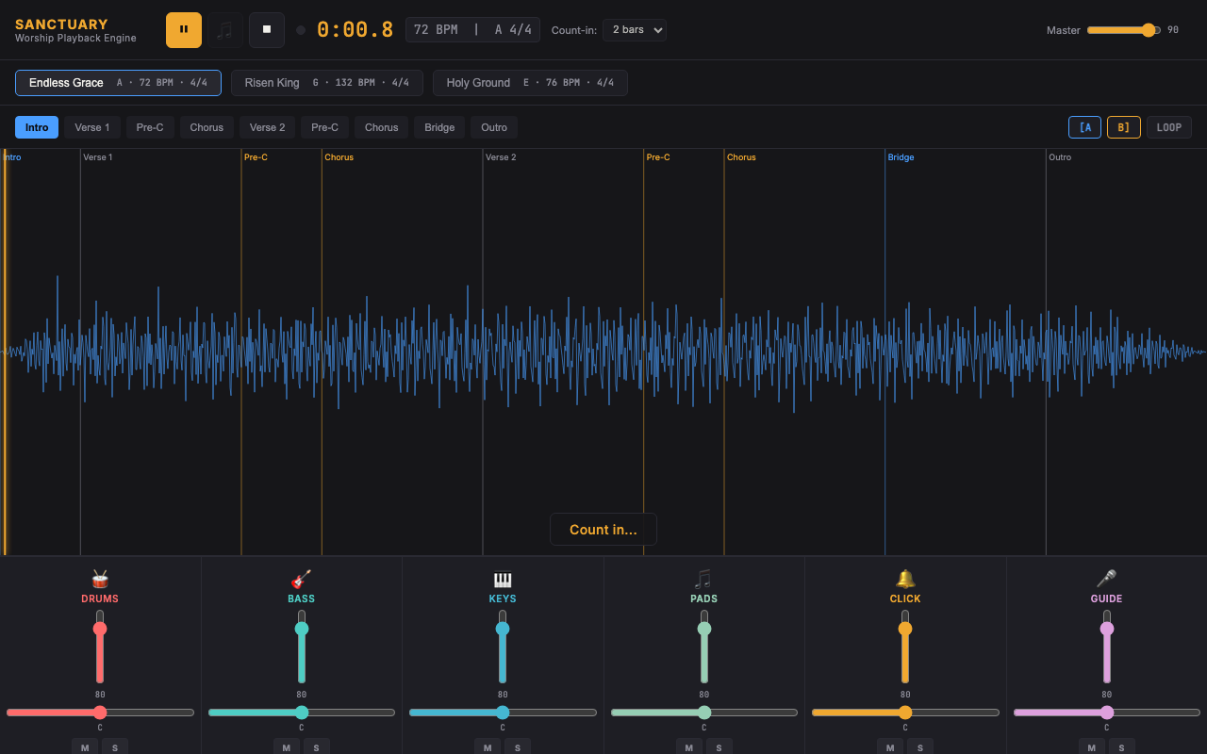
WORSHIP PLATFORM AUDIT
Sanctuary
Worship Playback Engine
Michael Wegter
Audio Software Engineer
Live demo:
michaelwegter.com/demos/audio-software-engineer-needed-for/

Slide 2
NINE PROBLEM AREAS
Every issue you listed, addressed in the live demo
✓
Playback transport reliability
✓
Section navigation behavior
✓
Audio synchronization
✓
Click track timing
✓
Guide cue timing and triggering
✓
Stem routing and playback
✓
Mixer channel behavior
✓
Count-in functionality
✓
Audio engine stability
Each implemented with sample-accurate Web Audio API scheduling.

Slide 3
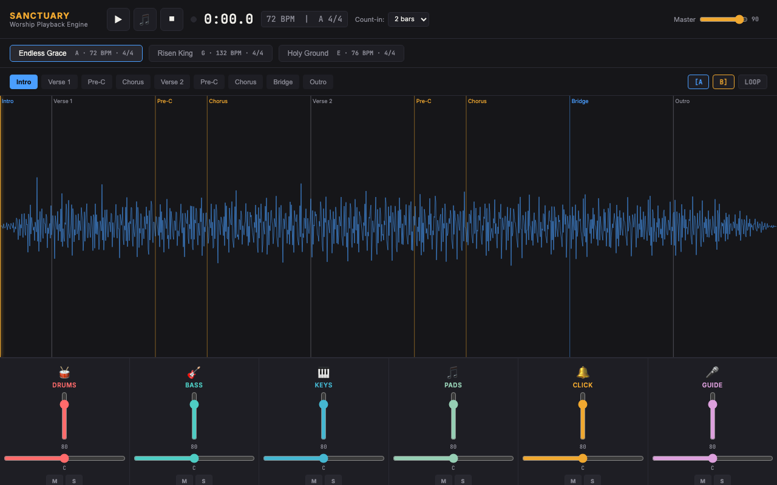
LIVE DEMO
Sanctuary Worship Playback Engine
Transport | Stems | Section Nav | Click Track | Count-In | A/B Loop | Full Mixer
michaelwegter.com/demos/audio-software-engineer-needed-for/

Slide 4
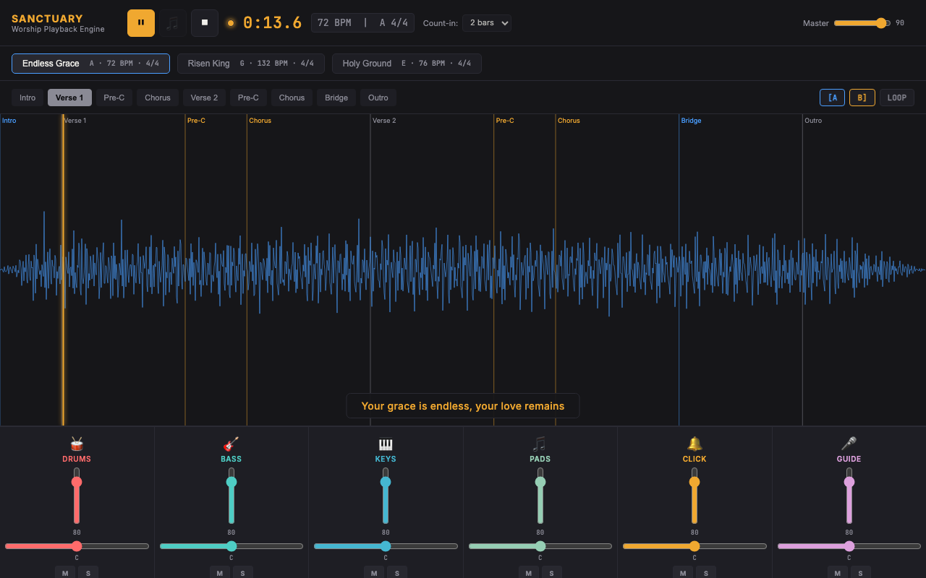

DEMO FEATURES
What the demo implements
Section navigation with BPM-locked seek
6-stem mixer: drums, bass, keys, acoustic, vocals, click
Wilson-pattern lookahead scheduler. OfflineAudioContext stem synthesis. Sample-accurate transport.

Slide 5

MUSIC BACKGROUND
Musician, DAW operator, and live audio professional
Bachelor of Music, St. Olaf College
Formal music theory, ear training, composition, and audio production.
DAWs since the fifth grade
Fifteen-plus years with Ableton Live, Logic Pro, and Pro Tools.
Professional Wedding DJ
Live events require audio that never fails. I am obsessed with getting it exactly right.
Built Python MIDI Bridge for Live Gigs
Real-time MIDI signal processing, running in production at every performance. Zero failures.

Slide 6
ENGINEERING BACKGROUND
Full-stack engineer, real-time audio systems
Optum / RHRP 4 (Current)
U.S. Bank via Turnberry (2.5 years)
Angular, .NET/C#, PostgreSQL, onion architecture. 150+ story points. Team AI lead.
React, Python, SQL, Java. Became sole dev and SME on 60,000-line platform in 2 months.
Python MIDI Bridge
Sanctuary Demo (this proposal)
rtmidi, custom signal processing, real-time mapping. Production-deployed for live gigs.
Web Audio API, OfflineAudioContext, GainNode, StereoPannerNode, Wilson lookahead scheduler.

Slide 7
AUDIT APPROACH
Diagnose first. Fix what is confirmed broken.
01
02
03
04
Review the codebase
Reproduce and root-cause
Fix high-priority bugs
Deliver recommendations
Read the full audio architecture: engine, scheduler, transport, and routing. Map the signal flow before touching anything.
Systematically reproduce each of your nine issues. Trace each one to its specific root cause. Document before writing fixes.
Targeted, surgical patches for transport reliability, sync drift, and timing issues. Each fix tested in isolation.
Written analysis of root causes, fixes applied, and architectural improvements for the platform's next stage.

Slide 8
NEXT STEPS
Let's talk about your codebase.
30 minutes to walk through the nine issues and look at the relevant parts of the architecture. I will give you an honest read on what I see before any engagement starts.
Live demo:
michaelwegter.com/demos/audio-software-engineer-needed-for/
Portfolio:
michaelwegter.com/work-samples
Michael Wegter
Audio Software Engineer | Musician | Full-Stack Engineer

