Slide 1
Ethnic group bubble
File created on: 3/27/2023 7:34:06 PM

Slide 2
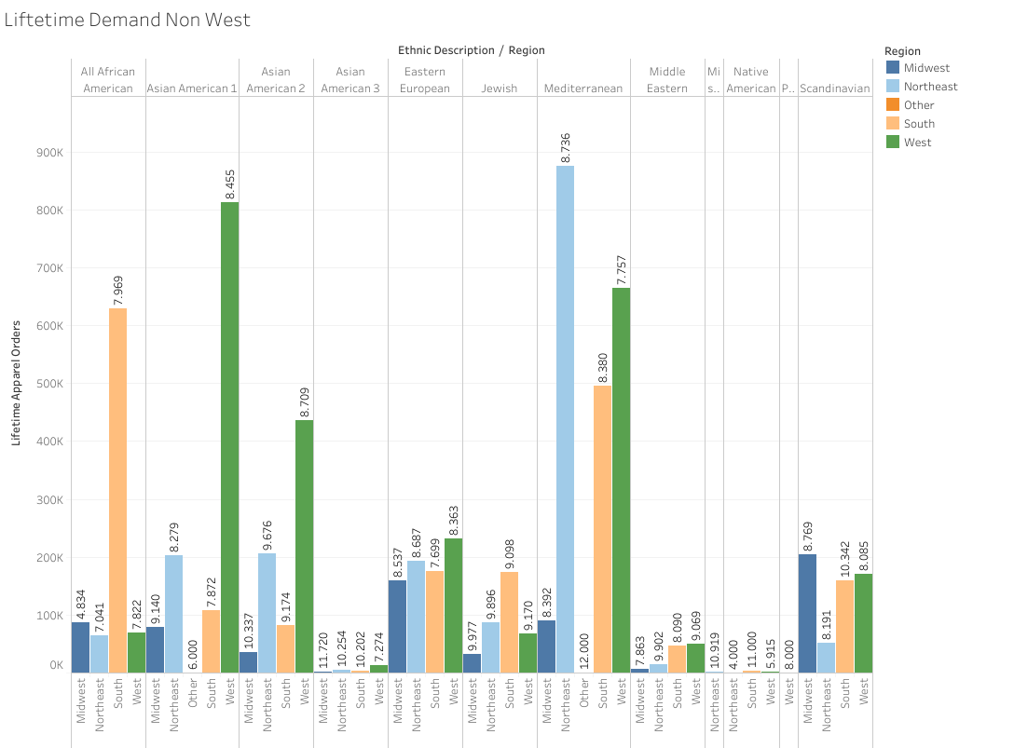
Removing the Western
European column, this chart
Shows the rest of the regions.

Slide 3
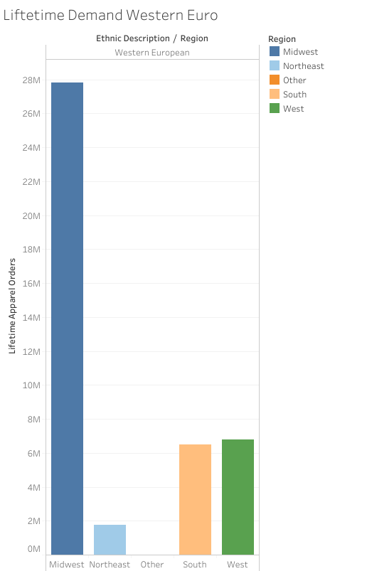
This chart shows ONLY Western
Europeans. This region is over-
whemingly high comparatively.

Slide 4
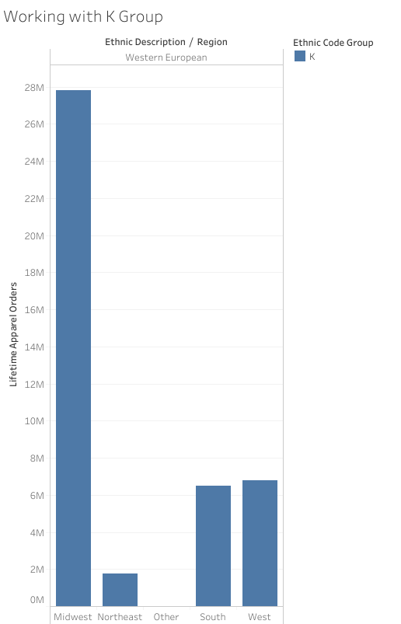

Slide 5
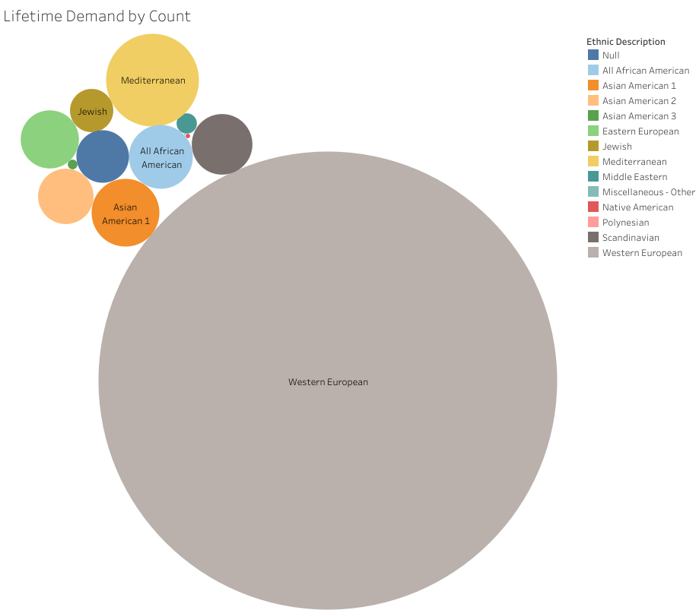

Slide 6
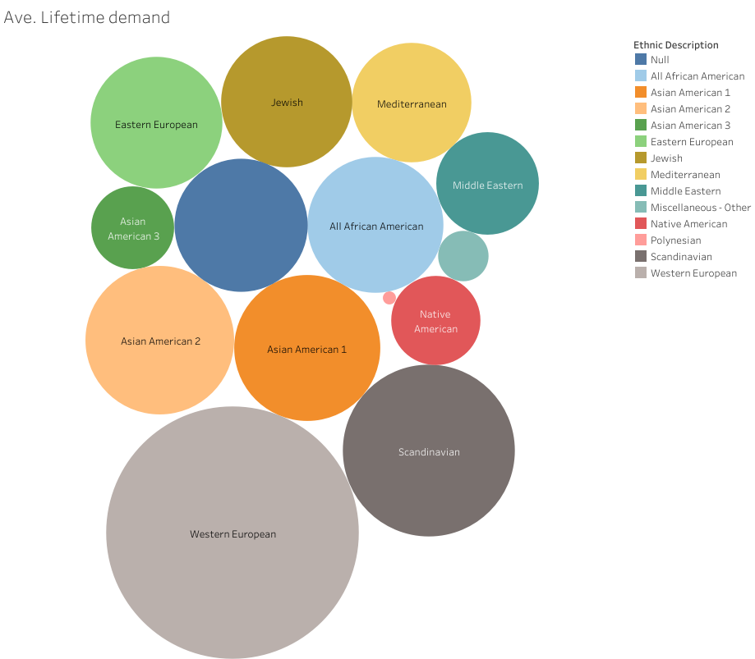
When we average count out
we get a more balanced view
of lifetime demand.

Slide 7
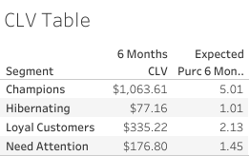
Chart shows the totals of the so-
Called “Champion” spenders.
The company could focus more on
The Hibernators and the Need
Attention groups going forward.
“CLV” stands for Customer Lifetime
Value.

Slide 8
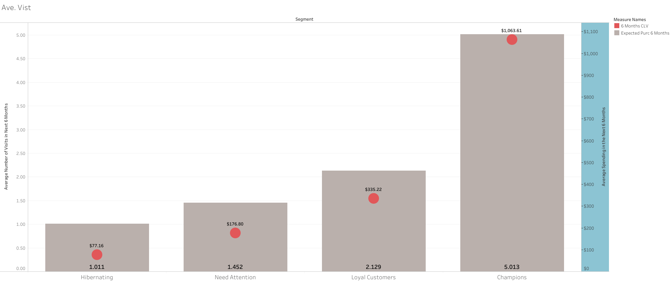
This grouping and bar chart intends to show the distribution of the separate groups who are in the
BG/NBD (Beta Geometric/Negative Binomial Distribution Model for Predicting Number of Purchase.
This model is a popular model in the retail industry today.

Slide 9
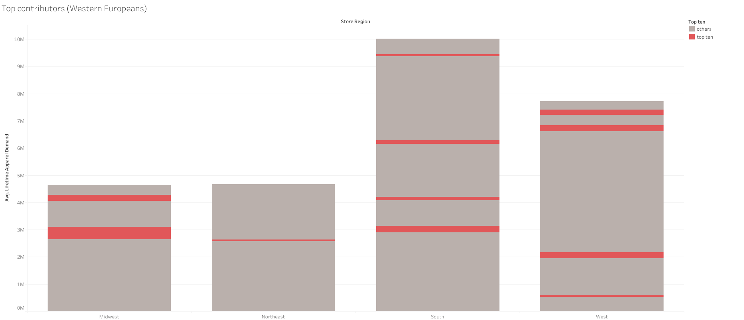
The top ten spenders or “Champions” are in red here, showing the distribution by store region.

Slide 10
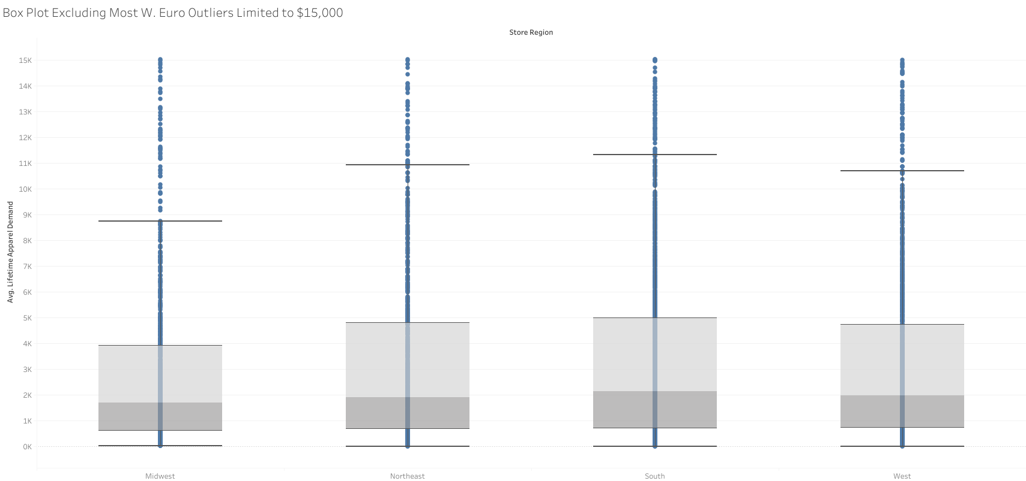
Box plot excluding most Western European outliers, and limited to $15,000.

Slide 11
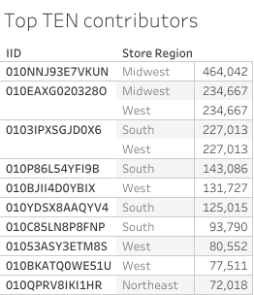
Important chart showing our top ten “contributors” or spenders in one group. Store region is included.

