Slide 1
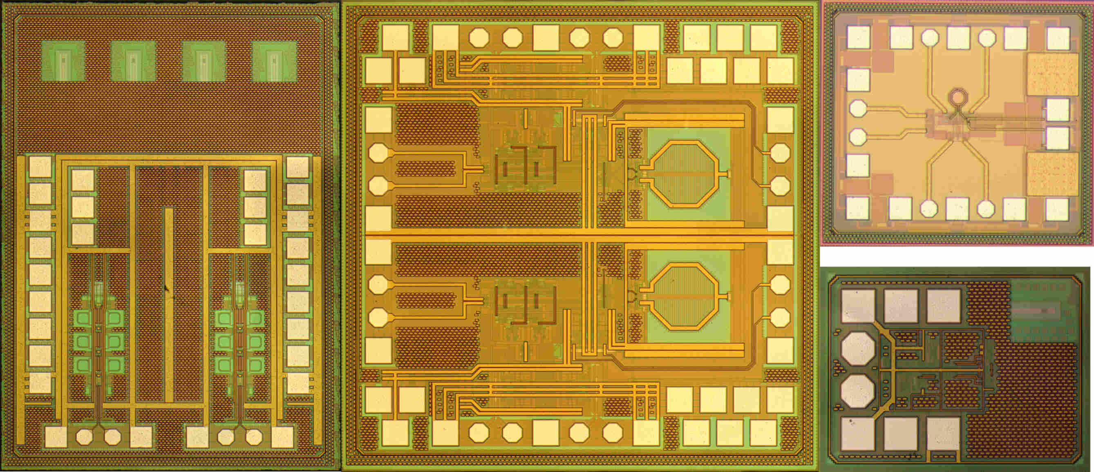
0_UPB_ORX_0623 Monolithically Integrated Coherent Optical Receiver in IHP SG25H5 EPIC
Maxim Weizel¹
Paderborn | 19 December 2023
1 Paderborn University, Department of System & Circuit Technology, Heinz Nixdorf Institute, Fürstenallee 11, 33102 Paderborn, Germany

Slide 2
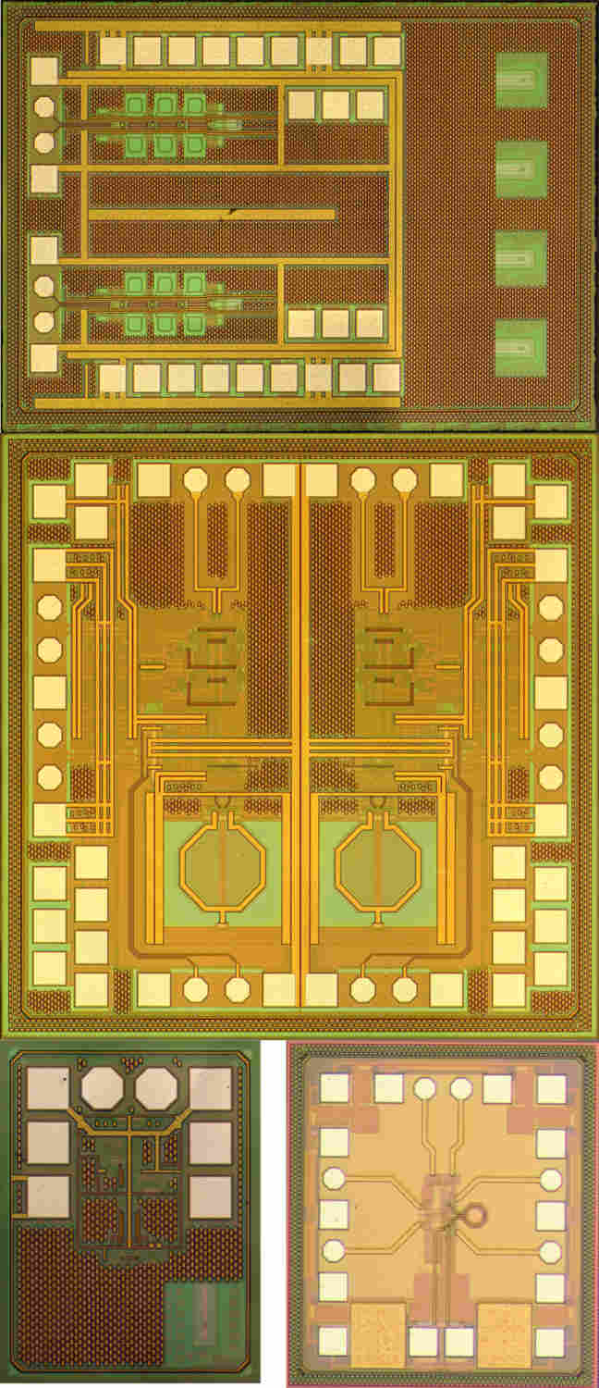
Table of Contents
Motivation
Overall System & Schematic
Layout
Post-Layout Simulation
Noise Sources in a BJT TIA
Conclusion & State of the Art

Slide 3
Motivation
1

Slide 4
Motivation
My Motivation

Slide 5
Overall System & Schematic
2

Slide 6
Single Receiver Channel
Blockdiagram

Slide 7
Transimpedance Amplifier (TIA)
Schematic

Slide 8
Variable Gain Amplifier (VGA)
Schematic

Slide 9
Output Buffer (50 Ohm)
Schematic

Slide 10
Layout
3

Slide 11
Layout IQ-Receiver
I Channel
Q Channel
50 Ohm
Offset
Compensation
VGA
TIA

Slide 13
Post-Layout Simulation
4

Slide 14
AC Simulation - Group Delay
Post-Layout EM (ADS RF Pro)

Slide 15
Noise Sources in a BJT TIA
5

Slide 16

Sensitivity
BER
$BER=\frac{M−1}{M}⋅\frac{1}{\log_{2}\left(M\right) }\operatorname{erfc}\left(\frac{i_{avg}}{\left(M−1\right)\sqrt{2}{ i}_{in,n}}\right)$ [3]
$P_{e2}=\frac{1}{2}\operatorname{erfc}\left(\frac{i_{avg}}{{\sqrt{2} i}_{in,n}}\right)$ for M=2
FEC 4e-3
PAM4
NRZ
input amplitude: 60uA
[3] K. Szczerba et al., "4-PAM for high-speed short-range optical communications," in Journal of Optical Communications and Networking, vol. 4, no. 11, pp. 885-894, Nov. 2012, doi: 10.1364/JOCN.4.000885.

Slide 17
Conclusion
6

Slide 18
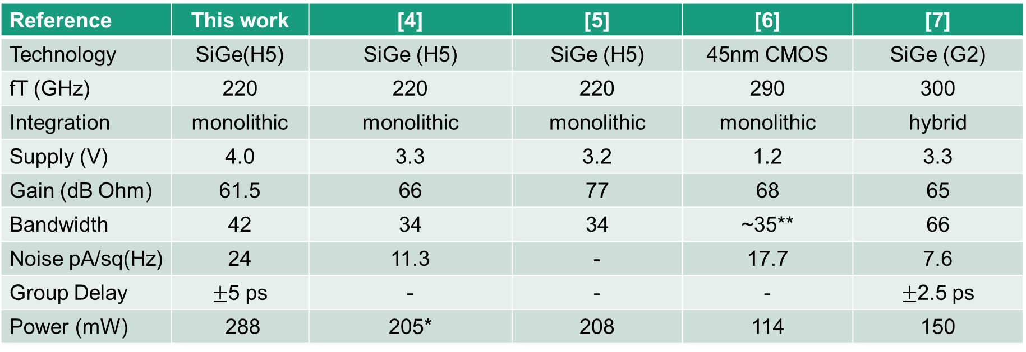
Conclusion
State of the Art
Reference | This work | [4] | [5] | [6] | [7]
Technology | SiGe(H5) | SiGe (H5) | SiGe (H5) | 45nm CMOS | SiGe (G2)
fT (GHz) | 220 | 220 | 220 | 290 | 300
Integration | monolithic | monolithic | monolithic | monolithic | hybrid
Supply (V) | 4.0 | 3.3 | 3.2 | 1.2 | 3.3
Gain (dB Ohm) | 61.5 | 66 | 77 | 68 | 65
Bandwidth | 42 | 34 | 34 | ~35** | 66
Noise pA/sq(Hz) | 24 | 11.3 | - | 17.7 | 7.6
Group Delay | $±$5 ps | - | - | - | $±$2.5 ps
Power (mW) | 288 | 205* | 208 | 114 | 150
*no 50 ohm outbut buffer
**simulated

Slide 19
Conclusion
Summary
Differential TIA in SG25H5 EPIC monolithically integrated
42 GHz BW
61 dBΩ
56 GBd/s
moderate noise
moderate power consumption
Use for coherent DP-16-QAM Receiver → 448 Gbit/s (DP:dual polarisation)

Slide 20
References
[1] Carusone, T. C., Johns, D. A., & Martin, K. W. (2011). Analog Integrated Circuit Design, 2nd Edition. Wiley
[2] Säckinger, E. (2005). Broadband Circuits for Optical Fiber Communication. Wiley
[3] K. Szczerba et al., "4-PAM for high-speed short-range optical communications," in Journal of Optical Communications and Networking, vol. 4, no. 11, pp. 885-894, Nov. 2012, doi: 10.1364/JOCN.4.000885.
[4] G. Dziallas, A. Fatemi, A. Peczek, L. Zimmermann, A. Malignaggi and G. Kahmen, "A 56-Gb/s Optical Receiver With 2.08-μA Noise Monolithically Integrated into a 250-nm SiGe BiCMOS Technology," in IEEE Transactions on Microwave Theory and Techniques, vol. 70, no. 1, pp. 392-401, Jan. 2022, doi: 10.1109/TMTT.2021.3104838.
[5] Sergiy Gudyriev, Christian Kress, Heiner Zwickel, Juned N. Kemal, Stefan Lischke, Lars Zimmermann, Christian Koos, and J. Christoph Scheytt, "Coherent ePIC Receiver for 64 GBaud QPSK in 0.25 μm Photonic BiCMOS Technology," J. Lightwave Technol. 37, 103-109 (2019)
[6] Thomas Baehr-Jones, Shahab Ardalan, Matthew Chang, Saman Jafarlou, Xavier Serey, George Zarris, Gabriel Thompson, Artsroun Darbinian, Brian West, Babak Behnia, Vesselin Velev, Yun Zhe Li, Katherine Roelofs, Wuchun Wu, Jim Mali, Jiahao Zhan, Noam Ophir, Chris Horng, Romanas Narevich, Fen Guan, Jinghui Yang, Hao Wu, Patrick Maupin, Rhys Manley, Yogi Ahuja, Ari Novack, Lei Wang, and Matthew Streshinsky, "Monolithically integrated 112 Gbps PAM4 optical transmitter and receiver in a 45 nm CMOS-silicon photonics process," Opt. Express 31, 24926-24938 (2023)
[7] I. García López, A. Awny, P. Rito, M. Ko, A. C. Ulusoy and D. Kissinger, "100 Gb/s Differential Linear TIAs With Less Than 10 pA/ √ Hz in 130-nm SiGe:C BiCMOS," in IEEE Journal of Solid-State Circuits, vol. 53, no. 2, pp. 458-469, Feb. 2018, doi: 10.1109/JSSC.2017.2782080.

Slide 21

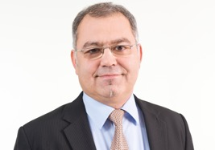
Contact
Max Mustermann
Prof. Dr.-Ing. Christoph Scheytt
Heinz Nixdorf Institut
Universität Paderborn
Fürstenallee 11
33102 Paderborn
Tel +49 5251 60 6XXX
Mustermann@hni.uni-paderborn.de
www.hni.uni-paderborn.de
Heinz Nixdorf Institut
Universität Paderborn
Fürstenallee 11
33102 Paderborn
Tel +49 5251 60 62 00
cscheytt@hni.uni-paderborn.de
www.hni.uni-paderborn.de

Slide 22
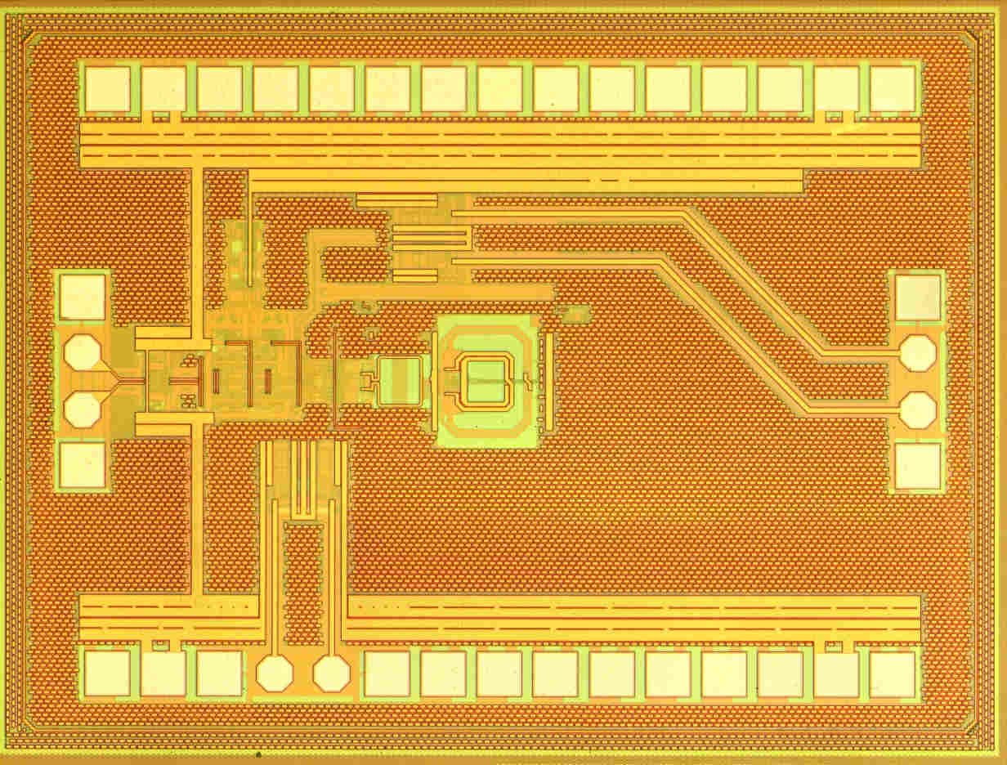
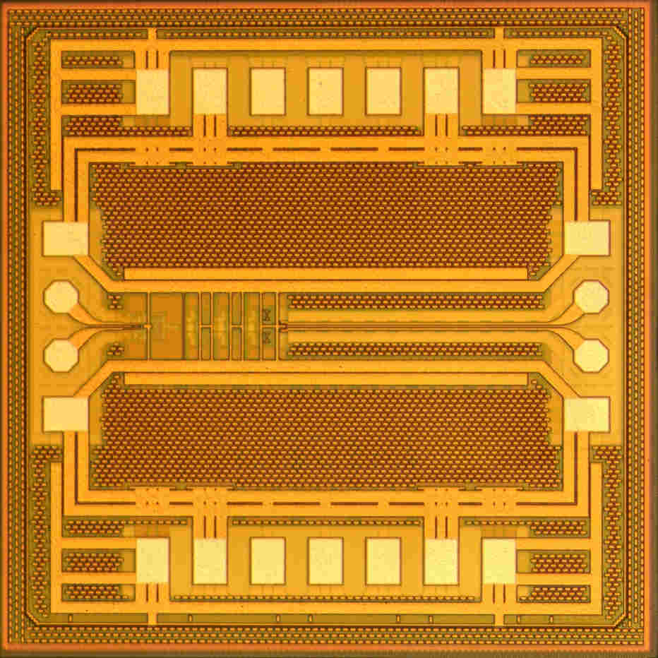
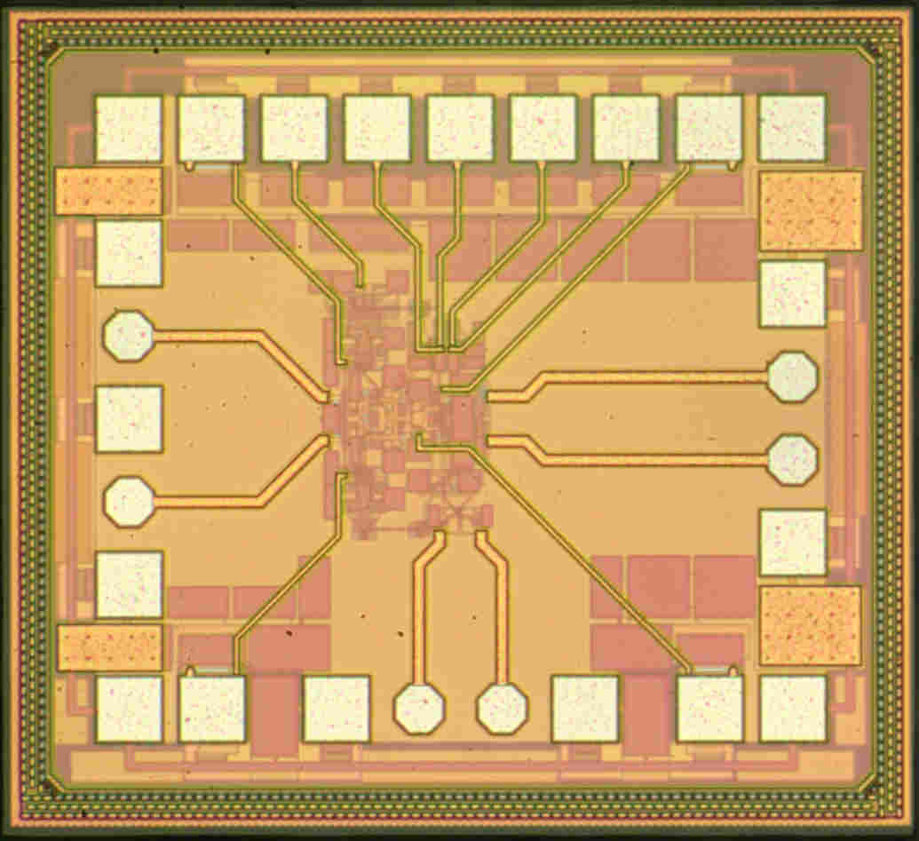
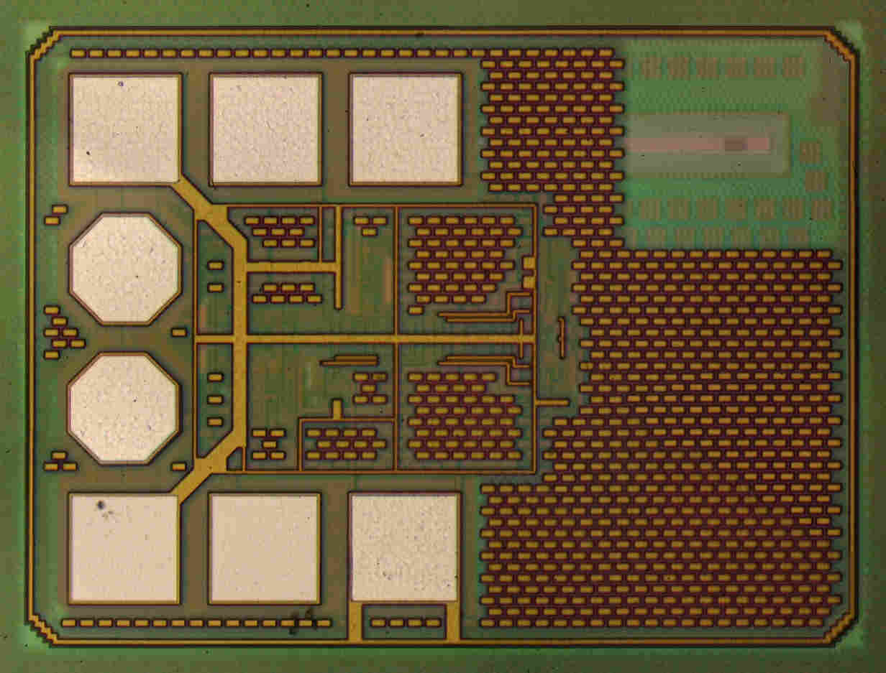
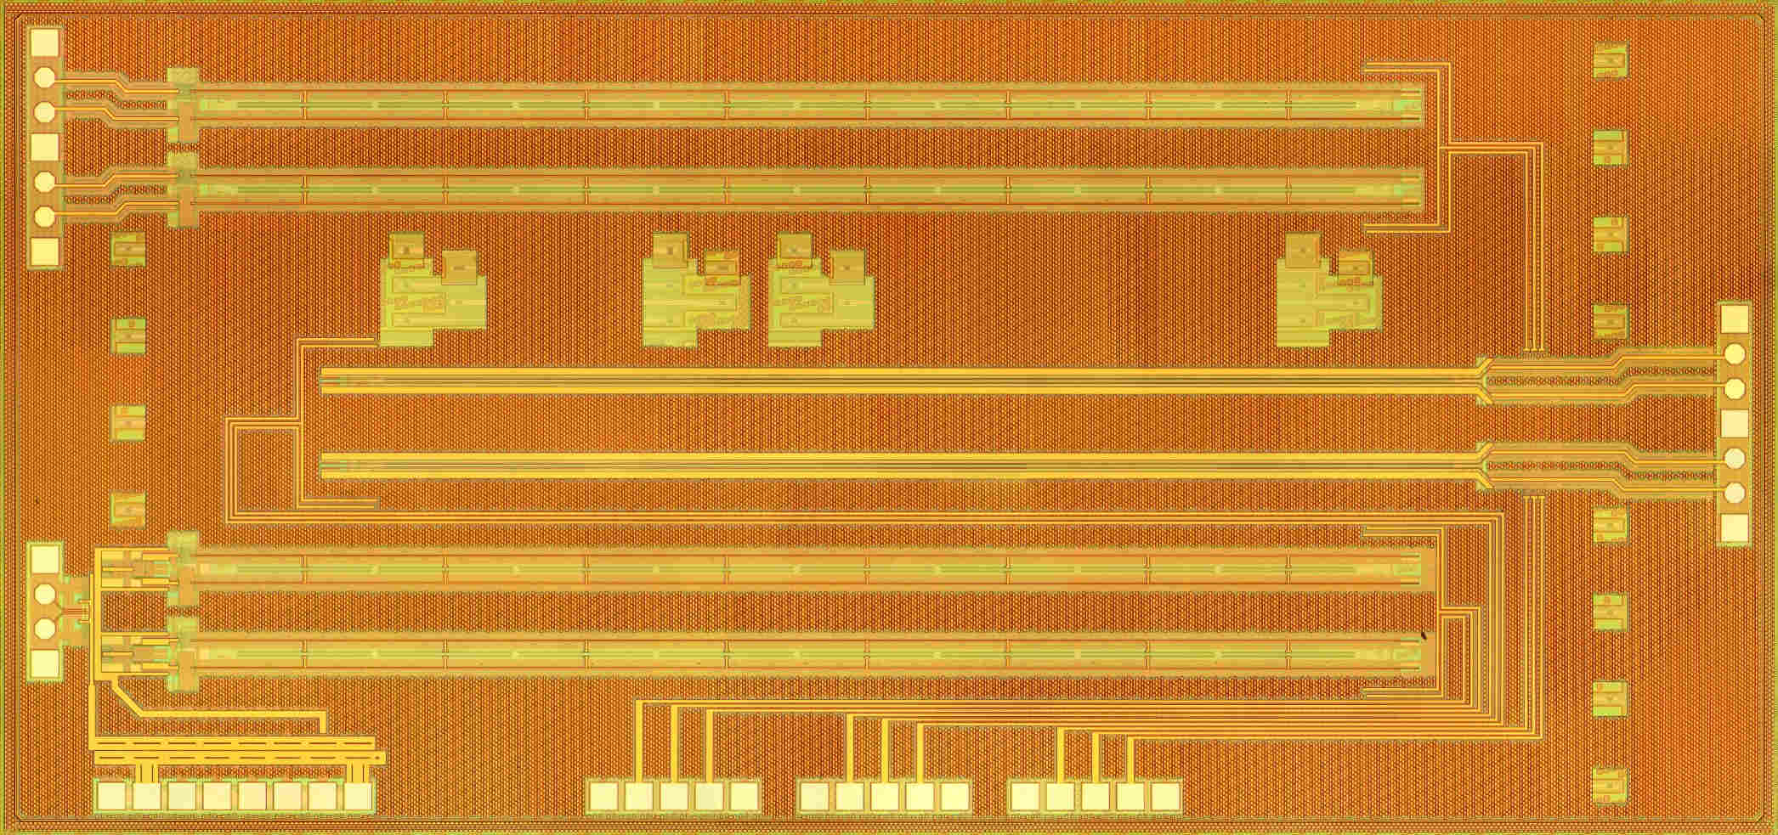
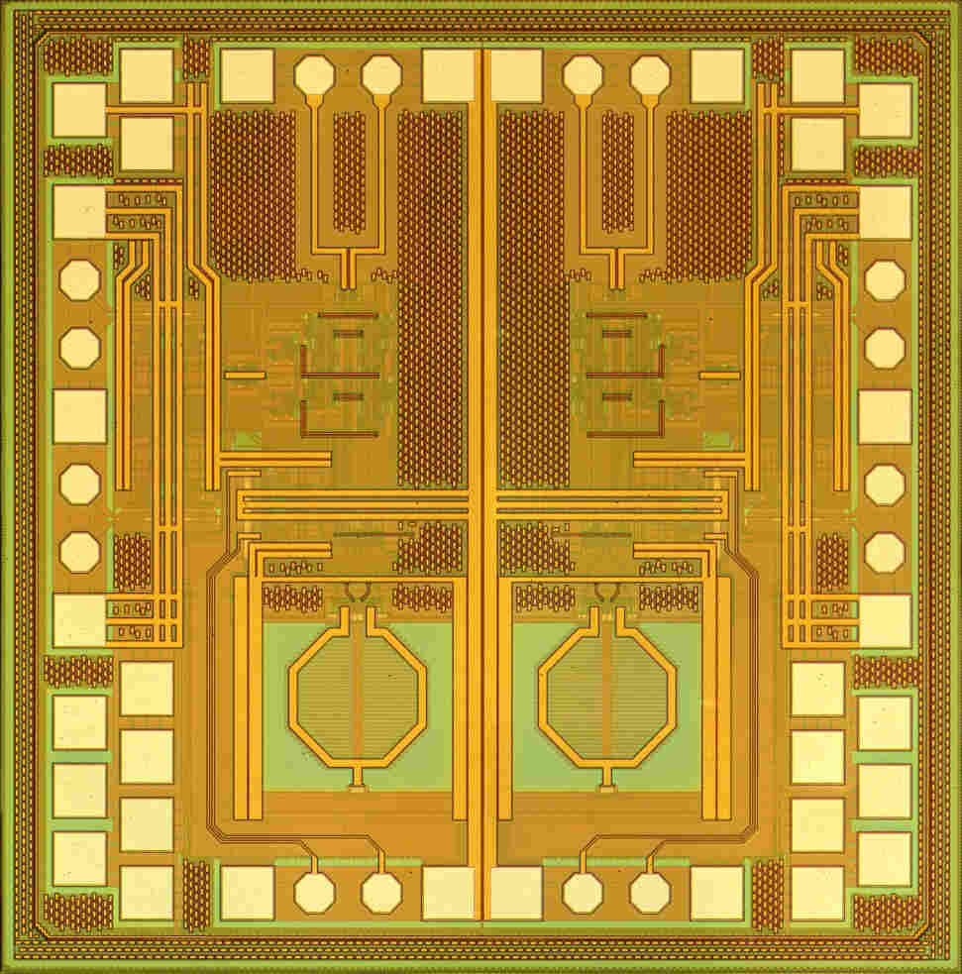
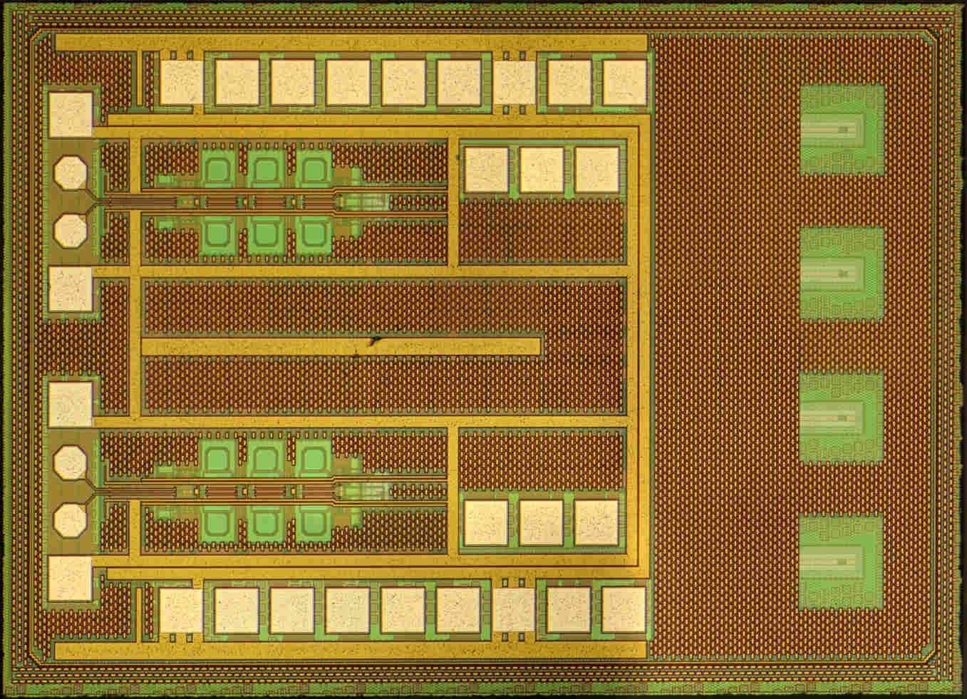
Thank you for your attention
!
Hintergrundbild-Platzhalter ist deaktiviert
→ über Menü „Start“ → Reiter „Bearbeiten“ → „Markieren“ → „Auswahlbereich“ → Ebene „Bild“ Symbol „Auge“ aktivieren →Bild in Platzhalter einfügen

