Slide 1
Getting started with R & RStudio
Valentina Subow

Slide 2
Target group & goal
Target group:
Anyone completely new to R & programming, anyone interested in learning more about how to get started with R and Rstudio
Goal:
Introduction to R and RStudio, get started with downloading & playing around, show what is possible & have some information on how to pursue it further

Slide 3
What you will learn:
Overview of R
Download R & RStudio (Integrated Development Environment)
Getting to know RStudio
Executing code & comments
Variables, variable manipulation & comparison
Sneak peek: Survey analysis with R

Slide 4
Overview of R
R is a language and environment for statistical computing and graphics.
R is available as a free software
Data analysis - data manipulation, calculation and graphical display.
Very popular in academic context, more and more companies employ it as well (for free!)

Slide 5
Download R & RStudio
Download R:
https://www.r-project.org/
http://cran.mtu.edu/
Downlaod Rstudio:
https://www.rstudio.com/products/rstudio/download/
See the “Installation Instructions” hand out for more details.

Slide 6
Download R & RStudio
What is the difference between R & RStudio?
R and RStudio work together! But you cannot use RStudio without downloading R first. At the same time, RStudio makes it easier to work with R.
R = programming language → ingredients
We cannot cook without the ingredients!
RStudio = Integrated Development Environment (IDE) → utensils
The right utensils help us to get more out of the ingredients!

Slide 7
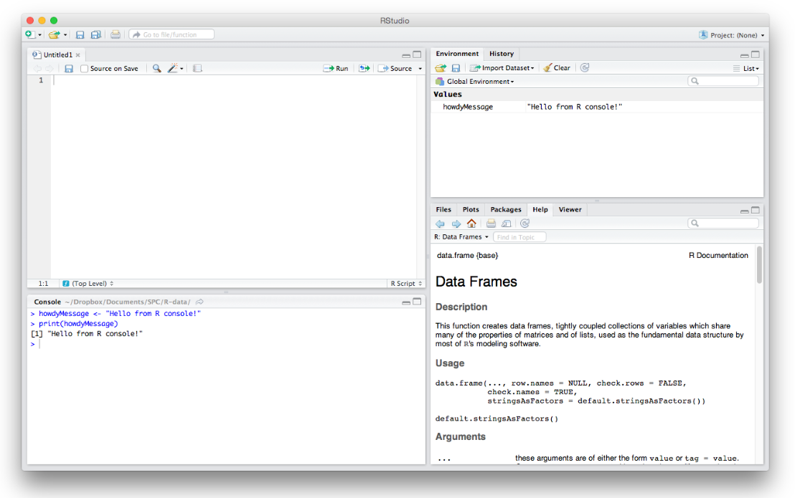
Getting to know RStudio
Environment/History:
Holds all the things you created as well as history of all of your commands
The Editor:
write R code you want to keep for later
Plots and other things:
Display graphics & help pages, see what packages you have loaded
The Console:
it’s here that you verify an idea you had works before copying it over into the editor above

Slide 8
Let’s get started!
Any questions?

Slide 9
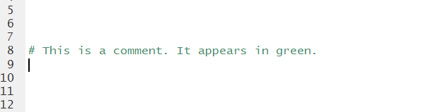
Code and Comments
There is a distinction between code & comments:
Code: program instructions
Comments: information that you want to pass on
You can write comments in R using “#”
#This is a comment.

Slide 10
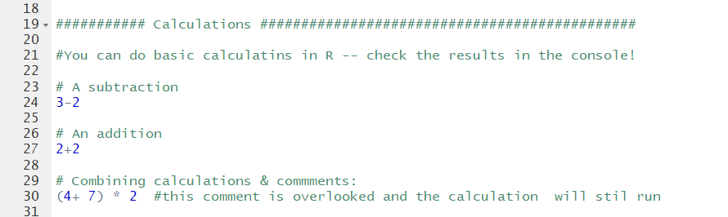
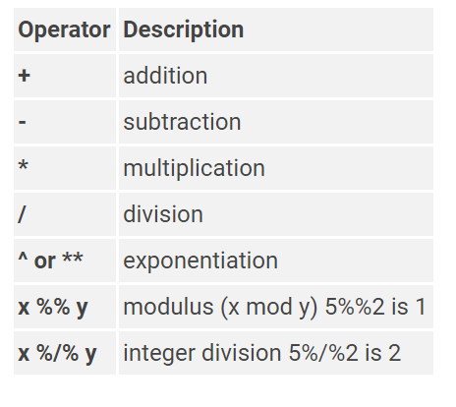

Running code doing basic math
Execute code: highlight the line(s) to be run and press ctrl + enter (windows) or press the “Run” button (top-right corner)

Slide 11
Variables
Variables hold information you can manipulate, change and use in different ways.
At the most simple level, we can store values in variables:
As a good practice, choose meaningful & descriptive variable names.

Slide 12
Manipulating variables
Once you have created variables they can be used to do different things:
Perform math operations like add & subtract
Overwrite variables
Combine variables to compute a new variable

Slide 13
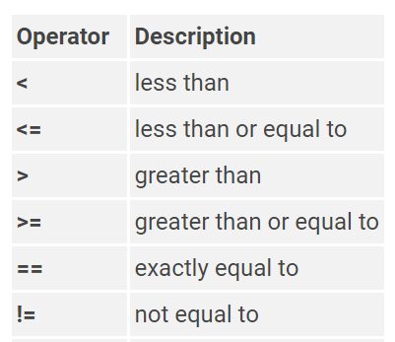
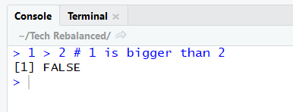

Comparing variables
Next to math operations, we can also compare variables to each other.
To compare values we use “Boolean logic” which only has two outcomes:
TRUE or FALSE

Slide 14
R for Data Analysis: Sneak Peek
Check out this short survey “Scoot Along” survey on Scooter usage in DC:
http://data.codefordc.org/dataset/730-dc-scoot-along/resource/694317f0-9045-461c-9883-302f086bb19d
We are going to read the data set into R, explore the responses to the questions visually & extract the most common reasons for using a scooter from a free format comments!

