Slide 1





Marketing
Overview
David Gitz, EE, ICARUS Lead Engineer

Slide 2

“To develop innovative and interoperable unmanned systems”
Sometimes, flying feels too godlike to be attained by man. Sometimes, the world from above seems too beautiful, too wonderful, too distant for human eyes to see . . .
— Charles A. Lindbergh, 'The Spirit of St. Louis,' 1953.'
There is an art, it says, or rather, a knack to flying. The knack lies in learning how to throw yourself at the ground and miss. [...] Clearly, it is this second part, the missing, which presents the difficulties.
— Douglas Adams,‘The Hitchhiker’s Guide to the Galaxy’

Slide 3
Core Team
Ben Wasson
  Masters Student
  ICARUS Business Manager
David Gitz
  Electrical Engineer
  ICARUS Lead Engineer
Michael Welling
  PhD Candidate
  ICARUS Systems Engineer
James Chaklos
  Masters Student
  ICARUS Test-Stand Engineer
Steve Warren
  Computer Engineer
  ICARUS Communications Engineer

Slide 4

Washington University UAV Team
SIU-Carbondale ECE Lab Team
SIU-Carbondale Senior Design (pending)
Boeing ONE Group (pending)

Slide 5

Applications
The Future
System Description
Capabilities
Competitor Analysis

Slide 6

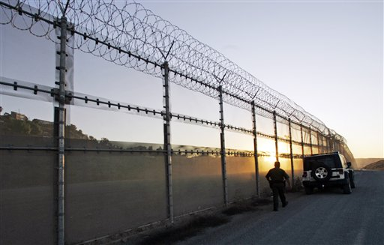
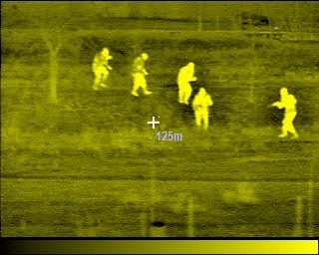
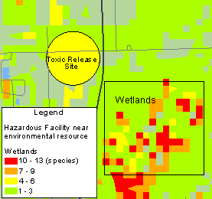

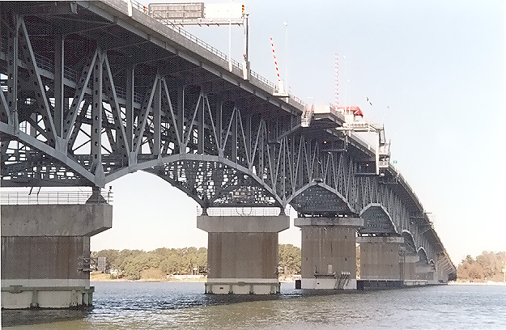
Notes:
Bridge Inspection
Crime Scene Investigation
Development Platform
Home Inspection
Nature Surveying
Reconnaissance
Survivor Search

Slide 7

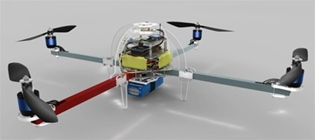
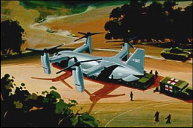
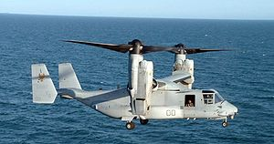
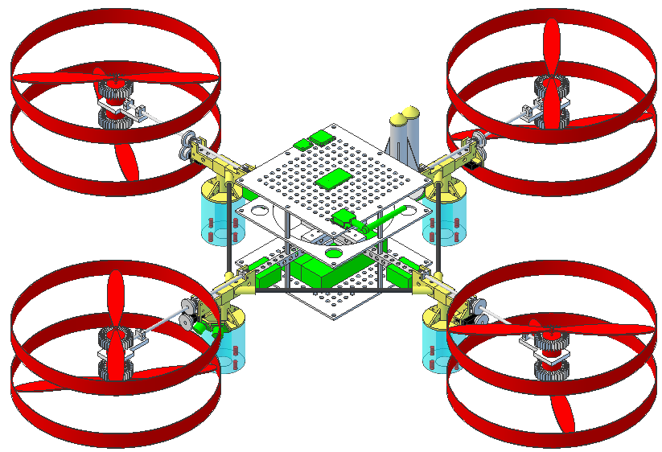
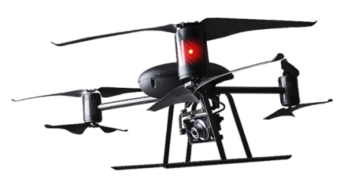
V-44
Bell/Boeing
Pending
ArduCopter
V-22 Osprey
Bell Helicopter
Boeing Rotorcraft Systems
2007
ICARUS
PAST
FUTURE
DraganFlyer v6

Slide 8

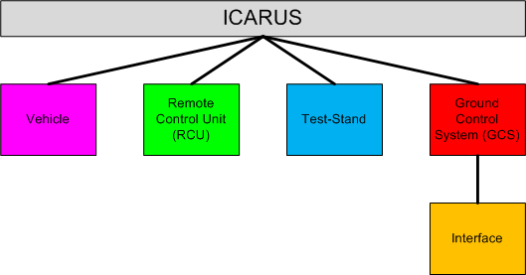
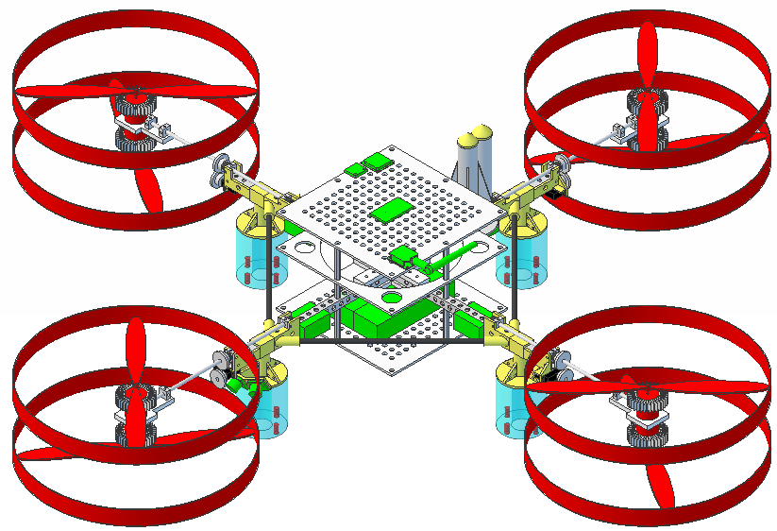
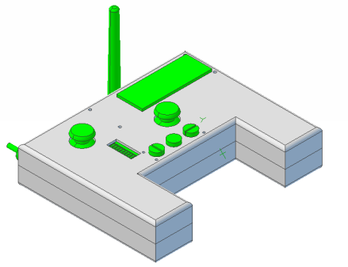
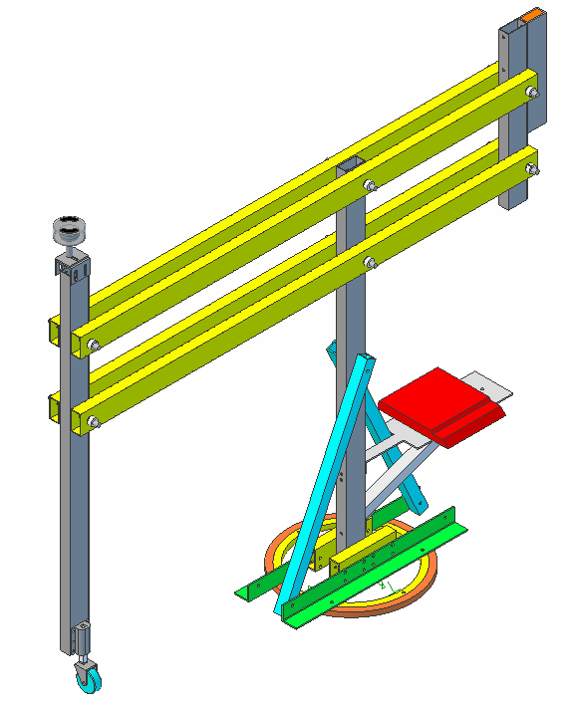
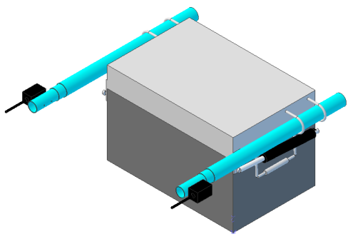
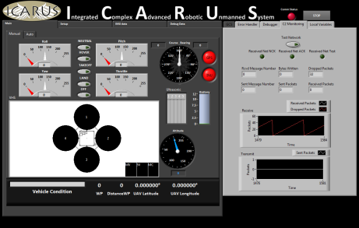

Slide 9

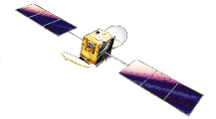

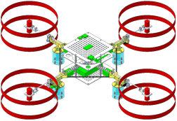
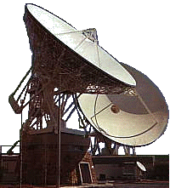

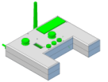
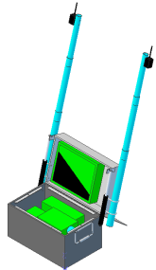
GPS Satellite
InmarSat Satellite
Command/Control
Video
GPS
Services
Diagram
Vehicle
WAN
Cellular Network
Ground Entry Point
RCU
GCS

Slide 10

Capabilities - Planned
Manual Control via RCU or GCS | Simple Calibration and Testing via Test-Stand
Limited Autonomous Navigation via RCU | Error Display on RCU and GCS
Extended Autonomous Navigation via GCS | Force-Feedback on RCU
Automatic Takeoff, Hover and Landing | Vehicle Health Reporting
Capabilities - Future
Real-Time Video Transmission to GCS | Image Capture
Wireless airborne programming | Advanced Hover modes
Vehicle Status Audio via RCU | Extended Range
Configurable Payloads | Terrain Following
Extended Flight Duration | Obstacle Avoidance
Swarm Autonomy | Vehicle Status - Audio

Slide 11

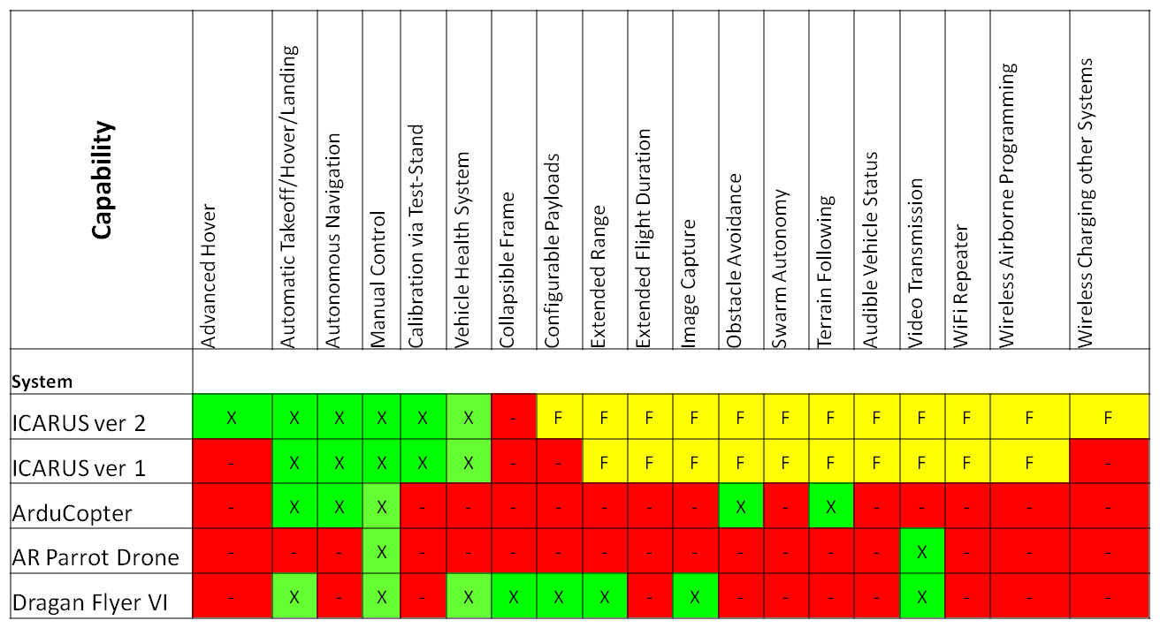

Slide 12


Contact:
  David Gitz: david.gitz@icarusuav.com
  Ben Wasson: ben.wasson@icarusuav.com

