Slide 1




David Gitz, EE, ICARUS Lead Engineer
Notes:
Yo mama

Slide 2
Team
Michael Welling
  PhD Candidate
  ICARUS Vehicle Engineer
Ben Wasson
  Masters Student
  ICARUS Business Manager
David Gitz
  Electrical Engineer
  ICARUS Lead Engineer
Steve Warren
  Computer Engineer
  ICARUS Communications Engineer

Slide 3

Applications
System Description
Capabilities
Development Progress
Q&A

Slide 4


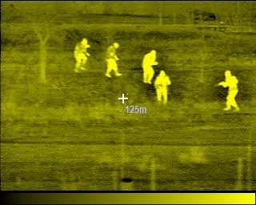
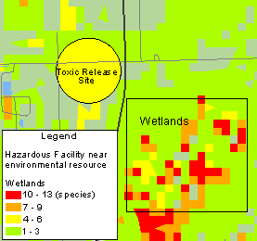

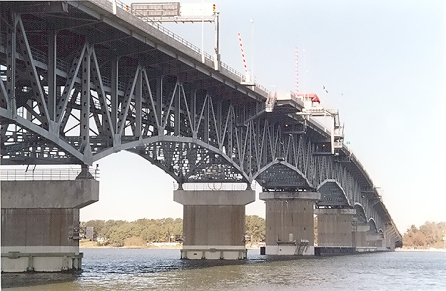

Slide 5

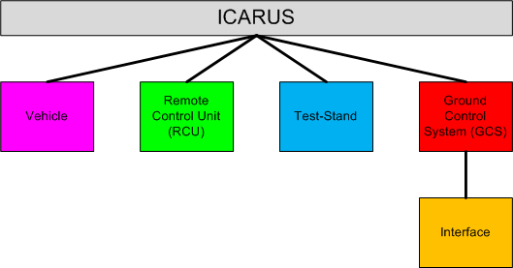
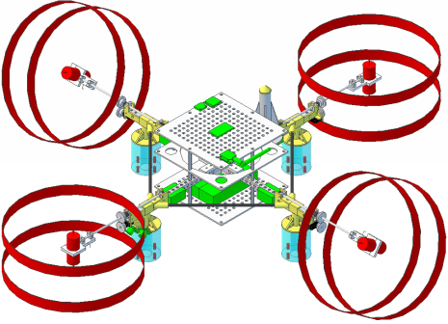
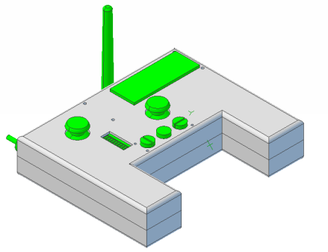
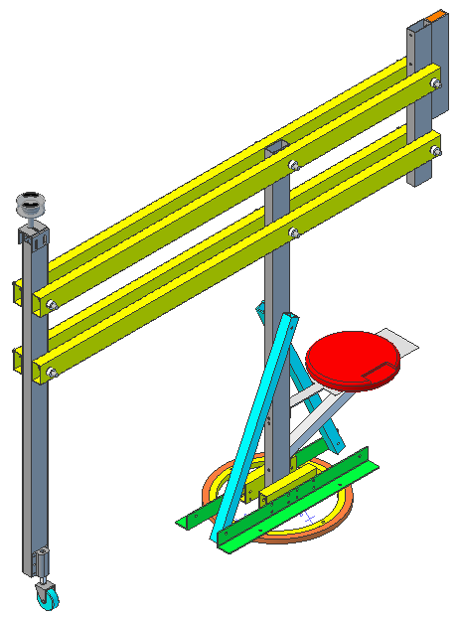
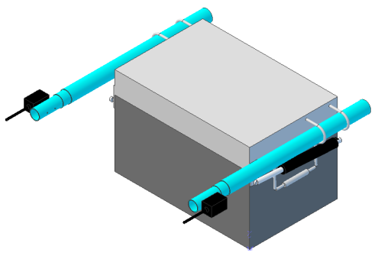
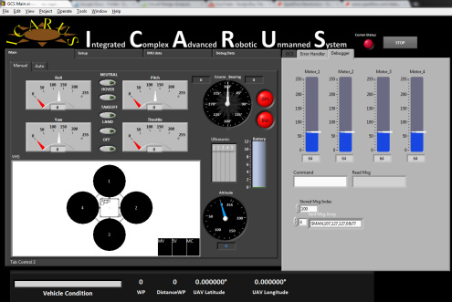

Slide 6

Vehicle

Slide 7

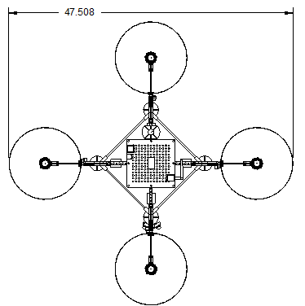

Quad-Rotor design – Offers simpler control system with fewer moving parts than a single rotor helicopter and minor reduction in lift capacity

Slide 8

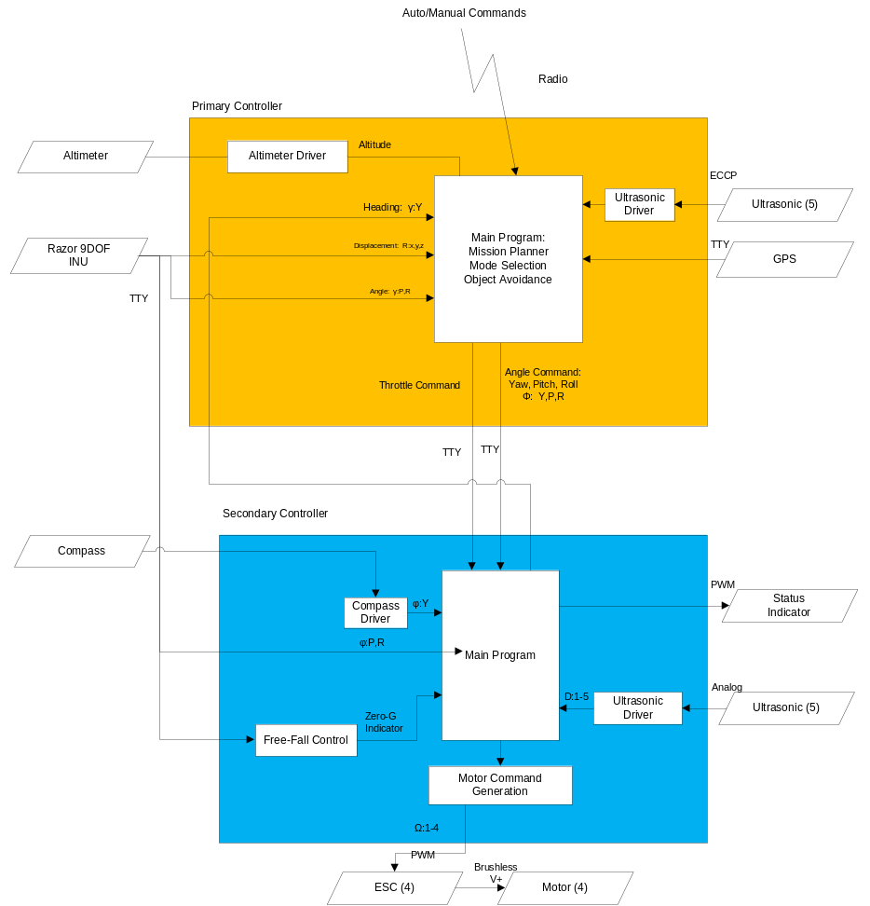
2 “Brains”, 1 SoM Board and
1 Parallax PropellerTM uC
SoM handles waypoint navigation, mission planning, vehicle health.
PropellerTM uC handles PWM generation.
In the event of an in-air mishap, PropellerTM uC can take over Vehicle and land safely.

Slide 9

Sensors: 3-Axis Accelerometer, 3-Axis Gyroscope, 3-Axis Magnetometer (INU), Digital Compass, Altimeter, GPS, 5 Ultrasonic Sensors
Power: 4 Brushless DC 200 Watt Motors, 2 Lithium-Ion 11.1V 5 Amp-Hours Batteries, 4 18A Electronic Speed Controllers, 5V and 3.3V Linear Voltage Regulators.
Control: SoM Controller (Primary), Propeller Controller (Secondary), custom PCB.
Communications: Xbee Radio for Command/Control, Video Transmitter, Wi-Fi (Field programming, tentative).
Fabrication: ~50% COTS, ~50% produced by MakerBot.

Slide 10

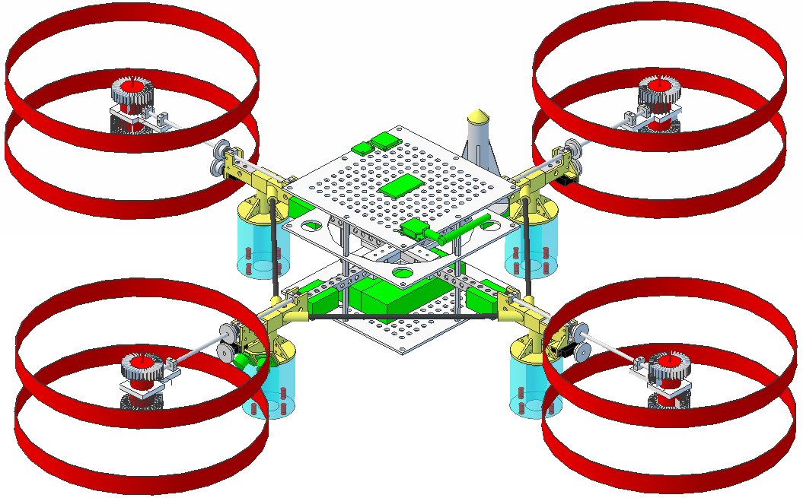
Pitch
CCW
CW
Roll
Yaw
Forward
CW
CW: Puller
CCW: Pusher
CCW

Slide 11


Custom PCB inside Xbox-360 Controller
Features Mode and Error Display, Vehicle Battery Indicator, Force-Feedback and 5 hours of continuous operation.

Slide 12

Communications: XBee Radio for Command/Control
Input/Output: 9 Switches/Buttons, 2 Dual-Axis Joysticks, GPS Sensor, 10-Segment LED, LCD Screen, Vibrating Motors.
Power: 2 Ni-Mh AA Batteries, 3.3 and 5V Boost Converters.

Slide 13
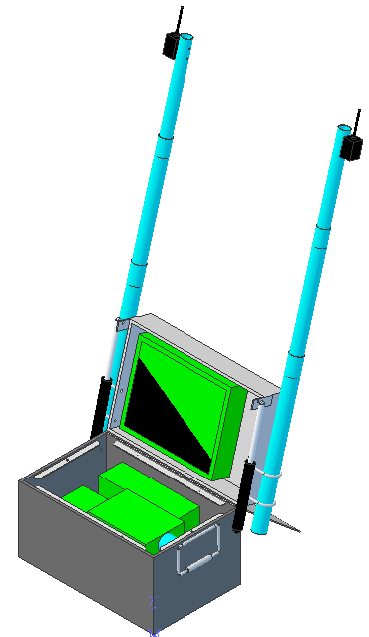
GCS
Includes computer, touch-screen monitor and batteries for field operation.
Communications Radio and Video Receiver
Heavy-duty field transportable case

Slide 14


GCS offers extended range – up to 3 km
Interface designed in LabView
Google Earth integration with Internet connection

Slide 15

Software: National Instruments LabView integrated with Google Earth mapping software.
Power: 2 12V 26Amp-Hour Batteries, 120V AC Power Inverter, Vehicle battery fast charger.
Communications: XBee Radio for Command/Control, Video Receiver

Slide 16
Test-Stand
Used for Vehicle Calibration and Capacity measurements
Able to Pivot vertically, rotate continuously and pitch/yaw/roll on Test-Fixture Assembly
Power applied to Vehicle via Slip-Ring – No tangled wires

Slide 17

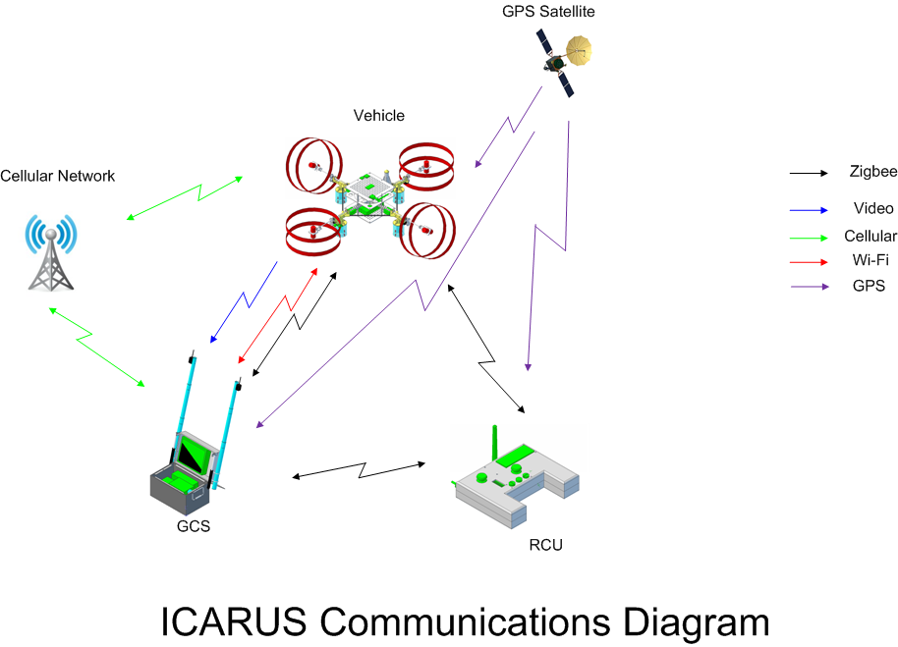
Using XBee API Mode, Vehicle, GCS and RCU all talk to each other
RCU and GCS can extend flight range of Vehicle due to API mesh network.

Slide 18

Capabilities - Planned
Manual Control via RCU or GCS | Simple Calibration and Testing via Test-Stand
Limited Autonomous Navigation via RCU | Error Display on RCU and GCS
Waypoint Navigation | Force-Feedback on RCU
Automatic Takeoff, Hover and Landing | Vehicle Health Reporting
Capabilities - Future
Real-Time Video Transmission to GCS | Image Capture
Wireless airborne programming | Advanced Hover modes
Vehicle Status Audio via RCU | Extended System Duration
Configurable Payloads | Terrain Following

Slide 19

Range: ~1.5 km LOS (~3km with Xbee Mesh Network)
Duration:
  Vehicle: ~12 min (80% Throttle)
  RCU: ~4-6 hrs
  GCS: ~4-6 hrs (including field charging Vehicle)
Speed: ~2 - 4 kph
Weight: ~5.5 lbs
Size: 35” x 35” x 7”
Propeller Rotation: Max: 10,000 RPM
Vertical Thrust: ~7.8 lbs
Notes:
*Educated Guesses

Slide 20

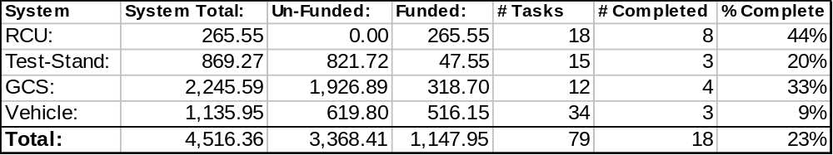
Cost: 25% of material/part cost invested.
Tasks: 23% of defined tasks completed.
Currently in Phase 1 with limited development in Phase 2.

Slide 21


Contact:
  David Gitz: davidgitz@gmail.com

